Slide 1
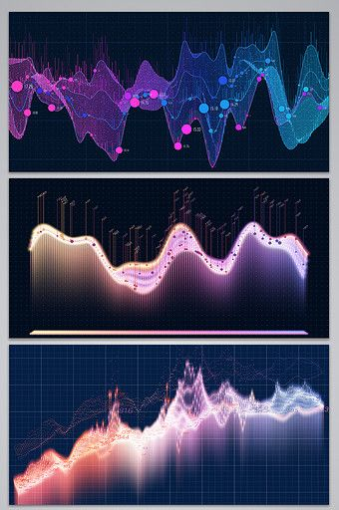
W E L C O M E
Third EDA house prediction Project for the Nexthike IT Solution
By Kuldeep Singh

Slide 2

Exploratory Data Analysis For Real Estate Pricing
This presentation explores the dynamics of house valuation in a dynamic market, using Exploratory Data Analysis (EDA) to uncover patterns, correlations, and trends within a real estate dataset.
By Kuldeep Singh

Slide 3
Problem Statement
The Challenge
The Goal
Determining an optimal and competitive price for a house is a multifaceted challenge in the dynamic real estate market.
Conduct a comprehensive analysis to identify and understand the myriad variables that significantly influence house prices.

Slide 4

Situation Overview
The real estate industry is inherently complex, influenced by numerous factors that collectively impact the pricing of residential properties. The task at hand is to navigate through this complexity and extract meaningful insights from the available data. As an analytics professional, you are entrusted with the responsibility to not only identify the key variables affecting house prices but also to provide actionable recommendations based on your findings.

Slide 5
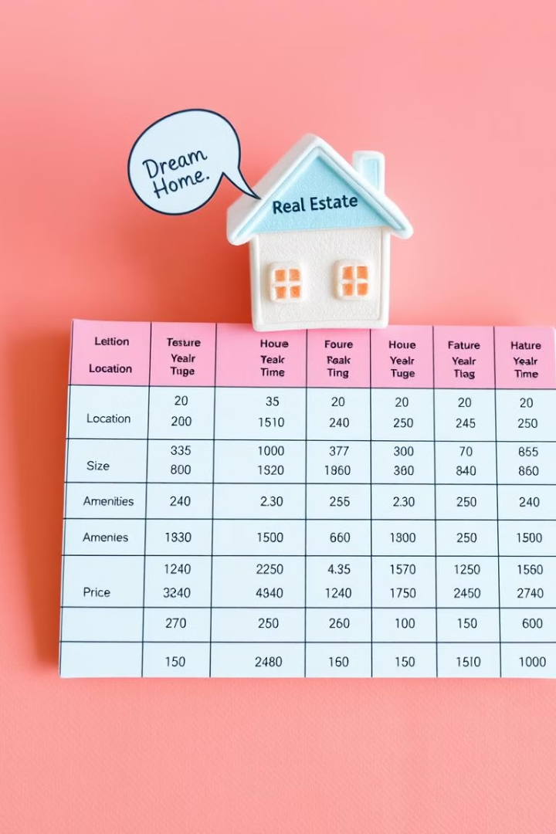
Dataset Overview
The dataset at your disposal comprises diverse parameters such as location, size, amenities, market trends, economic indicators, and historical transaction data. These variables contribute to the intricate web of pricing dynamics, and your role is to unravel their interdependencies through meticulous analysis.

Slide 6
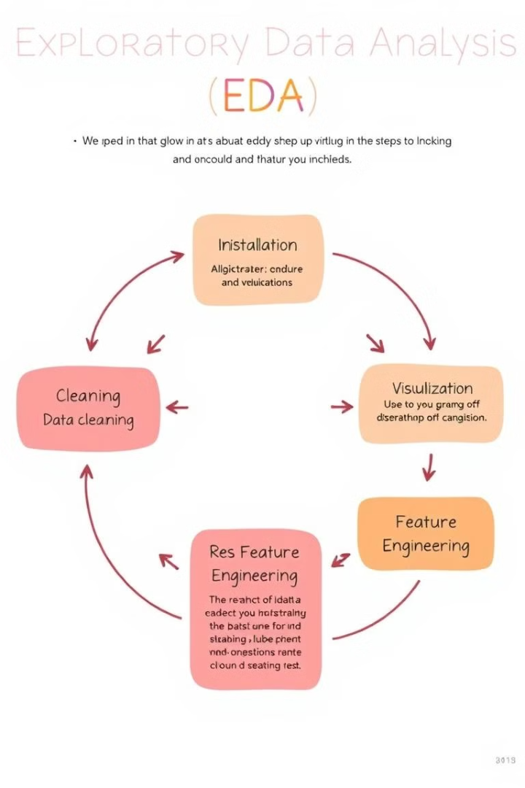
The Importance of EDA
EDA is indispensable in extracting actionable insights from raw data, especially in domains like real estate where numerous factors contribute to the final property value. Through EDA, we can identify key variables that significantly impact house prices, allowing us to tailor pricing strategies, enhance customer satisfaction, and gain a competitive edge in the market.

Slide 7
Steps in EDA for Real Estate Pricing
1
Feature Engineering and Size Impact
2
Market Trends and Historical Pricing
3
Customer Preferences and Amenities
Engineer new features capturing relevant information such as price per square foot or the age of the property. Visualize the relationship between key features like bedrooms, bathrooms, and square footage with house prices, determining their impact on valuation.
Analyze historical pricing trends over time, considering external factors like economic indicators. Create time-series visualizations to understand how market trends influence house prices, helping predict future valuation trends.
Explore the influence of customer preferences and amenities on house prices. Utilize sentiment analysis on customer feedback to gauge the perceived value of specific features. Apply clustering algorithms to group houses with similar amenity profiles, revealing distinct market segments and pricing strategies.

Slide 8
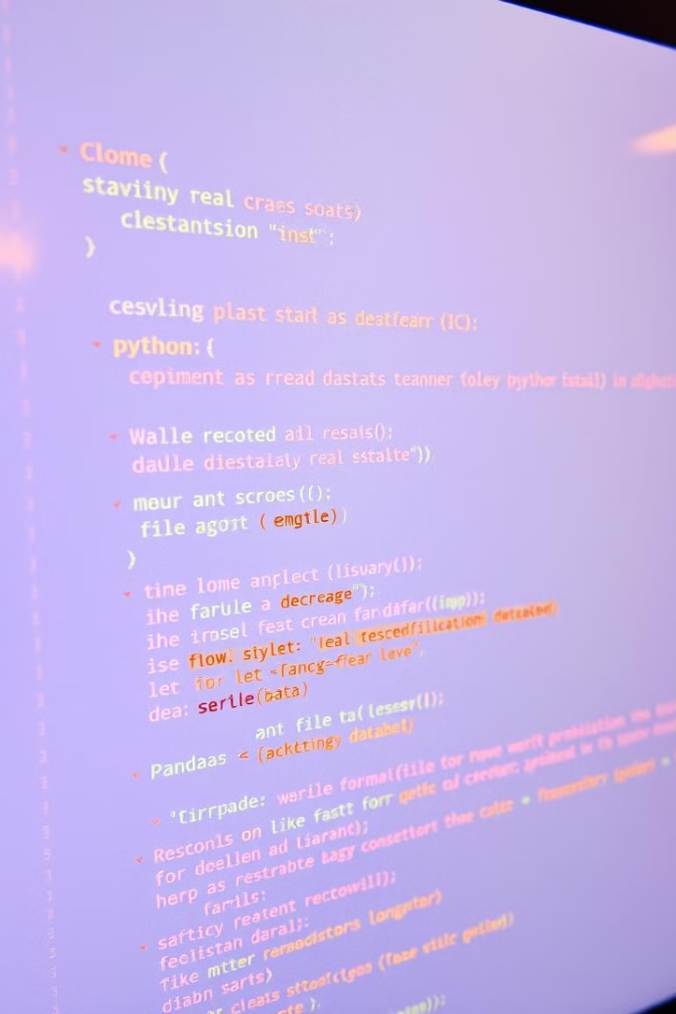
Loading and Cleaning the Data
The first step in our EDA journey is to load the real estate pricing dataset into a Pandas DataFrame. This allows us to easily manipulate and analyze the data. We then need to clean the dataset by handling missing values, removing duplicates, and addressing any anomalies. This ensures data quality and accuracy for our subsequent analysis.

Slide 9

Univariate and Multivariate Analysis
Once the data is loaded and cleaned, we perform univariate analysis to understand the distribution of key variables like house prices. We utilize histograms, kernel density plots, or other visualizations to gain insights into the data. Next, we conduct multivariate analysis to understand the correlations and dependencies between various features. We utilize techniques like correlation matrices or scatterplot matrices for a comprehensive view.

Slide 10

Feature Engineering and Size Impact
We further analyze the impact of features and size on house prices. We explore relationships between key features (e.g., number of bedrooms, bathrooms, square footage) and house prices. We identify how these features collectively contribute to the valuation.

Slide 11

Market Trends and Historical Pricing
We analyze the dataset temporally, looking at trends in house prices over different periods. We understand how external factors, such as economic indicators, may have influenced these trends. This helps us predict future valuation trends and make informed decisions.

Slide 12
C O N C L U S I O N !
In conclusion, this house prediction project demonstrate the power of machine learning in acuretlly
predicting propery price based on various feature such as location size and amenities .
Through data preprocessing, model tarining and evaluation we successfully build a prodective model
that can be applied in real world housing marketing scenerio. This result highlight the importance of
feature selection and model evalution in improving prediction model accurecy.
Thank you !

Slide 13
T h a n k Y o u
Do you have any question ?

