Slide 1

Logistic Regression
Kushal Lakhotia

Slide 2
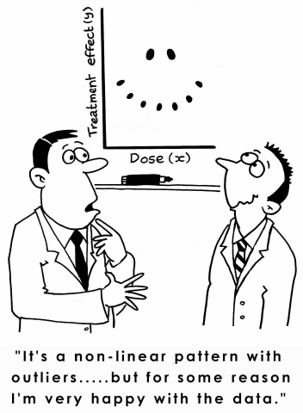
Agenda
Motivation
Logistic Regression
Gradient Descent
Overfitting
Regularization
Applications

Slide 3
Binary Classification
Example: We have an anonymized dataset of 200 users each containing: 1. User’s salary 2. Years of experience as Data Scientist 3. Whether the use paid for premium account or not
Task: Given a new user’s first two attributes, we want to predict whether she will pay for premium account.
Notes:
Example from Data Science from Scratch: Page 189

Slide 4
Motivating Logistic Regression
To do the task, we can estimate the probability that the user will pay for premium account.
Then we can find a threshold beyond which it is highly likely that the user will pay.
For example, if P(Will Pay) > 0.5 then we say Yes otherwise No.
Logistic Regression helps us estimate P(Will Pay).

Slide 5
Features and Labels
Any machine learning algorithm trains a model on training data.
Training Data consists of a set of training examples (or cases), e.g., for our premium account payment problem training examples could look like {(150,000, 5), 1 }, { (100,000, 1.5), 0 }, etc.
In general…
Each input (e.g., salary) is known as a feature. (x_{i})
The vector of all features is known as feature vector. (x₁, x₂, …, x_{D})
For each training example, we know whether the user will pay or not. This is known as the label. (y)
Thus, each training example is represented by the feature vector and the corresponding label. { (x₁, x₂, …, x_{D}), y }
Notes:
150000 is salary; 5 is the number of years and 1 means the user paid for premium account.
100000 is salary; 1.5 is the number of years and 0 means the user didn’t pay for premium account.

Slide 6
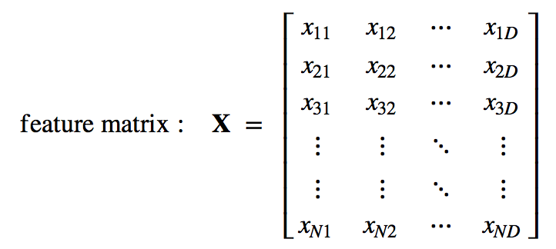
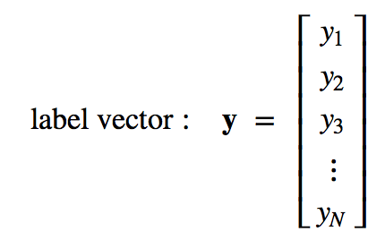
Features and Labels
Entire training data is a matrix of features and a vector of labels.
x_{ij} is the j^{th} feature of the i^{th} training example, e.g., x₃₂ y_{i} is the corresponding label, e.g., y₃
Notes:
Diagrams from http://blogsdedeveloppeurs.com/aggregator/sources/6
We have N training examples each of which has D features.

Slide 7
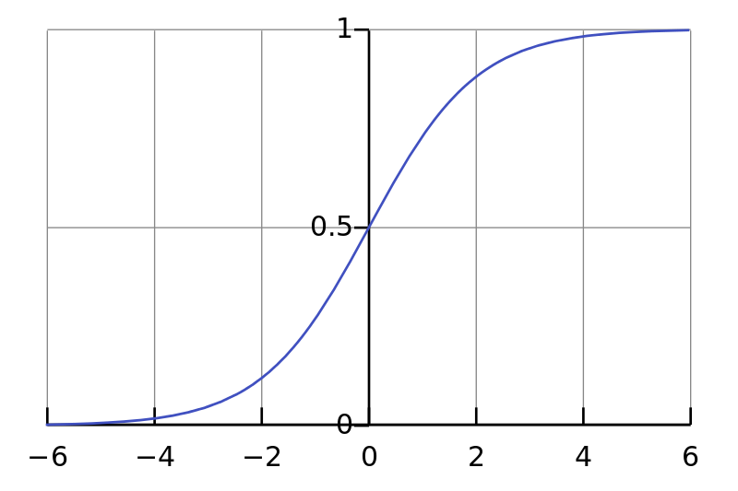
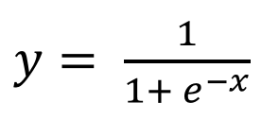

(Standard) Logistic Function
Many natural processes, such as those of complex system learning curves, exhibit a progression from small beginnings that accelerates and approaches a climax over time. (from Wikipedia)
$y= \frac{1}{1+ e^{−x}}$
This "S" shaped function is known as sigmoid or standard logistic function.
Notes:
Mention that CDF of Normal distribution has sigmoid shape. Also mention that sigmoid function is a special case of the logistic function.
We are going to use standard logistic function for model representation. Hence, logistic regression.

Slide 8




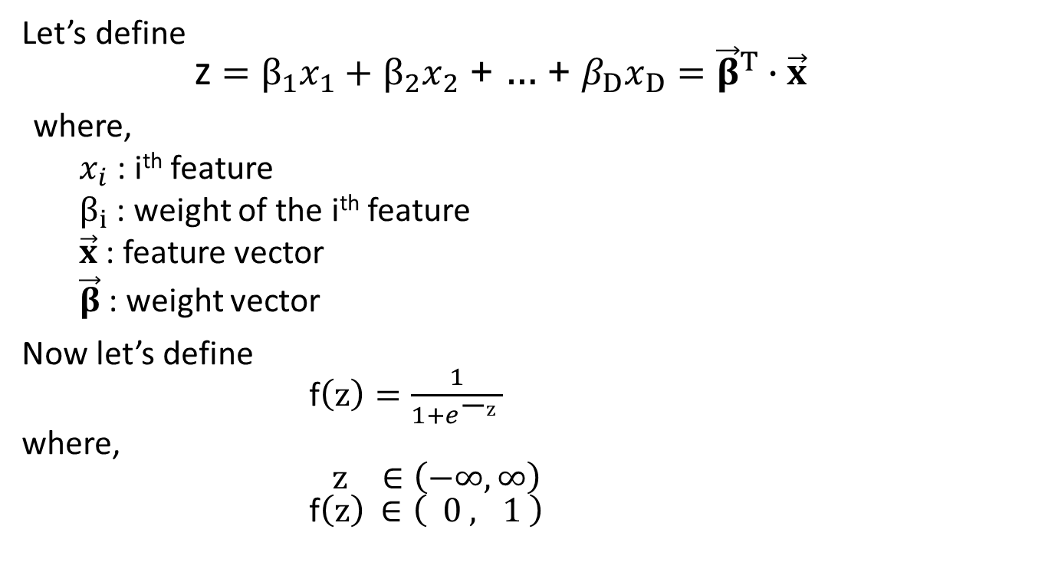
Logistic Regression: Model Representation
Let’s define z $=β_{1}x_{1}+$ $β_{2}x_{2}$ + … + $β_{D}x_{D}={\vec{β}}^{T}∙\vec{x}$
where, $x_{i}$ : i^{th} feature $β_{i}$ : weight of the i^{th} feature $\vec{x}$ : feature vector $\vec{β}$ : weight vector
Now let’s define f$\left(z\right)=\frac{1}{1+e^{\text{−}z}}$
where, $z ∈\left(\text{−}∞, ∞\right)$ f$\left(z\right)$ $∈\left(\text{ 0 }, 1 \right)$
Notes:
Explain z = dot product (beta, x) and f(z) = sigmoid(z). Then give an intuitive feel about

Slide 9
Logistic Regression: Model Interpretation
x₁
β₁
x₂
β₂
β₃
Σ
z
x₃
f(z)
β_{D}
x_{D}
β
β
β
x
x
x
Notes:
Explain relationship between feature and weight vectors using the lower diagrams: ||x|| ||beta|| cos(theta)
sharply acute feature-weight vector angles --> high probability
orthogonal feature-weight vectors --> 50:50
largely obtuse feature-weight vector angles --> low probability

Slide 10


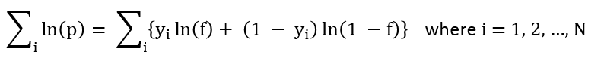

Learning: Maximizing Log Likelihood
P(y = 1) = f(${\vec{β}}^{T}∙\vec{x}$) P(y = 0) = 1 – f(${\vec{β}}^{T}∙\vec{x}$)
This is like tossing a coin. We can express this using Bernoulli’s distribution. Thus the p.m.f. of the conditional likelihood of y is
p( y | $\vec{β}$,$\vec{x}$ ) = ${f\left({ \vec{β}}^{T}∙\vec{x} \right)}^{y}$ $∗$ ${\text{(1 – }\text{f}\left({ \vec{β}}^{T}∙\vec{x} \right)\text{)}}^{1−y}$
We want to maximize this function. However it’s easier to maximize the log of this function. The log likelihood is
ln(p) = y ln(f) + (1 $−$ y) ln(1 $−$ f )
We will maximize the log likelihood over the entire training data to learn the weights.
$$\sum_{i}{\ln\left(p\right)= \sum_{i}{\left\{y_{i}\ln\left(f\right)+ \left(1 − y_{i}\right)\ln\left(1 −f\right)\right\}} \text{where} \text{i}\text{ = 1, 2, …, }\text{N} }$$
Notes:
May be a diagram of the loss function?

Slide 11




Measuring Classification
 | True = 0 | True = 1
Predicted = 0 | True Negative (tn) | False Negative (fn)
Predicted = 1 | False Positive (fp) | True Positive (tp)
Notes:
How to combine precision and recall? Harmonic mean of precision and recall. https://en.wikipedia.org/wiki/F1_score. 2pr/(p + r).
Start coding logistic regression’s function here.

Slide 12
Enough of “what”. Where’s the “how”?
Model representation helps us express our hypothesis by a function over the features.
Loss function helps us quantify the error in our hypothesis ,i.e., the error in estimation of the true value.
We still need to learn the function, specifically, the weights of the independent variables.
Enter Gradient Descent to put it all together.
Note: Gradient descent is one way of optimizing a function. There are several other ways. In fact the topic of optimization techniques would be a good subject for a talk in itself.
Notes:
So far we have talked what we need to do in order to pose the classification problem. How to learn the weights?

Slide 13
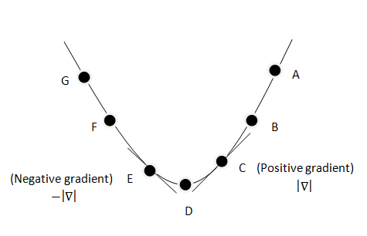
Gradient Descent: Ascend the hill of learning
Gradient of a function gives us the direction in which the function increases at the highest rate. (Vector Calculus)
This gives us a way to minimize a function. We just keep taking small steps (how small?) in the direction opposite the gradient.
Example
Notes:
Diagram from http://stackoverflow.com/questions/21064030/gradient-descent-in-linear-regression.
Explain how starting from A/B/C, we can reach point D. Also explain how starting from point E/F/G we can reach point D.

Slide 14
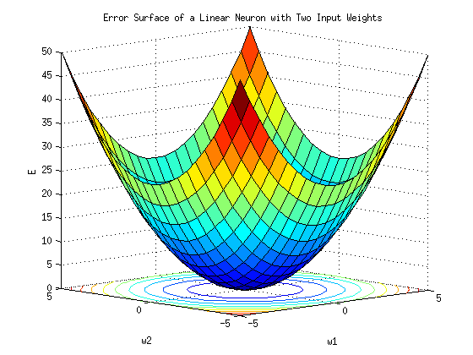
Error Surface
Let’s say we have two features. The loss function could look like
Notes:
Diagram from https://en.wikipedia.org/wiki/Backpropagation
This is a nice diagram to ease into contours from a 3-D error surface.

Slide 15
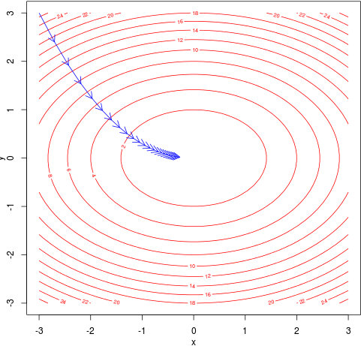
Error Surface: Contour Representation
Notes:
Diagram from http://vis.supstat.com/2013/03/gradient-descent-algorithm-with-r/
Explain why contours are easier to understand than 3-D surfaces and then explain G.D. along the blue line.

Slide 16
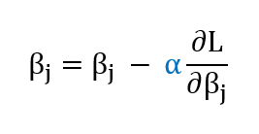
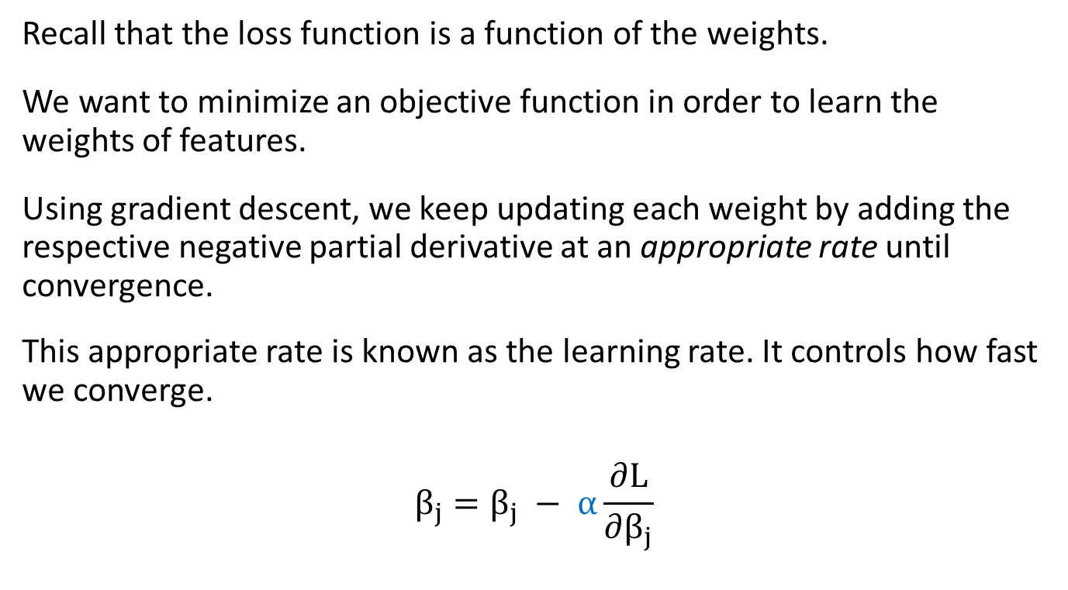
Why Gradient Descent works?
Recall that the loss function is a function of the weights.
We want to minimize an objective function in order to learn the weights of features.
Using gradient descent, we keep updating each weight by adding the respective negative partial derivative at an appropriate rate until convergence.
This appropriate rate is known as the learning rate. It controls how fast we converge.
$$β_{j}=β_{j} − α\frac{∂L}{∂β_{j}}$$

Slide 17

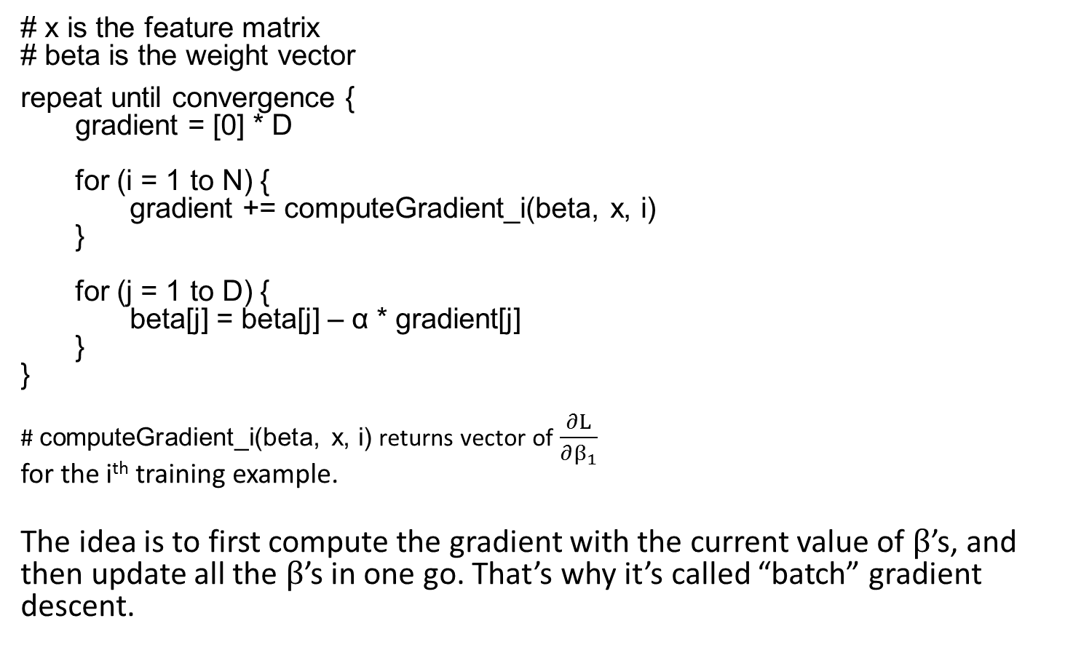
Batch Gradient Descent Algorithm
# x is the feature matrix # beta is the weight vector repeat until convergence { gradient = [0] * D for (i = 1 to N) { gradient += computeGradient_i(beta, x, i) } for (j = 1 to D) { beta[j] = beta[j] – α * gradient[j] } }
# computeGradient_i(beta, x, i) returns vector of $\frac{∂L}{∂β_{1}}$ for the i^{th} training example.
The idea is to first compute the gradient with the current value of β’s, and then update all the β’s in one go. That’s why it’s called “batch” gradient descent.
Notes:
computeGradient() will differ depending on the loss function.

Slide 18
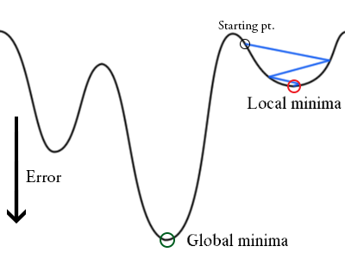

Limitations of Gradient Descent
It is prone to getting stuck at local minima.
If a function doesn’t have a minima then the algorithm can run forever because it will never “converge”.
You have to choose a learning rate.
It works well for functions which are well-behaved.
Notes:
Diagram from https://thinkingandcomputing.com/2014/03/09/genetic-algorithms-neural-networks/

Slide 19
Stochastic Gradient Descent
Stochastic or online gradient descent is a modification of batch gradient such that we update the weight (β’s) with each training example.
In other words we approximate the gradient by only computing it for one training example. Recall that in batch gradient descent we compute the gradient over the entire training set and then update the β’s.
It iterates over the training data until it finds a stopping point.
This works because our error function is additive, i.e., the total error is the sum of all errors.
Notes:
It is stochastic, that is, the point it ends up is completely random and will differ by weight initialization and the order of training examples being examined.

Slide 20
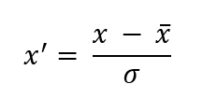
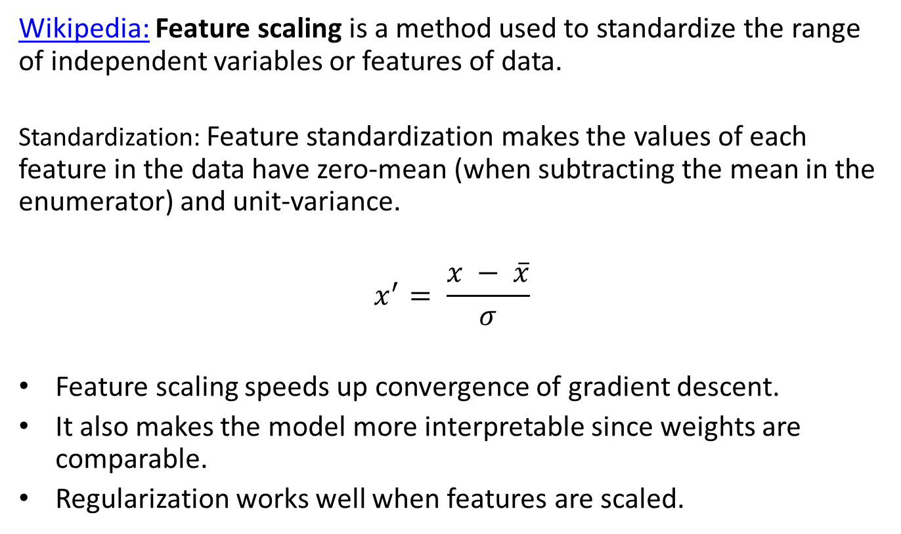
Tip: Feature Scaling
Wikipedia: Feature scaling is a method used to standardize the range of independent variables or features of data.
Standardization: Feature standardization makes the values of each feature in the data have zero-mean (when subtracting the mean in the enumerator) and unit-variance.
$$x^{′}= \frac{x − \overline{x}}{σ}$$
Feature scaling speeds up convergence of gradient descent.
It also makes the model more interpretable since weights are comparable.
Regularization works well when features are scaled.

Slide 21
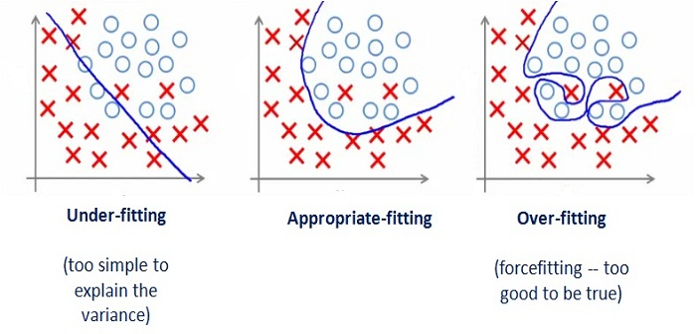
Overfitting
If we have lots of features the learned model may fit the training data very well. It can even achieve zero error on the training set. Is that a good thing?
Not necessarily. This does not guarantee that the model will generalize well to unseen data.
Notes:
During the training phase the model has almost memorized the training data.
Explain overfitting by using the 2-D diagram.

Slide 22
How to prevent overfitting?
Get more training data. More training data means the model trains on broader set of examples. This can help generalize better.
Manually select which features to keep. Lower number of features allows the model to generalize better.
However, both these options may not be cheap or even feasible.
Third option is regularization.
Notes:
Explain why a lot of features with small training data leads to over-fitting.

Slide 23
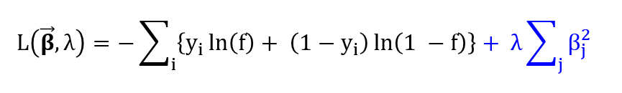
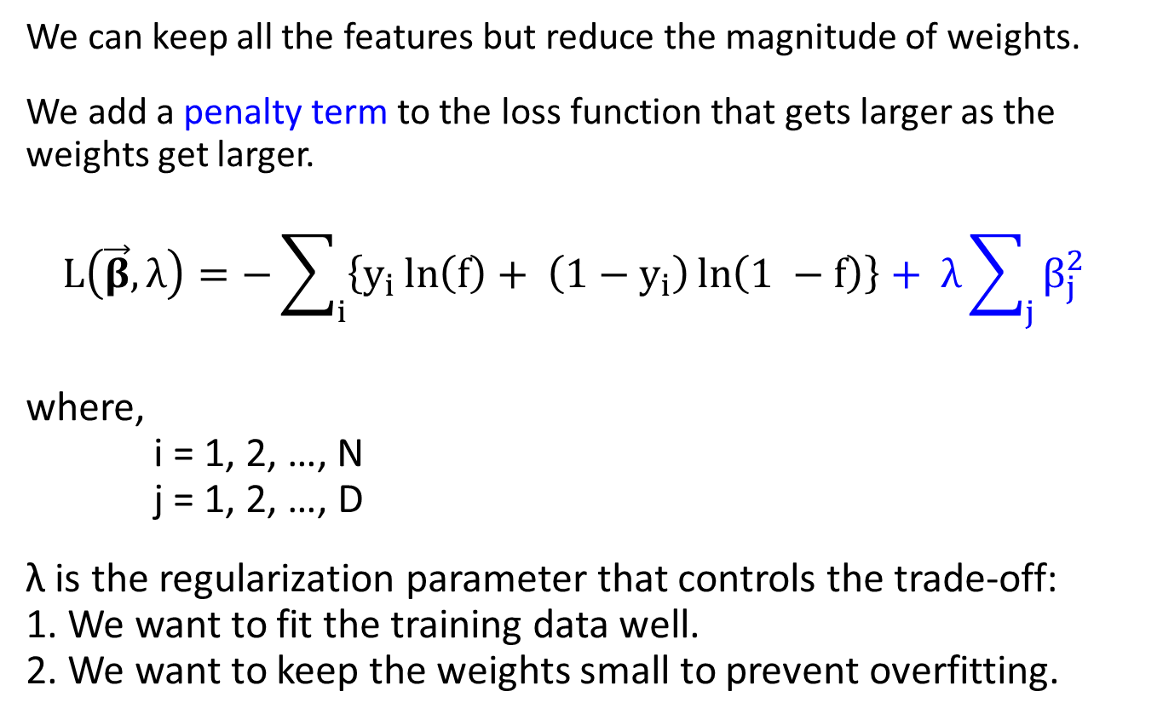
Regularization
We can keep all the features but reduce the magnitude of weights.
We add a penalty term to the loss function that gets larger as the weights get larger.
$$L\left(\vec{β}, λ\right){=−\sum_{i}{\left\{y_{i}\ln\left(f\right)+ \left(1−y_{i}\right)\ln\left(1 −f\right)\right\}}+ λ\sum_{j}{β_{j}^{2}} }$$
where, i = 1, 2, …, N j = 1, 2, …, D
λ is the regularization parameter that controls the trade-off: 1. We want to fit the training data well. 2. We want to keep the weights small to prevent overfitting.
Notes:
Explain how decreasing magnitude of weight helps. Extreme case is when a weight becomes zero then that feature has no contribution at all.
Mention that this regularization term is ridge regularization. There are other ways of penalizing large weights, e.g., lasso (also mentioned in Joel’s book)
L1/L2 regularization: http://www.chioka.in/differences-between-l1-and-l2-as-loss-function-and-regularization/

Slide 24

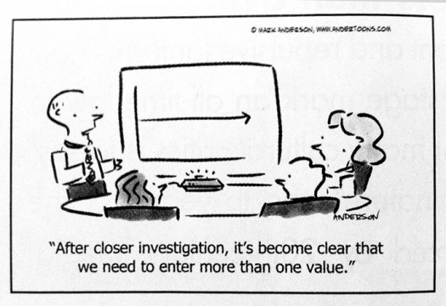
Multi-class Classification
Let’s say we want to classify movies into genres: drama, thriller, comedy, action.
How can we use logistic regression to multi-class classification problem?
One v/s all
We can break this into 4 classification problems:
Is this movie a drama?
Is this movie a thriller?
Is this movie a comedy?
Is this movie an action?
We then predict the genre whose probability is highest.

Slide 25
Some applications
In the last session we had used Naïve Bayes algorithm to classify emails as spam and ham. We can use logistic regression for solving the same problem.
Election campaign organizers can use it to predict whether someone will vote for their candidate.
Marketers can use it to predict whether a customer will respond to an ad.
In healthcare it can be used to predict whether a tumor is malignant or not.
Notes:
A list of applications.

Slide 26

Acknowledgement
Kenny Herrington
Bhaumik Chokshi
Ying Li

Slide 27

Appendix

Slide 28
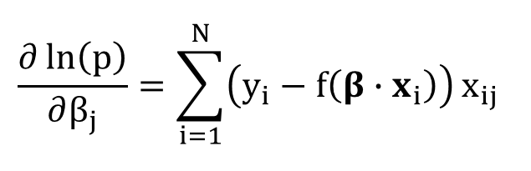
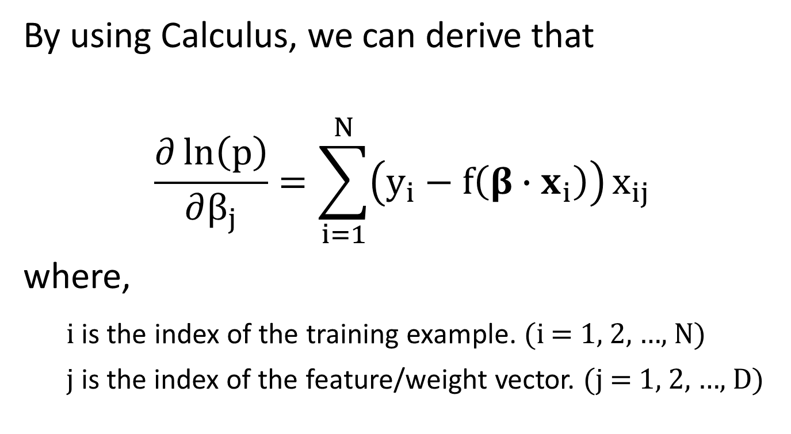
Gradient Computation
By using Calculus, we can derive that
$$\frac{∂\ln\left(p\right)}{∂β_{j}}=\sum_{i=1}^{N}{\left(y_{i}−f\left(β∙x_{i}\right)\right)}x_{ij}$$
where,
i is the index of the training example. (i = 1, 2, …, N)
j is the index of the feature/weight vector. (j = 1, 2, …, D)
Notes:
We will need this formula while coding.

Slide 29

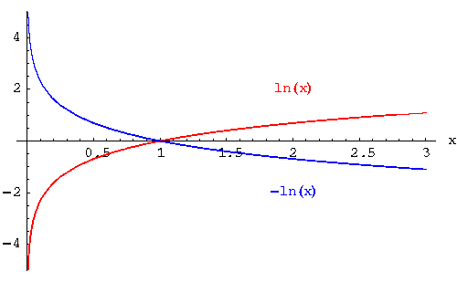

Learning: Minimizing Loss function
In some texts you’ll find that a loss function is minimized to learn the weights.
Loss function for Logistic Regression is the simply negative log likelihood over the entire training set.
$$L\left(\vec{β}\right){=−\sum_{i}{\left\{y_{i}\ln\left(f\right)+ \left(1 − y_{i}\right)\ln\left(1 −f\right)\right\}} }\text{where} \text{i}\text{ = 1, 2, …, }\text{N}$$
Notes:
Diagram from http://www.sosmath.com/algebra/logs/log4/log42/log422/log422.html.
Use the graph to build the intuition why this loss function works:
When y_i = 1, loss is –ln(f) which increases when f tends to 0 and decreases when f tend s to 1.
When y_i = 0, loss is –ln(1-f) which increases when f tends to 1 and decreases when f tends to 0. Why? Because when f tends to 1, 1-f tends to 0 and –ln(1-f) tends to inf.
Move to appendix.

Slide 30

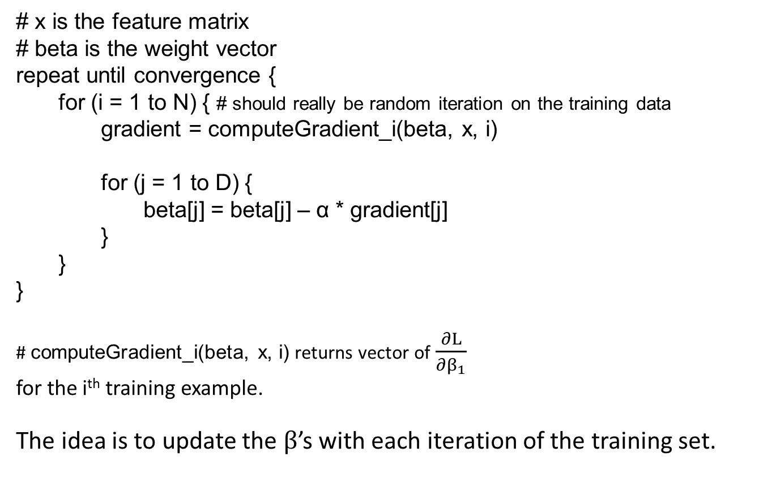
Stochastic Gradient Descent Algorithm
# x is the feature matrix # beta is the weight vector repeat until convergence { for (i = 1 to N) { # should really be random iteration on the training data gradient = computeGradient_i(beta, x, i) for (j = 1 to D) { beta[j] = beta[j] – α * gradient[j] } } }
# computeGradient_i(beta, x, i) returns vector of $\frac{∂L}{∂β_{1}}$ for the i^{th} training example.
The idea is to update the β’s with each iteration of the training set.

