Slide 1
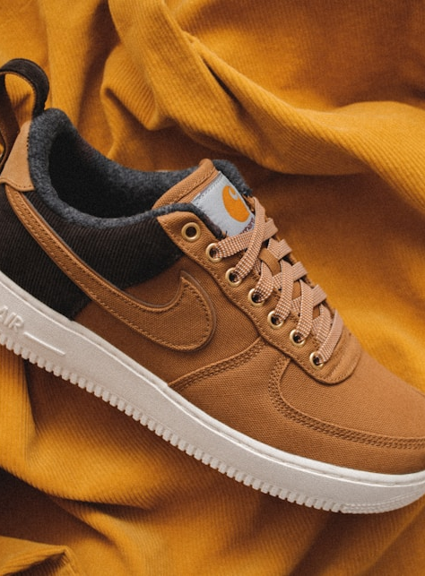
SOLEVIEW
Interactive 3D Shoe
Showroom and Product
Comparison System
Integrative Programming 2
Prefinal Week 1 Title Presentation
Group members: [Add names]
Section: [Add section]
Notes:
Image source: https://images.unsplash.com/photo-1549298916-b41d501d3772
Replace bracketed group information before submission.

Slide 2
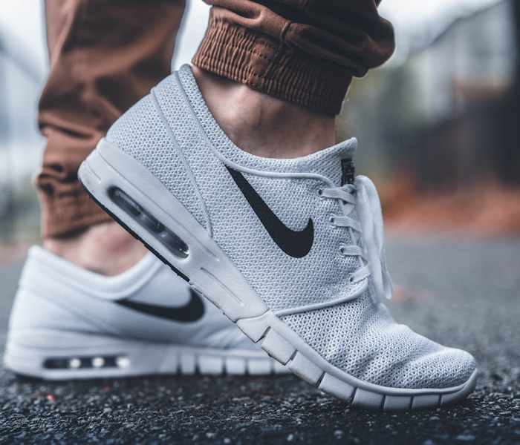
Target users and context
02
Primary user
Online shoe shoppers
Customers who want to inspect footwear closely before deciding which pair fits their needs and style.
Context
Product browsing happens on phones and computers, where shoppers currently depend on static photos and short descriptions.
SoleView proposal
Notes:
Image source: https://images.unsplash.com/photo-1460353581641-37baddab0fa2
Target-user description is the project team's proposed scope.

Slide 3
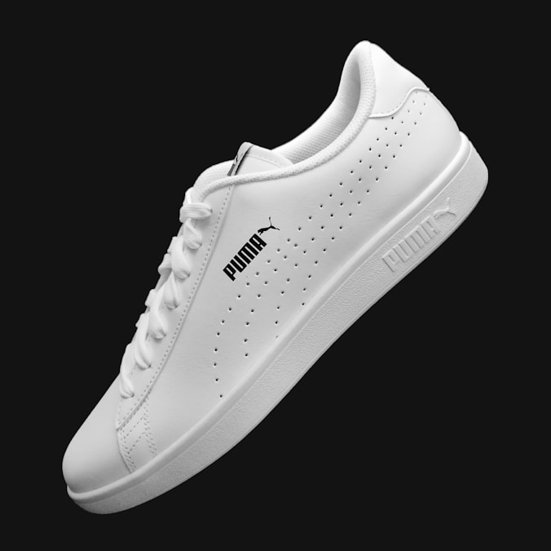
Problem statement
03
Static photos hide important product details
Customers cannot freely inspect shoe shape, material texture, sole design, or appearance from every angle.
Why it matters
Limited visual information creates uncertainty. Shoppers may abandon the product, search across several pages, or visit a physical store only to inspect it.
SoleView proposal
Notes:
Image source: https://images.unsplash.com/photo-1608231387042-66d1773070a5
Problem statement is a project hypothesis. Validate it through a short shopper survey during testing.

Slide 4
Current process
04
01
Browse static photos
Customer checks a small set of fixed product angles.
02
Search for more details
Customer opens other pages or asks shop staff questions.
03
Guess before choosing
Customer decides without a complete view of the product.
04
Visit the physical store
Some customers travel to inspect the shoe in person.
Main pain point: customers lack direct control over product inspection.
SoleView proposal
Notes:
Current-process description represents the proposed problem framing. Validate it through observation or user interviews.

Slide 5
Proposed solution
05
SoleView gives shoppers one focused path from discovery to a saved decision.
1
2
3
4
5
Browse
Inspect
Customize
Compare
Save
Search and filter shoe catalog
Rotate and zoom 3D model
Switch available colors
Review products side by side
Keep preferred shoes in shortlist
Owner workflow
Add product details, upload a GLB model, preview it, then publish or update the shoe record.
SoleView proposal
Notes:
Workflow reflects the planned system scope and current prototype capabilities.

Slide 6
Innovation and improvement
06
Existing online shoe stores rely mainly on static product photos, which limit how customers inspect footwear before choosing.
SoleView improves this through interactive 3D viewing and direct product comparison. Customers can examine details from multiple angles and save better-informed choices.
Measurable test
Compare task completion time and user confidence between static photos and SoleView's 3D workflow.
Notes:
Innovation statement follows the required sentence structure from the instructor handout. The proposed measurement needs user testing before reporting results.

Slide 7
Core features
07
01
02
03
Interactive 3D viewer
Comparison and shortlist
Owner catalog management
Customers rotate, zoom, and switch available material variants while viewing each shoe.
Customers compare product details and save preferred shoes for later review.
Owner creates, updates, and removes products, images, variants, sizes, and GLB files.
Optional after core workflow works: product inquiry form and usage analytics.
SoleView proposal
Notes:
Sample GLB source used in prototype: https://github.com/KhronosGroup/glTF-Sample-Assets/tree/main/Models/MaterialsVariantsShoe
License: Creative Commons Attribution 4.0 International, © 2021 Shopify.

Slide 8
Scope and limitations
08
Included
Excluded from first version
Customer shoe catalog
Interactive GLB model viewing
Color and size information
Side-by-side product comparison
Persistent favorites
Owner product and model management
Real payment processing
Delivery and courier tracking
Augmented-reality fitting
Automatic foot-size scanning
Full accounting or physical POS
Automatic 3D model generation
System can store many products. Initial defense data will use several complete models so every model receives proper optimization and testing.
SoleView proposal
Notes:
Scope follows the two-week implementation limit described in the project guide. Product count is a demonstration choice, not a database limit.

Slide 9
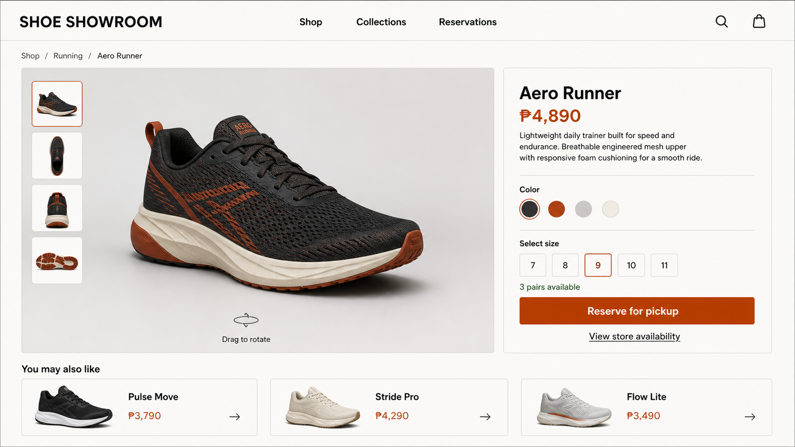
UI design and prototype
09
Current product-detail screen
SoleView proposal
Notes:
UI concept generated for the SoleView prototype. The working Vue prototype implements the same product focus, 3D controls, size selection, and material selection.

Slide 10
SOLEVIEW
Closing summary
Problem
Static product photos limit shoe inspection.
Solution
Interactive 3D viewing supports closer product review.
Innovation
Customers control viewing angles and compare choices in one workflow.
Scope
Focused showroom with owner-managed GLB models.
Questions?
Ready to explain workflow, 3D model handling, database plan, and project boundaries.
Notes:
Closing slide. Invite questions about implementation, risk, testing, and scope.

