Slide 1
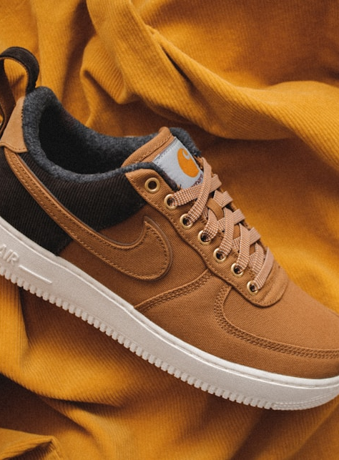
SOLEVIEW
3D Shoe Viewing and
Pickup Reservation
System
Integrative Programming 2
Prefinal Week 1 Title Presentation
Group members: [Add names]
Section: [Add section]
Notes:
Image source: https://images.unsplash.com/photo-1549298916-b41d501d3772
Replace bracketed group information before submission.

Slide 2
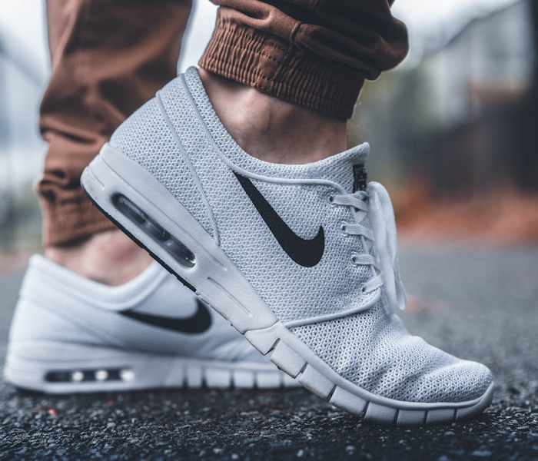
Target users and context
02
Primary user
Customers of one shoe store
Customers inspect branded shoes, check available variants, and reserve a pair before visiting the store.
Secondary user
The store owner signs in to manage products, GLB models, size and color stock, and pickup reservations.
SoleView proposal
Notes:
Image source: https://images.unsplash.com/photo-1460353581641-37baddab0fa2
Target-user description is the project team's proposed scope.

Slide 3
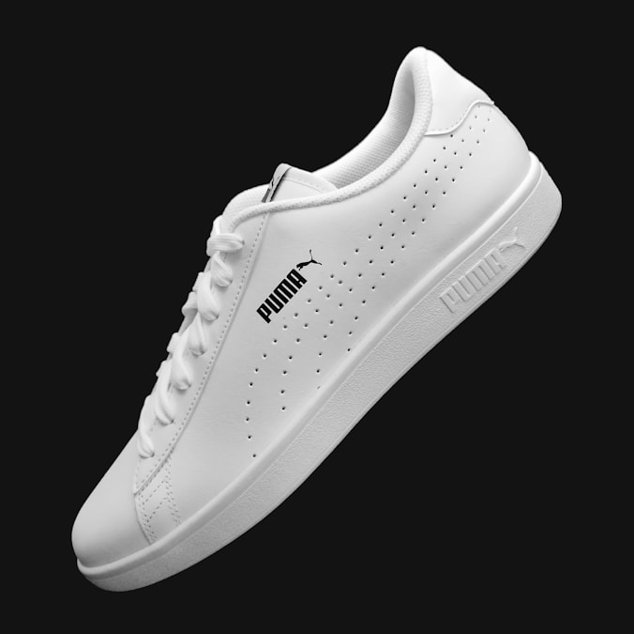
Problem statement
03
Customers cannot inspect shoes or confirm stock quickly
Static photos limit product inspection. Size and color availability often requires a separate message to the store.
Why it matters
Customers spend more time asking questions and may visit the store without knowing whether their preferred variant remains available.
SoleView proposal
Notes:
Image source: https://images.unsplash.com/photo-1608231387042-66d1773070a5
Problem statement is a project hypothesis. Validate it through a short shopper survey during testing.

Slide 4
Current process
04
01
Browse static photos
Customer checks a small set of fixed product angles.
02
Message the store
Customer asks whether a size and color are still available.
03
Wait for confirmation
Staff manually checks stock and replies when available.
04
Visit without a hold
The selected pair may sell before the customer arrives.
Main pain point: product inspection and pickup availability require separate manual steps.
SoleView proposal
Notes:
Current-process description represents the proposed problem framing. Validate it through observation or user interviews.

Slide 5
Proposed solution
05
SoleView connects product inspection, stock checking, and pickup reservation in one workflow.
1
2
3
4
5
Browse
Inspect
Select
Reserve
Confirm
Open the store's shoe catalog
Rotate and zoom the 3D model
Choose an available size and color
Enter pickup contact details
Owner approves and prepares the pair
Owner workflow
After login, manage products and GLB files, update variant stock, then confirm or reject reservations.
SoleView proposal
Notes:
Workflow reflects the planned system scope and current prototype capabilities.

Slide 6
Innovation and improvement
06
Existing shoe-store pages rely on static photos and manual messages for stock confirmation and pickup requests.
Our system improves this through interactive 3D viewing, variant-level stock display, and pickup reservation, which helps customers inspect a shoe and secure an available pair faster.
Measurable test
Compare the time and number of steps needed to inspect a shoe and confirm a pickup-ready variant.
Notes:
Innovation statement follows the required sentence structure from the instructor handout. The proposed measurement needs user testing before reporting results.

Slide 7
Core features
07
01
02
03
Interactive 3D viewer
Stock-linked reservation
Secure owner management
Customers rotate and zoom licensed branded shoe models before selecting a variant.
Customers select a size and color, then reserve an available pair for store pickup.
The owner logs in to manage products, GLB files, stock, and reservation statuses.
Customers browse and reserve without an account. Only the owner requires login.
SoleView proposal
Notes:
Sample GLB source used in prototype: https://github.com/KhronosGroup/glTF-Sample-Assets/tree/main/Models/MaterialsVariantsShoe
License: Creative Commons Attribution 4.0 International, © 2021 Shopify.

Slide 8
Scope and limitations
08
Included
Excluded from first version
Public catalog for one shoe store
Interactive GLB model viewing
Stock by size and color
Guest pickup reservation
Reservation reference and status
Owner login and management tools
Online payment processing
Delivery and courier tracking
Multiple stores or seller accounts
Customer login and loyalty program
Augmented-reality fitting
Automatic 3D model generation
Branded sample models require a valid asset license, creator attribution, and an academic-use disclaimer.
SoleView proposal
Notes:
Scope follows the two-week implementation limit described in the project guide.
Brand and asset guidance: https://www.nike.com/help/a/nike-corporate-details/app
Sketchfab license guidance: https://sketchfab.com/licenses
Downloaded Creative Commons models require the attribution shown on each model page. A model license does not by itself grant brand authorization.

Slide 9
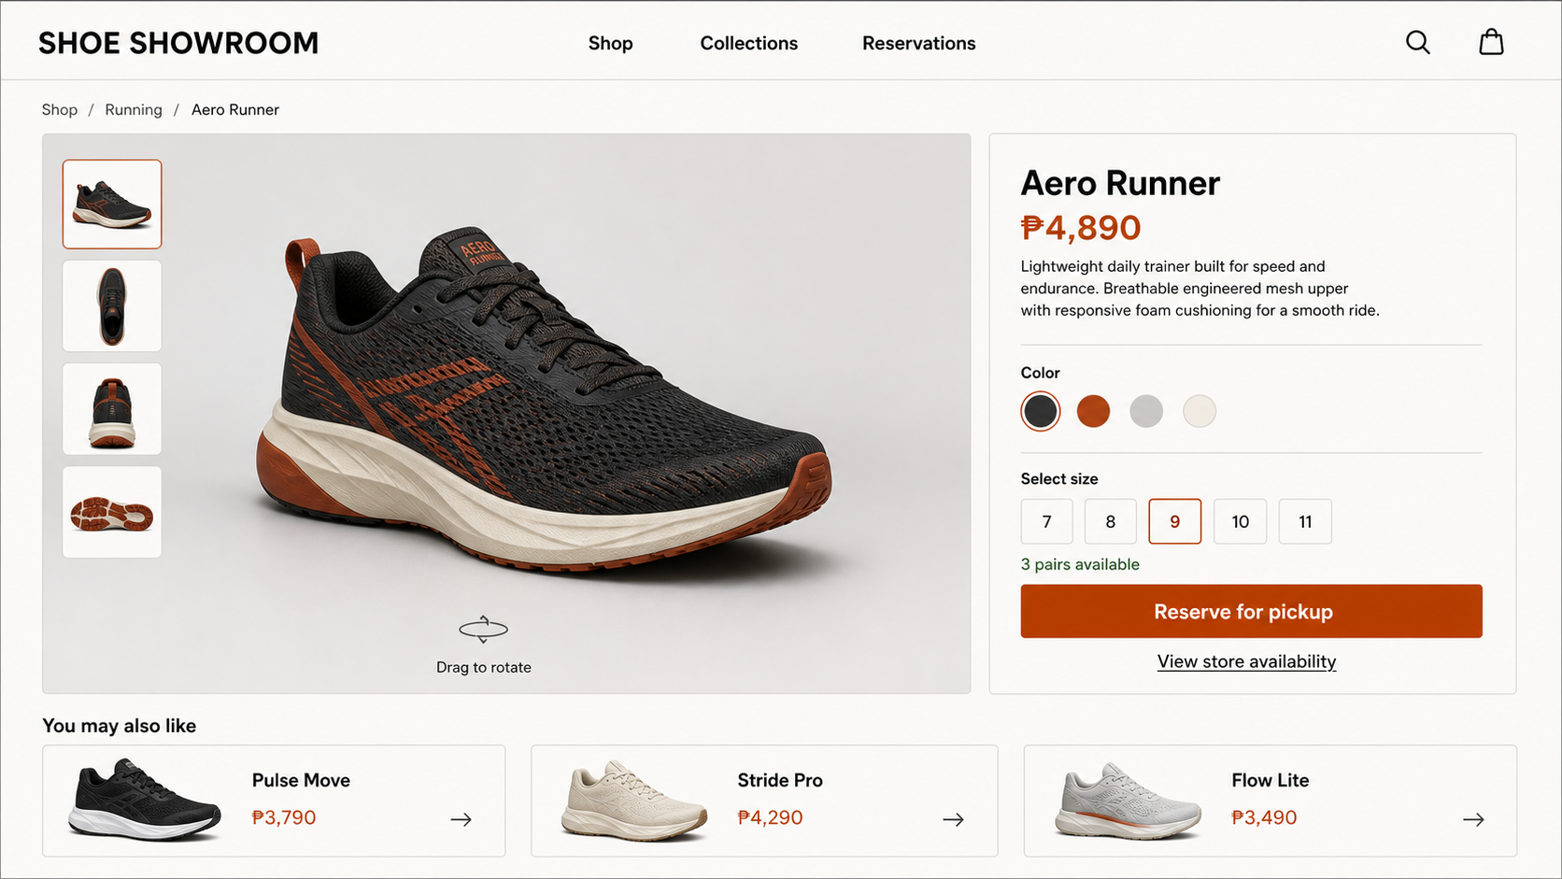
UI design and prototype
09
Customer product-viewing screen
SoleView proposal
Notes:
UI concept generated for the SoleView prototype. The reservation form and owner confirmation screen follow this product-viewing step.

Slide 10
SOLEVIEW
Closing summary
Problem
Static photos and manual stock inquiries slow customer decisions.
Solution
3D viewing connects variant selection with pickup reservation.
Innovation
Customers inspect and secure an available pair in one workflow.
Scope
One shoe store with public browsing and secure owner tools.
Questions?
Ready to explain reservation states, stock handling, GLB licensing, and project boundaries.
Notes:
Closing slide. Invite questions about implementation, risk, testing, and scope.

