Slide 1
Group project presentation
S02-01: Yoshua Kock, Renis Hila and Guleesh Spithorst

Slide 2
Index
Our Solutions
UML-diagram
Demo

Slide 3
Our Solutions
Project Problems:
Uncommunicated minor issues - Complaints
Tenants did not get groceries – Shopping list
Unfulfilled tasks - Tasks
Unannounced events - Announcements

Slide 4
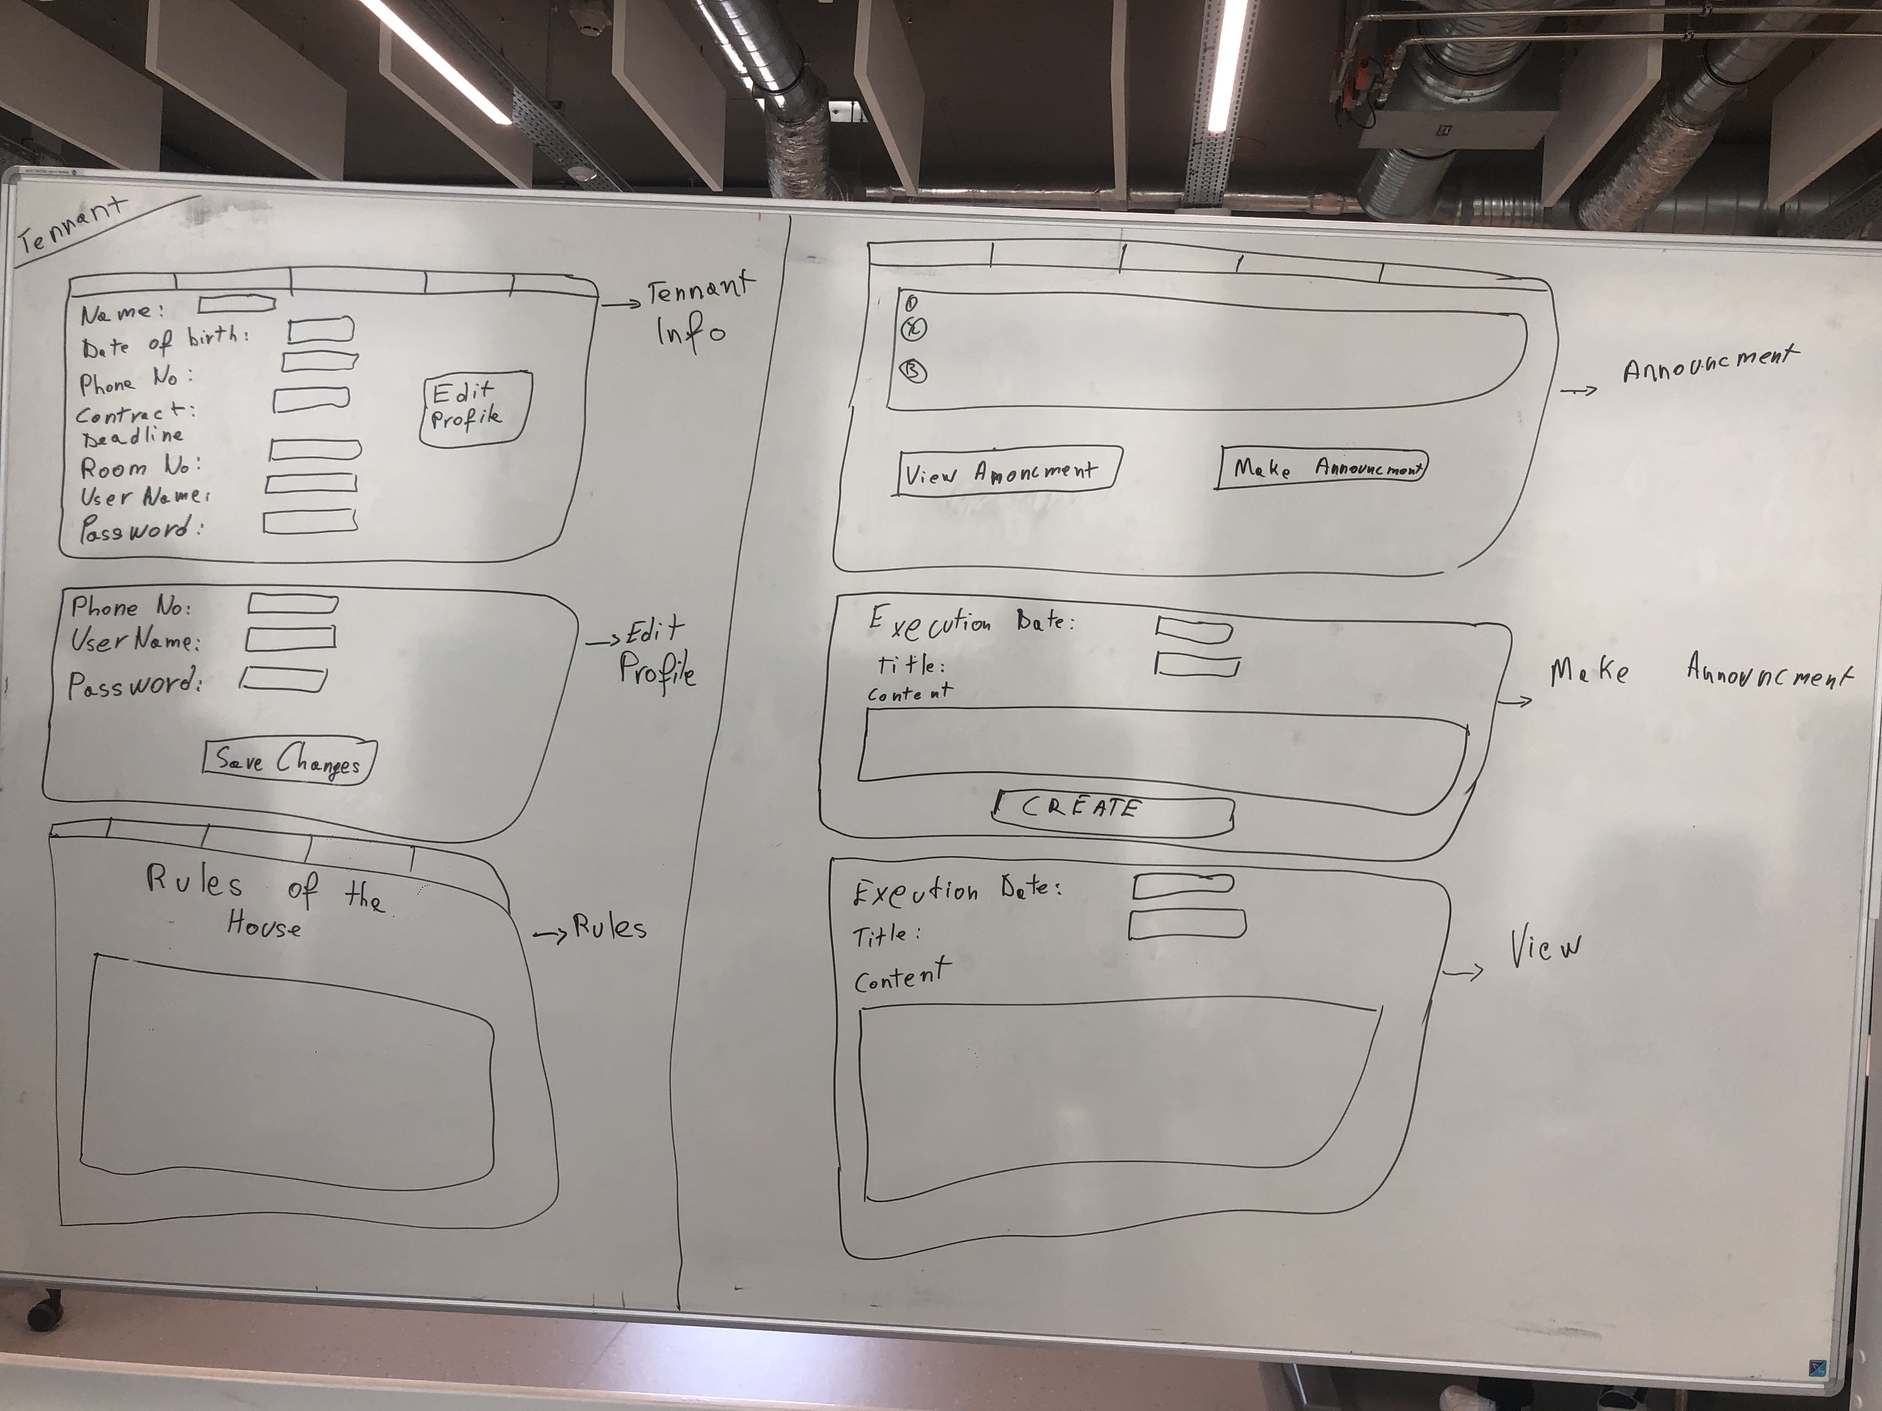
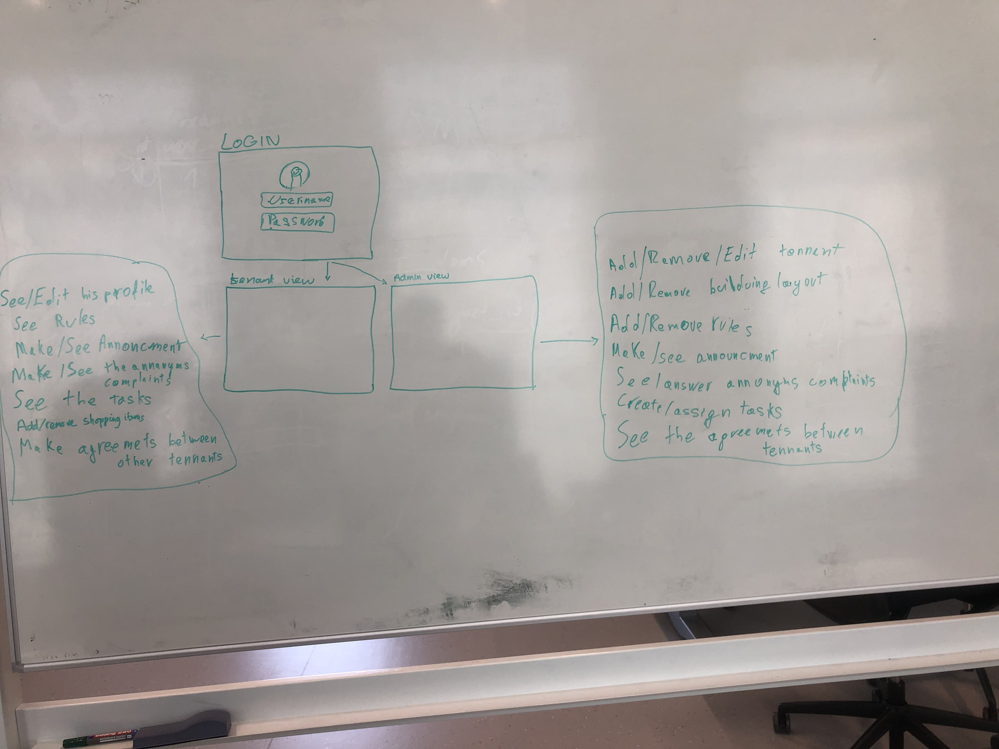
Paper Prototype

Slide 5
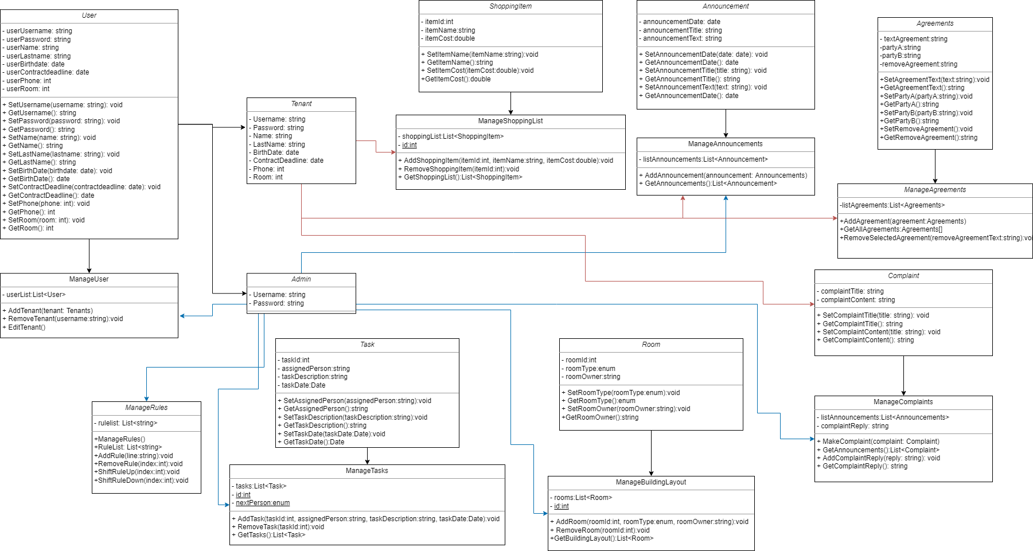
UML Diagram

Slide 6
Demo
We will demonstrate in Visual Studio

