Slide 1
Android Project
Project 1: Learning facial expressions for autism
Hilal Yavuz
218CS2112

Slide 2
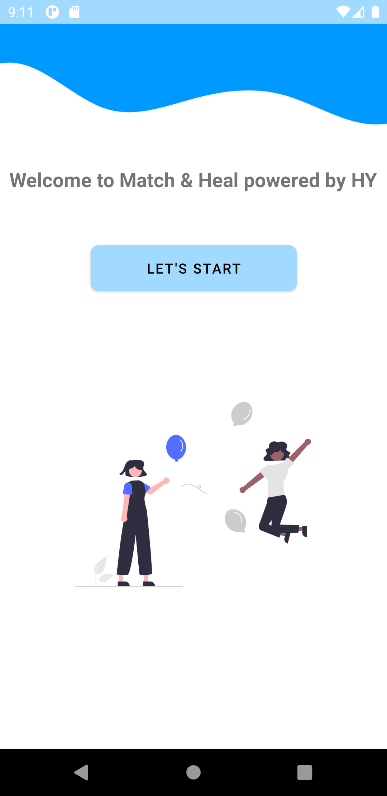
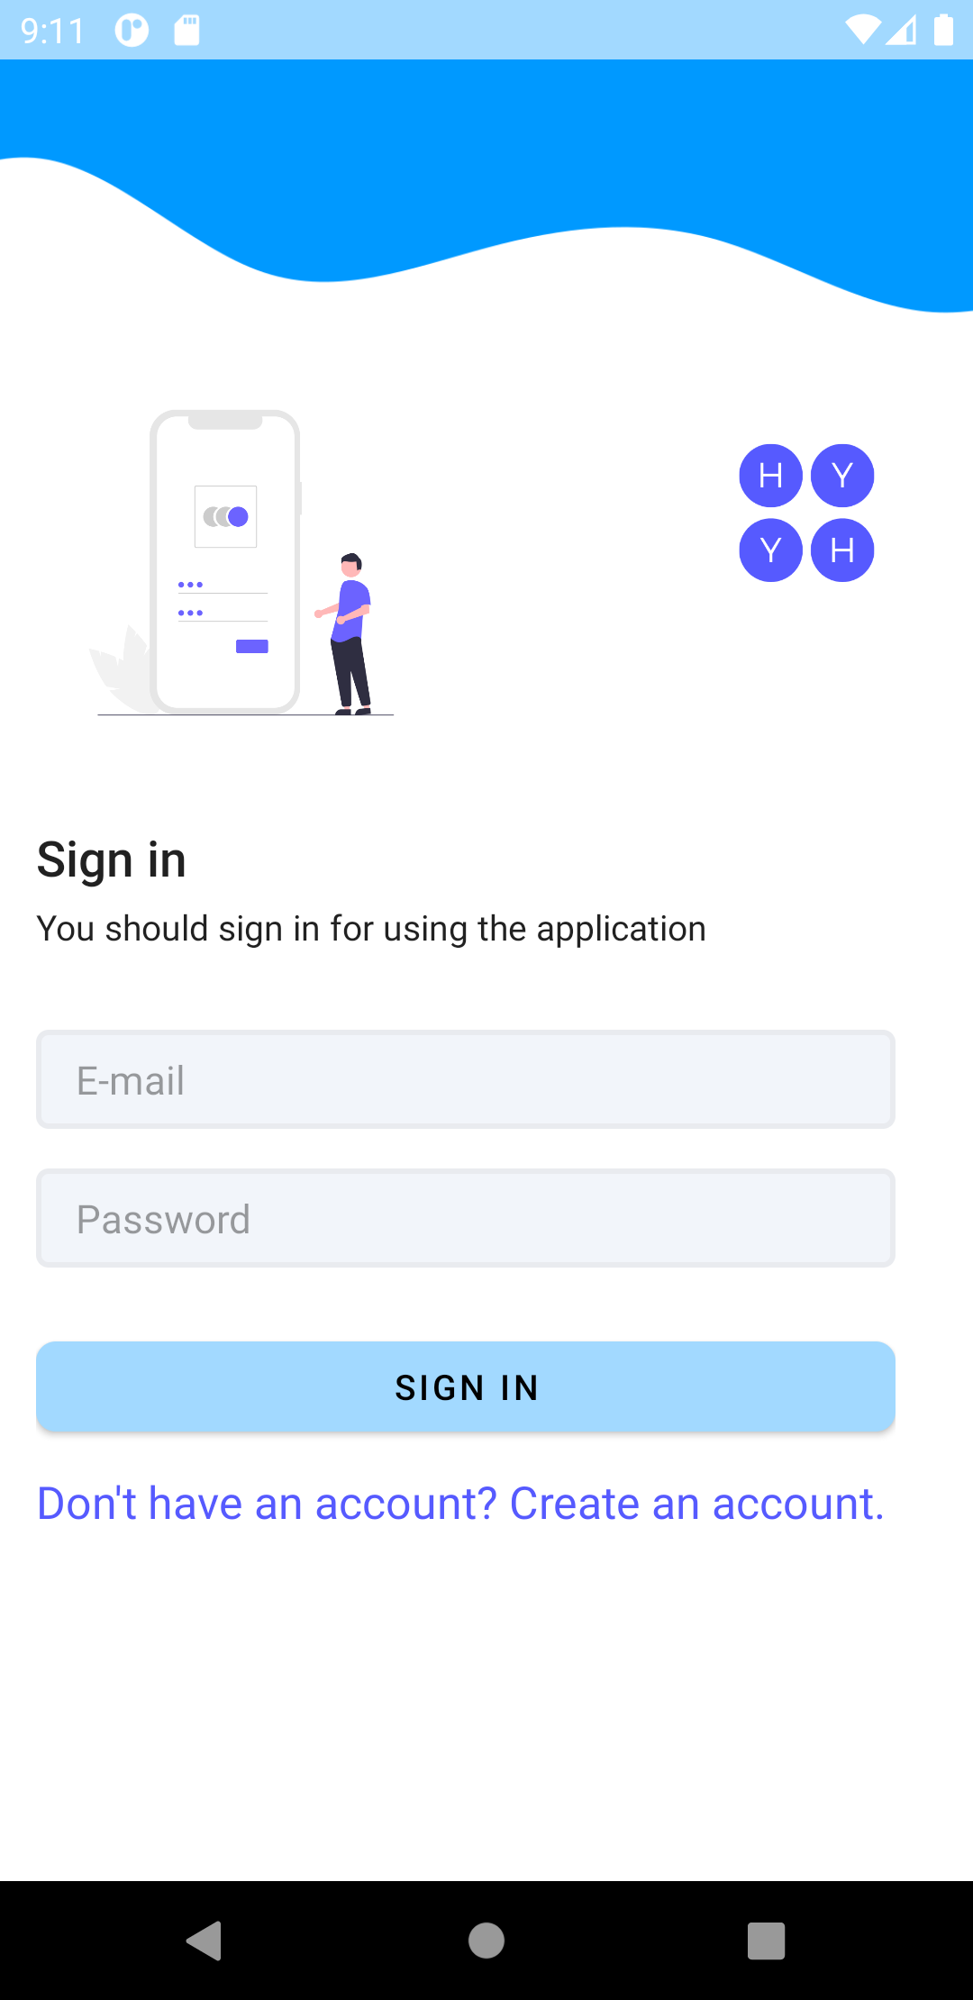
Here is a start & sign in pages of my app.

Slide 3
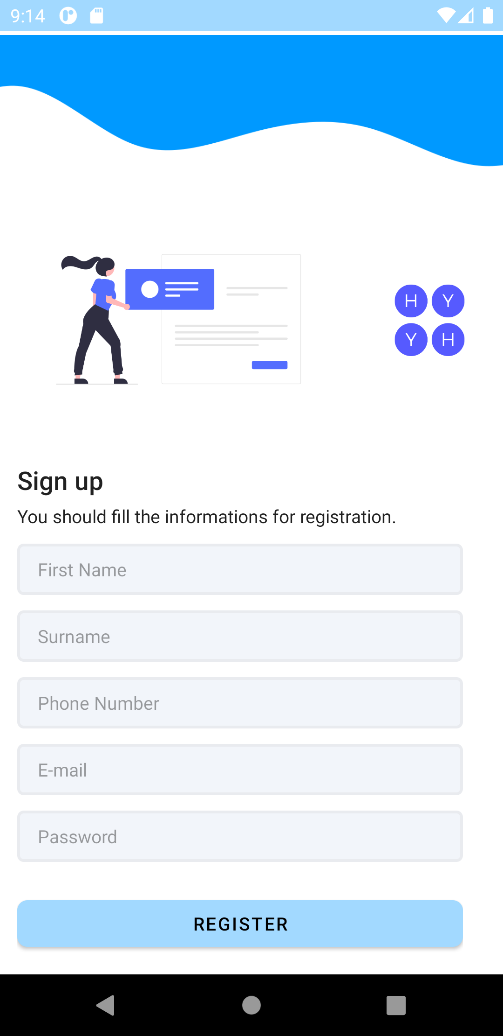
Registration Page
If user doesn't have an account, by clicking the create an account text in the sign in page, user’ll redirecting to the registration page.
After finishing the registration process, user’ll redirect again sign in page.

Slide 4
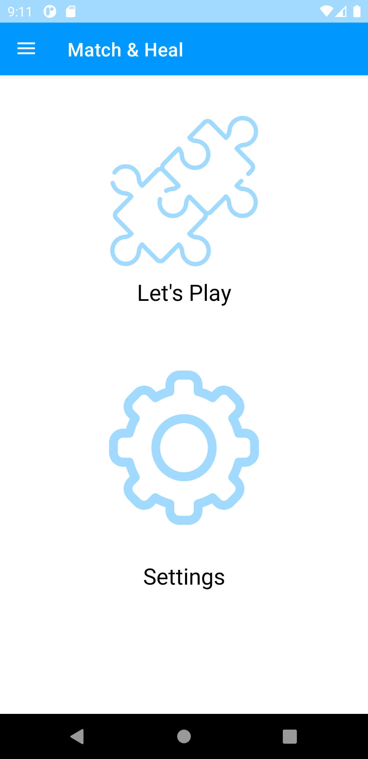
Main Page
In my main page, there are 2 options. User can start play game by selecting the Let’s Play button or user can select settings option and in the settings option, user can change account image.

Slide 5
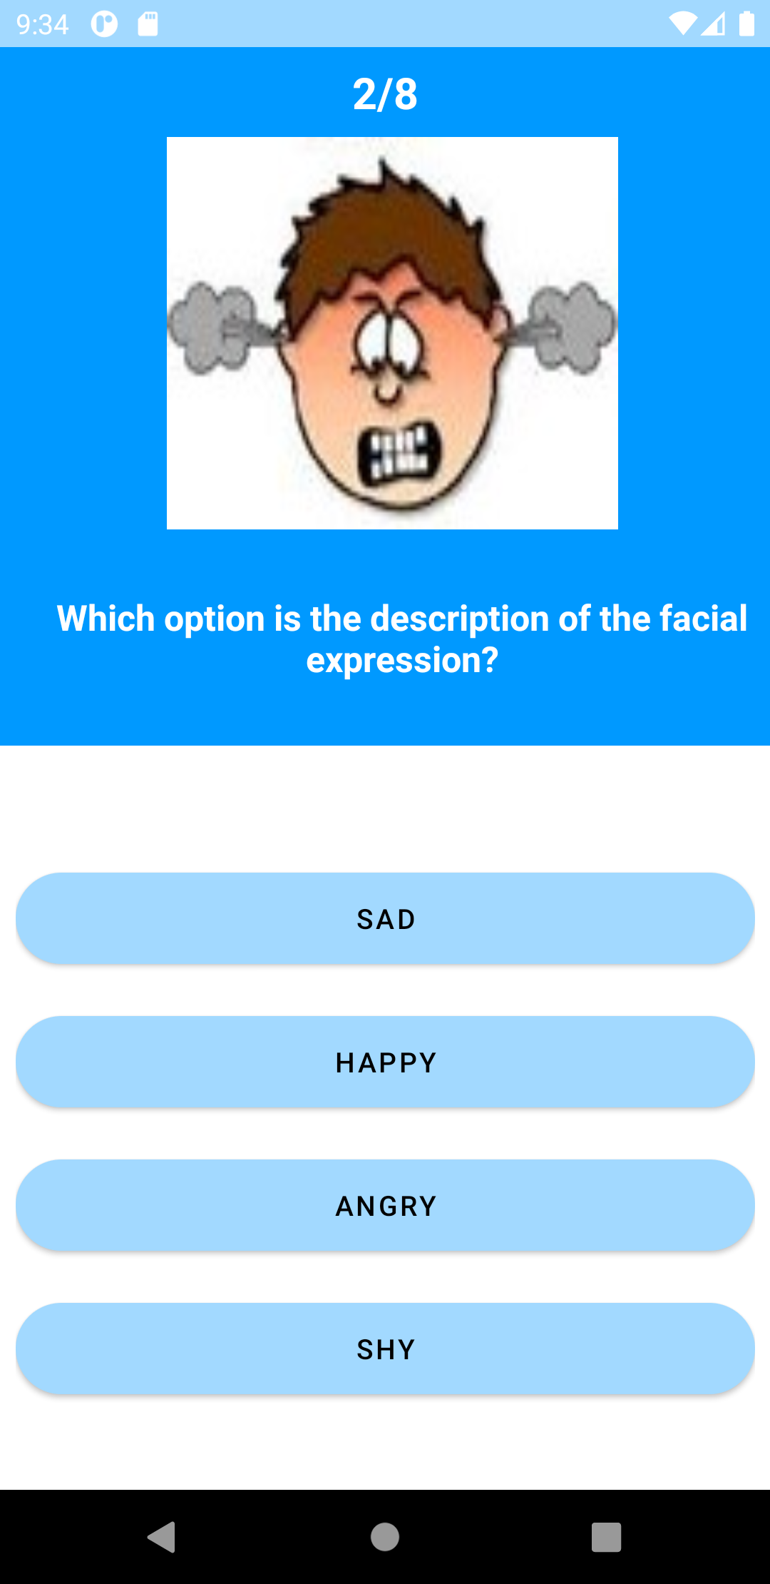
Game/Quiz Page :Question view

Slide 6
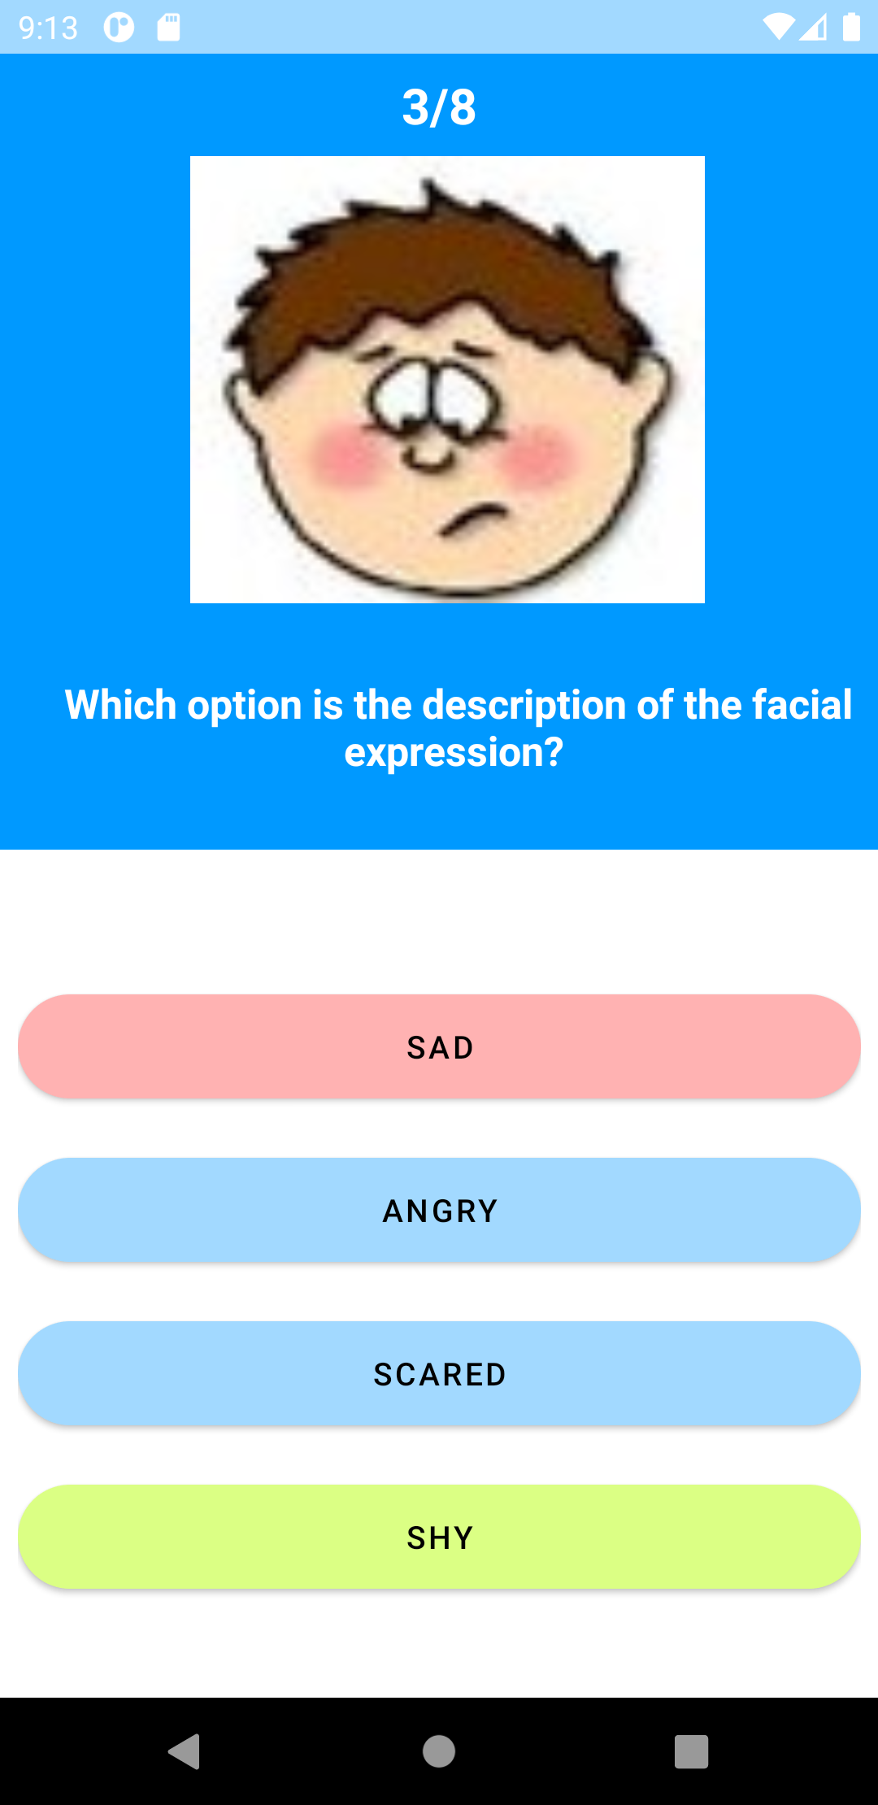
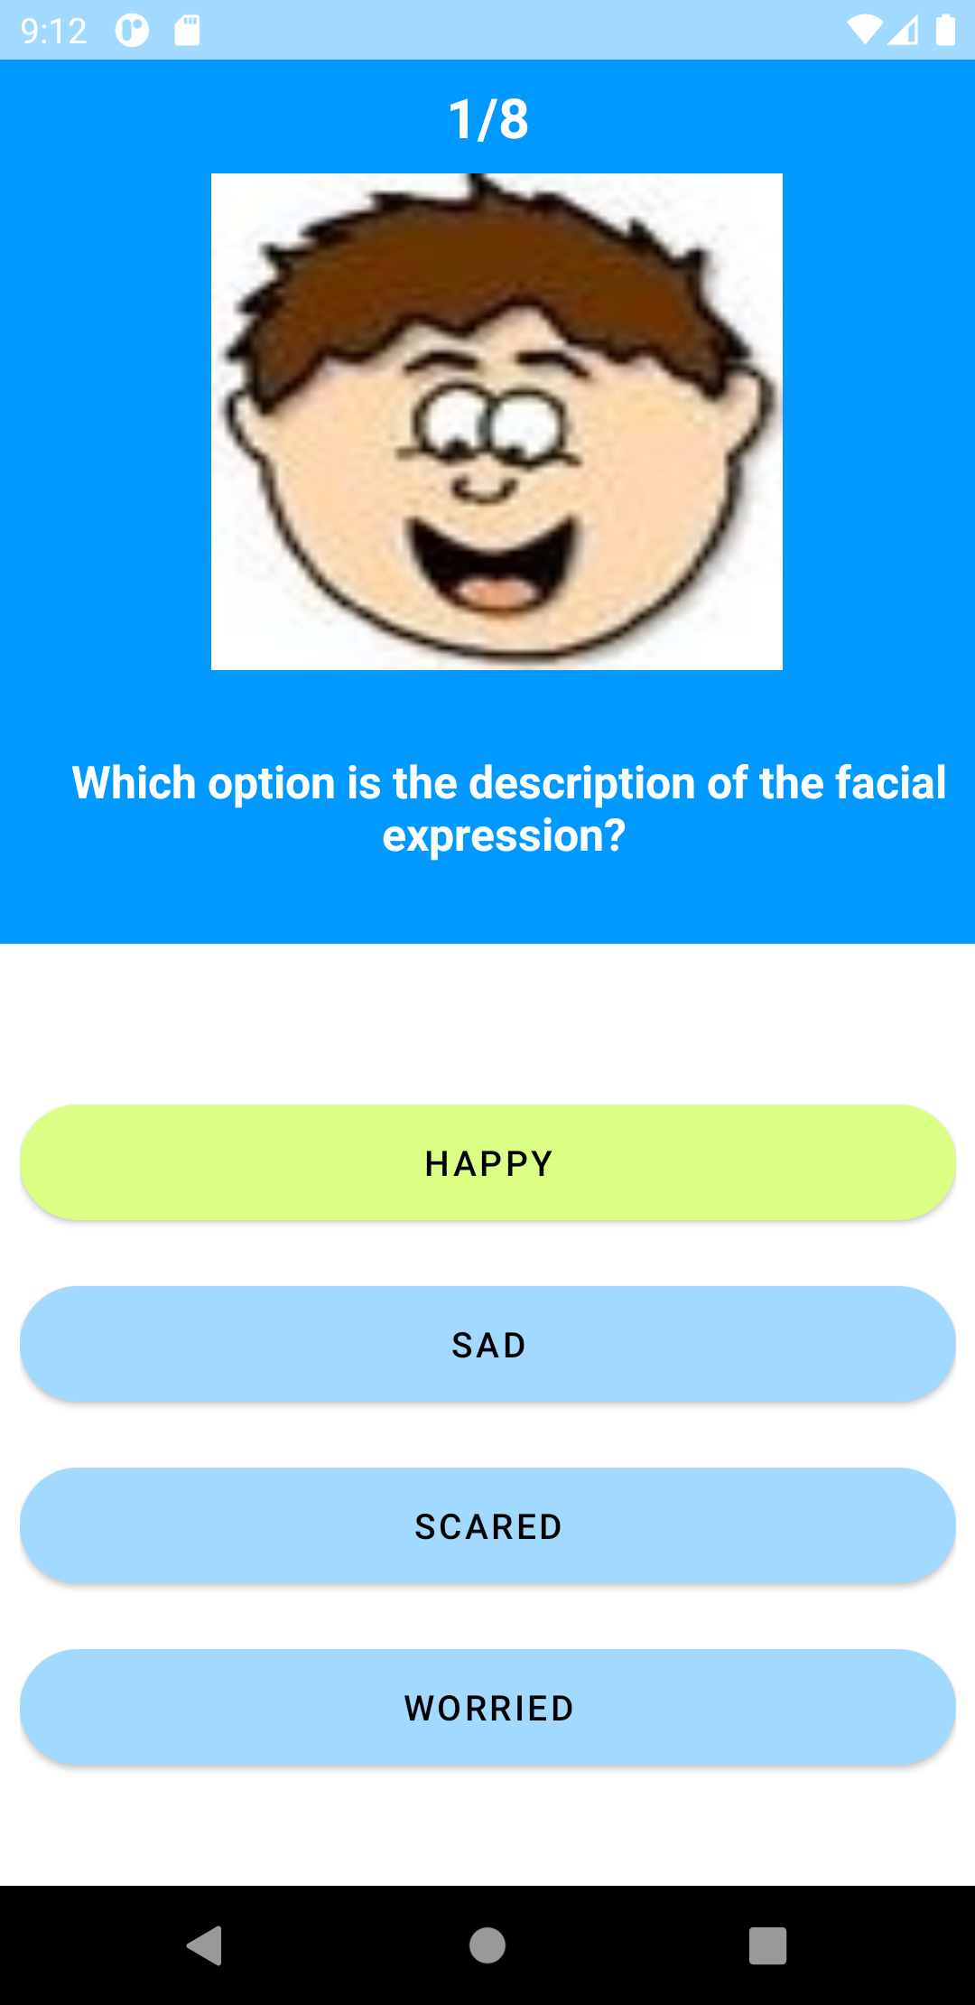
Response to wrong and correct answers

Slide 7
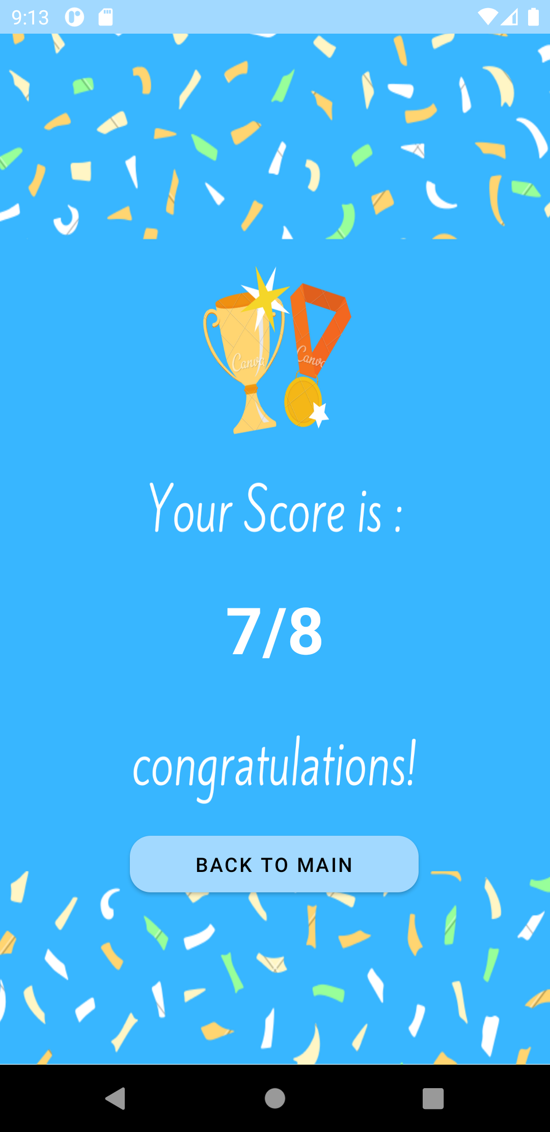
Result Page

Slide 8
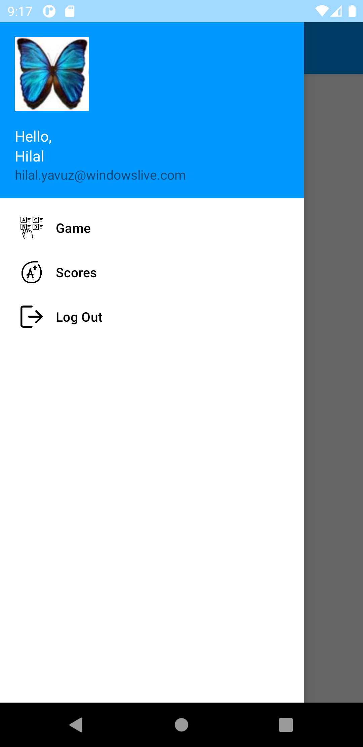
Navigation View : Menu for user
I pull the user information from my database and show users first name and e-mail in the navigation view.

Slide 9
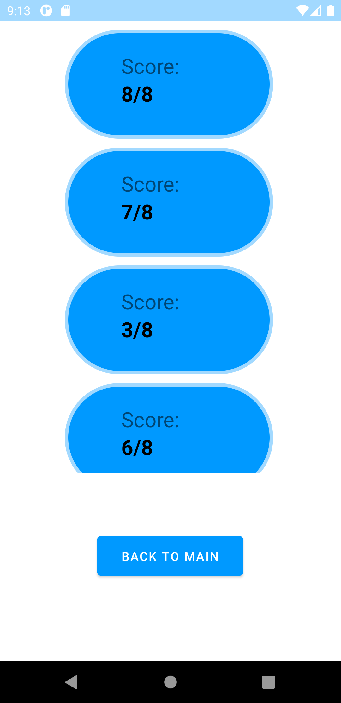
My Scores Page: Recycler View
Under the Scores section in the menu, users past scores are listed in the Recycler view. I pull these score informations from database.

Slide 10
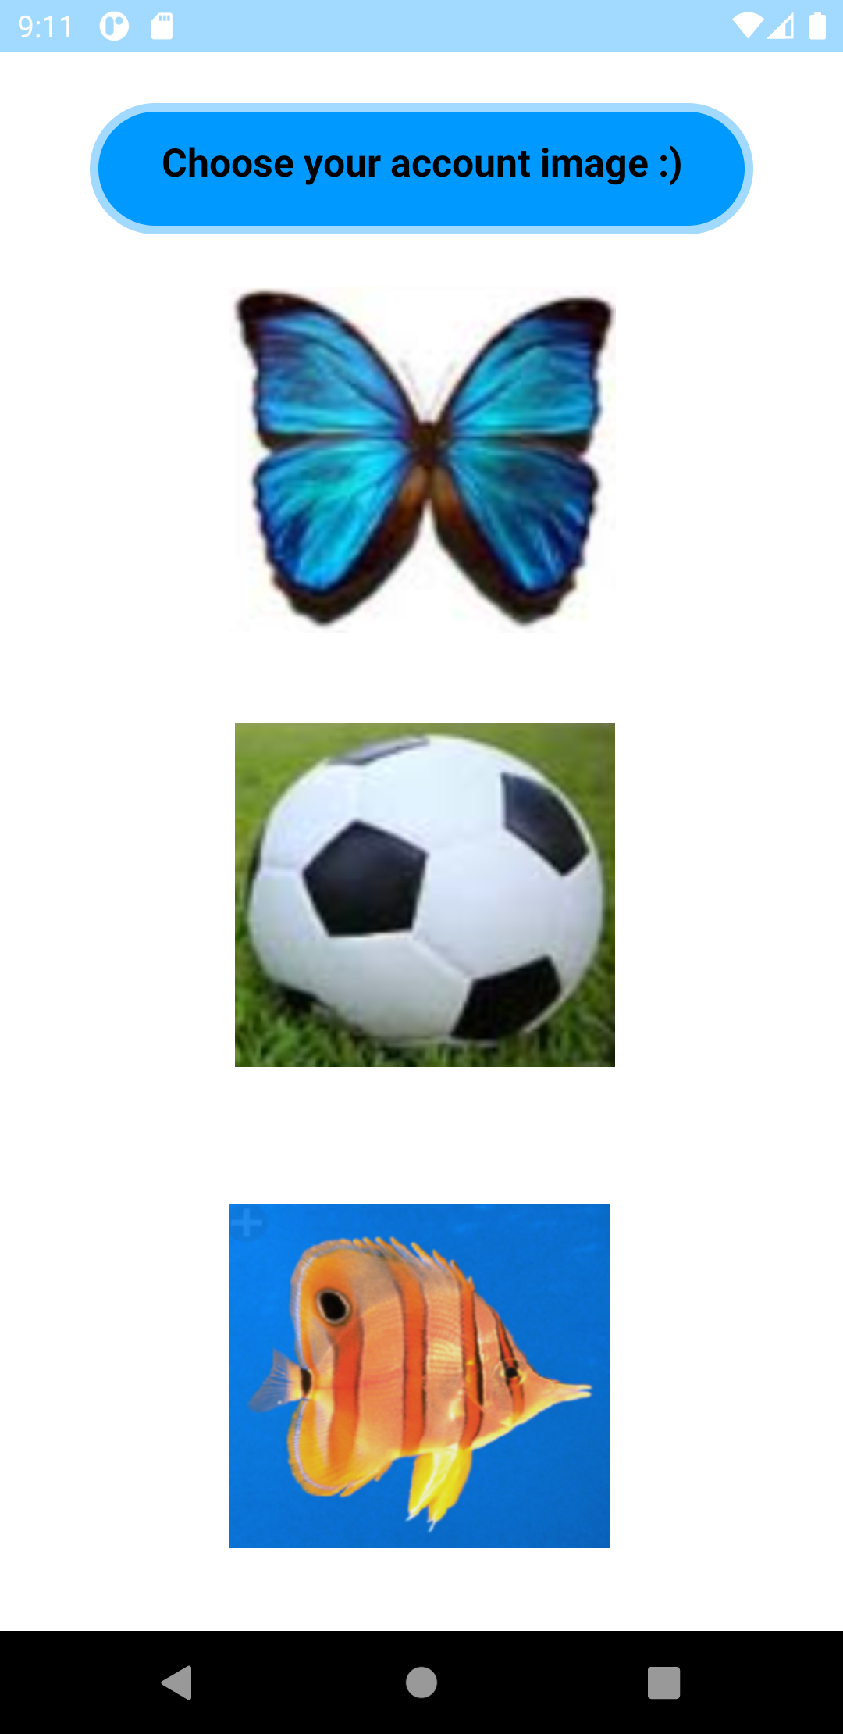
Settings Page
When user selects the settings button from the main page, this setting page will appear and user can select his/hers account image and change his/hers account image easily.

Slide 11
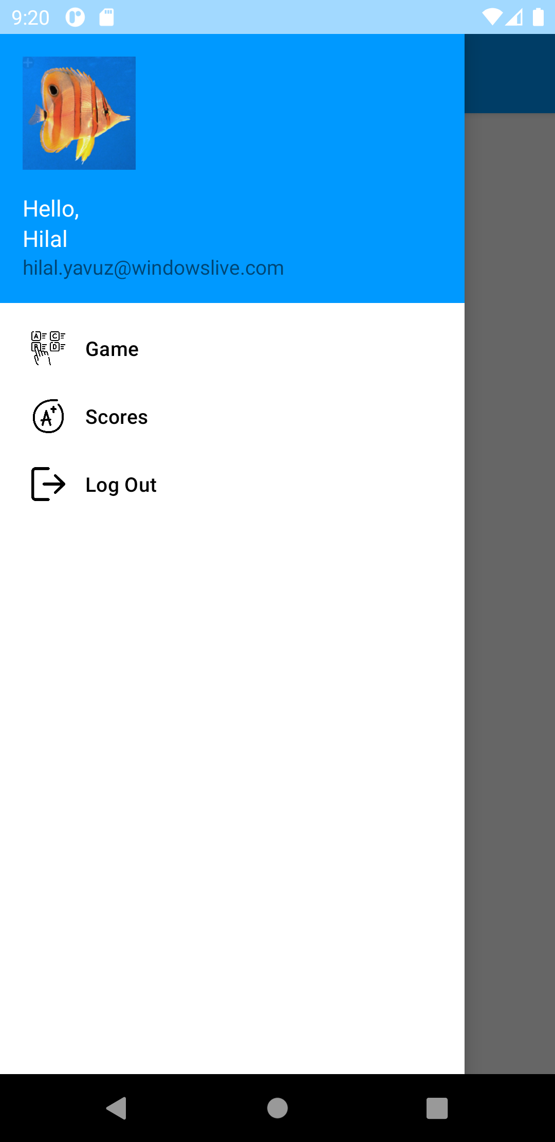
Menu view after account image change
User can also click the Game section in the menu to start the game. And when user wants to log out from game, he/she can click the Log Out section/button in the menu.
After log out process, user’ll redirect to the start page again.

Slide 12
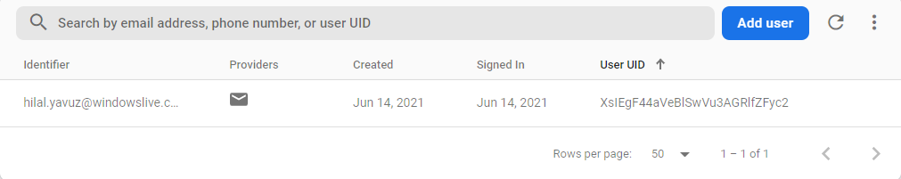
Firebase / Authentication

Slide 13
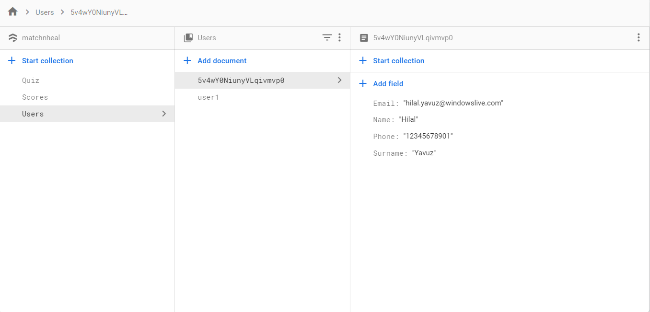
User Information Storage

Slide 14
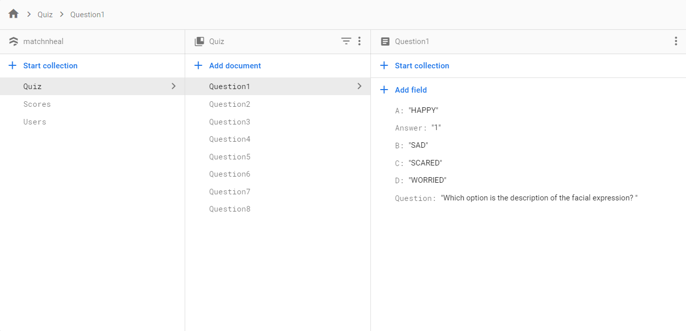
Question Storage

Slide 15
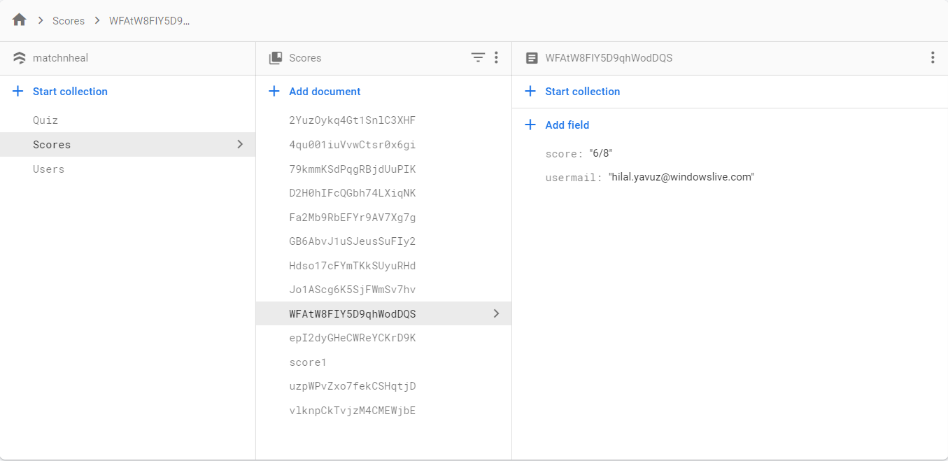
Score Storage

Slide 16
Thank you for listening..

