Slide 1


8th International Conference for
Convergence in Technology (8th I2CT 2023)
Sentiment Analysis on Indonesia-English Code-Mixed Data
Paper ID: 1614
Hilal Ramadhan Utomo; Ade Romadhony
Telkom University, Indonesia

Slide 2


Code mixed
Code-mixing phenomenon is common in multilingual countries like Indonesia. The practice of incorporating linguistic constructions from one language, such as words and phrases, into another is known as code-mixing. It can take many different forms. For example, a person might use words or phrases from one language in the midst of speaking or writing in another language, or they might switch back and forth between languages within a single sentence or phrase. Code-mixing can also involve combining elements of different language varieties, such as combining standard and colloquial forms of a language or mixing dialects.
8th I2CT 2023 India, 07-09 April 2023

Slide 3
Methodology
Indonesian-English Code-Mixed Dataset
Preprocessing data
Data splitting
Data Train (80%)
Data Test (20%)
Tokenization
The process of breaking a stream of textual data into words, terms, sentences, symbols, or some other meaningful elements called tokens.
Train Model
Evaluation
8th I2CT 2023 India, 07-09 April 2023

Slide 4
Data Collection
900 Tweets total of Indonesia-English Data
825 Indonesia-English code-mixed Tweets from “Normalization of Indonesian-English code-mixed data” study.
75 Indonesia-English code-mixed Tweets randomly from “Multi-label hate speech and abusive language detection in Indonesian Twitter” study.
8th I2CT 2023 India, 07-09 April 2023
[1]A. M. Barik, R. Mahendra, and M. Adriani, “Normalization of Indonesian-English code-mixed Twitter data,” in Proceedings of the 5th Workshop on Noisy User-generated Text (W-NUT 2019). Hong Kong, China: Association for Computational Linguistics, Nov. 2019, pp. 417–424. [Online]. Available: https://aclanthology.org/D19-5554
[2]M. O. Ibrohim and I. Budi, “Multi-label hate speech and abusive language detection in Indonesian Twitter,” in Proceedings of the Third Workshop on Abusive Language Online. Florence, Italy: Association for Computational Linguistics, Aug. 2019, pp. 46–57. [Online]. Available: https://aclanthology.org/W19-3506

Slide 5
Annotation
Annotator:
3 People; 2 Male & 1 Female
Indonesian nationality
EPrT (English Proficiency Test) : min.450
20-25 years old
Task:
Label | Description
Positive | There is an explicit or implicit clue in the Tweets, suggesting the writer is in a positive state or can be based on the text if most of the text showed a non-negative word.
Negative | There is an explicit or implicit clue in the Tweets, suggesting the writer is in a negative state or can be based on the text if most of the text showed a negative word.
8th I2CT 2023 India, 07-09 April 2023

Slide 6
Data Labelling
Sentiment | Total
Positive | 463
Negative | 437
Total | 900
Sentiment categories: Positive & Negative
Labeling method: Annotator (3 people)
Example:
Positive
Tweet: Ehhh welcome back a .Sering sering tengokin twitternya, udah berdebu itu haha
Translate: Ehhh welcome back a. I often look at his Twitter, it's already dusty haha
Negative
Tweet: susah kalau udah gak jujur.....I'm not signing up for this…
Translate: it's hard if you're not honest.....I'm not signing up for this...
8th I2CT 2023 India, 07-09 April 2023

Slide 7
Preprocessing
Removing the stopwords that do not have strong meaningful connotations for instance, ‘will’, ‘they’, ‘and’, ‘a’, etc.
Natural Language ToolKit (NLTK) 'stopwords' module
Check if a particular string matches a given regular expression and then remove the particular string
Regular Expression (RE) module
8th I2CT 2023 India, 07-09 April 2023

Slide 8
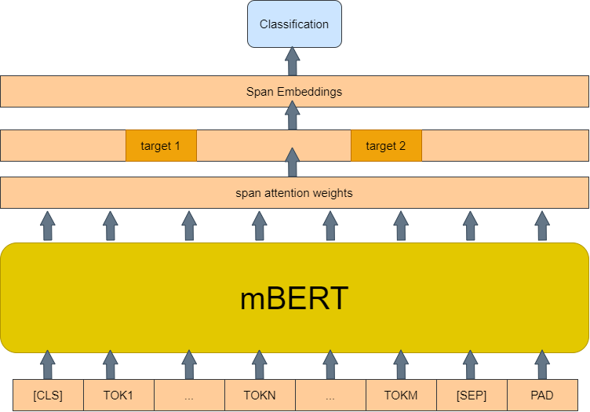
Model Architecture
Multilingual BERT (mBERT) architecture
8th I2CT 2023 India, 07-09 April 2023

Slide 9
Evaluation
Confusion matrix
Evaluation metrics
Accuracy
Recall
F-score
Precision
8th I2CT 2023 India, 07-09 April 2023

Slide 10
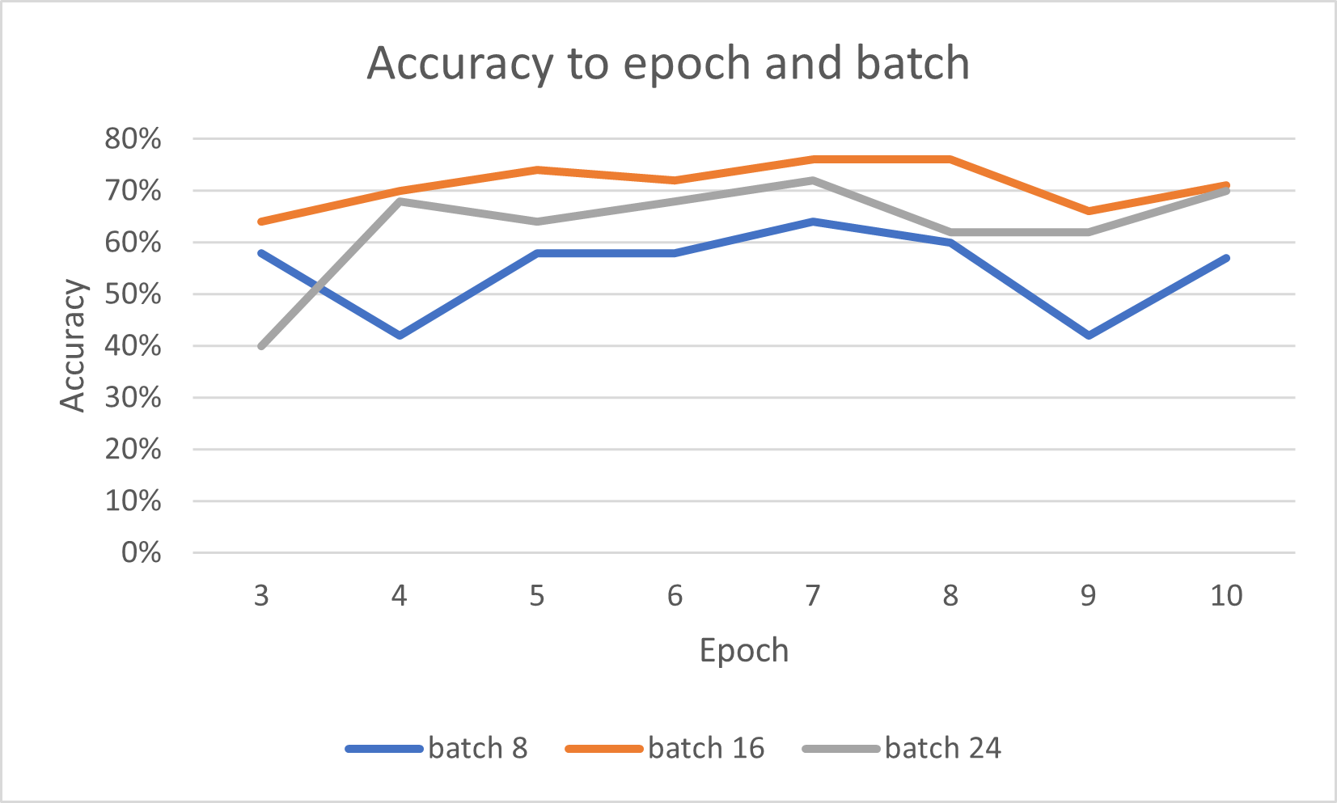
Result and Discussion
Comparison between accuracy to epoch and batch size
Conducted some experiment to the model to get most optimum parameter. We also use several batch and epoch settings to see how the model with our dataset react. The result of overall model accuracy that we get after conducting several parameter based on figure above is 76% with 90 test data, with the most optimum batch and epoch is 16 and 7 respectively.
8th I2CT 2023 India, 07-09 April 2023

Slide 11
Result and Discussion
Classification report with the best optimal record 16 batch and 7.0 epoch
 | Precision | Recall | F1-score | Support
Negative | 0.66 | 0.74 | 0.69 | 34
Positive | 0.83 | 0.77 | 0.80 | 56
Accuracy |  |  | 0.76 | 90
Macro avg | 0.74 | 0.75 | 0.75 | 90
Weighted avg | 0.76 | 0.76 | 0.76 | 90
8th I2CT 2023 India, 07-09 April 2023

Slide 12
Result and Discussion
Confusion matrix that is obtained from the 90 data that is tested on our model, which is based on mBERT model. The confusion matrix shows that the model predict 25 positive Tweets and 43 negative Tweets data correct. Also, predict 9 positive Tweets and 13 negative Tweets data wrong from 90 test data that is collected.
 |  | Predicted Label
 |  | Positive | Negative
Actual Label | Positive | 25 | 9
 | Negative | 13 | 43
Confusion matrix data tested on mBERT model
8th I2CT 2023 India, 07-09 April 2023

Slide 13
Result and Discussion
Error Example 1:
“saya lebih parah nder setangan tangan sampai ke punggung tangan ngelopek kering begitu rajinin pakai vaseline yang petroleum or whatever jelly nder it works well on me so far”
Translation: I have more severe hand attacks to the back of my hands peeling dry so diligently use vaseline which is petroleum or whatever jelly sender it works well on me so far
Actual sentiment: Positive
Predicted sentiment: Negative
8th I2CT 2023 India, 07-09 April 2023

Slide 14
Result and Discussion
Error Example 2:
“sa aku sudah tau kamu kan jutek sama orang baru you know me so well berarti lah yah ya hahaha jutek sama jaga jarak memang beda tipis tebal”
Translation: sa I know that you don't care about new people you know me so well that means yeah hahaha being tough and keeping your distance is a little bit different
Actual sentiment: Negative
Predicted sentiment: Positive
8th I2CT 2023 India, 07-09 April 2023

Slide 15
Conclusion
Based on evaluation result, conclusions can be made that using mBERT model can be able to predict and classify Indonesia-English code-mixed Tweets by using two labels of sentiment which is positive and negative with the optimum accuracy of 76% with the obtained dataset by using 16 batch size and 7 epochs. This study has potential limitations. The effect estimates in the model are based on interventional and prospective observational studies. They are therefore subject to biases and confounding that may have influenced our model estimates. Our estimates may be conservative to the Insufficient dataset size for model training. For future research, it is highly suggested to provide a good quality dataset and more train data to improve the classification model performance and make a higher accuracy of prediction.
8th I2CT 2023 India, 07-09 April 2023

Slide 16
Thank You for your attention!
8th I2CT 2023 India, 07-09 April 2023

