Slide 1
Microbial Community Changes in Bagged Romaine Lettuce After Use By Date
Hilal Samut
BIOMI6300
April 30, 2025

Slide 2
Introduction
Leafy greens are highly perishable and one of the most wasted commodities
  Nearly 70% of leafy greens are wasted
Major driver of food waste for leafy greens: Confusion over date labeling
  Use By: the date after which a product is no longer remaining sufficient quality and should not be consumed, but not necessarily associated with food safety
  Best Before/Best if Used Before: the date after which a product loses the best quality for consumption
  Sell Before: the last day on which a product should be sold
Many consumers discard produce past these dates, even if the food remains safe and of acceptable quality
Microbial spoilage is typically what limits the shelf life of leafy greens and plays a key role in food loss.
Research Gap: Limited knowledge of microbial changes after Use By Date
Notes:
The abundance of spoilage microorganisms increased in alfalfa after 3 weeks of cold storage at 4°C

Slide 3
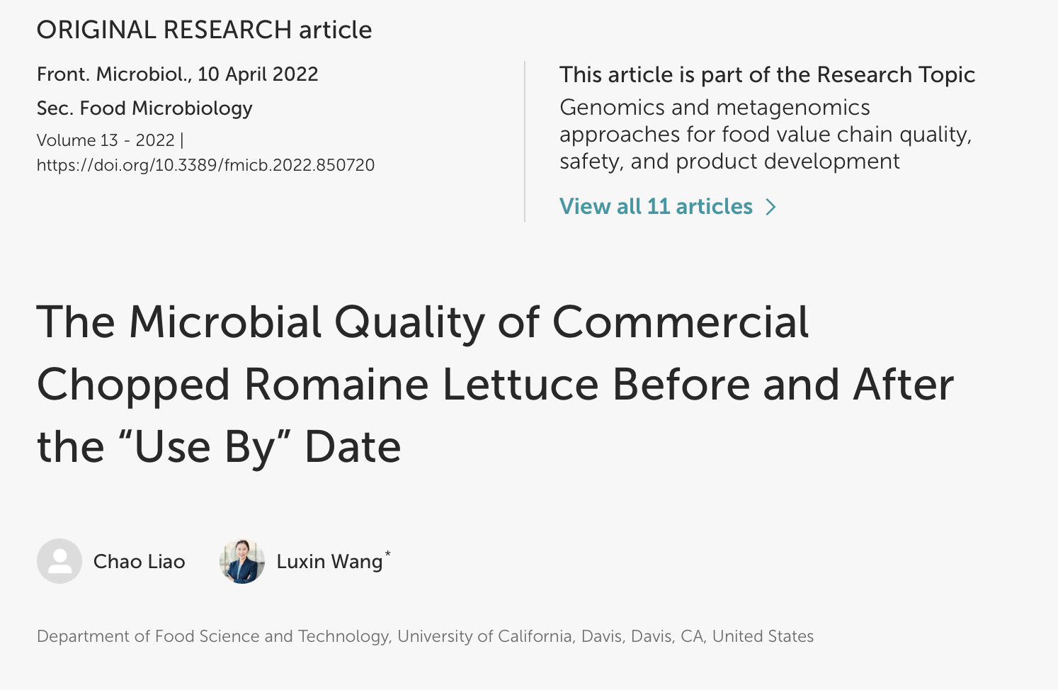
Chopped Romaine samples (n = 108):
  Use By Date (UBD) vs 5-days-post UBD (UBD5)
  Harvest Season
  Brand
  Inoculum
How does the microbial biodiversity in chopped Romaine lettuce change during storage beyond use by date (UBD)?
  Null hypothesis: The microbial biodiversity doesn’t change during storage beyond UBD.
  Alternative Hypothesis: Microbial biodiversity, particularly in terms of dominant community members, increases in chopped Romaine stored beyond UBD. This increase is expected due to the decline of early-dominant taxa, allowing multiple microbial taxa to co-dominate during extended storage due to cold storage and limited nutrients.

Slide 4
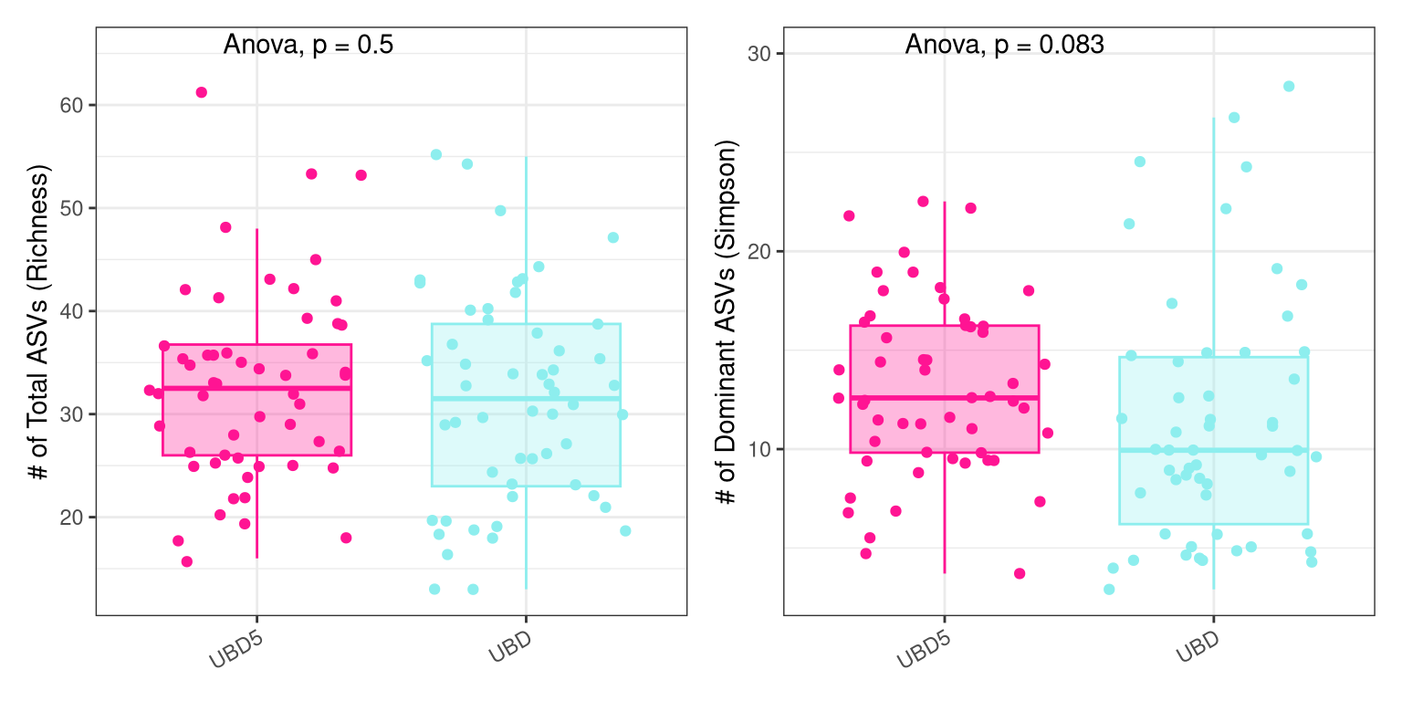
Romaine stored 5-days-post UBD had slightly higher richness and had more dominant members.
Richness (q = 0):
Storage beyond UBD does not significantly affect the number of total ASVs present.
The microbial community remains comparably rich in both conditions, suggesting that ASVs are not being lost.
Simpson (q = 2):
UBD5 samples showed higher Simpson diversity compared to UBD samples.
In terms of dominant community members, lettuce samples become more even by a few taxa 5 days beyond the use by date, suggesting a shift in the microbial community where no single group outcompetes others better.

Slide 5
How does the microbial composition in chopped Romaine lettuce change during storage beyond use by date (UBD)?
Null Hypothesis: Microbial composition does not differ for prolonged storage durations after UBD for chopped Romaine lettuce
Alternative Hypothesis:
  Microbial composition during prolonged storage is driven by presence or absence of rare taxa (i.e., Sorensen), with increased dissimilarity in the samples collected in UBD5 samples.
  Dominant members of the microbial community (i.e., Bray-Curtis) are unique in UBD5 samples.
Notes:
Alternative #1 Hypothesis is related to presence/absence, whereas Alternative #2 Hypothesis is related to dominant members of the community.

Slide 6
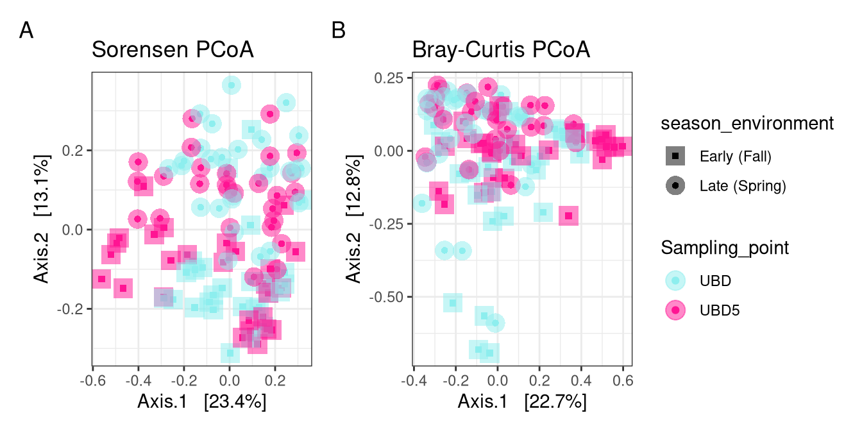
Storage duration plays a minor role in driving microbial community shifts on chopped Romaine.
Sorensen Dissimilarity:
Season: R² ~9%, p-value <0.001
Storage: R² ~3%, p-value <0.001
Bray-Curtis Dissimilarity:
Season: R² ~9%, p-value <0.001
Storage: R² ~4%, p-value <0.001
Storage time significantly influences microbial composition. However, it only explains a small proportion of variation.
Temporal microbial changes during storage are less impactful than the differences introduced by harvest season.
Harvest season explained the largest proportion of the variation in microbial community
The seasonal shifts may reflect differences in environmental conditions (e.g., ambient temperature, rainfall, field management) influencing microbial colonization and persistence.
Notes:
the total residiuals of the model is ~88% of the variation remains unexplained by these variables, which is higher than 85%.
Betadispers was significant in bray-curtis

Slide 7
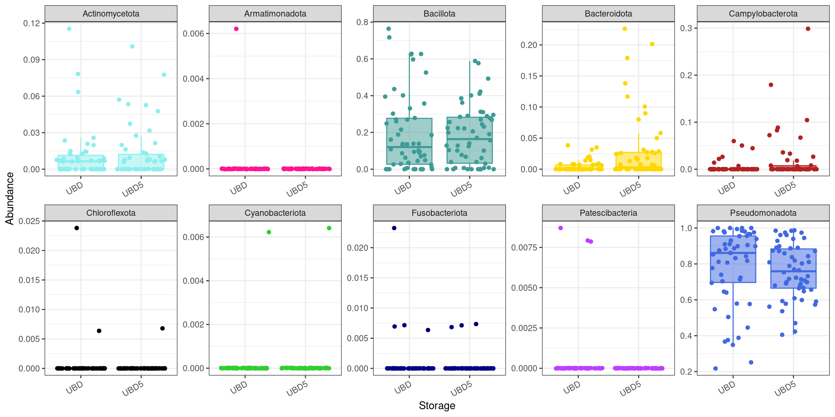
Pseudomonadota was the most abundant phylum in chopped Romaine.
Microbial community composition varied modestly during storage of chopped Romaine.
While several phyla appear stable across storage, others show potential slight shifts in relative abundance.
This suggests subtle shifts in relative abundance might be due to (i) onset of spoilage, (ii) microbial die-off and (iii) selective pressure from low temperature.

Slide 8
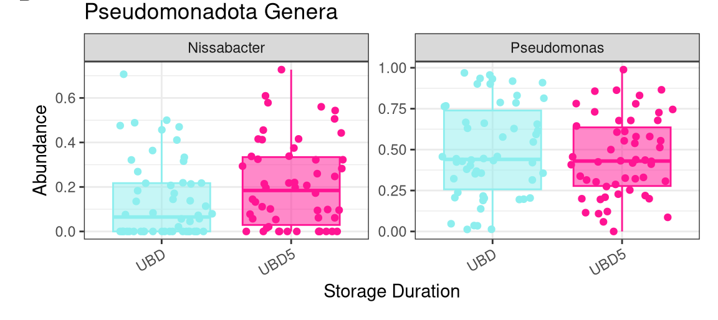
Genus Pseudomonas remained abundant and stable across storage.
Pseudomonas: Genus Pseudomonas drove the dominance of Pseudomonadota. The stable relative abundance of Pseudomonas across storage durations suggests strong resilience and potential roles in spoilage or cold adaptation.
Nissabacter: Contrary to the Pseudomonadota trend, Nissabacter increased in UBD5 samples. However, there is a need for genus-level resolution when interpreting spoilage related dynamics.

Slide 9
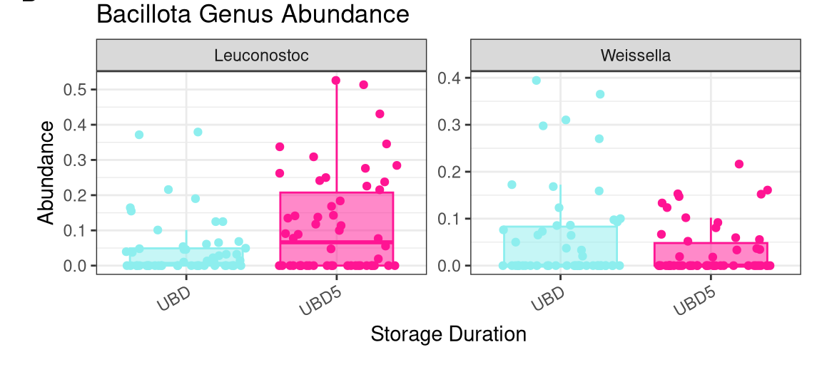
Genus Leuconostoc showed a slight increase in chopped Romaine beyond storage.
Leuconostoc showed a notable increase with extended storage (UBD5). While Bacillota appeared relatively stable across storage durations at the phylum level, Leuconostoc’s behavior suggests a potential role in spoilage or fermentation-like processes during storage.
Weissella showed a low relative abundance with a high variability. This might imply that some Bacillota genera may be outcompeted or suppressed as storage progresses.

Slide 10
Conclusion
Storage duration didn’t have a significant impact on the microbial richness and abundance of bagged Romaine lettuce.
Extended storage beyond UBD doesn’t favor major spoilage-associated genus - Pseudomonas.
Findings can guide better shelf-life assessments, helping reduce unnecessary food waste by informing the industry about when quality actually declines.

Slide 11
Future Directions
Studies on Nissabacter and whether it affects produce spoilage or not, its growth dynamics
Examine whether spoilage-associated shifts (e.g., increased Pseudomonas) create conditions that inhibit or favor foodborne pathogen growth
  Does a rise in spoilage microbes suppress pathogens through nutrient competition or antimicrobial production?
How does microbial composition affect risk assessment for post-UBD consumption?

