Slide 1
AngularJs Introduction
<nilesh-M & virendra-V>

Slide 2

By Miško Hevery
Adam Abrons
http://angularjs.org

Slide 3

Agenda – Day 1
Getting Started
Why
Directives
Filters
Data Binding

Slide 4
Getting Started

Slide 5
Why?

Slide 6
Angular Js
Open Source JavaScript framewok
Powered by Google
Single Page Application, DI
Enables developers to extend HTML syntax to clearly express the apps components
Object oriented in nature
Cross browser compatibility
Ready made availability of components
2k+ Stars on Github, > 900 Contributors, , 85k+ stackoverflow questions

Slide 7
Angular Key terms
SPA – fast load, high performing, responsive
Part of Mean Stack
Thin server architecture
State and Routing
Data binding
Filters,
i18n, l10n
Suited for CRUD

Slide 8
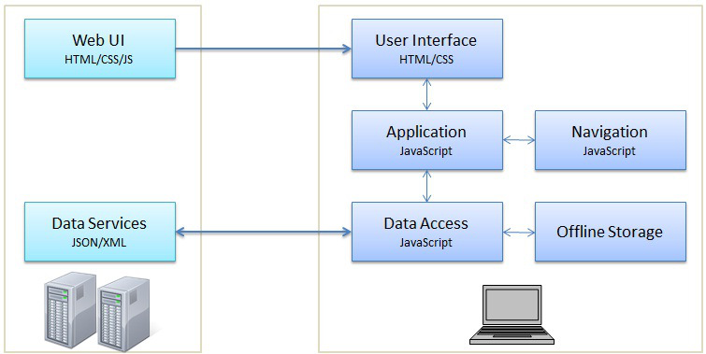
SPA
A SPA moves logic from the server to the client. This results in the role of the web server evolving into a pure data API or web service.
In an SPA, either all necessary code – HTML, JavaScript, and CSS – is retrieved with a single page load,[1] or the appropriate resources are dynamically loaded and added to the page as necessary, usually in response to user actions.
Interaction with the single page application often involves dynamic communication with the web server behind the scenes.

Slide 9
What benefit one gets with Angular
• Almost no page reloads, UI built by JavaScript
• Most of the logic is executed on the client-side
• Richer Interaction between UI Components, which makes the web application work seamlessly
• No URL Change other than #
• Back Button works as expected
• Bookmark-able Links
• Ability to go Offline
Eg. http://www.innowhere.com/jnieasy/#!st=jnieasy.home

Slide 10
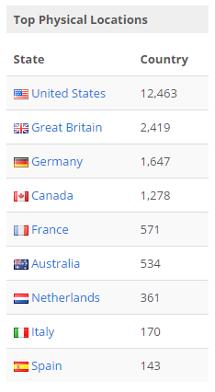
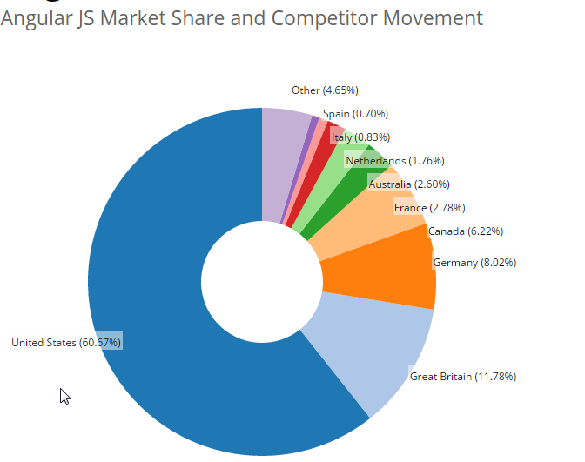

Slide 11
Some basics before we go ahead… Basic approach
<!DOCTYPE html>
<html xmlns="http://www.w3.org/1999/xhtml">
<head>
<title>Traditional HTML </title>
</head>
<body>
Name: <input id="NameInput" type="text" /><br />
Hello <span id="NameSpan"></span>
<script>
var textNameInput = document.getElementById("NameInput"),
textNameSpan = document.getElementById("NameSpan");
textNameInput.addEventListener('keyup', function () {
var text = textNameInput.value;
textNameSpan.innerHTML = text + "!!!";
});
</script>
</body>
</html>

Slide 12
Some basics before we go ahead… jQuery approach
<!DOCTYPE html>
<html xmlns="http://www.w3.org/1999/xhtml">
<head>
<title>Traditional HTML with jQuery</title>
<script src="../../Js/JQuery/jquery-2.0.3.min.js"></script>
</head>
<body>
Name: <input id="NameInput" type="text" /><br />
Hello <span id="NameSpan"></span>
<script>
$('#NameInput').on('keyup', function () {
$('#NameSpan').html($('#NameInput').val() + "!!!");
});
</script>
</body>
</html>

Slide 13
Directives, Filters
and Data Binding

Slide 14
What are Directives?
They teach HTML new tricks!

Slide 15
Using Directives and Data Binding
Angular approach
Directive
<!DOCTYPE html>
<html ng-app>
<head>
<title>Welcome to Angular Js </title>
</head>
<body>
<div class="container">
Name: <input type="text" ng-model=“yourname” />
Hello {{ yourname }} !!!
</div>
<script src="../../Js/AngularLibs/Angular/angular.js"></script>
</body>
</html>
Directive
Data Binding Expression

Slide 16
Iterating with the ng-repeat Directive ng-repeat demo 1
<html ng-app="">
<div ng-init="teamMembers=['Gautam G.','Armstrono','Akshay','Gautam N.','Neha','Prashant','Siddesh','Nilesh','Virendra']">
<h3>Looping with the ng-repeat Directive</h3>
<ul>
<li ng-repeat="name in teamMembers">{{ name }}</li>
</ul>
There are {{ teamMembers.length }} team members
<br/>
{{ teamMembers[teamMembers.length - 1] }} you joined recently.
</div>
</html>
Iterate through names

Slide 17
Iterating with the ng-repeat Directive ng-repeat demo 2
<html ng-app="">
<div class="container" ng-init="number=1; Multiplier=[1,2,3,4,5,6,7,8,9,10]">
Enter number to generate table: <input ng-model="number" />
<h4>Looping with the ng-repeat and generate Table of {{ number}} </h4>
<ul>
<li ng-repeat="i in Multiplier">{{ number * i }}</li>
</ul>
</div>
</html>
Iterate through multipliers

Slide 18
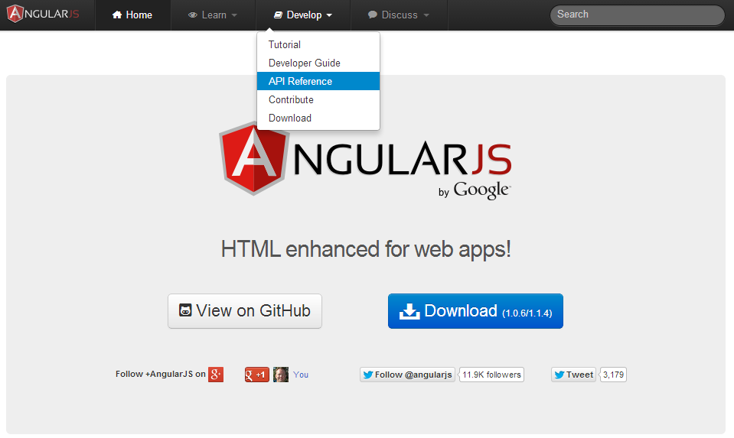
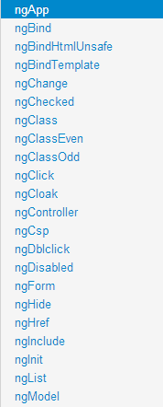
AngularJS Help for Directives

Slide 19
Filters Reorder using filter demo
Order teammembers by index 0
<h3>Looping with the ng-repeat Directive Order By</h3>
<ul>
<li ng-repeat="name in teamMembers | orderBy: 0">{{ name }}</li>
</ul>
<h3>Looping with the ng-repeat Directive Order By with ulowercase</h3>
<ul>
<li ng-repeat="name in teamMembers | orderBy: 0">{{ name | lowercase }}</li>
</ul>
lowercase
Model value filter demo
Filter teammembers by model value searchName
Filter Crieteria: <input ng-model="searchName"/>
<ul>
<li ng-repeat="name in teamMembers | filter:searchName | orderBy: 0">{{ name }}</li>
</ul>

Slide 20
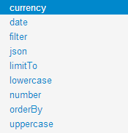
AngularJS Help for Filters

Slide 21
Implementation Comparisons
<!DOCTYPE html>
<html xmlns="http://www.w3.org/1999/xhtml">
<head>
<title>Traditional HTML with jQuery</title>
<script src="../../Js/JQuery/jquery-2.0.3.min.js"></script>
</head>
<body>
Name: <input id="NameInput" type="text" /><br />
Hello <span id="NameSpan"></span>
<script>
$('#NameInput').on('keyup', function () {
$('#NameSpan').html($('#NameInput').val() + "!!!");
});
</script>
</body>
</html>
jQuery
<!DOCTYPE html>
<html xmlns="http://www.w3.org/1999/xhtml">
<head>
<title>Traditional HTML </title>
</head>
<body>
Name: <input id="NameInput" type="text" /><br />
Hello <span id="NameSpan"></span>
<script>
var textNameInput = document.getElementById("NameInput"),
textNameSpan = document.getElementById("NameSpan");
textNameInput.addEventListener('keyup', function () {
var text = textNameInput.value;
textNameSpan.innerHTML = text + "!!!";
});
</script>
</body>
</html>
DOM
Angular Js
<!DOCTYPE html>
<html ng-app>
<head>
<title>Welcome to Angular Js </title>
</head>
<body>
<div class="container">
Name: <input type="text" ng-model=“yourname” />
Hello {{ yourname }} !!!
</div>
<script src="../../Js/AngularLibs/Angular/angular.js"></script>
</body>
</html>

Slide 22
Summary
Key features:
Directives and filters
Two-way data binding

