Slide 1
MBARARA UNIVERSITY OF SCIENCE AND TECHNOLOGY
FACULTY OF COMPUTING AND INFORMATICS
DATABASE MANAGEMENT SYSTEMS
TOURISM DESTINATION MANAGEMENT SYSTEM
BY
HILARY AKEBA
May 2026

Slide 2
Executive Summary
The Tourism Destination Management System (TDMS) — Destination Module is developed as part of Group C's project for the Database Management Systems course at Mbarara University of Science and Technology.
The system is built on MySQL 8.0 and manages tourism destinations in Uganda, including national parks, lakes, cultural heritage sites, and urban attractions. It enables tourism operators, travel agents, and tourists to browse destinations and discover activities.
The database comprises five core entities: DestinationCategory, Destination, Activity, Tourist, and Booking. The design follows Third Normal Form (3NF) and includes full referential integrity, ENUM-enforced constraints, soft-delete patterns, and UTF-8 multilingual support for local Ugandan language names.
Sample data drawn from Uganda's iconic tourism sites — Bwindi Impenetrable National Park, Murchison Falls, Lake Bunyonyi, Queen Elizabeth National Park, and Kampala — demonstrates real-world applicability.

Slide 3
Business Case
Application Domain
Uganda's tourism sector is a significant contributor to the national economy, attracting visitors to world-class wildlife destinations including Bwindi's mountain gorillas and Murchison Falls. The TDMS serves as the central registry and discovery engine for tourism destinations within the country.
The system serves three primary user groups:
Tourism Operators & Travel Agents — who need to manage destination listings and bookings.
Tourists (domestic & international) — who browse destinations.
System Administrators — who maintain data integrity, manage categories, and generate reports.
Supported operations include destination registration and categorisation, activity management and pricing, tourist registration, and booking processing.

Slide 4
Benefits Analysis
Tangible Benefits
Elimination of manual, paper-based booking records reduces data entry errors and retrieval time.
Centralised destination catalogue enables travel agents to find and quote packages faster.
Analytical queries provide real-time revenue and occupancy data for business decisions.
Unique review per tourist-destination pair ensures authentic feedback, improving package quality.
Intangible Benefits
Enhanced tourist experience through structured destination information and transparent pricing.
Preservation of Uganda's cultural tourism data in a multilingual (UTF-8) format.
Improved coordination between tourism sub-modules — payments, hotels, and transport.
Supports Uganda Tourism Board's digital transformation agenda.

Slide 5
List of Entities
The Destination Module consists of five core entities. Each entity represents a distinct real-world concept:
1. DestinationCategory
Classifies destinations into types such as National Park, Lake, or Urban site. Supports sub-categories through a self-referencing parent_category_id field.
2. Destination
The central entity. Represents a specific tourism site in Uganda with location, pricing, and category details.
3. Activity
Defines specific offerings at a destination, such as Gorilla Trekking or Game Drive Safari, with type, difficulty, and pricing.
4. Tourist
A registered customer who browses destinations and makes bookings.
5. Booking
A confirmed reservation linking a tourist to a destination on a specific travel date.

Slide 6
Entity Attributes — DestinationCategory & Destination
DestinationCategory
category_id — INT, PK, AUTO_INCREMENT
category_name — VARCHAR(100), NOT NULL
description — TEXT, NULL
parent_category_id — INT, FK (self-reference for sub-categories)
is_active — BOOLEAN, DEFAULT TRUE (soft-delete flag)
Destination
destination_id — INT, PK, AUTO_INCREMENT
category_id — INT, FK → DestinationCategory
destination_name — VARCHAR(150), NOT NULL, UNIQUE
region — VARCHAR(50), NOT NULL (e.g. Western, Northern)
district — VARCHAR(100), NOT NULL
entry_fee_usd — DECIMAL(10,2), CHECK(fee >= 0)

Slide 7
Entity Attributes — Activity, Tourist & Booking
Activity
activity_id — INT, PK | destination_id — INT, FK → Destination
activity_name — VARCHAR(100) | activity_type — ENUM (Wildlife, Adventure, Cultural, Water, Scenic)
price_per_person — DECIMAL(10,2), CHECK >= 0 | difficulty_level — Easy / Moderate / Challenging
Tourist
tourist_id — INT, PK | first_name, last_name — VARCHAR(50/80)
email — VARCHAR(100), UNIQUE | nationality — VARCHAR(80)
passport_number — VARCHAR(20), UNIQUE, NULL | registration_date — DATE, DEFAULT CURRENT_DATE
Booking
booking_id — INT, PK | tourist_id — FK → Tourist | destination_id — FK → Destination
booking_date — DATE, DEFAULT CURRENT_DATE | travel_date — DATE, CHECK >= booking_date
num_participants — INT, DEFAULT 1 | total_amount_usd — DECIMAL(10,2) | booking_status — ENUM (Pending, Confirmed, Cancelled, Completed)

Slide 8
Entity Relationships
Category to Destination (1:N)
One category (e.g. National Park) can classify many destinations. Each destination belongs to exactly one category. DestinationCategory also references itself to support sub-categories.
Destination to Activity (1:N)
One destination can offer multiple activities such as a game drive and a boat cruise. Each activity is tied to a single destination.
Tourist to Booking (1:N)
A single tourist can make multiple bookings over time. Each booking record is strictly tied to one registered tourist.
Destination to Booking (1:N)
A destination can receive many bookings from different tourists on different travel dates. Each booking references exactly one destination.

Slide 9
Entity-Relationship Diagram (ERD)
The diagram below uses structured text notation. PK = Primary Key, FK = Foreign Key.
DestinationCategory (category_id PK, category_name, description, parent_category_id FK, is_active)
| 1 (self-ref: parent_category_id)
| CLASSIFIES
| N
Destination (destination_id PK, category_id FK, destination_name, region, district, entry_fee_usd)
|1 |1
| OFFERS RECEIVES |
|N |N
Activity (activity_id PK, Booking (booking_id PK, tourist_id FK, destination_id FK,
destination_id FK, booking_date, travel_date, num_participants,
activity_name, type, total_amount_usd, booking_status)
price_per_person, | N
difficulty_level) MAKES |

Slide 10
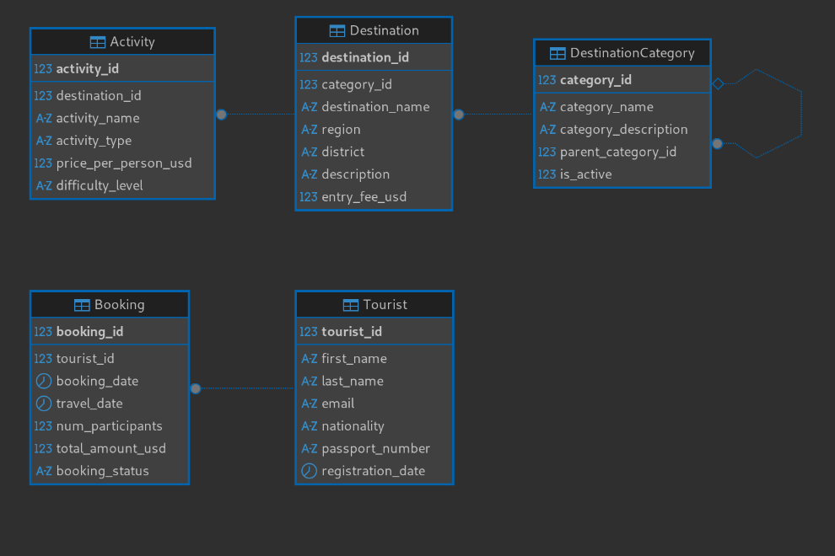
Database Schema

Slide 11
The physical schema consists of five interrelated tables linked through foreign key constraints:
Key Constraints Applied:
CHECK (travel_date >= booking_date) ensures logical booking dates.
CHECK (num_participants > 0) prevents zero or negative group sizes.
CHECK (entry_fee_usd >= 0) and CHECK (price_per_person >= 0) enforce non-negative pricing.
ENUM types enforce valid values for activity_type, difficulty_level, and booking_status.
ON DELETE CASCADE on Activity ensures activities are removed when a destination is deleted.
ON DELETE RESTRICT on Booking prevents deletion of tourists with active booking records.

Slide 12
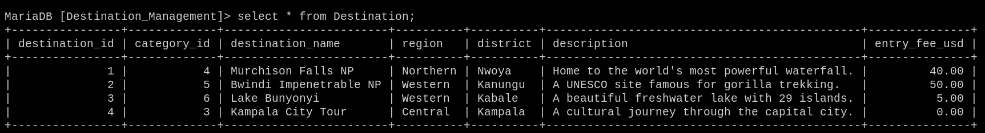
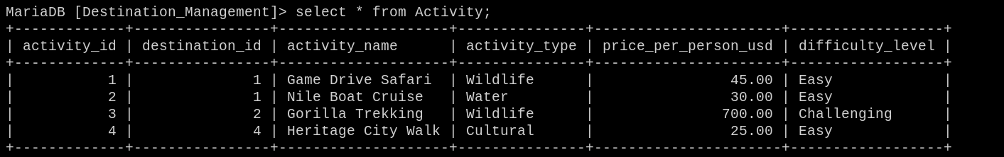
Sample Data
Destinations
Activities

Slide 13
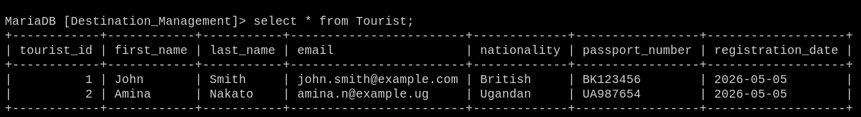
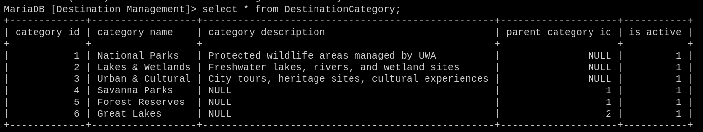
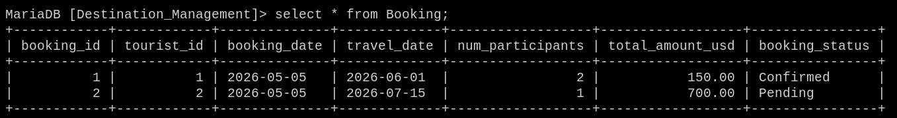
Tourist
6
DestinationCategory

Slide 14
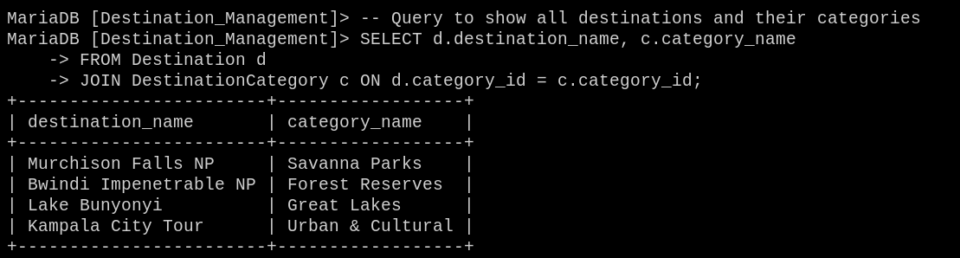
Sample queries and results.
A query is a request for information on a database.
It allows users to:
• Search – Find specific records
• Filter – Show only what you need
• Calculate – Sum, count, average data
• Combine – Pull data from multiple tables

Slide 15
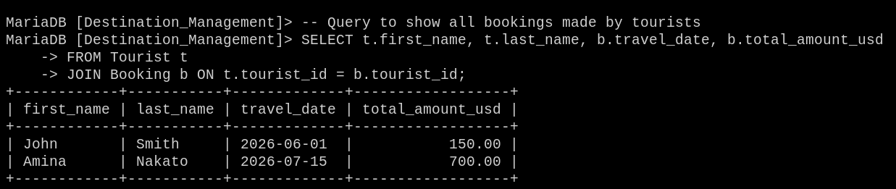

Slide 16
Integration Points with Other Modules
The Destination Module is designed as a self-contained, loosely-coupled sub-system. The following fields serve as integration anchors for other group members in the tourism sector:
tourist_id | Tourist Table | Hotel, Transport, Payments Modules
Shared identity key across all modules. Any other module that needs to reference a specific tourist uses this ID to maintain consistency across the system.
booking_id | Booking Table | Payments Module
Acts as the booking reference for payment invoices. The Payments Module will use booking_id to link financial transactions to specific reservations.
destination_id | Destination Table | Transport, Hotel Modules
Transport and hotel modules can reference destination_id to associate accommodation and travel routes with a specific tourism site.
This modular architecture ensures data integrity across the broader Tourism Management Platform while allowing each group member's module to operate independently during development.

Slide 17
Bibliography
1. Connolly, T. & Begg, C. (2015). Database Systems: A Practical Approach to Design, Implementation and Management (6th ed.). Pearson Education.
2. Ramakrishnan, R. & Gehrke, J. (2003). Database Management Systems (3rd ed.). McGraw-Hill.
3. Oracle Corporation (2023). MySQL 8.0 Reference Manual. https://dev.mysql.com/doc/refman/8.0/en/
4. Uganda Wildlife Authority (2024). Uganda National Parks & Tourism Statistics. https://www.ugandawildlife.org
5. Uganda Tourism Board (2023). Tourism Sector Annual Performance Report 2022/2023. UTB, Kampala.
6. Date, C.J. (2004). An Introduction to Database Systems (8th ed.). Addison-Wesley.
7. Silberschatz, A., Korth, H.F. & Sudarshan, S. (2020). Database System Concepts (7th ed.). McGraw-Hill.

