Slide 1
Northern dialect evidence for the chronology of the Great Vowel Shift
Hilary Prichard
27th October, 2012
New Ways of Analyzing Variation 41

Slide 2
Outline
Background
Great Vowel Shift
The Debate: Dueling chronologies
Towards a resolution: How can dialect geography help?
The Data
The Evidence
Intersection with theory
Conclusion

Slide 3
The Great English Vowel Shift
A sound change that happened between Middle English (ME) and Early Modern English (EME)
Around the 15th century
Produced a rotation in the ME long vowel system
E.g. the front vowels show the following evolution:
Pronunciation: | Chaucer | Shakespeare | Modern
bite | /biːtə/ | /beit/ | [bait]
beet | /beːtə/ | /biːt/ | [biːt, bijt]
beat | /bɛːtə/ | /beːt/ | [biːt, bijt]
abate | /aᴵbaːtə/ | /əᴵbæːt/ | [əᴵbeit]
(Jespersen 1909)

Slide 4
The Great English Vowel Shift
bite
price
iː
eː
ɛː
aː
uː
oː
ɔː
house
mouth
beet
fleece
boot
goose
beat
fleece
boat
goat
bait
face
ai
au

Slide 5
Luick’s chronology
1896 Untersuchungen zur englischen Lautgeschichte
Push-chain led by mid vowels
Argument:
lack of mouth diphthongization in areas of goose fronting in the North
so mouth diphthongization depends on the raising of goose

Slide 6
Luick’s chronology
price
iː
eː
ɛː
aː
uː
oː
ɔː
mouth
fleece
goose
fleece
goat
face
ai
au

Slide 7
Luick’s chronology in the North
price
iː
eː
ɛː
aː
uː
oː
ɔː
mouth
fleece
!
goose
fleece
goat
face
ai
au

Slide 8
Jespersen’s chronology
1909: A Modern English Grammar on Historical Principles
Drag-chain led by high vowels
Argument:
Some spelling evidence to suggest low vowels were last to shift
Contra push-chains – why don’t the vowels merge?
Some places, mouth simply didn’t diphthongize

Slide 9
Jespersen’s chronology
price
iː
eː
ɛː
aː
uː
oː
ɔː
mouth
fleece
boot
fleece
boat
face
ai
au

Slide 10
Stockwell & Minkova’s challenge
1988: The English Vowel Shift: problems of coherence & explanation
Not actually a coherent chain shift at all
Linguists’ hindsight interpretation of unrelated historical mergers
Evidence:
Handful of dialect data
mouth diphthongization did happen in a few places where
goose fronting had occurred
Undercuts the basis of Luick’s argument
…or does it?

Slide 11
How to resolve this debate?
In this talk, I’ll argue that these few data points
do not invalidate Luick’s argument, and actually might be expected under a certain approach
Apply novel (to this debate) methods to existing data
Examine the dialectal data in its entirety
Look for new evidence in geographic patterns

Slide 12
Kolb 1966
The Phonological Atlas of the Northern Region
Data collected as part of the SED, 1950-1961
independently analyzed & mapped by Kolb
80 locations in the 6 northern counties
includes N. Lincolnshire
200+ maps of words
conveniently organized by ME vowel class

Slide 13
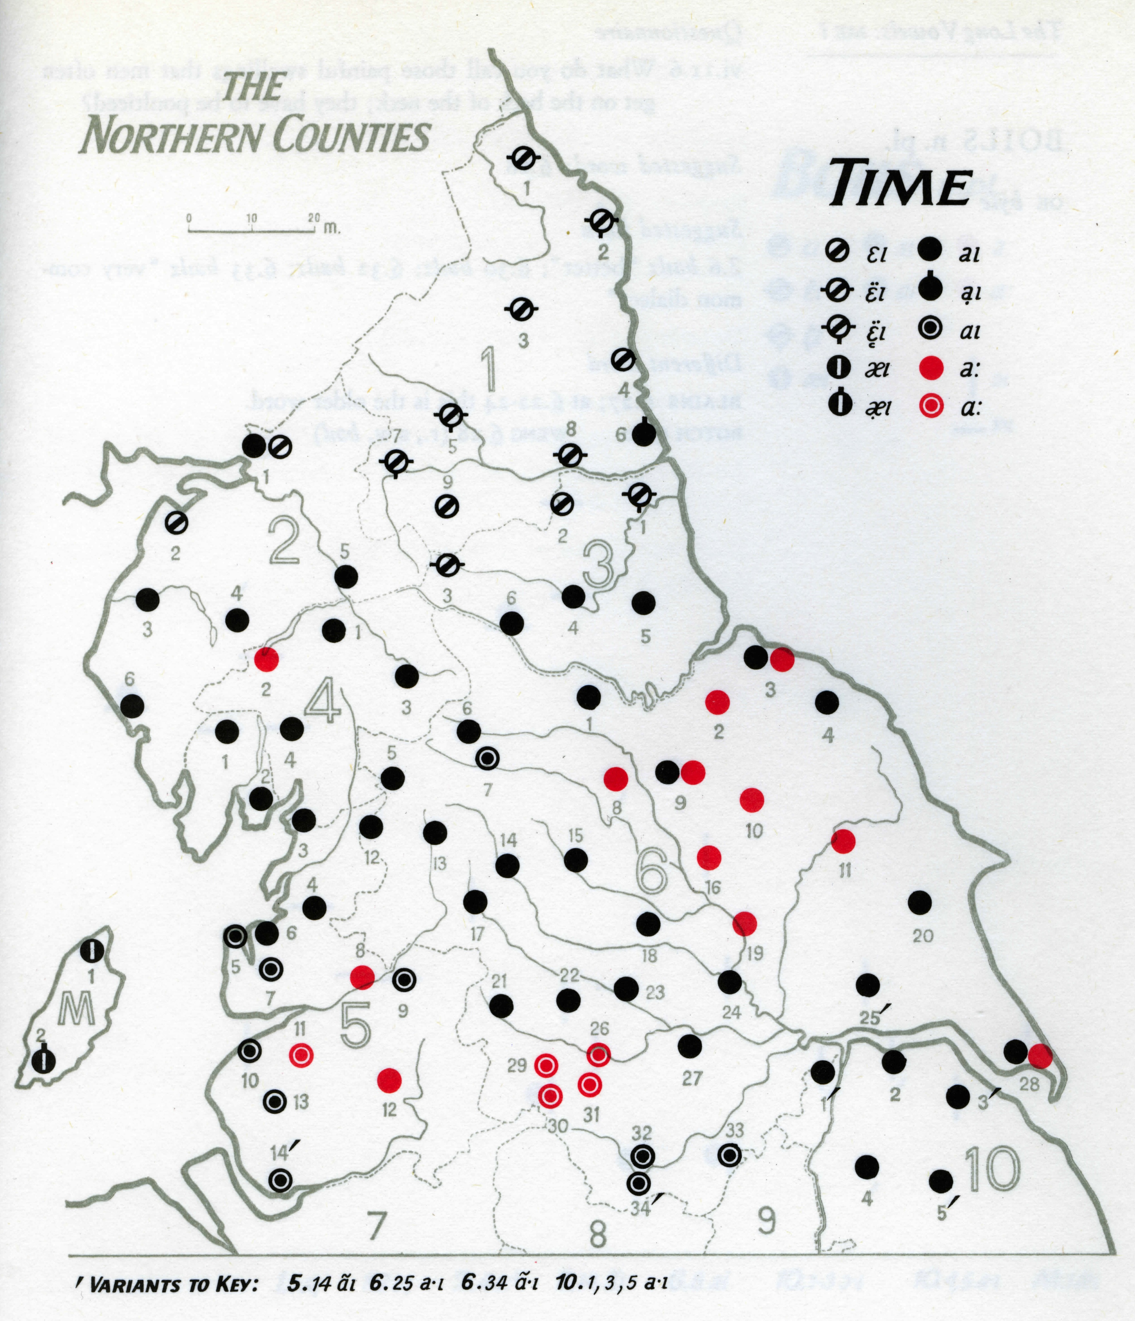
Sample map from the Phonological Atlas

Slide 14
Modern realizations of ME /iː/ (price)

Slide 15
Modern realizations of ME /eː/ (fleece)

Slide 16
Modern realizations of ME /uː/ (mouth)

Slide 17
Modern realizations of ME /oː/ (goose)

Slide 18
Relationship between /uː/ (mouth) and /oː/ (goose)

Slide 19
Transmission vs. Diffusion
Labov’s (2007) resolution to tension between family tree and wave models of linguistic change
Two different mechanisms of change:
Transmission is linguistic descent of the type modeled by the family tree; faithful transmission from generation to generation via child language acquisition
Diffusion occurs in contact situations between adults, and thus is expected to show more irregular outcomes than transmission, due to imperfect learning by adults

Slide 20
Diffusion outcomes
Labov illustrates irregular diffusion outcomes:
In diffusion of NYC short-a system to northern New Jersey, function word constraint is lost
This model has also been used by Dinkin to explain the seemingly inconsistent outcomes of the Northern Cities Shift in New York:
Only structurally compatible NCS changes diffuse
Existing nasal short-a system in the Hudson Valley blocks adoption of fully-raised NCS short-a system

Slide 22
Conclusion
Dialect geography allows us to step back and look at the whole picture, provides a different mode of reasoning
Nesting patterns of modern vowels provide support for Luick’s chronology
Problematic points identified by Stockwell & Minkova are the result of diffusion, and do not pose a problem for the coherence of the GVS

Slide 23
Thank you! Many thanks to Don Ringe, Bill Labov, Gillian Sankoff, the Penn Socio Lab, and the audience at the 5th Northern Englishes Workshop.
hilaryp@ling.upenn.edu  www.ling.upenn.edu/~hilaryp
References
Jespersen, Otto. 1909. A Modern English Grammar on Historical Principles. Munksgaard: Copenhagen.
Kolb, Eduard 1966. Linguistic Atlas of England. Phonological atlas of the Northern region. Francke: Bern.
Labov, William. 2007. Transmission and diffusion. Language, 83(2): 344–387.
Luick, Karl. 1896. Untersuchungen zur englischen Lautgeschichte. Trübner: Straßburg.
Stockwell, R. and D. Minkova. 1988. The English Vowel Shift: problems of coherence and explanation. In Luick Revisited. Tübingen: Gunter Narr Verlag.
Wales, Katie. 2006. Northern English: A social and cultural history. Cambridge: Cambridge University Press.

