Slide 1
Northern England and the Great Vowel Shift A dialect geographical approach
Hilary Prichard
3rd April 2012
The 5th Northern Englishes Workshop
Notes:
Today I’ll be revisiting a century-old debate surrounding one of the largest sound changes in the history of English, and presenting one approach which can be used to shed light on some of the issues that have been tied up in this debate.

Slide 2
Outline
Background
Great Vowel Shift
The Debate: Dueling chronologies
Towards a resolution: How can dialect geography help?
The Data
The Evidence
Intersection with theory
Conclusion
Notes:
So here’s the roadmap for this talk – I’ll start out by giving some background on the Great Vowel Shift, what it is, when it happened, and then summarize the key positions scholars have taken in the debate surrounding the shift. I’ll then present my own research and explain where it fits into this debate, and I’ll draw on ideas from modern sociolinguistic research to propose a resolution.

Slide 3
The Great English Vowel Shift
A sound change that happened between Middle English (ME) and Early Modern English (EME)
Around the 15th century
Produced a rotation in the ME long vowel system
E.g. the front vowels show the following evolution:
Pronunciation: | Chaucer | Shakespeare | Modern
bite | /biːtə/ | /beit/ | [bait]
beet | /beːtə/ | /biːt/ | [biːt, bijt]
beat | /bɛːtə/ | /beːt/ | [biːt, bijt]
abate | /aᴵbaːtə/ | /əᴵbæːt/ | [əᴵbeit]
(Jespersen 1909)
Notes:
If you’ve ever taken a history of English class, you’ve probably learned about the Great Vowel Shift – a sound change that happened between ME and EME, around the 15th century. This shift produced a rotation in the ME long vowel system, such that the high vowels diphthongized, and the mid and low vowels raised. So you get this first word, which was pronounced in ME as “” being pronounced as “” in EME, and then bite in ModE. Then the next of the high vowels raises, so “” to “” to beet, and so forth. You can see from the examples in this chart that there was also schwa loss, but that was a separate change.

Slide 4
The Great English Vowel Shift
bite
price
iː
eː
ɛː
aː
uː
oː
ɔː
house
mouth
beet
fleece
boot
goose
beat
fleece
boat
goat
bait
face
ai
au
Notes:
And here’s a diagram of all the changes involved. I’ve given both the key words used in Jespersen, along with their modern Wells lexical set. For simplicity’s sake, throughout this talk, I’ll be referring to these various changes using the Wells sets, so just keep in mind that when I say something like “goose raising” I don’t mean the modern goose vowel, I mean the ME vowel for that class. So here each of the words is shown next to their ME vowel, and then the GVS happened [click] and we end up with the modern vowels.
When you schematize the change in this way, it seems pretty straightforward, and when you take a history of English class, this is usually as much as you learn. So what have historical linguists been debating about for the past hundred years? Well, the most contentious issue has been the chronology of the changes – the way I’ve animated this diagram makes it look like all the vowels moved at once, but it’s very unlikely that that’s what actually happened. So did the low vowels raise first, or did the high vowels diphthongize first? In arguing about this issue, linguists have relied heavily on data from the regional dialects of British English, particularly focusing on regions where diphthongization in the MOUTH class didn’t happen – so places where house is still pronounced hus. So now let’s take a look at the various proposals which have been made.

Slide 5
Luick’s chronology
1896 Untersuchungen zur englischen Lautgeschichte
Push-chain led by mid vowels
Argument:
lack of mouth diphthongization in areas of goose fronting in the North
so mouth diphthongization depends on the raising of goose
Notes:
The first proposed chronology was made by Karl Luick in 1896, and he said that the GVS was a push-chain led by the mid vowels. In other words, it was the mid vowels raising which caused the high vowels to diphthongize, and the low vowels to raise along behind. [click] His argument in favor of this position was the fact that some places [click] where diphthongization in the MOUTH class didn’t occur had undergone a prior change which fronted the GOOSE class, and so the back mid vowel was not available to start the push chain. [click] He took this as clear evidence that MOUTH-diphthongization depended on the raising in GOOSE.

Slide 6
Luick’s chronology
price
iː
eː
ɛː
aː
uː
oː
ɔː
mouth
fleece
goose
fleece
goat
face
ai
au
Notes:
So if we were to animate Luick’s proposed chronology, it would look something like this. [CLICK] Where the mid vowels raise first, causing the high vowels to diphthongize, and the low vowels trail along behind.

Slide 7
Luick’s chronology in the North
price
iː
eː
ɛː
aː
uː
oː
ɔː
mouth
fleece
!
goose
fleece
goat
face
ai
au
Notes:
However, here’s what happens in the north. GOOSE fronts, then the GVS happens – but GOOSE isn’t part of the back long vowel system anymore, so MOUTH is not pressured to diphthongize.

Slide 8
Jespersen’s chronology
1909: A Modern English Grammar on Historical Principles
Drag-chain led by high vowels
Argument:
Some spelling evidence to suggest low vowels were last to shift
Contra push-chains – why don’t the vowels merge?
Some places, mouth simply didn’t diphthongize
Notes:
So that was Luick’s idea. Then in 1909, Otto Jespersen came along, and proposed the opposite chronology. He said it could just as easily be a drag-chain led by the diphthongization of the high vowels. [click] In favor of this position[click] he cites some spelling evidence from the 16th century which suggests that the low vowels were the last to shift, but his argument really seems to rest more on abstract reasoning about the nature of chain shifts than on any conclusive evidence. [click] For instance, he objects to Luick’s proposal on the grounds that it’s not obvious why the raising of the mid vowels would cause diphthongization of the high vowels rather than simply resulting in merger. [click] And finally in response to Luick’s evidence of the locations where the MOUTH class didn’t diphthongize, he says well, it just didn’t happen everywhere.

Slide 9
Jespersen’s chronology
price
iː
eː
ɛː
aː
uː
oː
ɔː
mouth
fleece
boot
fleece
boat
face
ai
au
Notes:
So if we were to schematize Jespersen’s proposal, it would look like this. [CLICK] The high vowels diphthongize first, and the other vowels raise in response.

Slide 10
Stockwell & Minkova’s challenge
1988: The English Vowel Shift: problems of coherence & explanation
Not actually a coherent chain shift at all
Linguists’ hindsight interpretation of unrelated historical mergers
Evidence:
Handful of dialect data
mouth diphthongization did happen in a few places where
goose fronting had occurred
Undercuts the basis of Luick’s argument
…or does it?
Notes:
Ok, the last position I’ll mention here, is the objection raised by Stockwell and Minkova in 1988, who said that based on the dialect data, the GVS was not actually a coherent chain shift at all. Rather, it’s pretty much wishful thinking on the part of linguists, who have imposed this nice neat schema on a change which was actually a rather messy series of historical changes and mergers. [click] They base this claim largely on [click] evidence from a few locations in the North where we see that GOOSE fronting occurred, but MOUTH diphthongization ALSO occurred. [click] So clearly this undercuts the basis of Luick’s argument, since the causal relationship between those two vowels is not maintained. [click] …or does it?

Slide 11
How to resolve this debate?
In this talk, I’ll argue that these few data points
do not invalidate Luick’s argument, and actually might be expected under a certain approach
Apply novel (to this debate) methods to existing data
Examine the dialectal data in its entirety
Look for new evidence in geographic patterns
Notes:
So in this talk I’ll argue that these few data points cited by Stockwell and Minkova do NOT invalidate Luick’s argument, and actually might be expected under a certain approach to sound change. How will I make this argument? [enumerate points listed]

Slide 12
Kolb 1966
The Phonological Atlas of the Northern Region
Data collected as part of the SED, 1950-1961
independently analyzed & mapped by Kolb
80 locations in the 6 northern counties
includes N. Lincolnshire
200+ maps of words
conveniently organized by ME vowel class
Notes:
The data I’ll be using comes from a phonological atlas of the North of England which was assembled by Eduard Kolb in 1966. etc.

Slide 13
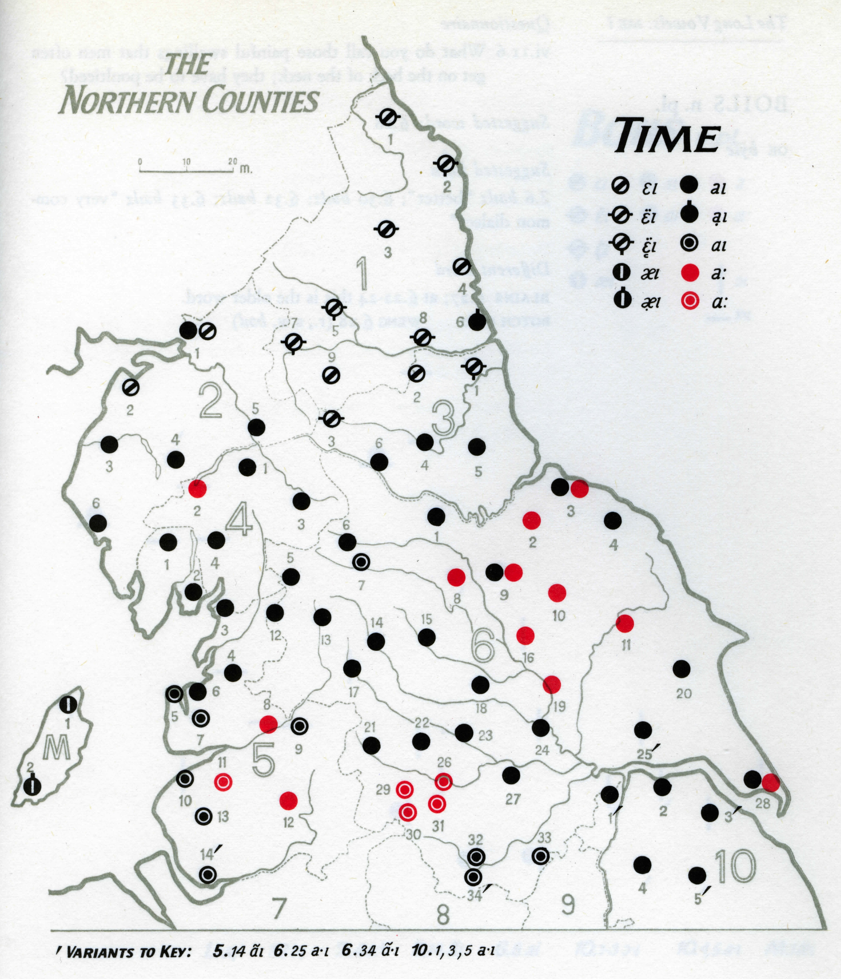
Sample map from the Phonological Atlas
Notes:
This is an example of the type of map that’s given in the atlas. You can see that it has preserved a wealth of phonetic data, but as you might imagine, since you only see data for one word at a time, it’s not always easy to generalize any patterns you see across entire vowel classes. So what I’ve done is taken the data for each ME long vowel class, which consists of anywhere from 3-5 words per vowel, and I’ve summarized that data by taking only the most common vowel variant at each point, and plotted that on a map. So what you’ll be seeing on the following maps does not represent the full breadth of the variation at any one location, but rather the variant which was used most often for the words in that class. One last note before we move on and look at the actual data – I will only present data from the high and mid vowels here, because what happens in the low vowels is a bit too messy to explain in the time given. So although the FACE and GOAT class were involved in the shift, I won’t discuss them here.

Slide 14
Modern realizations of ME /iː/ (price)
Notes:
Ok, moving on to look at the actual data. What you see here is the modern reflexes of the PRICE class. You can see from this map that diphthongization of the ME vowel has occurred across the entire North, although there is some variation in how this vowel is now realized. So there’s this swath of the expected outcome of this change, /ai/, which runs from the Lake District all the way over to Northern Lincolnshire. And then below this area, we see some forms that look like a further advance of the shift – so some places show further backing of the nucleus while others show monophthongization. And then finally in the far North we see something a little odd. There’s definitely a diphthong, but it’s not completely lowered the way it is elsewhere. So it looks like some sort of intermediate form.

Slide 15
Modern realizations of ME /eː/ (fleece)
Notes:
Next, let’s look at the ME mid front vowel, which is in the FLEECE class. We can see that raising of this vowel happened pretty uniformly across the entire North. The exception of course is this little area in red, where there’s actually a centralized diphthong. I don’t really have any ideas why this is the case, it could be a relic dialect area, or it could be an innovation – maybe someone here has worked on this and can comment on that. Regardless, the main result here is the striking uniformity in the FLEECE class, especially compared to the PRICE class we just looked at – there’s very little variation here, and certainly no nesting patterns, which while not conclusive, is certainly consistent with Luick’s chronology of the change – if FLEECE raising happened before PRICE diphthongization, then it stands to reason that it might also have gone to completion throughout the north before PRICE did.

Slide 16
Modern realizations of ME /uː/ (mouth)
Notes:
The next vowel to look at is that of the MOUTH class. This is the one that so much of Luick’s argument rests on, and we can see clearly here the phenomenon he identified. All of the red points on this map are places where this vowel did not diphthongize at all – the original ME pronunciation is maintained. The areas where this happens is pretty clearly defined. [point out on map] There’s this clear block of red in the far north, as well as in east Yorkshire. In the middle we see a few intermediate forms, and all the purple dots are the expected outcome of this change. Again, there seem to be some further advances in the southernmost area. So again a pretty clear nesting pattern, with the most advanced forms in the southwest, and the least advanced forms in the northeast.

Slide 17
Relationship between /uː/ (mouth) and /oː/ (goose)
Notes:
Now, rather than simply looking at the variation in the GOOSE class, let’s have a look specifically at the dependency relationship between diphthongization in MOUTH and raising in GOOSE which really formed the crux of Luick’s argument. On this map, all the blue points mark locations which did undergo diphthongization in the MOUTH class, and all the red points mark places that underwent fronting in the GOOSE class. We can see there’s a pretty striking boundary between the area that had GOOSE fronting in ME, and the area that didn’t [CLICK]. However, the boundary between the areas that have MOUTH diphthongization and those which don’t is a little more fuzzy [CLICK] and you can see that there’s an intermediate area where these two systems heavily overlap, and these are exactly the points that Stockwell and Minkova cited as problematic for Luick’s analysis. So does the existence of these points mean that Luick was wrong about the chronology of the shift? Stockwell and Minkova think so, but I disagree. What I think we’re seeing here is a classic case of diffusion of a change. So let’s step aside for a minute and talk about diffusion, because I’m using it here not in the traditional sense of the spread of forms from place to place, but rather in Labov’s sense of diffusion vs. transmission.

Slide 18
Transmission vs. Diffusion
Labov’s (2007) resolution to tension between family tree and wave models of linguistic change
Two different mechanisms of change:
Transmission is linguistic descent of the type modeled by the family tree; faithful transmission from generation to generation via child language acquisition
Diffusion occurs in contact situations between adults, and thus is expected to show more irregular outcomes than transmission, due to imperfect learning by adults
This model has been used plausibly by Dinkin to explain the seemingly inconsistent outcomes of the Northern Cities Shift in New York.
Notes:
This distinction comes out of a paper by Bill Labov in 2007 the goal of which was to propose a resolution to the tension between the family tree and wave model of linguistic change. Labov said that we see these two different types of change because there are actually two different mechanisms of change. [bullet points] [click]

Slide 19
Notes:
So let’s go back to this map and look at how the difference between transmission and diffusion comes into play. In this intermediate zone, we don’t see regular transmission of the entire chain shift, but rather diffusion of the shift via contact between adult learners. As we know from Bill Labov’s and others’ work, changes spread via diffusion are not always faithfully reproduced. So what I propose is happening here is that this change from the south, diphthongization [CLICK] is diffusing into an area which had a different starting system, because of this prior fronting in GOOSE, and that’s why you see conflicting data in the North.

Slide 20
Conclusion
Dialect geography allows us to step back and look at the whole picture, provides a different mode of reasoning
Nesting patterns of modern vowels provide support for Luick’s chronology
Problematic points identified by Stockwell & Minkova are the result of diffusion, and do not pose a problem for the coherence of the GVS
Notes:
So in conclusion, when we use dialect geography to step back and look at the spatial distribution of the entire dialect data, we see that the nesting patterns of the modern vowels do provide support for Luick’s chronology. Additionally, by identifying the GVS outcomes in the North as the product of diffusion of the original chain shift, we see that the problematic points identified by Stockwell and Minkova do not in fact pose a problem for the coherence and chronology of the GVS.

Slide 21
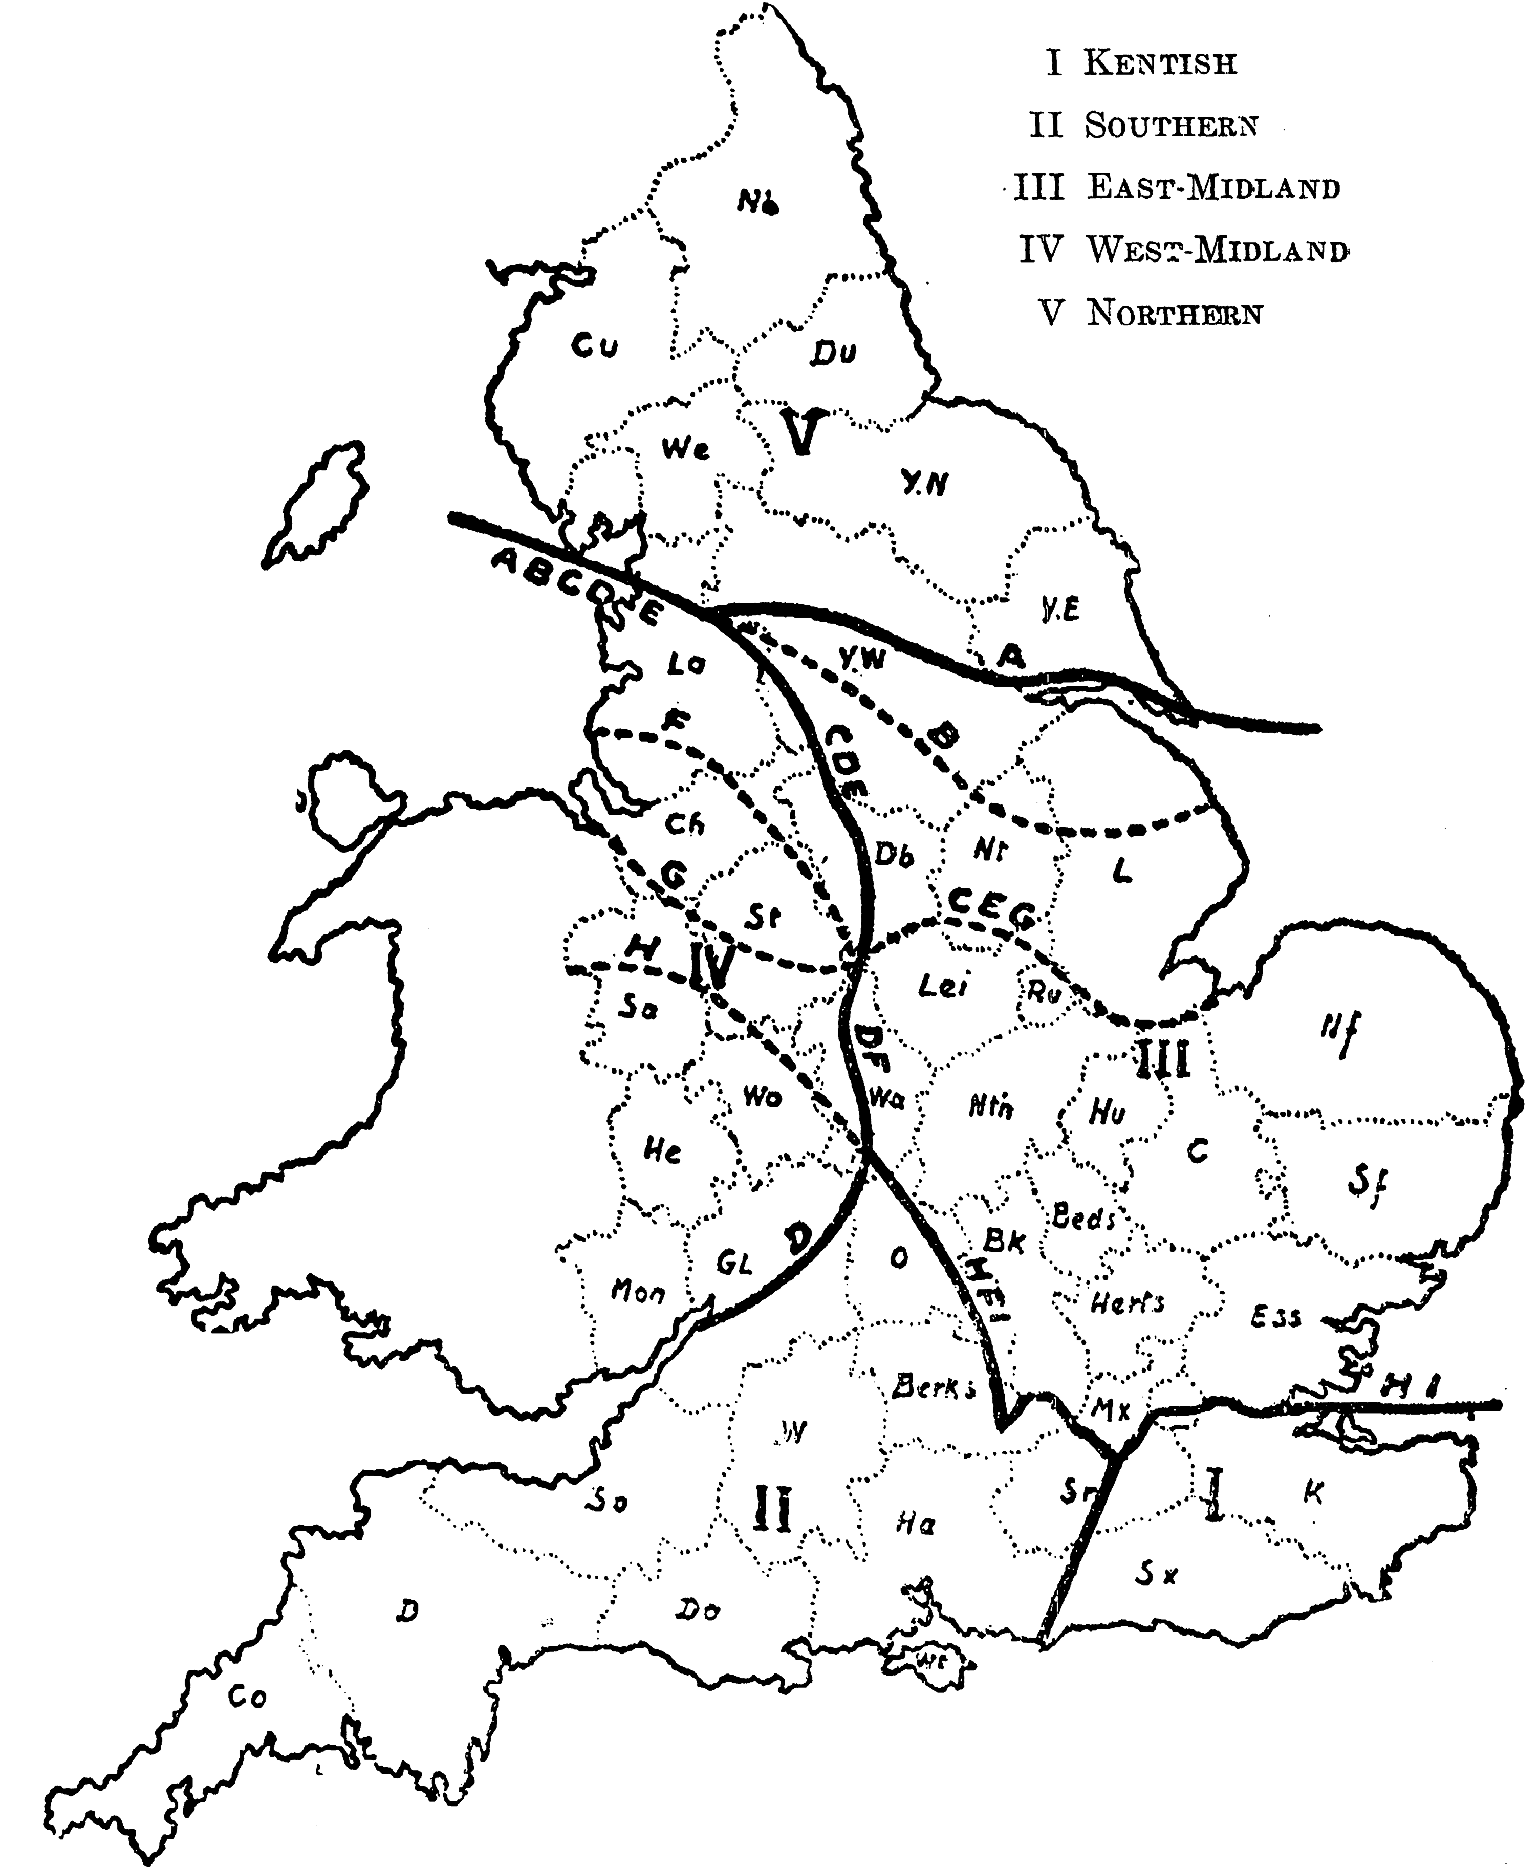
Middle English Dialects
according to Moore-Meech-Whitehall, from Mossé 1952
Notes:
Side note – persistence of dialect boundaries.

Slide 22
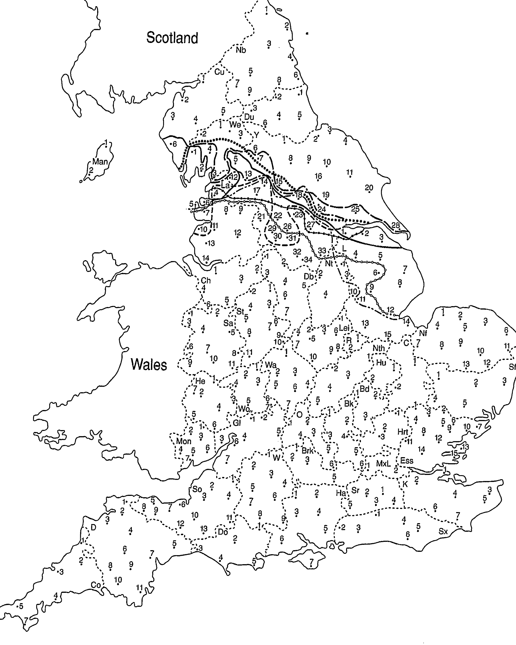
The Ribble–(Calder–Aire–)Humber Line
from Wales 2006

Slide 23
Thank you! Many thanks to Don Ringe, Bill Labov, Gillian Sankoff, and the Penn Socio Lab.
hilaryp@ling.upenn.edu  www.ling.upenn.edu/~hilaryp
References
Jespersen, Otto. 1909. A Modern English Grammar on Historical Principles. Munksgaard: Copenhagen.
Kolb, Eduard 1966. Linguistic Atlas of England. Phonological atlas of the Northern region. Francke: Bern.
Labov, William. 2007. Transmission and diffusion. Language, 83(2): 344–387.
Luick, Karl. 1896. Untersuchungen zur englischen Lautgeschichte. Trübner: Straßburg.
Stockwell, R. and D. Minkova. 1988. The English Vowel Shift: problems of coherence and explanation. In Luick Revisited. Tübingen: Gunter Narr Verlag.
Wales, Katie. 2006. Northern English: A social and cultural history. Cambridge: Cambridge University Press.

