Slide 1
HILDA DEVAPRIYAM.X
COLLEGE NAME: SARANATHAN COLLEGE OF ENGINEERING BRANCH:ARTIFICIAL INTELLIGENCE AND DATA SCIENCE YEAR:THIRD YEAR
NM ID: au813821243021 REGISTER NUMBER:813821243021
EMAIL ID: pxaviertrc1972@gmail.com
Final Project: FACIAL RECOGNITION USING CONVOLUATIONAL NEURAL NETWORK
3/21/2024 Annual Review
1

Slide 2
FACIAL RECOGNITION USING CONVOLUTIONAL NEURAL NETWORK
1

Slide 3

AGENDA
Problem statement
Proposed system/solution
System Development Approach
Algorithms And Deployment
Result
Conclusion
References
3

Slide 4

PROBLEM STATEMENT
Develop a deep learning CNN model for real-time facial recognition that achieves high accuracy, robustness to environmental variations, and scalability while minimizing computational overhead for deployment across diverse platforms and applications.
4

Slide 5

PROJECT OVERVIEW
Load the dataset
Preprocessing
Train Test Split
Build And Train CNN
Evaluation
Deployment
5

Slide 6

WHO ARE THE END USERS
Security and Surveillance Companies
Law Enforcement Agencies
Government Organizations
•
Commercial Enterprises
•
Human Resources Departments
•
Healthcare Industry
•
Educational Institutions
•
Smart Device Manufacturers
•
Transportation and Aviation Industry
Social Media Platforms
3/21/2024
Annual Review
6

Slide 7
YOUR SOLUTION AND ITS VALUE PROPOSITION
One solution is robust facial recognition system utilizing deep learning convolutional neural network(CNNs) to accurately identify individuals from images or video frames in real time.The system is designed to be highly accurate,scalable and adaptable to diverse environments and applications.
Enhanced Security
Operational Efficiency
Improved User Experience
Cost Savings
Compliance and Accountability

Slide 8

THE WOW IN YOUR SOLUTION
•
Accuracy
Robustness to Variability
•
Feature Learning
•
End-to-End Learning
•
Scalability
•
Privacy Preservation
•
Real-Time Processing
•
Adaptability
•
Continuous Improvement

Slide 9
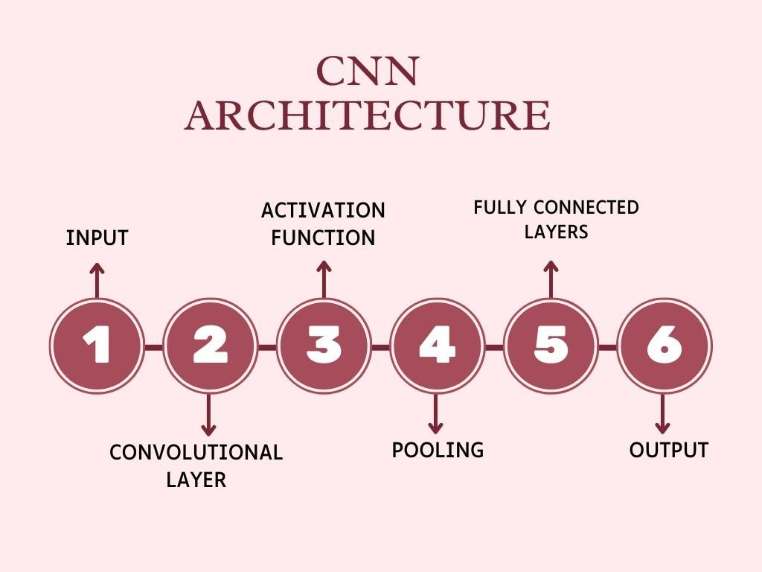
MODELLING
9

Slide 10
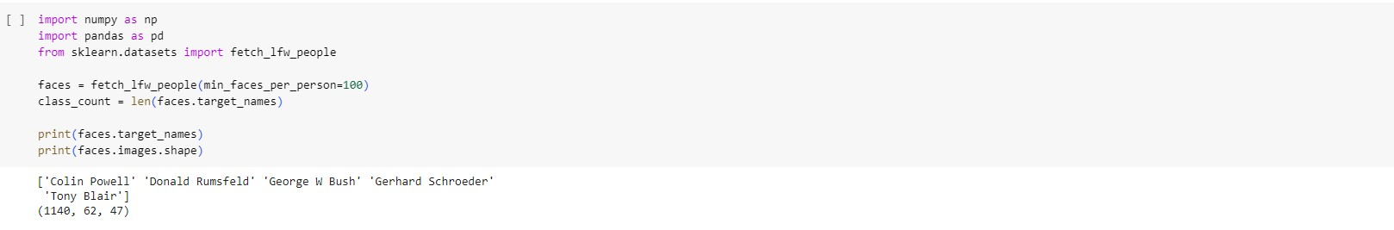
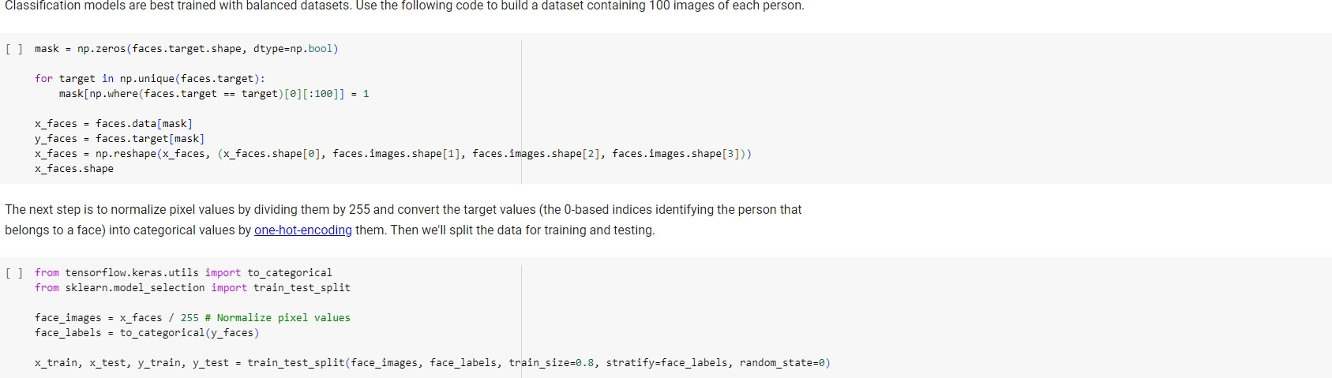
1.Importing required modules and loading the dataset
2.Preprocessing
10

Slide 11
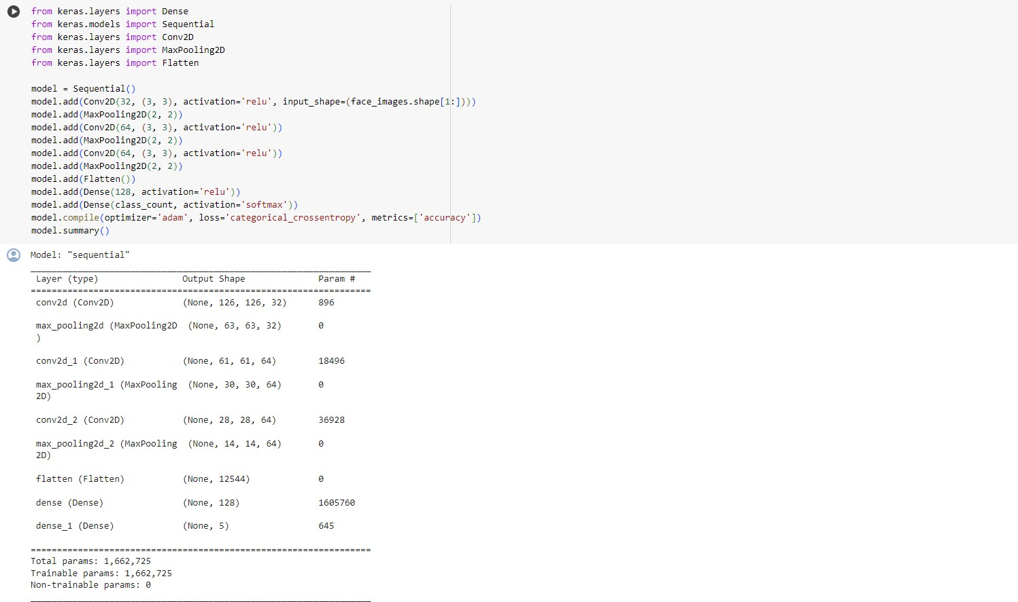
3.Building the model
11

Slide 12
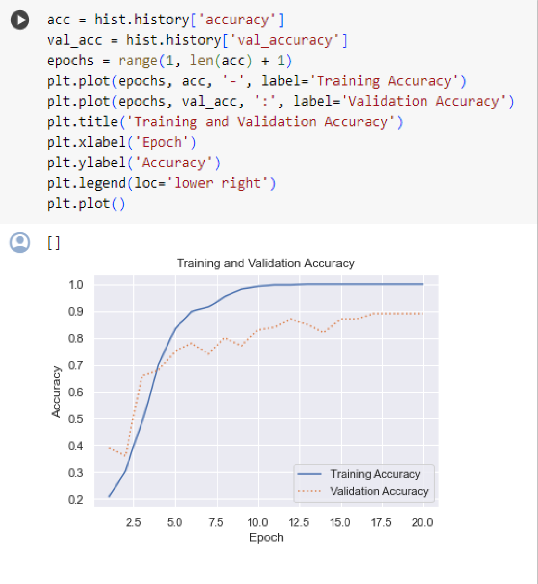
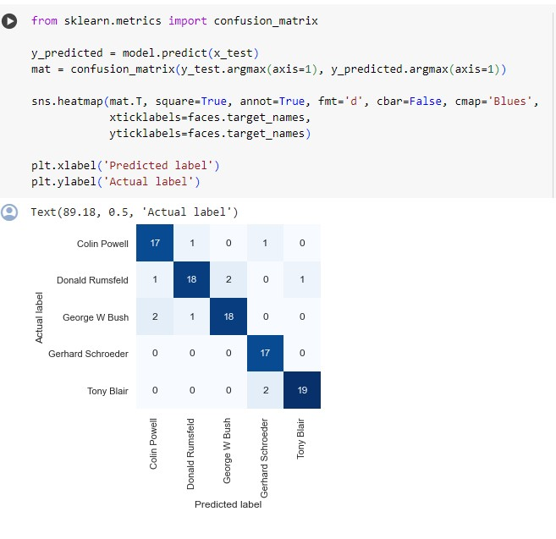
RESULTS
1.Training And validation Accuracy
2.Confusion Matrix
12

Slide 13
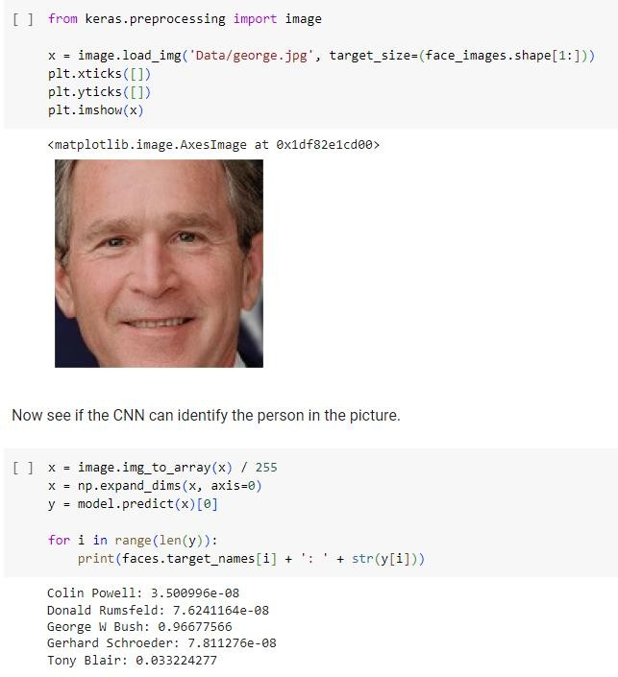
3.Prediction
13

Slide 14
CONCLUSION
Facial recognition employing deep learning CNNs presents promising accuracy for face detection and identification across various applications. However, ethical and privacy concerns, including bias and data misuse, necessitate stringent regulations. Continued research is vital to enhancing system accuracy, fairness, and accountability. While facial recognition holds potential benefits, cautious and responsible deployment is imperative to mitigate potential societal harms.
14

