Slide 1
println("RMSD before mapping: ", compute_rmsd(sys[1], sys[2]))

Slide 2
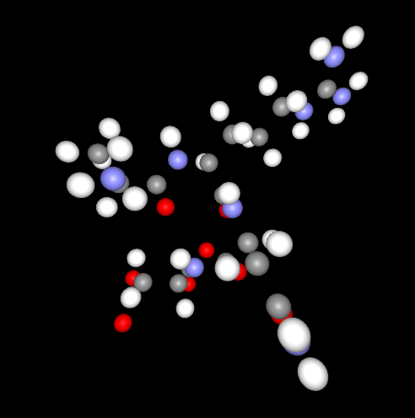
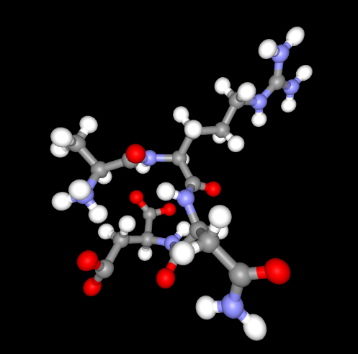
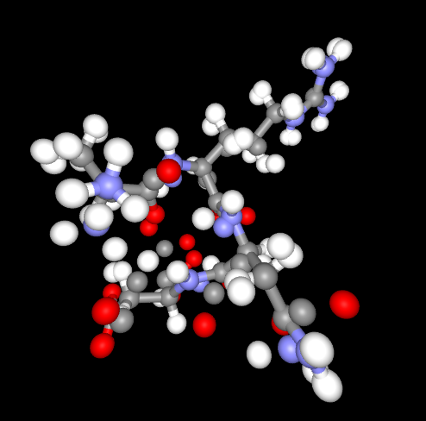

Slide 3
