Slide 1
hPathSim: User-Guided Meta-Path Framework in Heterogeneous Networks
Hilfi Alkaff (alkaff2)
Efe Karakus (karakus1)

Slide 2
Outline
Problem
Related Work
PathSim
OLAP operations: roll-up, drill-down, slice
Dataset
Contribution
Better Storage
Handling Hierarchies
User-specified constraints
Results
Network Statistics
hPathSim run-time and memory
Live Demo
Discussion

Slide 3
Problem
Similarity search using PathSim on networks is expensive.
We can not apply similarity search under specific context. (e.g. applying an OLAP operation first)
PathSim does not allow for user-constrained search. Hard to find meaning by looking at meta-path.

Slide 4
Related Work: PathSim
Computing similarity in heterogeneous networks.
Favor “peers”- objects with strong connectivity and similar visibility under a meta-path.
Example meta-paths: author-paper-author (co-authors), author-paper-venue-paper-author (submitted to same conference).

Slide 5
Related Work: OLAP Operations
Roll-up: Summarization of data along a dimension.
Drill-down: Navigate to more detailed levels of the dimension.
Slice: Pick a subset of the data cube.

Slide 6
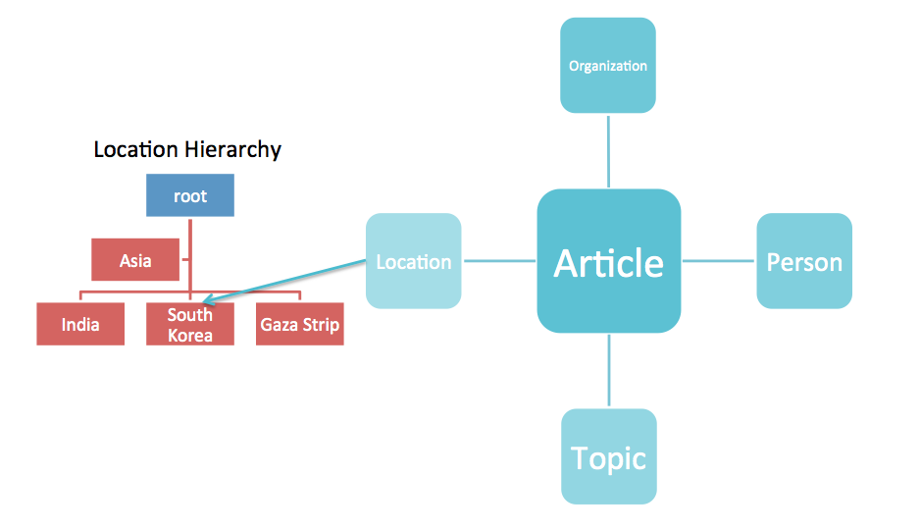
Dataset: New York Times

Slide 7
Contribution: Better Storage
Build a hash-table with k = (node1, node) v = set of meta-paths
Start with empty hash-table
Caches as user issues similarity search queries.

Slide 8
Contribution: Handling Hierarchies
Build a forest of hierarchical trees
Hashtable to allow fast lookup of a category in the tree.
Iterative DFS for roll-up and drill-down operations on the tree.
5 operations, N is number of nodes in tree:
is_member() O(N) - is_slice() O(1)
get_categories() O(N) - get_children() O(1)
get_parent() O(1)

Slide 9
Contribution: User-Specified Constraints
Two types of constraints: must-link and cannot link.
Modified BFS to handle constraints.
Cannot-link enforced every time a new partial path is explored.
Must-link enforced every time a new complete path is about to be added into the meta-path set.

Slide 10
Evaluation
DBLP Dataset: - 70,000+ vertices - Average degree: 9.0, std: 74.8 - Average path length: 4.0, std: 1.1
NYTimes News Dataset: - 180,000+ vertices - Average degree: 10.0, std: 73.7 - Average path length: 4.5, std: 0.97

Slide 11
Results: Similarity Search
Graph | Average (s) | Std
DBLP Full | 1.02 | 2.70
NYT Full | 12.25 | 10.31
DBLP DB | 0.21 | 0.27
NYT Jordan | 7.34 | 7.35

Slide 12
Results: OLAP Operations
Graph | Average (s) | Std
DBLP Drill-Down | 0.055 | 0.024
DBLP Roll-Up | 0.0058 | 0.00093
NYT Drill-Down | 5.70 | 0.44
NYT Roll-Up | 19.22 | 0.91

