Slide 1
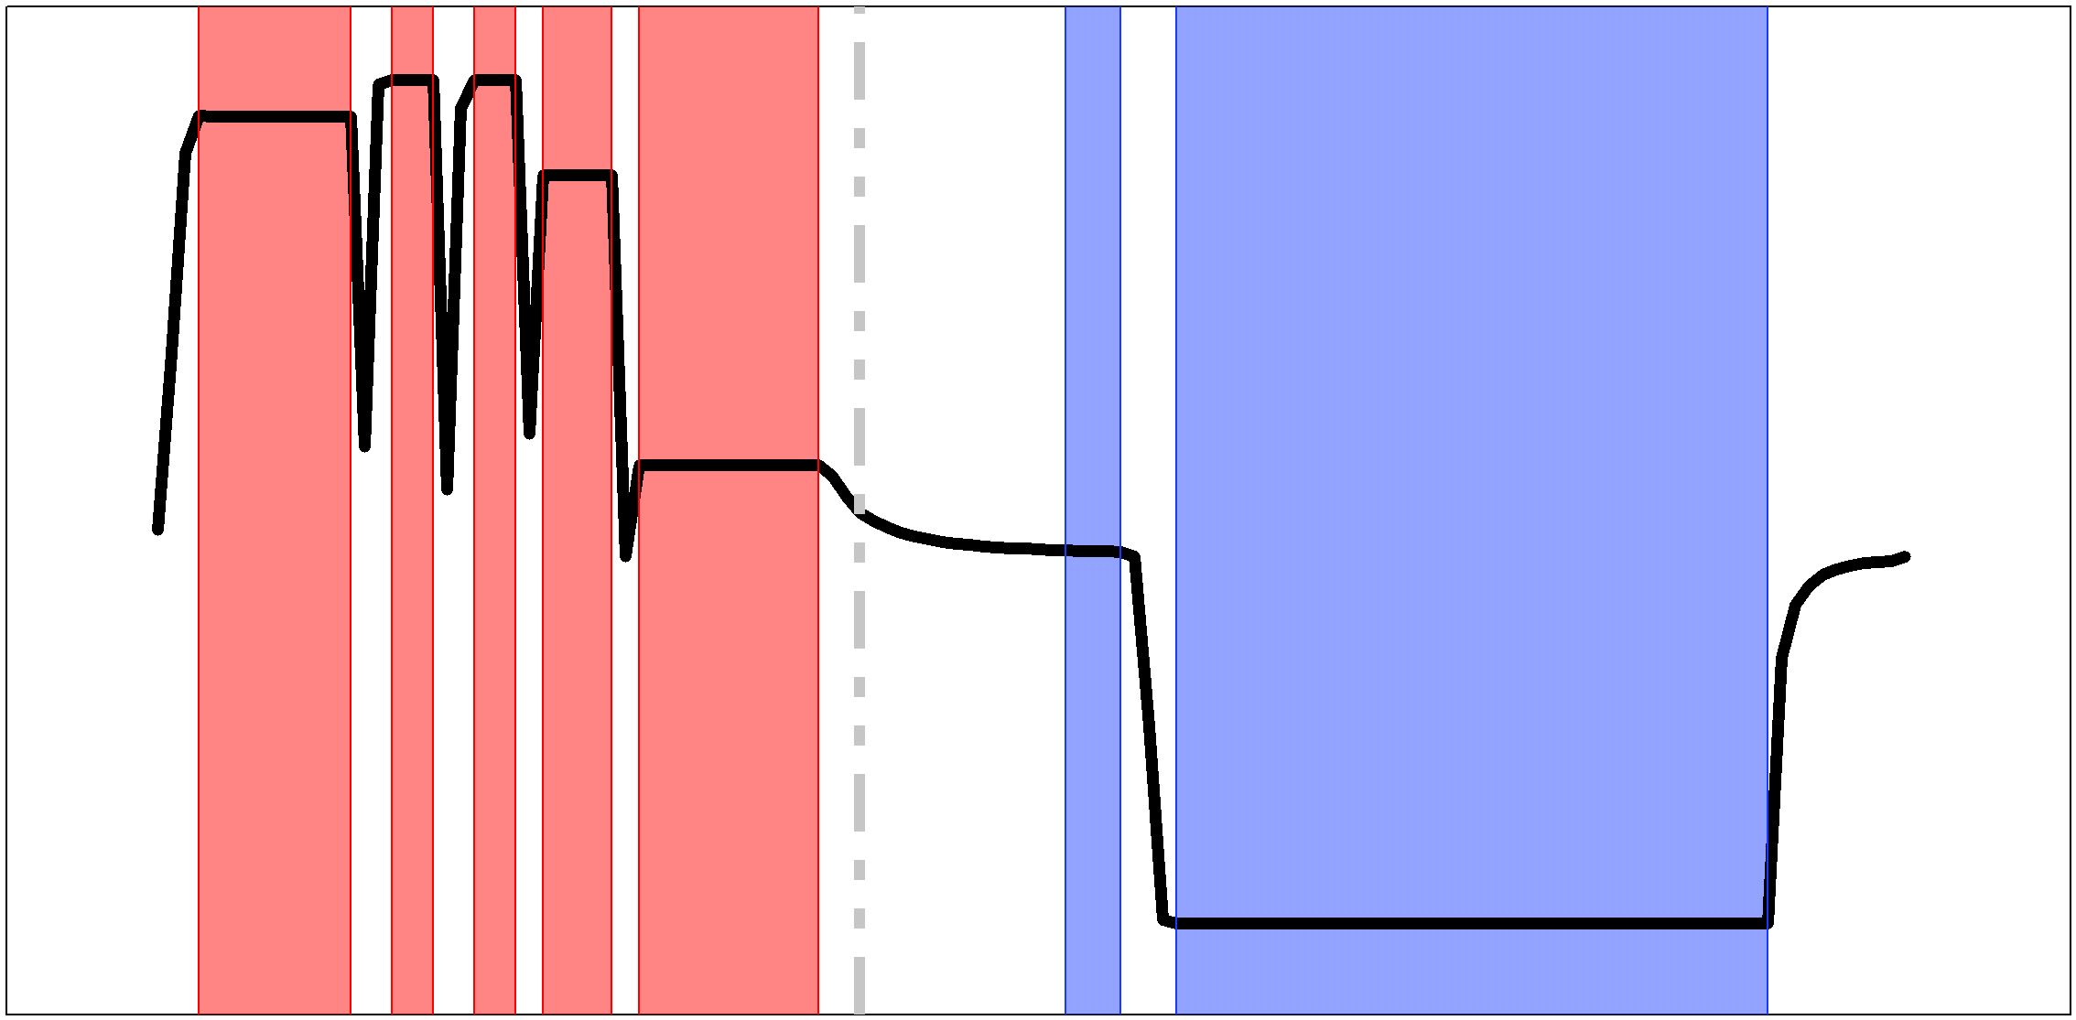


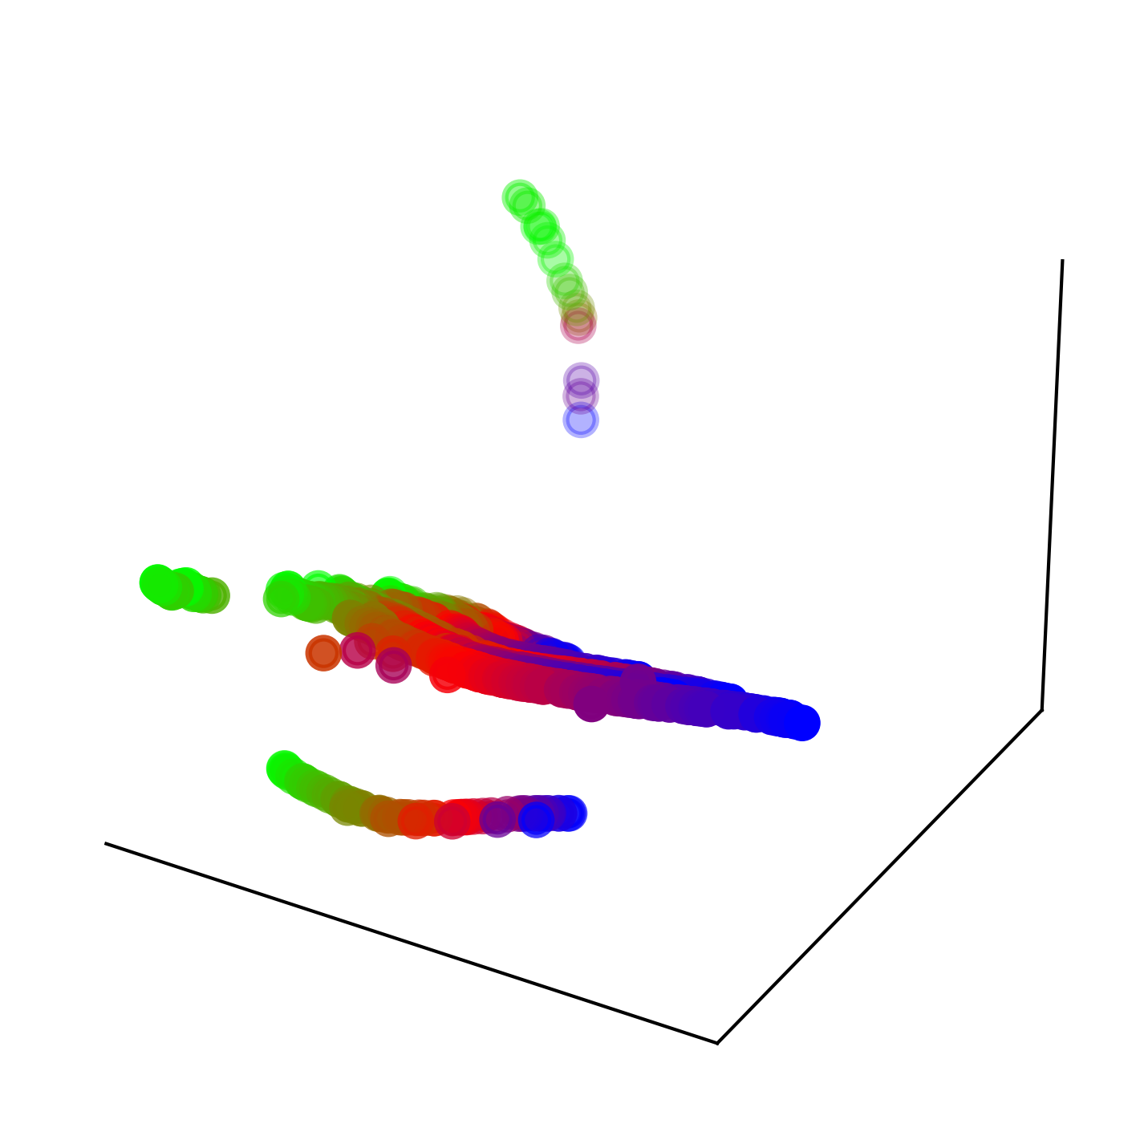
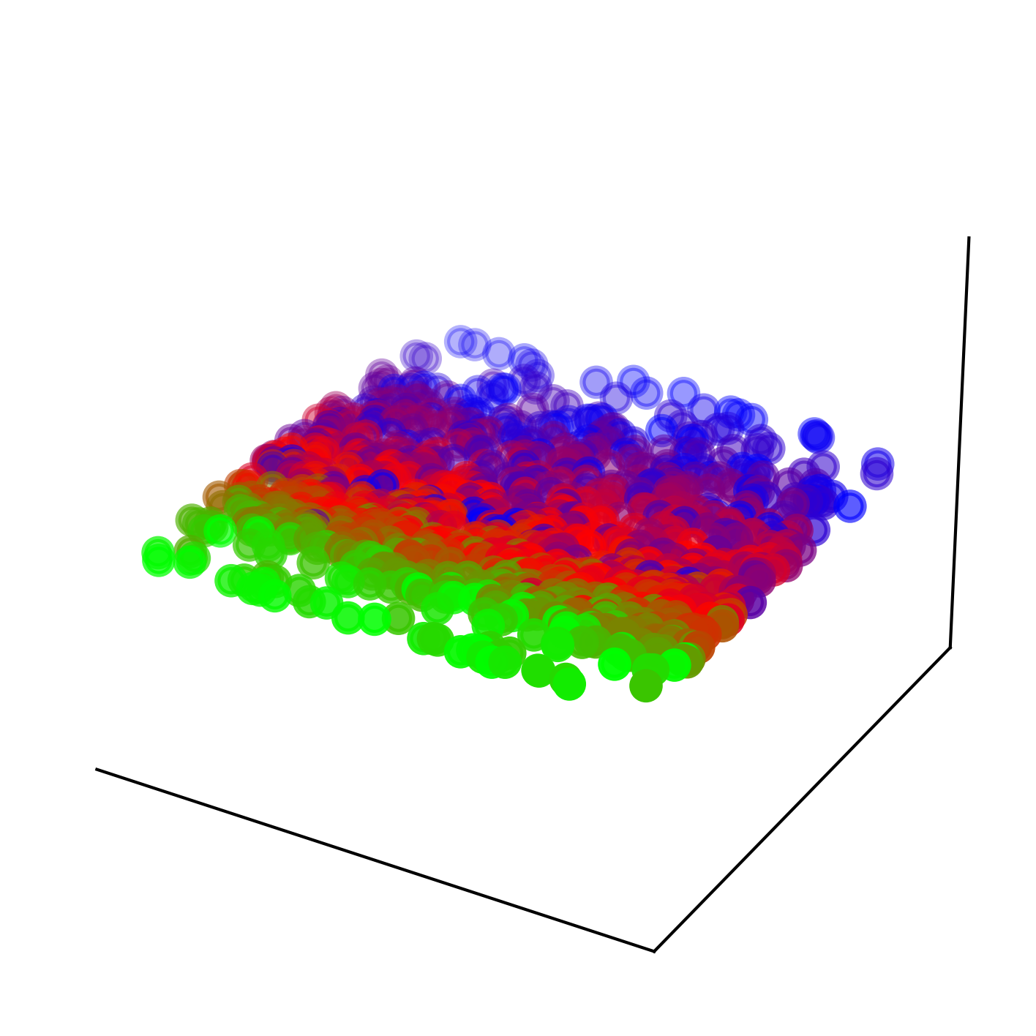

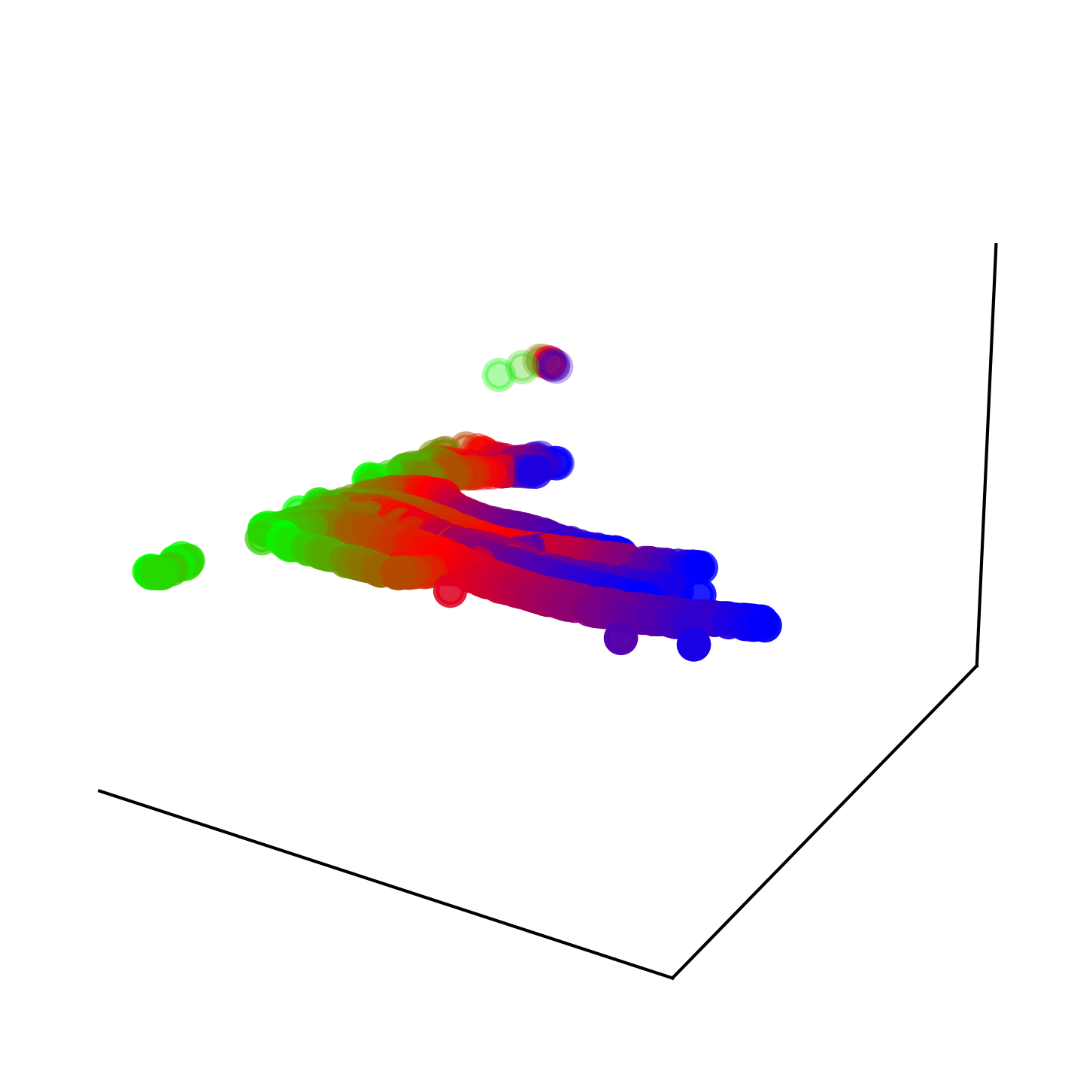

Charging Phase
Redundancy Ratio: 78.4%
Discharging Phase
Redundancy Ratio: 63.6%
Information Dilution
Manifold Fracture
Representation Overlap
3D Manifold
1D Manifold
2D Manifold

Slide 2
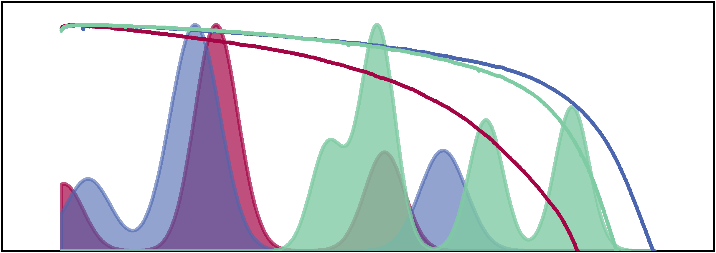
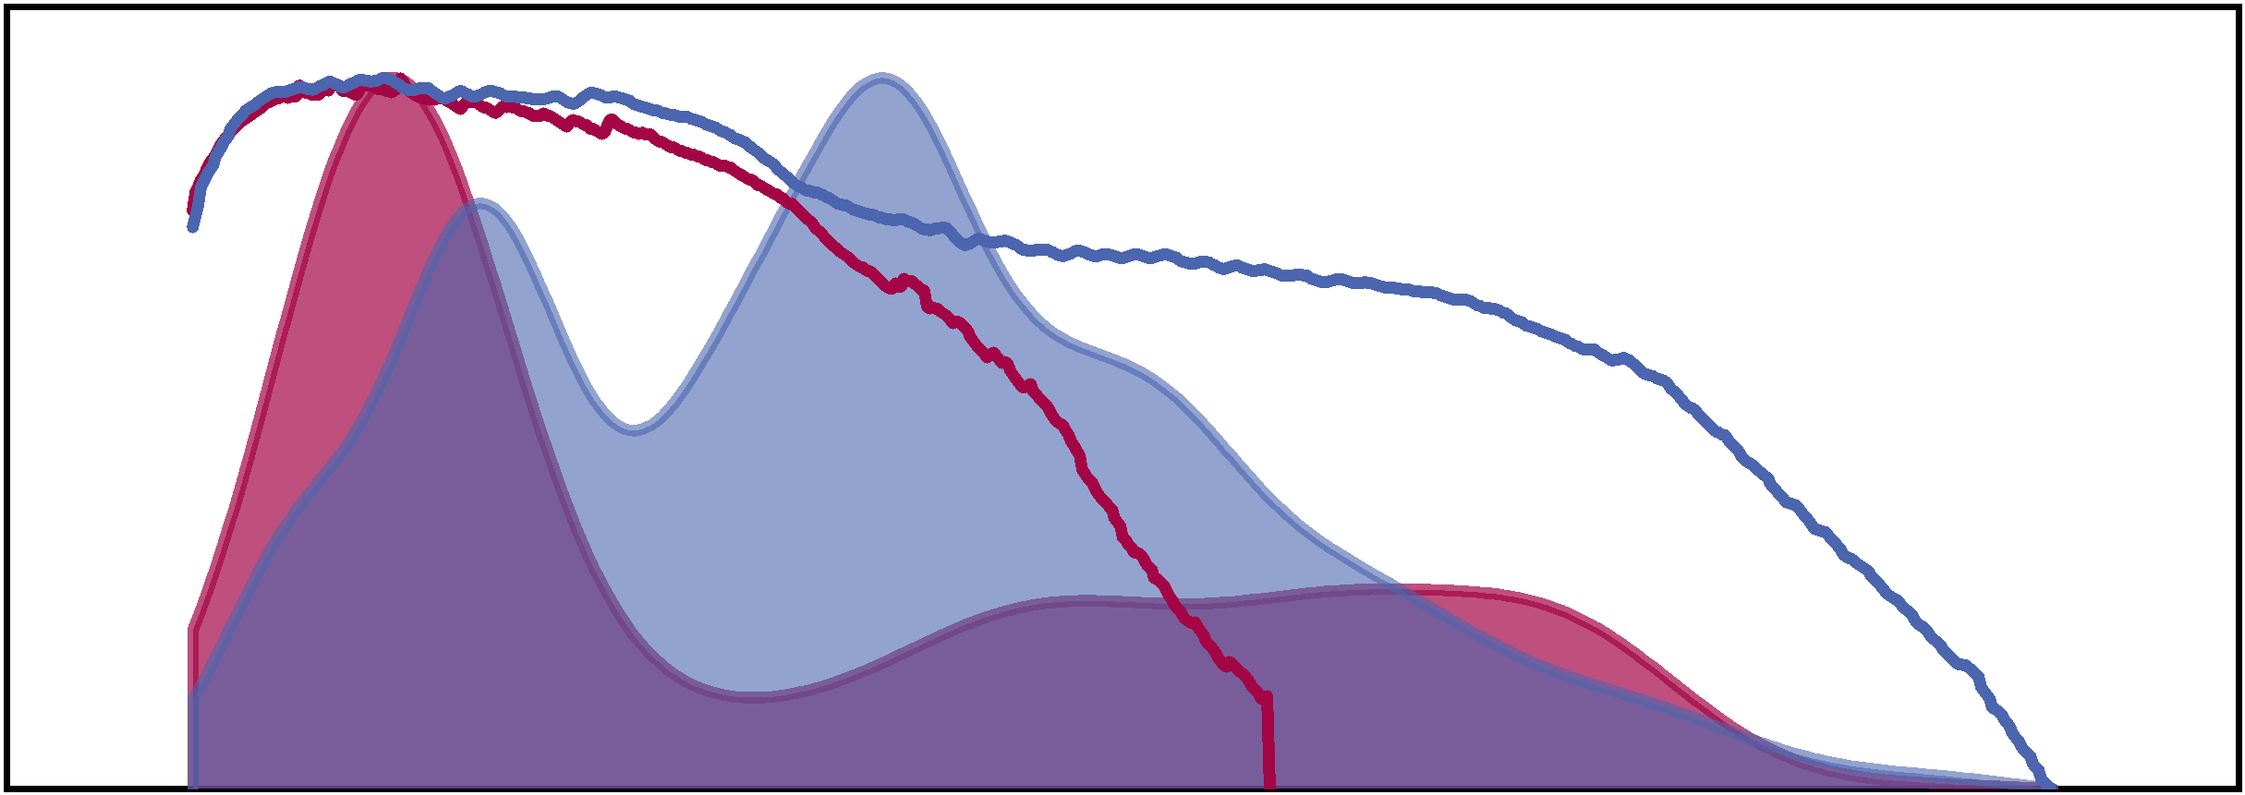
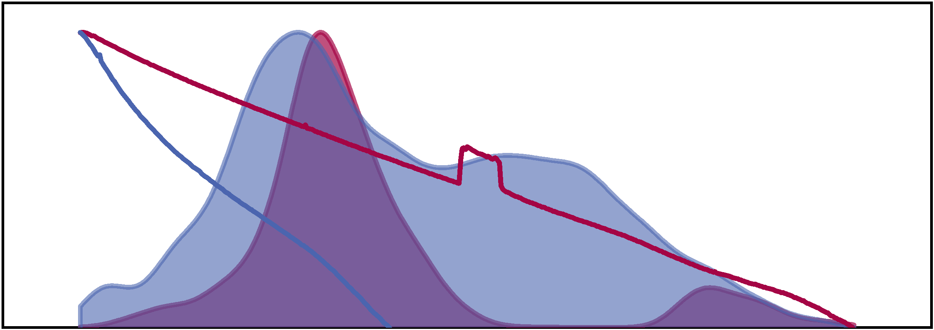
Fast-charge Protocol
Cathode Active Material
Depth of Discharge

Slide 3
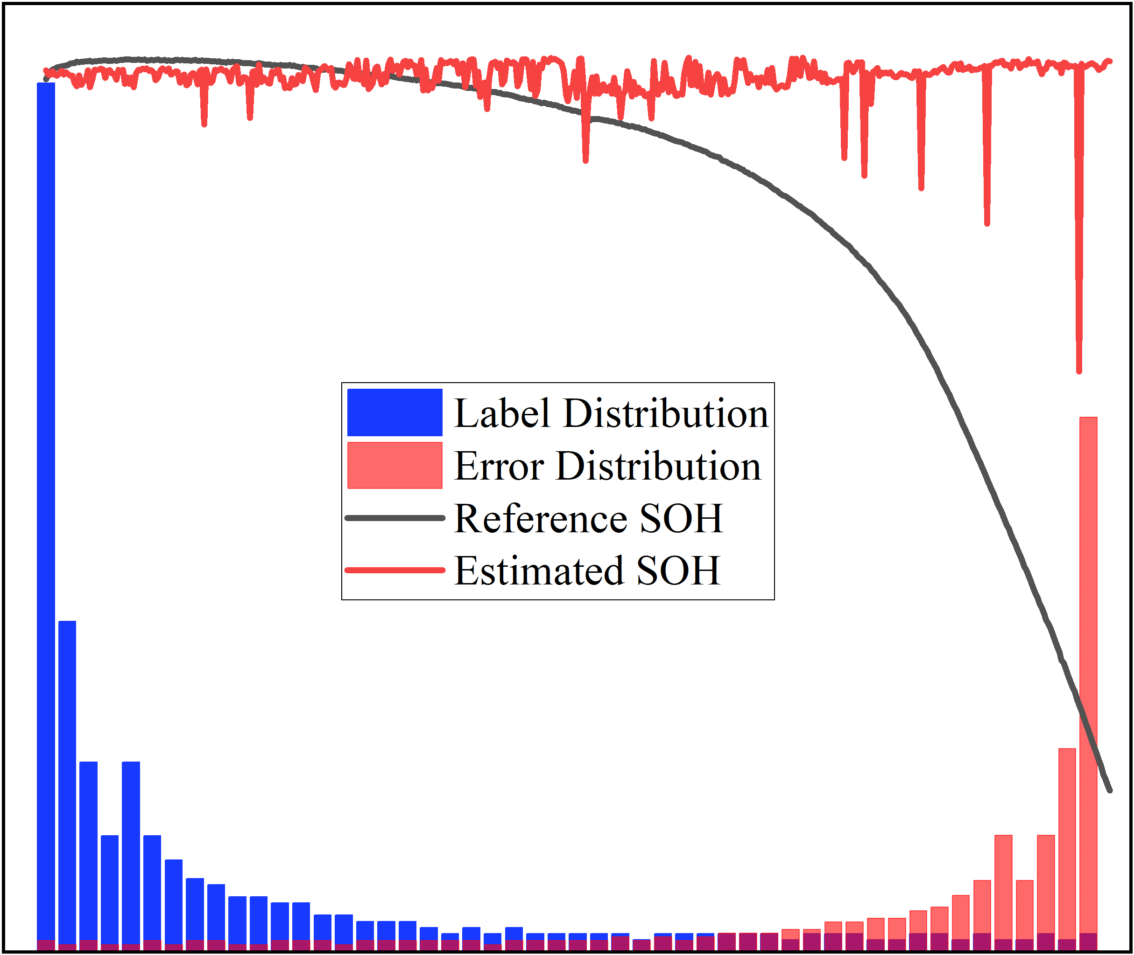

Early Stage
Late Stage
Overrepresented Degradation Samples
Underrepresented Degradation Samples

Slide 4
Charging Phase
Redundancy Ratio: 78.4%
Discharging Phase
Redundancy Ratio: 63.6%
Fast-charge Protocol
Information Dilution
Cathode Active Material
Manifold Fracture
Representation Overlap
Depth of Discharge
3D Manifold
1D Manifold
Early Stage
Late Stage
2D Manifold
Overrepresented Degradation Samples
Underrepresented Degradation Samples
(a) Insufficient Spatiotemporal Coverage
(b) Domain Shifts-induced Statistical Uncertainty
(c) Long-tail Degradation Distribution

Slide 5
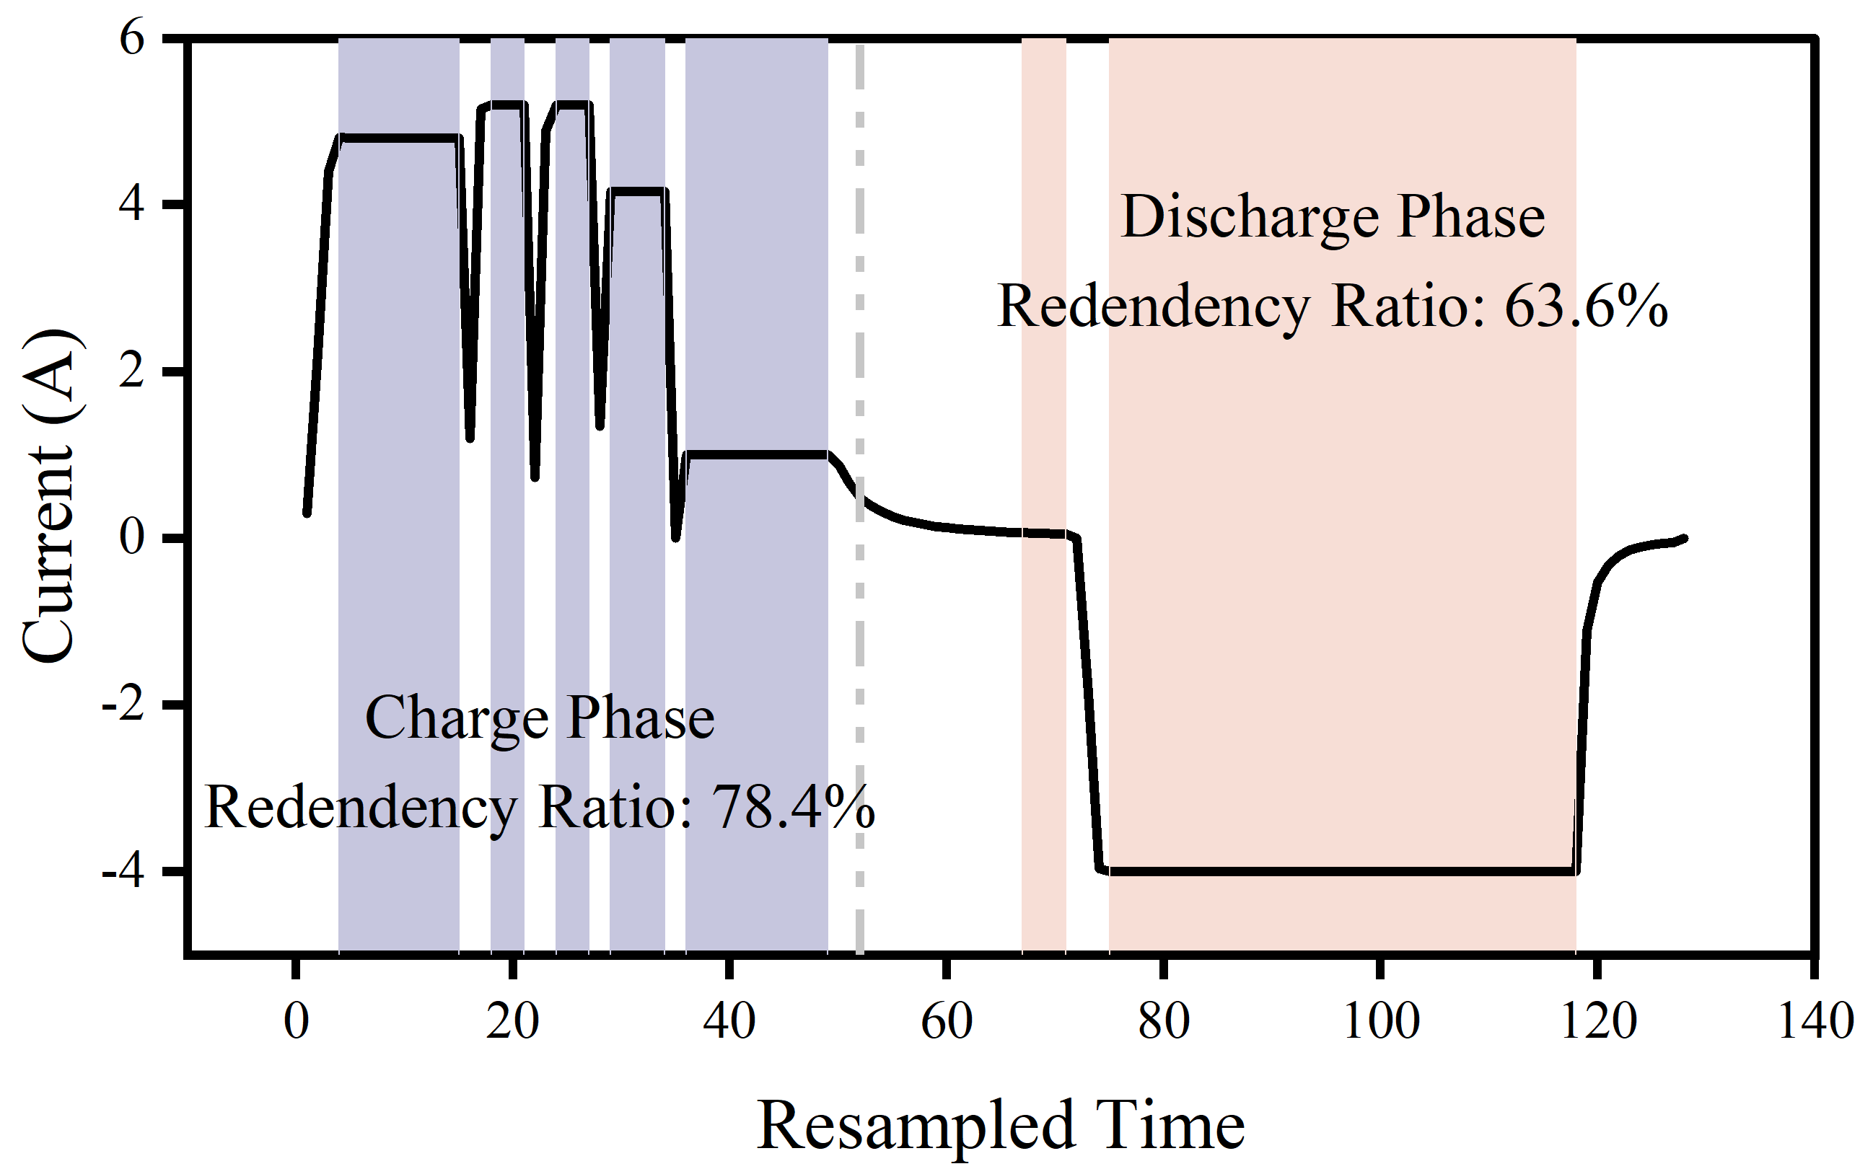
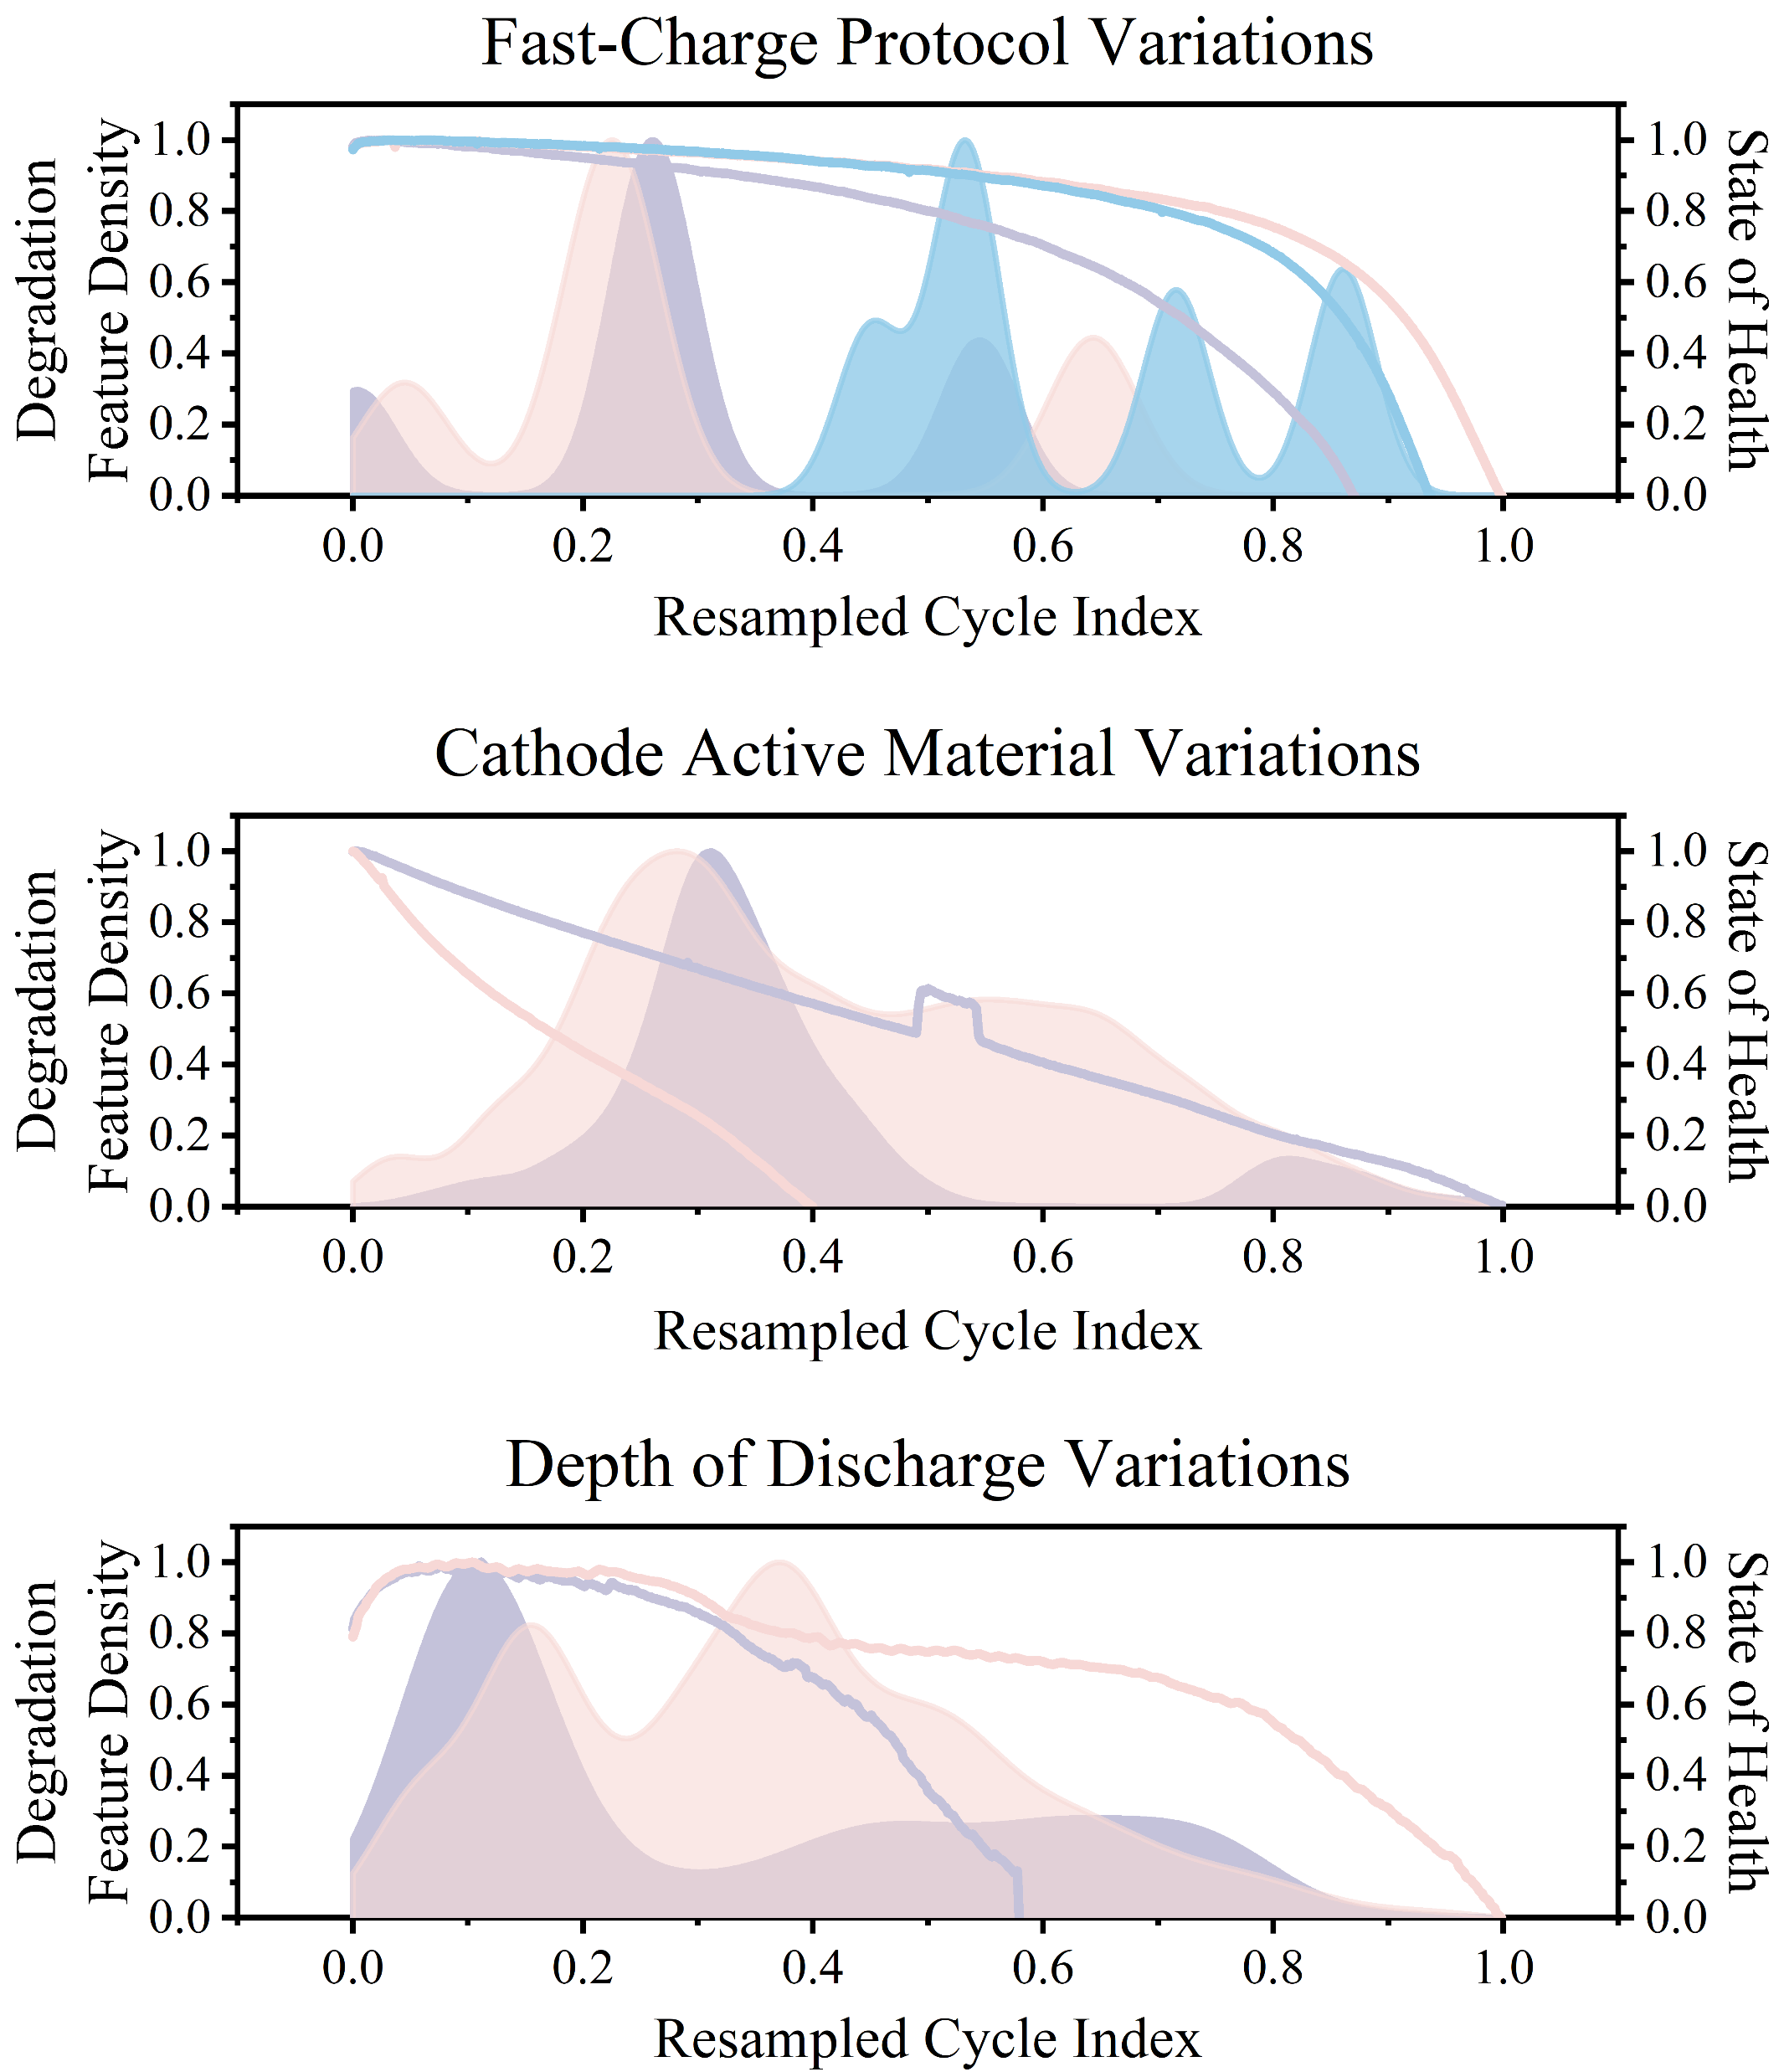
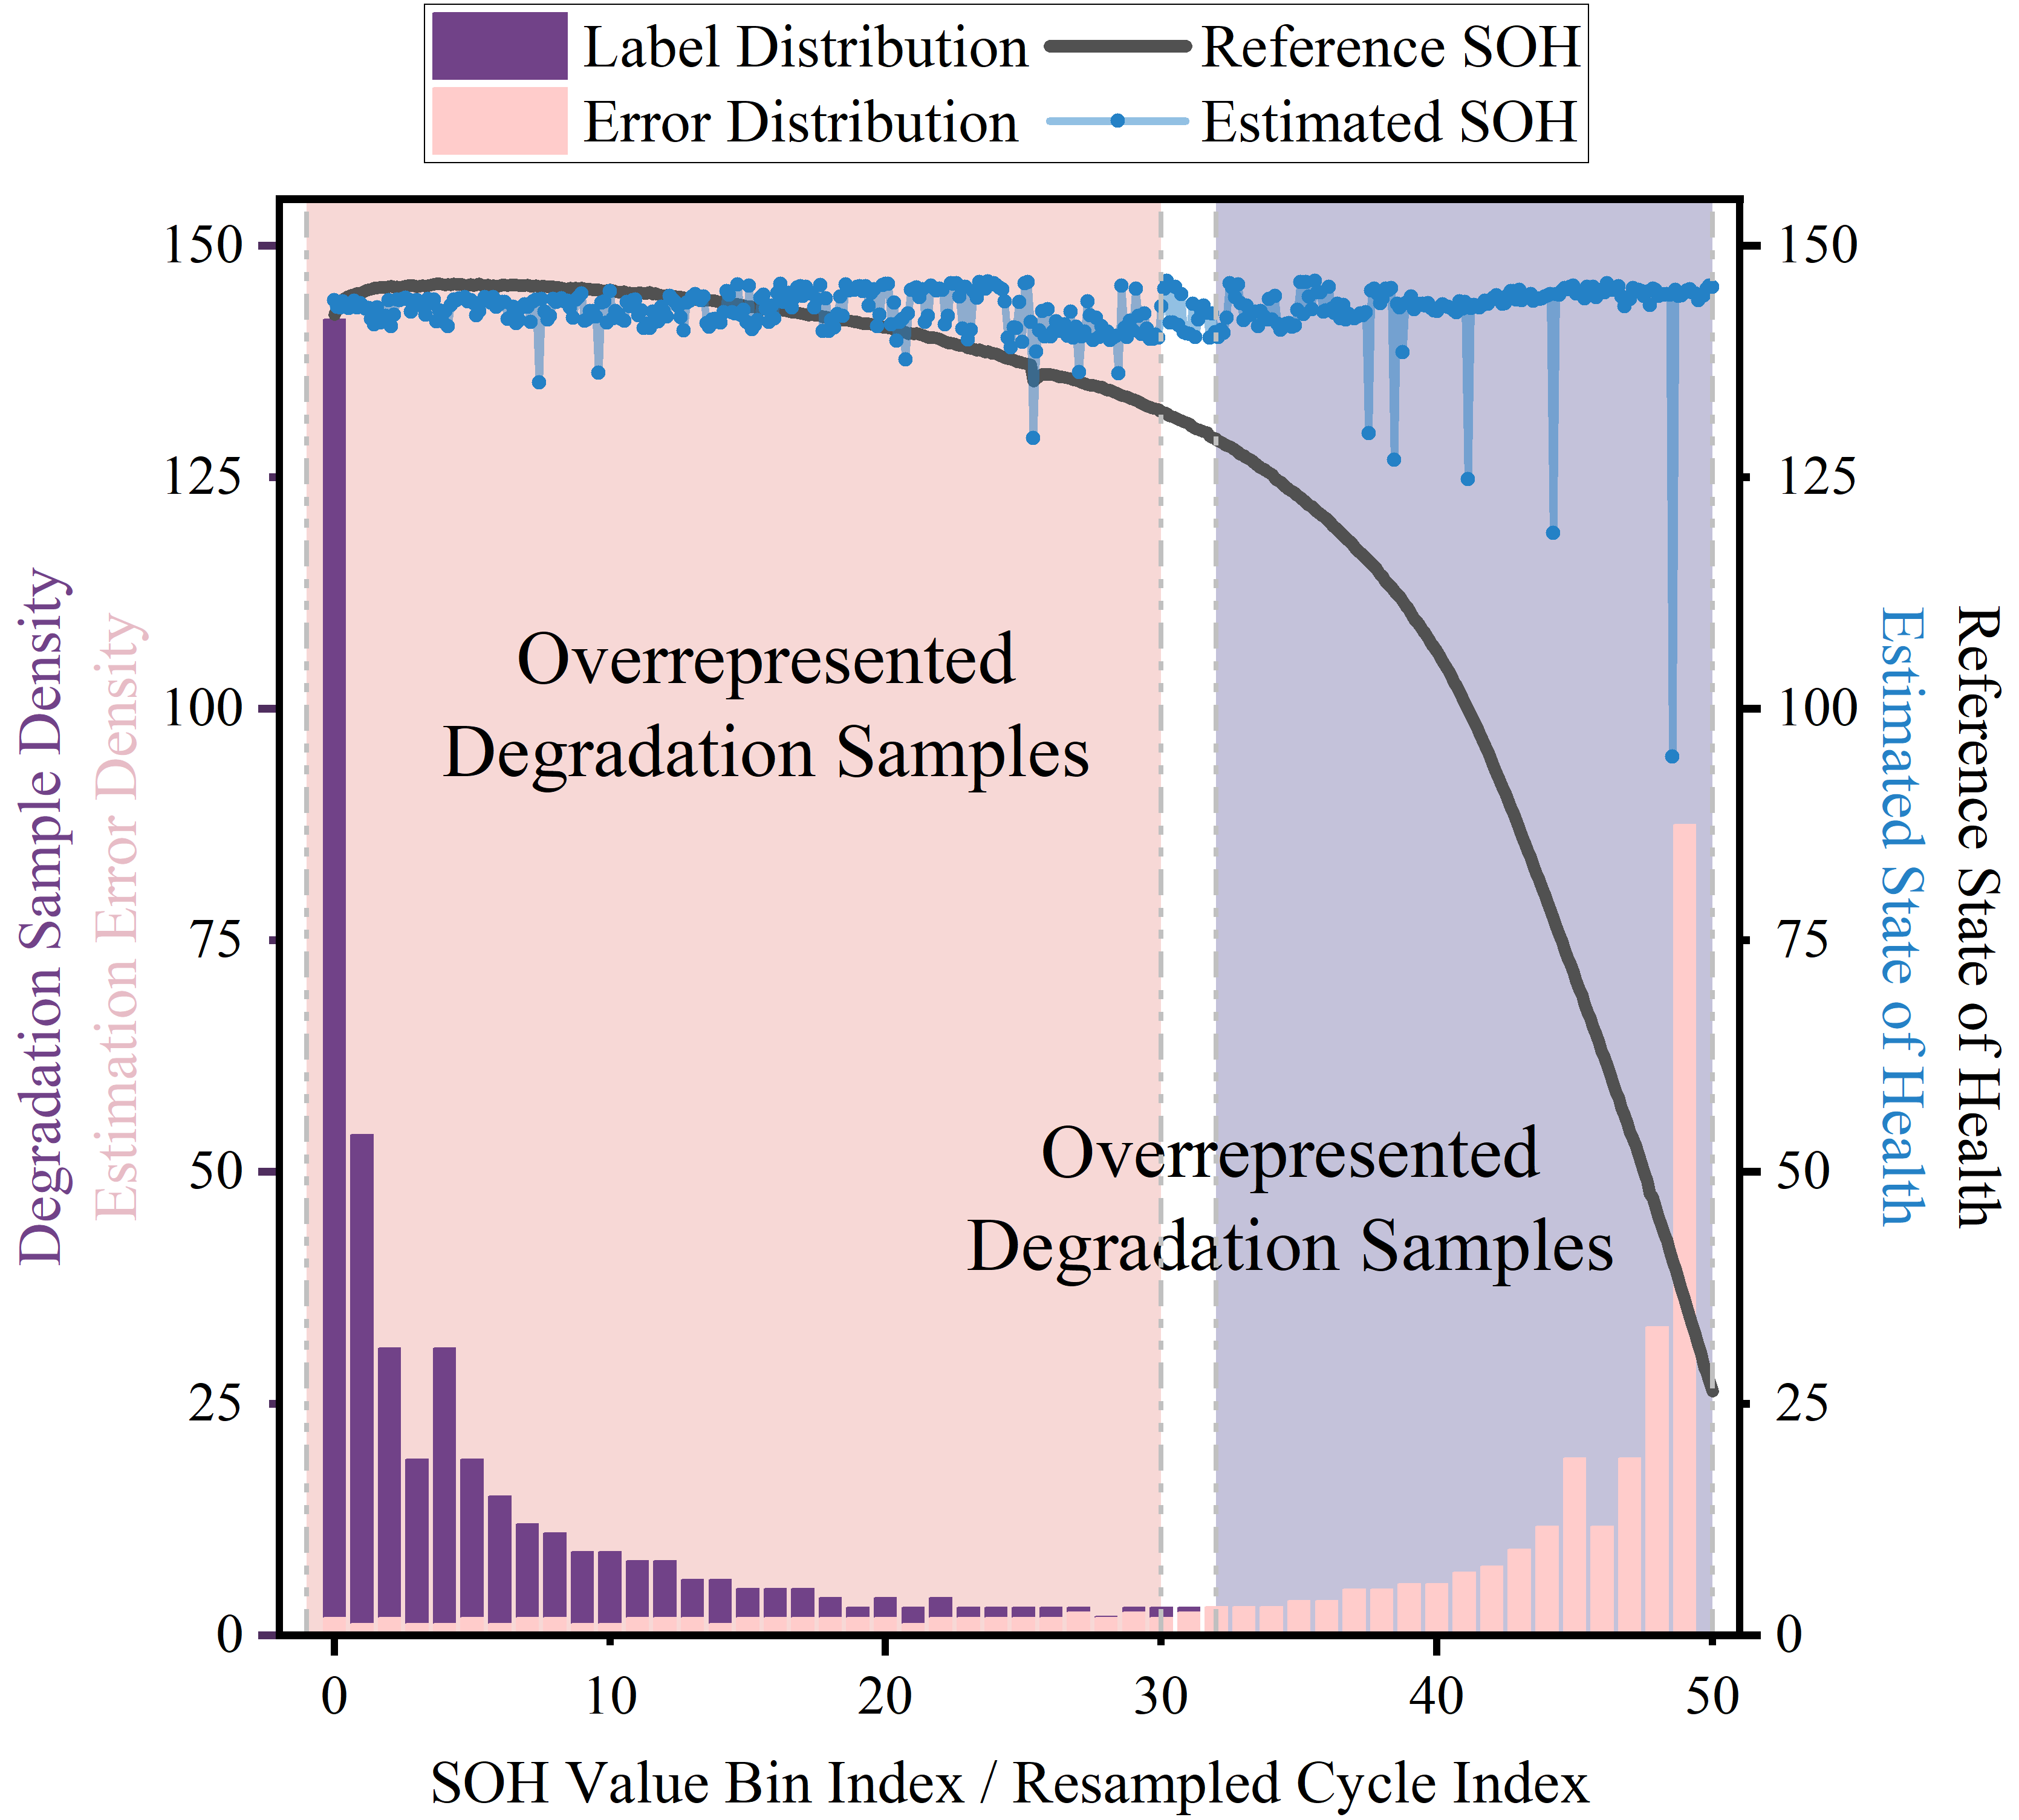



1)
2)
3)
1) Information Dilution
2) Manifold Fracture
3) Representation Overlap
3D Manifold
1D Manifold
2D Manifold
(a) Insufficient Spatiotemporal Coverage
(b) Domain Shifts-induced Statistical Uncertainty
(c) Long-tail Degradation Distribution

