Slide 1
LebTutors
The purpose of our project is to help both students and tutors in reaching out to each other.

Slide 2
HTML//CSS/JS
For the frontend, we used html to structure the website and added to it some fonts and colors by using css and js.

Slide 3
Django
We used Django for the backend…

Slide 4
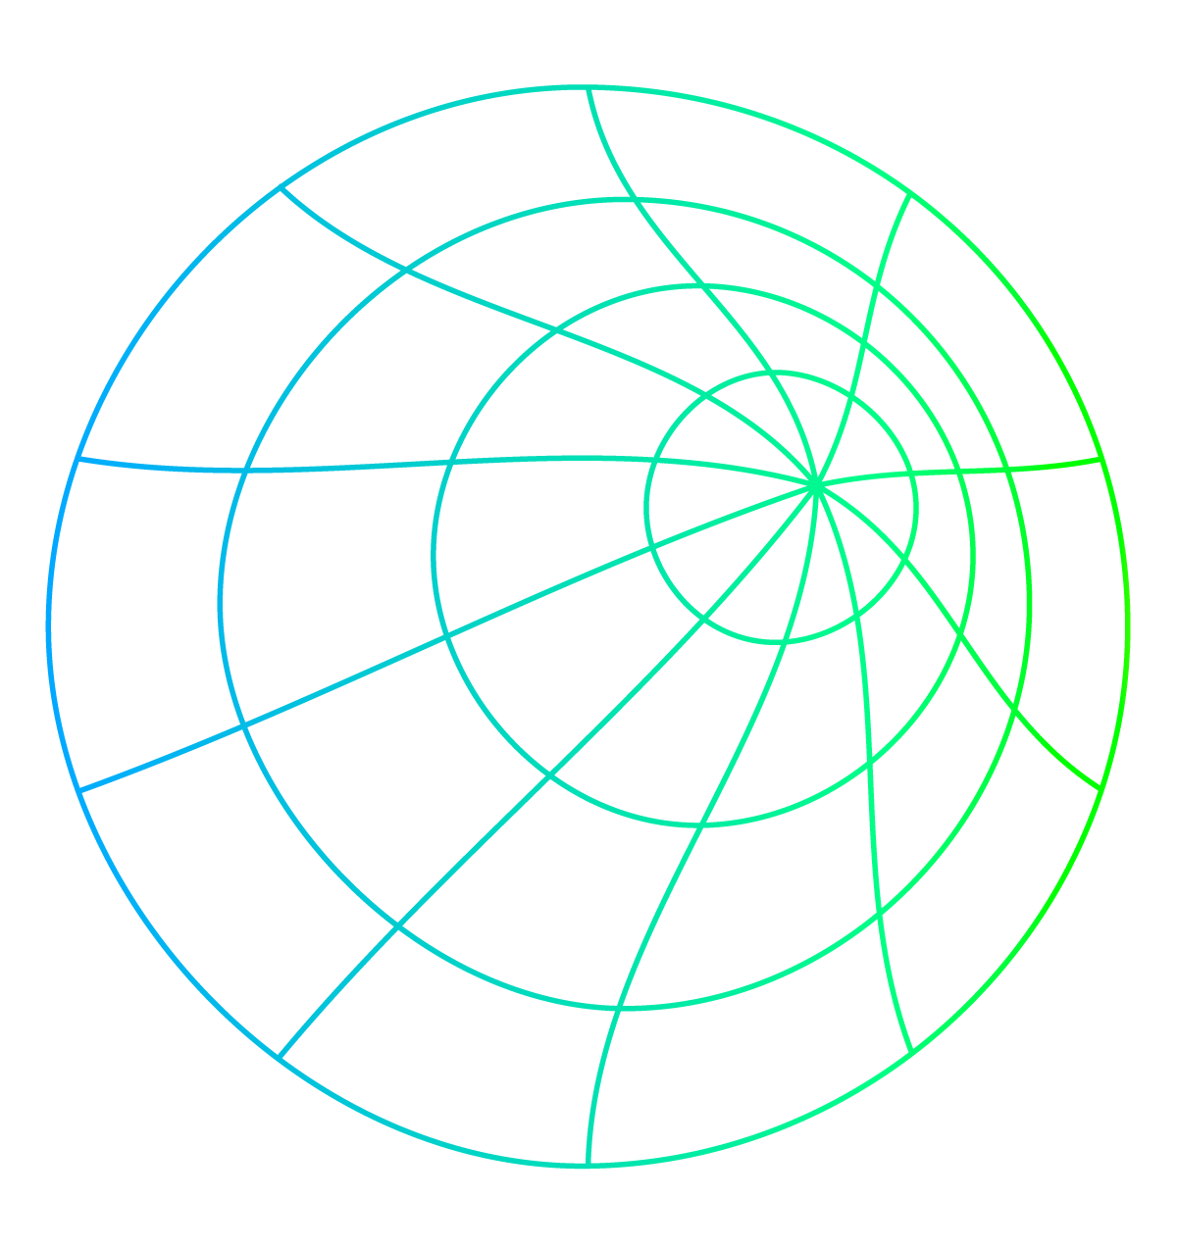

THANKS
Do you have any questions?
Please keep this slide for attribution

