Slide 1
Network Optional Warfare (NOW) Operational Concepts and Enabling Technologies
Don Brutzman
Information Sciences Department
Undersea Warfare Academic Group
Naval Postgraduate School
2 March 2014

Slide 2
A “bigger picture” is now emerging
New operational concept for communications,
command and control, sensing in littorals
Notes:
Critique is especially valuable now as we try to apply (technical + tactical) progress to (operational + strategic) challenges.

Slide 3
Original motivation
Major historical enablers of Naval power missing
Emissions Control (EMCON) for covert stealth
Semaphore and flashing light
Signal book has power: Nelson at Trafalgar
Independence within coordinated operations
Currently these appear to be lost capabilities
Many “practical” reasons for giving them up
… ALARM! … or maybe … OPPORTUNITY?
Notes:
Navy ships and aircraft are vulnerable to detection, tracking and targeting because they are constantly emitting detectable EM energy.

Slide 4
Definition: NCW
Network-centric warfare (NCW)
“Seeks to translate an information advantage, enabled in part by information technology, into a competitive advantage through the robust networking of well-informed geographically dispersed forces.”
“This networking—combined with changes in technology, organization, processes, and people—may allow new forms of organizational behavior.”
http://en.wikipedia.org/wiki/Network-centric_warfare
Notes:
Four tenets:
A robustly networked force improves information sharing;
Information sharing enhances the quality of information and shared situational awareness;
Shared situational awareness enables collaboration and self-synchronization, and enhances sustainability and speed of command; and
These, in turn, dramatically increase mission effectiveness.
Also:
Navy Network-Centric Warfare Concept: Key Programs and Issues for Congress
Congressional Research Service Report for Congress
Ronald O'Rourke Specialist in National Defense Foreign Affairs, Defense, and Trade Division Congressional Research Service, The Library of Congress Updated 31 May 2005
http://www.history.navy.mil/library/online/navy_network.htm

Slide 5
Working definition: NOW
Network Optional Warfare (NOW)
Vulnerabilities arise for naval forces conducting constant communications due to lack of stealth and dependence on continuous data exchange.
Emissions control (EMCON) and judicious use of low-probability of intercept (LPI) data channels can restore naval covertness and tactical surprise.
Data compression and a well-defined signal book can enable fluid operations across NCW and NOW, aiding command autonomy and freedom of action.
https://wiki.nps.edu/display/NOW/Network+Optional+Warfare
Notes:
NCW = Network-Centric Warfare

Slide 6
Sea change in naval strategy is under way
Imminent threats
Freedom of maritime operations, South Pacific
Budget pressures simply preclude status quo
Major strategic response: Flotilla concept
Bimodal fleet provides selective presence where needed, only use blue-water ships when decisive
Bimodal fleet supports maritime collaboration and gradated response in littoral operations
Must deeply integrate use of unmanned systems
Notes:
Careful choice of words: gradate. http://en.wiktionary.org/wiki/gradate#English
TODO: consider relevance to Air-Sea Battle

Slide 7
(Concluding) Wrap Up – The Real Transition
From Hughes and Kline briefing “Transitioning the U.S. Navy to the Twenty First Century,” 18 DEC 2013
The transition puts U. S. Navy in the missile age
It puts some of our combat eggs in many smaller baskets
Distributability is key:
Tactical for missile age combat
Operational for affordable presence anywhere, but not everywhere
Simpler designs. Smaller unit cost. Shorter lifetimes. Single functions. Rapid adaptation to change.
Exploits cyber and unmanned technology
Anticipates the impending Era of Robots
Success entails creating a cadre of professional sailors who know the technology and develop littoral doctrine & tactics

Slide 8
Command, Control and Networked Warfare
From Hughes and Kline briefing “Transitioning the U.S. Navy to the Twenty First Century,” 18 DEC 2013
This briefing is about ships. Aerial systems, scouting, C2, tactics, and combat doctrine are crucial, too
C2 Example: The littoral fleet can and should operate under a new concept: Network Optional Warfare
The current fleet is vulnerable to detection because NCW assumes constant, open radiations
Excessive communication is now baseline, EMCON a lost skill
Controllable comms (NOW operations) are achievable, with . . .
Digital flashing light and digital semaphore (QR codes) for LOS, LPI
A modern Signal Book for succinct tactical messaging ad in WWII
Doctrinal methods for semi-silent maneuver and cooperation
ROO/ROE should be SOP by all littoral ships and aircraft
Notes:
Acronymns:
NCW = Network Centric Warfare, being pursued because blue water Carrier Battle Groups, Expeditionary Strike Groups, and Surface Action Groups depend on constant radiation
EMCON = Emission Control, much discussed but rarely practiced.
NOW = Network Optional Warfare—using many means to stay silent and achieve surprise attacks, historically natural for submarines and practiced by coastal flotillas.
LOS = Line of sight connectivity.
LPI = Low probability of intercept technology.
ROO = Rules of operations: can be different for the flotilla and ASW, MCM, NGFS, and logistics ships.
ROE = Rules of engagement: there will be a sharp distinction between the tight, risky rules for peacetime confrontation and almost unconstrained ops locally, once conflict has started.
SOP = Standard operating procedures: tactics, techniques, doctines, and C2.

Slide 9
Strategic benefits as well
Low-cost escalation becomes practical rather than destabilizing reliance on high-stakes forces
Leading with carriers and submarines carries risk of immense economic, political costs if one is lost
… U.S. might win battle but lose the longer war
Flotilla + NOW conops can change the playing field
Shift economics of gradual escalation in our favor
Stabilizing: allies hold the asymmetric advantage
Notes:
Critique is especially valuable now as we try to apply (technical + tactical) progress to (operational + strategic) challenges.
For maximum impact, also need to look at how this changes the fleet’s logistics chain and further influences acquisition criteria for new systems.

Slide 10
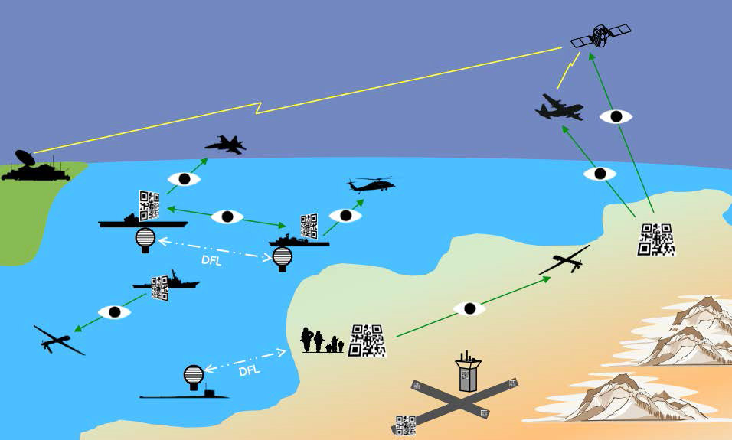
EMCON Signaling: OV-1 Operational View
https://en.wikipedia.org/wiki/Operational_View

Slide 11
NOW: Operational Concepts
See
accompanying
point paper
Problem statement
Technical opportunities
Communications
Sensing for contacts and navigation
Adaptive deployment
Tactical opportunities
Stealth, Surprise, Coherence, Uncertainty, Flexibility, Scalability
Notes:
This might evolve into an information dominance strategy, not just an operational concept.

Slide 12
Insight: transition space exists
NCW (transmit on) versus NOW (transmit off) initially appear to be completely disjoint
Useful to compare/contrast sharp differences
However, transition is also possible and useful
Quiet vessels, unmanned systems can still listen
Forward-deployed units will occasionally need to report critical new information
EMCON affects more than just comms and C2
Also changes message types, contacts, navigation
Notes:
For maximum impact, also need to look at how the NOW operational concept changes the fleet’s logistics chain and further influences acquisition criteria for new systems. (See research slides for examples.)

Slide 13
Information Transfer Considerations Net-Centric through Network-Optional Warfare
Operating mode | Net-Centric | Theater Broadcast | Unit Messaging | Net-Optional
Directionality | Full Multiplex | Send constantly | Receive all Send rarely | Line of Sight (LOS) or internal networks
Communications | Chatty, “internet” Relies on bandwidth EM vulnerabilities | Constant updates Monitor, receive Often-quiet circuits | Infrequent burst | EMCON, stealth
C2 | Synchronized Fully linked | OPORD transitions AIS, sharable info | Terse signaling Shared codebook | Loosely coupled command, ops
Messaging | Plethora of formats | Plain text primarily Some data needed | Rare compressed microburst | Low power for system endurance
Contact detects | Correlation, sharing | High-interest data IFFN, unknowns | Organic UVs and sensor nets | Passive EM, visual, acoustic, intel
Navigation | Many configurations Not a commodity | GNSS satellites LORAN-C (maybe) Time synchronize | A2AD response: availability report or fix queries? | Inertial, celestial, bathymetric, visual alternative sources
See
accompanying
matrix details
Netted operations not bimodal, rather a range of alternatives is available
Notes:
Longer detailed version of matrix is online

Slide 14
Optical signaling
Several emerging capabilities
provide enabling technology for NOW

Slide 15
QR codes for tactical signaling
Original concept: CRUSER Warfare Innovation Workshop
No single person, emerged from 5-person breakout session
Three theses (one external to NPS) explored potential use of QR code visual channel for streamed communications
Sophisticated but technically feasible data-flow channel
Camera is primary controlling factor for long range
Tactically important new applications are possible
FOUO page, soon to be refactored on NPS wiki
https://savagedefense.nps.navy.mil/qrcode

Slide 16
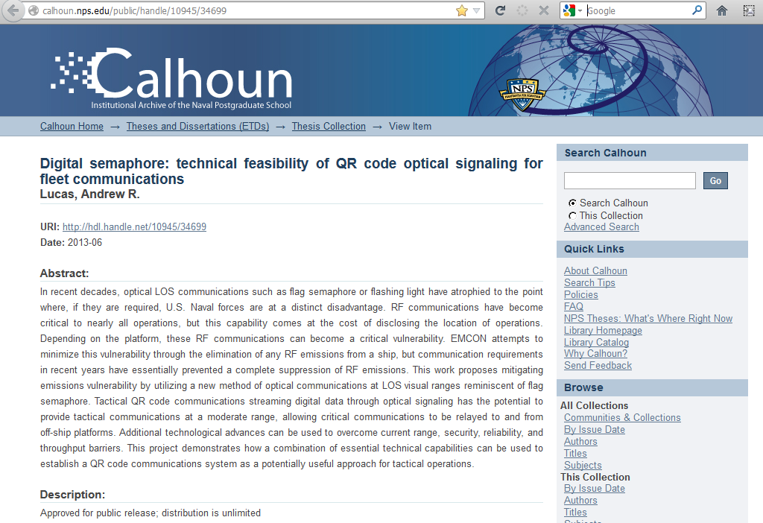

Slide 17
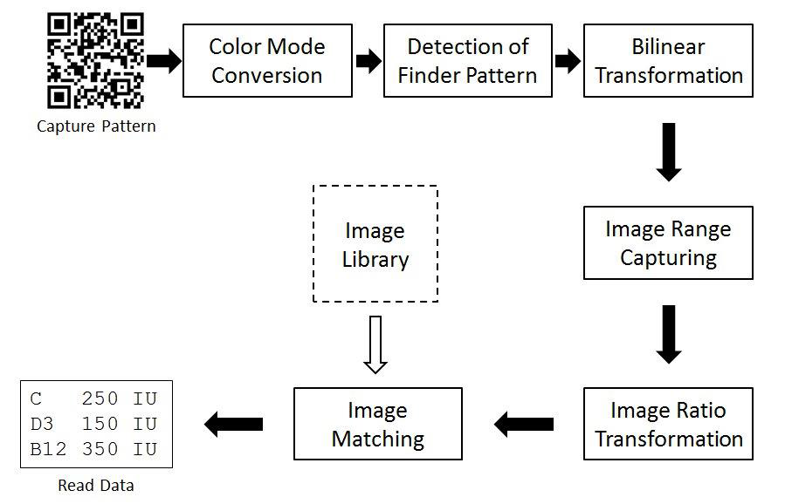
QR codes are easily readable
Summary: QR codes work
Major overlooked benefit: widely deployed infrastructure is already in place, worldwide

Slide 18
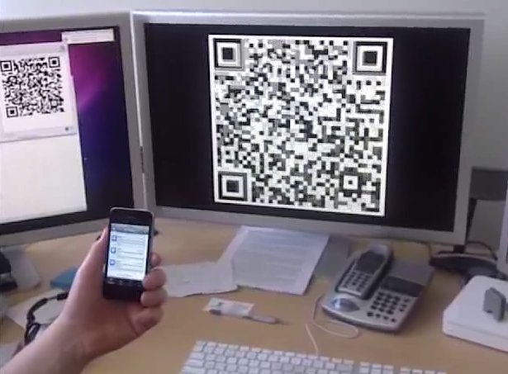
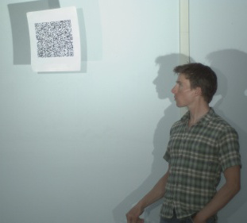
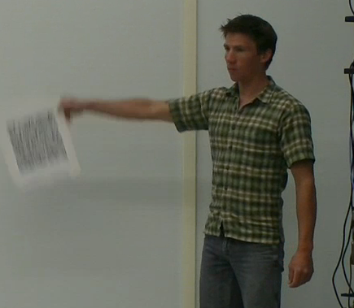
QR codes are streamable and capturable
Streaming Hamlet’s Soliloquy via QR codes
4K camera can de-blur imagery at 60Hz
Interlaced display is inherently distorted, but nearby handheld captured all text
4K video uses progressive display instead, allowing capture at far greater ranges
https://savagedefense.nps.navy.mil/qrcode

Slide 19
Many factors involved in optical capture
Thesis research by two officers with staff support worked over a year to discern all imaging factors
Data-flow diagram shows all critical relationships
Quite numerous and complex, but each separable
Insight: this is a general information channel
Nearly identical path for Digital Flashing Light (DFL)
Key question for operators is usually unchanged:
“How far can we read codes under current conditions?”
We’re building open-source Tactical Decision Aid (TDA) to determine maximum range and sensitivity factors

Slide 20
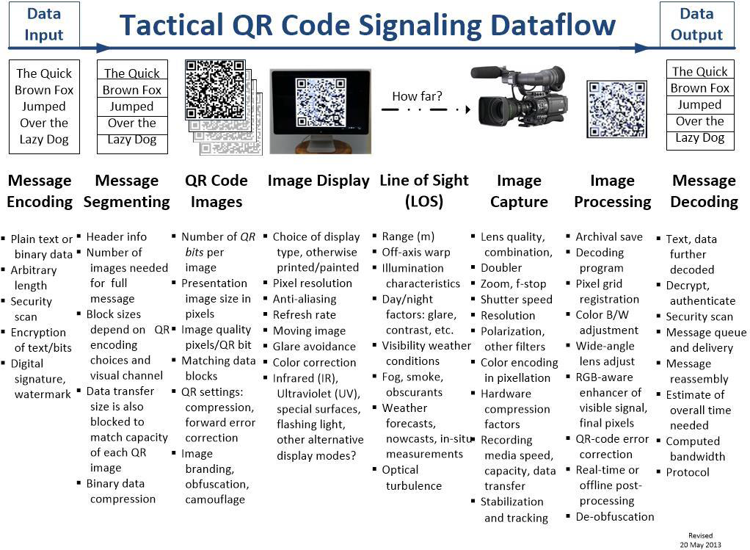
QR signaling is a general data channel

Slide 21
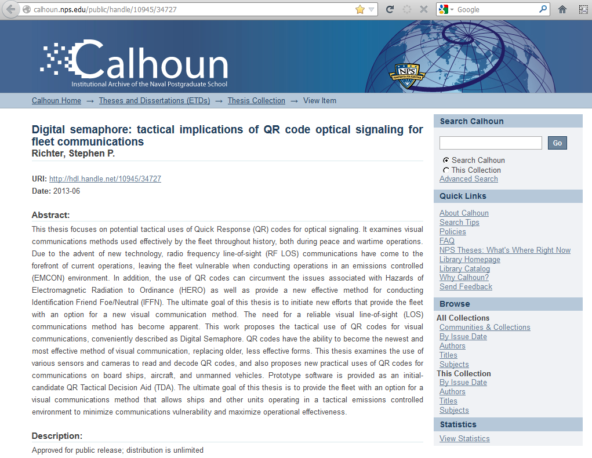

Slide 22
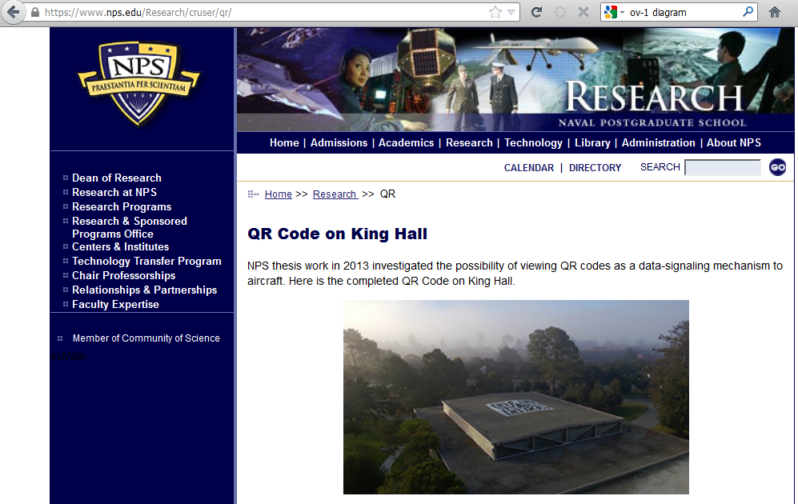
QR codes readable from above

Slide 23

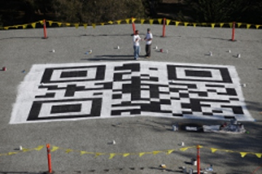
Hmmm, who can see this?
http://qr.nps.edu
http://zxing.appspot.com/generator

Slide 24
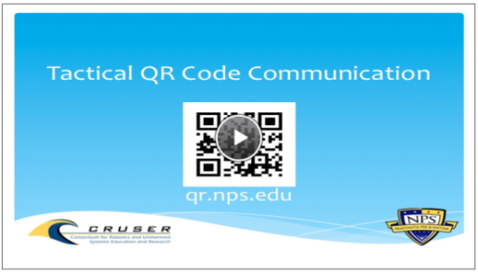
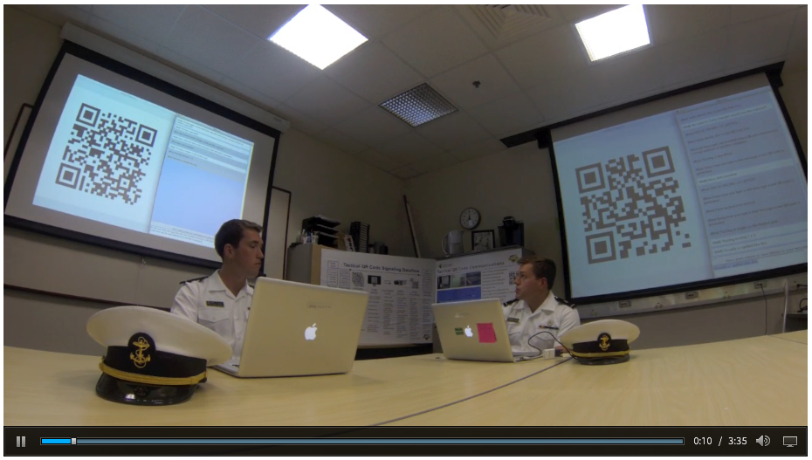
QR visual chat: no network
NPS team is building an open-source Tactical Decision Aid (TDA) to explore all factors

Slide 25
Research opportunities
Tactical + technical
Numerous candidate theses

Slide 26
Multiple candidate student projects
Hot topics continue to appear for multiple graduate theses, course projects, workshops, wargames, testing
Strategic approach is needed to explore all possibilities
“How might any given area of modern naval operations change with addition of EMCON and NOW capabilities?”
“How can NOW serve as organizing basis for flotilla concept of operations (CONOPS) situated in littorals?”
Possibly have begun a 10-year R+D campaign for NPS…
Goal: all the way from original concept to fleet deployment
Perhaps a “constellation” of theses painting a bigger picture?
Current and open topic summaries follow

Slide 27

EXI for bandwidth reduction
Efficient XML Interchange (EXI) for compressing XML
World Wide Web Consortium (W3C) Recommendation
Tighter compression + faster decompression
Keeps structure of data, helps semantic interoperability
Candidate benefits
Greater channel capacity for afloat Navy circuits
Efficiency improves power consumption, endurance
Supports terser structured messaging… new signal book
Perhaps EXI might also bridge NCW to NOW?
POCs: Don Brutzman, Scot Miller, Don McGregor
2 theses complete, work on 2 more has commenced

Slide 28
TDA for QR, Digital Flashing Light (DFL)
Continue project: Tactical Decision Aid (TDA) for QR/DFL
Open-source Java; initial version demonstrates QR chat
Now time to implement remainder of data-flow diagram for understanding visual-communications channels
Objective is to answer expected naval operator question:
“Can my unit use optical signaling in a given situation?”
Lots of well-defined work to implement and evaluate:
Digital Flashing Light (DFL) requirements are subset of QR
Define RFCs for Internet Protocol (IP) over QR and DFL
Test deployment at Camp Roberts, at sea with USVs
Can fleet repurpose, upgrade existing camera assets?
Prepare tech-transition deployment plan for fleet
Notes:
Selected for approval during 2014 OPNAV NPS Studies Program… but not on the funding list due to budget shortfalls.
RFC = Internet Engineering Task Force (IETF) Request for Comments (RFC), namely the peer-reviewed formal definition of a network protocol

Slide 29
Airport use of QR displays
Fixed codes on ground to provide automated feedback mechanism along flight path
Possibly averting avoidable crashes
Updateable displays along runways
Providing automated backup to pilots for avoiding wrong-turn (wrong-runway or -taxiway) errors
See relevant masters thesis by Chris Sokol, Embry-Riddle University
Extended NPS concepts in Electromagnetic Maneuver (em2) MMOWGLI game while working at STRATCOM
Notes:
Electromagnetic Maneuver (em2) MMOWGLI game described at https://portal.mmowgli.nps.edu/em2

Slide 30
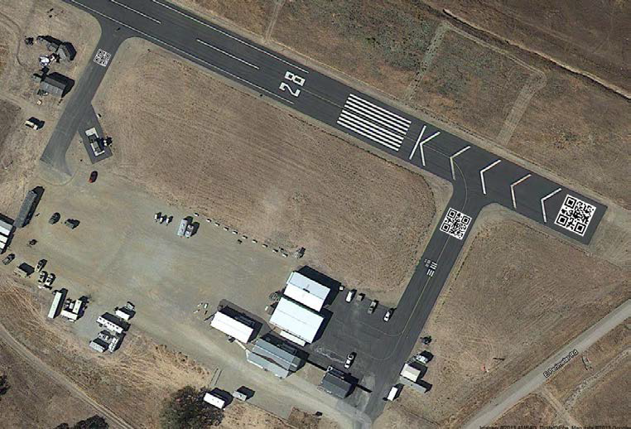
Add QR codes to MacMillan Airfield, Camp Roberts for CRUSER experimentation
proposed

Slide 31

Torrey Pines Logic
La Jolla company builds digital circuits, devices
Numerous products for optical or acoustic communications
often simple PCM at a single frequency, filtered
Examples: UNREP voice circuit, LOS voice/data etc.
Worth tracking, possibly adapting/evaluating in a variety of thesis research projects
http://tplogic.net

Slide 32
Laser: opportunities and concerns
Many great capabilities and variations emerging, but what work looks at problems, vulnerabilities?
How to consistently maintain a locked track?
Protections against dazzling or damage to eyes or EO/IR equipment?
How to determine maximum detectable distance that laser signal travels past receiver?
Can relay blimps receive covertly, without reflecting or revealing data transfer?
Does other work examine protections, precautions?

Slide 33
Celestial navigation using tablet?
Candidate technique, currently hypothetical:
Wave a tablet-computer camera from horizon to zenith for large section of night sky
Stitch together images to form a sky map
Needs precise time mark, computational capability
Probably need accurate azimuth? TBD
Insight: isn’t this equivalent to sextant readings?
If so, can get navigational fix without needing GPS or any special equipment
POCs: Ray Buettner and Don Brutzman
Notes:
Tablet computers include high-quality camera, sufficient computation to stitch imagery together and compute a fix, accurate time, and motion sensors.
TBD = to be determined

Slide 34
Ekelund ranging for robots?
Ekelund Range equations enable target tracking using passive sensor bearings
Own ship makes two bearing rate measurements, speed change across line of sight emulates effect of “crossed bearings” for range estimation
Commonly used by submarine sonars
“The Ekelund Range: A story of JO Innovation, Determination, and Communication” by JOC Michael Foutch, USN
http://www.navy.mil/navydata/cno/n87/usw/issue_15/ekelund.html
Applicable to UAVs in transit or on station?
Popup, perform dipsy doodle maneuver, return to deck
Passive EM or optical each appears possible
Has implications for design and construction of UAVs
Notes:
Notional.

Slide 35
Imperceptible signaling
QR streaming above ~20Hz appears solid grey
Japanese augmented reality (AR) company is modulating lighting at shopping mall stores to pop up location-specific displays on handhelds
Modulate characteristics for lighthouses or navigation buoys to transmit data streams?
Imperceptible to humans, not optical systems

Slide 36
Logistics changes: subtle but important
Flotilla operations using unmanned systems lead to a logistics support for a completely different order of battle
Tenet remains “fire effectively first” once hostilities start
Logistics chain becomes skinnier but also longer and wider
Much greater dispersal, not concentrated in supply ships
NOW reduces power consumption, improves endurance
On-board additive manufacturing (aka “3D printing”) and UAV delivery will offer significant resupply options
UV trucks (such as repackaged LCU) needed?
Acquisition changes also likely: for example, do we need different electro-optical sensors and signaling designs?
Broad investigation and analysis needed
Notes:
“Once started” = caveat that we do not expect to ever commence hostilities, but engage once they have started… by following Rules of engagement (ROE).

Slide 37
Looking ahead
Building out the bigger picture

Slide 38
Open Questions
Is there a larger “there” there, NCW versus NOW?
Mutually exclusive, or is there a transition area?
Information Transfer tables reveal a spectrum…
Lots of project work on new technical capabilities
Lots of strategic + tactical thinking needed
How to best execute evolution of comms channels, messaging, tactics, logistics, acquisition, and strategy?
(Much) more to follow…
Student engagement is important to “break trail”
Reactions and insights are always welcome!
Thanks for all contributions and comments received

Slide 39
NPS wiki space
Public repository for relevant resources
https://wiki.nps.edu/display/NOW/Network+Optional+Warfare

Slide 40
Contact
Don Brutzman, Ph.D.
brutzman@nps.edu
brutzman@nps.navy.smil.mil
http://faculty.nps.edu/brutzman
Code USW/Br, Naval Postgraduate School
Monterey California 93943-5000 USA
1.831.656.2149 work
1.831.402.4809 cell

