Slide 1
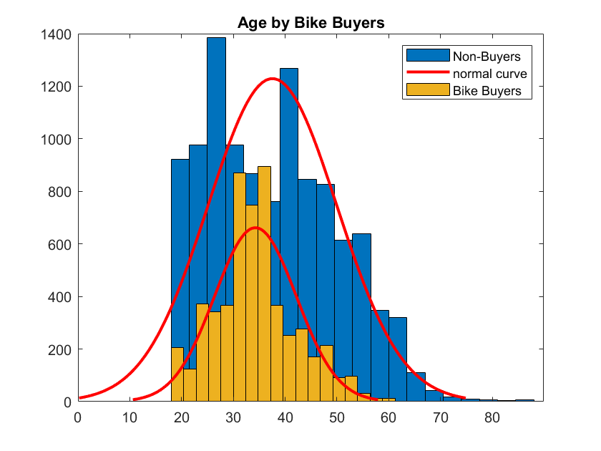
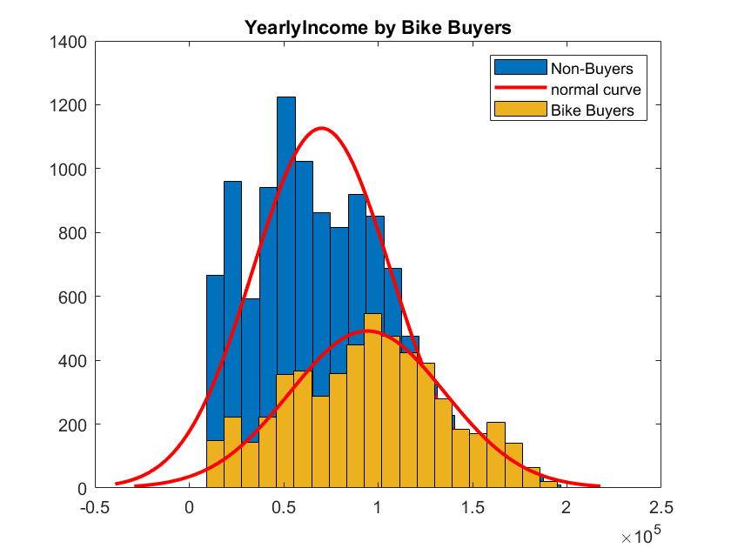
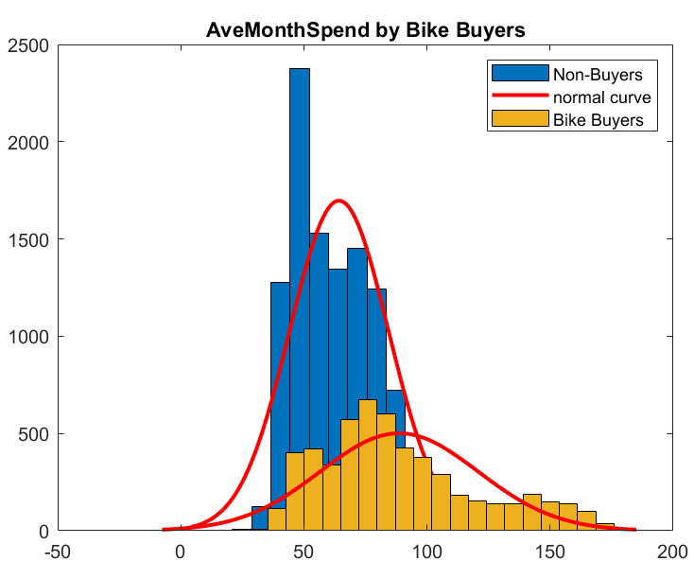
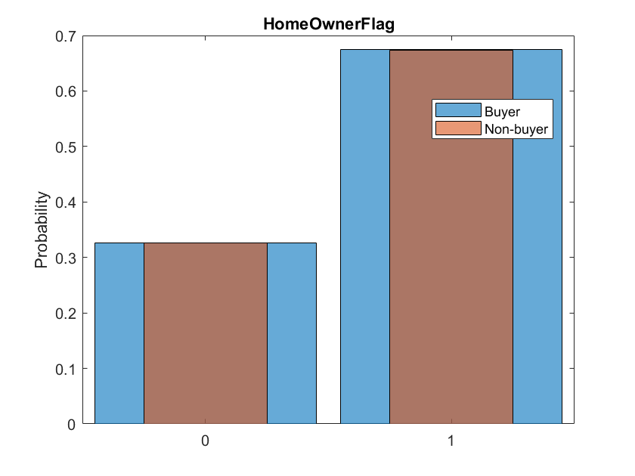
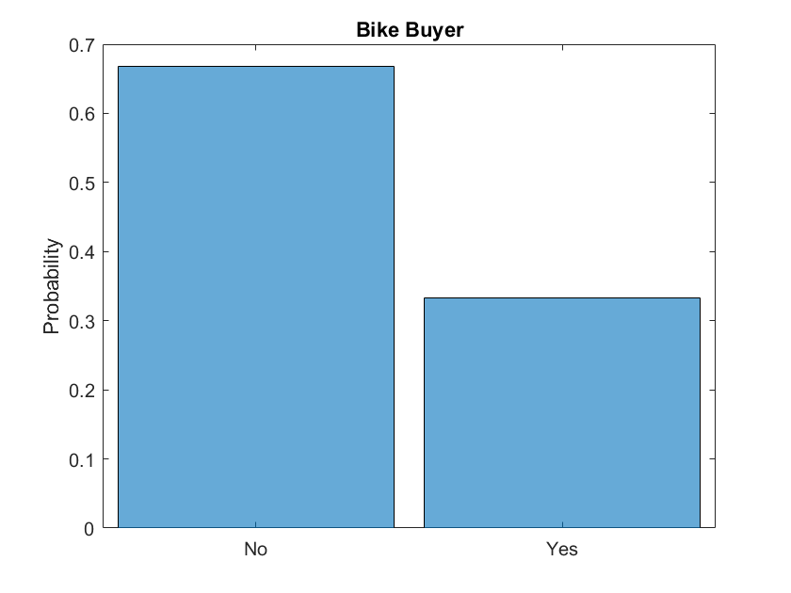
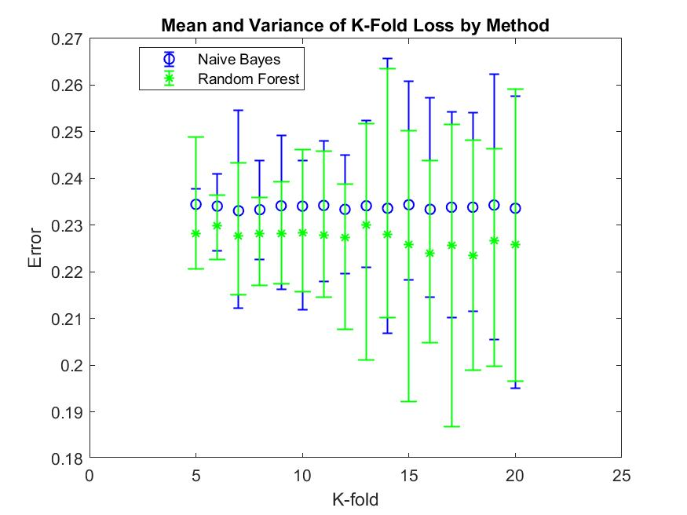
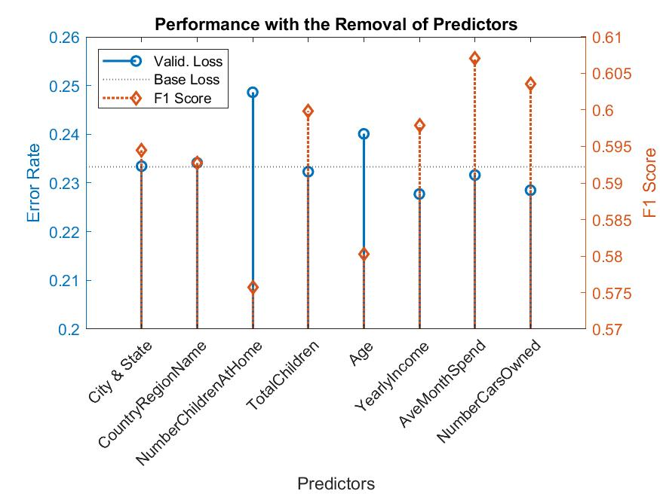
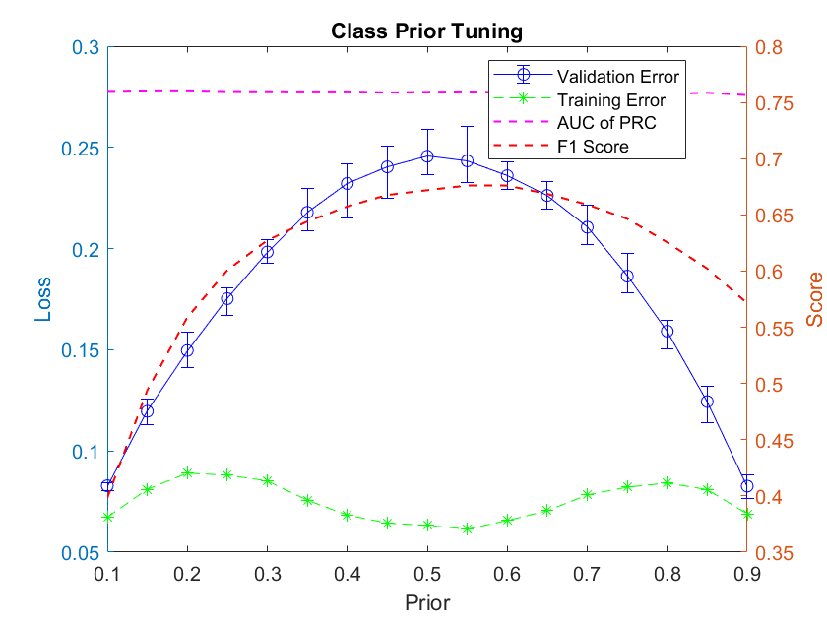
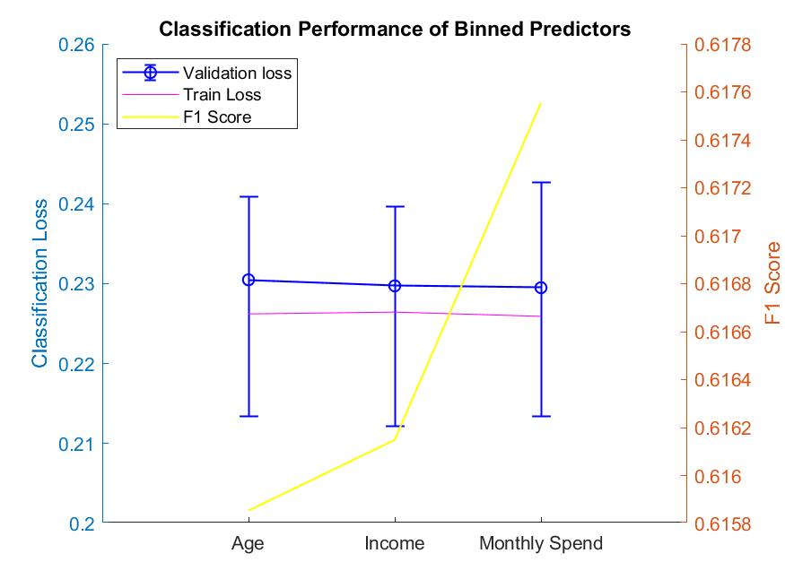
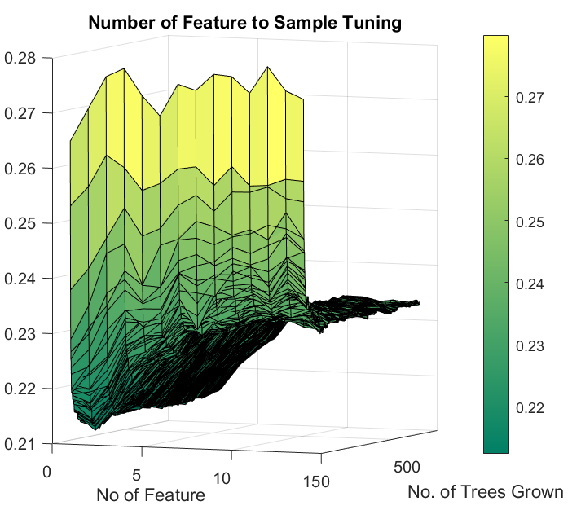
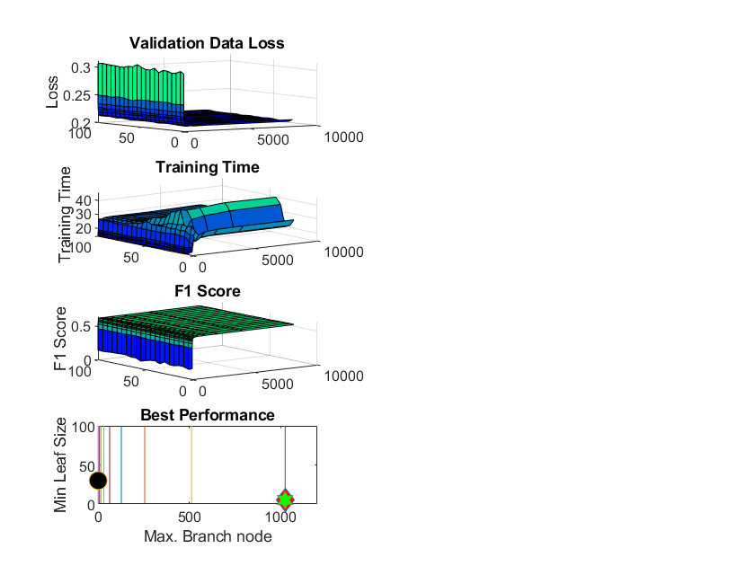

Application of Naïve Bayes and Random Forest on Classification of Potential Bike Customer
Problems & Motivation:
To predict and classify potential bike buyers from the existing customer database of a company based on the given demographic features such as age, accommodation, income, gender etc.
To compare the performance of two classification algorithms (Naïve Bayes & Random Forest) on binary class classification based on a preliminary classification model analysis conducted by S. Jaya Prada
Description and Initial Analysis on Data Source:
3 Datasets imported from Kaggle as dataset of Microsoft EDX competition and merged into one dataset with 16400 observations.
Data wrangling done in Python, including removal of duplicate identity/ information of customers, derivation of Age from Birth Date, removal of messy features e.g. detail address, Customer ID etc.
The merged dataset consists of 14 predictors (8 categorial & 6 numeric) and 1 labelled binary class
Dataset is slightly imbalance with 66% non-buyers
Age & Monthly Spending in company shows slightly negatively skewed distribution, while age of bike buyers are normally distributed. However, age does not show noticeable difference between two distributions. Yearly Income are normally distributed. Distributions of different classes overlays.
Other numeric predictors, as non-negative integers, are pre-dominant by 0
Uniform distributions observed among Martial Status & Gender
Distribution of Home Owner Flag against buyer and non-buyer is similar
Pre-dominance of a few locations in City/ State Province features
Buyer | Mean |  | Std |  | Skewness
 | Yes | No | Yes | No | Yes | No
NumberCarsOwned | 1.77 | 1.37 | 1.30 | 1.02 | 0.24 | 0.34
NumberChildrenAtHome | 1.97 | 0.50 | 1.82 | 1.03 | 0.33 | 2.45
TotalChildren | 2.56 | 1.73 | 1.77 | 1.56 | -0.10 | 0.59
YearlyIncome | 94271 | 70097 | 41137 | 36439 | 0.02 | 0.46
Age | 34.3 | 37.5 | 7.9 | 12.4 | 0.47 | 0.42
AveMonthSpend | 88.68 | 64.28 | 32.10 | 20.08 | 0.72 | 1.37
Naïve Bayes (NB)
A simple classifier that built upon Bayes’ rule of conditional probability (Assume class prior probability) and calculate the posterior probability
Adapt a naïve approach that all predictors are conditionally independent
Decision-making based on class with highest posterior probability
Pros ⁽²⁾
As independent variables are assumed, only the variances of the variables for each class need to be determined and not the entire covariance matrix
Short training time and can handle both categorical and numeric predictors
Requires a small amount of training data to estimate the parameters
Cons
Sensitive to training dataset
“ Zero Conditional Probability Problem” that wipes away the joint probability from other predictors ⁽⁵⁾
Random Forest (RF)
Random forests are a combination of ensembled decision trees where randomness is accomplished by bootstrapping (sampling with replacement) from the training dataset
A subset of predictors is selected to consider at the node of each decision tree.
Splitting criteria based on impurity such as entropy, information gain and Gini index
Final classification based on the majority voting of trees.
Pros
Bagging and boosting are classic ensemble learning techniques, which demonstrated handling class imbalanced problem effectively ⁽¹⁾
Can handle both categorical and numeric predictors ⁽⁴⁾
Averaging several trees reduces risk of overfitting
Cons
Time Consuming to train the models and computational expensive
Less interpretable than decision tree and Naïve Bayes
Review of
Two Classification Methods
Hypothesis Statement
As per previous researches, it is proposed that demographic features including Region, Age, Number of Vehicle Owned, Education, Marital Status demonstrate predictability in classification ⁽³⁾
Due to ensemble and bagging methods, Random Forest is expected to handle imbalance dataset better than Naïve Bayes and to be more accurate, specifically in the classification of Bike Buyers.
Evaluation Methodology & Performance Measurements
As suggested by Prada, 20% of the data are left for final validation. 13120 observations are used for training.
Models parameters and hyperparameters are tuned to fit in the data. Details as follows.
Features are selected based on correlation and by summing the change of risk due to spilt on every predictor (RF)
K-fold cross validation (optimal K=8 as in right chart) to calculate generalization error to reduce the variance of training errors and to reduce the dependency on single set of training data.
Overall model performance are assessed by validation error and training time
As target is to identify potential bike buyers, F1 Score will be used to measure the performance of positive prediction among the slightly imbalanced dataset
Parameter Tuning and Experimental Results
Naïve Bayes
Parameter
Additive smoothing adapted for categorical predictors to reduce impact of Zero Conditional Probability
Appropriate probability density and bandwidth ⁽⁵⁾ ⁽⁷⁾
Tune the Class Prior/ Weighting⁽⁸⁾
Best Experimental Results
Kernel distribution, kernel type: box (Width= 0.1294)
Age: Fixed-interval age bin (interval=4)
Yearly Income: Fixed bin (bin=12)
AveMonthSpend: Fixed bin (bin=20)
Class Prior ([0,1]) = [0.17 0.83]
Discussion and Further Analysis
Classification of positive class is improved at the expense of negative class accuracy
Tuning class prior gives best improvement, followed by discretization and kernel density tuning
Removal of highly correlated predictors reduce error
Random Forest
Parameter
Number of learning cycles/ trees grown
Split criterion to split nodes
Number of predictors to select randomly in each split
Tree depth – Max. number of node & Min. observation in leaf
Tune the Class Prior/ Weighting
Best Experimental Results
Number of tree = 800 & split by Cross Entropy
Number of predictors in each split=2
Max. branch node= 1024, Min. leaf size = 5
Class Prior ([0,1]) = [0.27 0.73]
Discussion and Further Analysis
Significant improvement by tuning tree depth and class weight
In feature selection, the error rate is constant when adding the 6-8th, and 9-14th importance predictors.
City is the most important predictors, followed by Yearly income, age, monthly spending & no. of children
 | Training Loss | Validation Loss | Val. F1 Score | Val. AUC - PRC | Final Test Loss | Final F1 Score | Final AUC
NB | 20.02% | 21.01% | 62.58% | 70.41% | 23.90% | 56.0% | 63.77%
RF | 8.06% | 19.62% | 65.28% | 78.56% | 19.64% | 64.91% | 77.40%
Critical Evaluation and Analysis on the Result
Align with hypothesis statement, Random Forest (RF) performs better than Naïve Bayes (NB) in terms of overall accuracy and positive prediction, as reflected by F1 score and Area Under Curve of precision-recall curve.
Results demonstrates that RF, as like tree models, is a high variance, low bias model which is prone to overfitting. Yet bagging and averaging across multiple trees reduces risk. Random selection of predictor in each split also reduces correlation between trees. In contrast, NB is a comparatively high bias, low variance model due to small variations of training & validation loss.
Results show all predictors have positive impact on the performance of both models, whereas removal of any predictor increase generalization error. This align with previous assessments that demographic profiles were associated with buying behaviour. Our results also suggest NB, with assumption in predictor independence, perform better when highly correlated predictors are removed.
Our results shows that in an imbalanced dataset, class prior is considered as a crucial parameter in tuning model, as model tended to oversampled from the majority class and likely to inaccurately predict minority class. In our result, both model improves significantly after adjusting the class weighting, compared with impact of other tunings.
NB works well with skewed numeric predictors, as it captures uncertainties in full probability density with different kernel functions and probability distributions ⁽⁵⁾. In this study, optimizing the kernel density, type and bandwidth impose another noticeable improvement in accuracy. On top of that, discretizing numerical features improves our performance by avoiding assumption in detailed underlying distributions ⁽⁷⁾. Adjusting k-interval or fixed number of bin also prevents information loss from over-generalized kernel functions, with a slight trade off in training time.
An interesting result is RF does not produce far better result than NB. This implies weak RF classifiers as the accuracy and strength of classifier drops sharply after number of predictors in each split >2. This may attribute to the overlaying distributions/ weak difference of input variables between two classes ⁽⁹⁾ .
Some RF predictors did not add accuracy to model when combined with other predictors at number of predictors in each split=1. This implies similar noises among those predictors and the importance of first 5 predictors. Results suggest that RF is robust to noise as the increase of error rate do not double with addition of similar predictor.
While NB manage noises of data by kernel function & discretization, RF manage noises by tree depth with pruning. In this study, RF minimized noises by setting node=1024 and leaf size =5 to control noises at the expense of higher training time.
RF Tree Depth Tuning
Future Work and Lesson Learned
NB is a fast and simple model that works better with independent predictors. Model tunings are likely on how to process data and approach probability distributions through feature engineering and hyperparameter tuning. RF is a complex model by minimizing correlations between trees. Model improvements are often made by tuning the RF parameters and improving the algorithm.
Future work on handling imbalanced dataset– adapt different state-of-art approaches to adjust class prior e.g. SMOTE, ADASYN and to ensure balanced information from all classes ⁽¹⁰⁾
Future work on NB – Discretise numeric distribution to minimize noise and outliners, while finding suitable way to produce an accurate kernel probability density. ⁽⁸⁾
Future work on Random Forest – Investigate in correlation between trees and evaluate methods giving strong but low correlated trees e.g. Cluster approach to identify uncorrelated trees ⁽⁴⁾
⁽¹⁾ M. Galar, A. Fernandez, E. Barrenechea, H. Bustince and F. Herrera, "A Review on Ensembles for the Class Imbalance Problem: Bagging-, Boosting-, and Hybrid-Based Approaches" in IEEE Transactions on Systems, Man, and Cybernetics, Part C (Applications and Reviews), vol. 42, no. 4, pp. 463-484, July 2012,
⁽²⁾ D. Doreswamy, K.S. Hemanth, "Performance Evaluation of Predictive Classifiers for Knowledge Discovery from Engineering Materials Data Sets.“ in Artificial Intelligent Systems and Machine Learning [Online], vol 3.3 , pp. 162-168, 2011
⁽³⁾ J.F. Sallis, T. L. Conway, L. I. Dillon, L. D. Frank, M. A. Adams, K. L. Cain, B. E. Saelens, “Environmental and demographic correlates of bicycling” in Preventive Medicine, vol. 57, Issue 5, pp. 456-460, 2013, doi: 10.1016
⁽⁴⁾ A. Chaudhary, S. Kolhe, R. Kamal, An improved random forest classifier for multi-class classification. Information Processing in Agriculture. 3, 215–222 ,2016
⁽⁵⁾ K. Pouria, D. Sunita. “Short Survey on Naive Bayes Algorithm” in. International Journal of Advance Research in Computer Science and Management, vol. 04, 2017
⁽⁶⁾ S.J. Prada, “BIKE BUYER PREDICTION” in. International Journal of Computer Engineering and Technology, vol. 11, issue 3, pp. 45-55, 2020
⁽⁷⁾ Y. Ying & W. Geoffrey, " Discretization for naive-Bayes learning: Managing discretization bias and variance " in Machine Learning, vol. 74, pp. 39-74, 2009, doi: 10.1007/s10994-008-5083-5.
⁽⁸⁾ K.M. Schneider, “Techniques for improving the performance of naive Bayes for text classification” in Gelbukh A. (eds) Computational Linguistics and Intelligent Text Processing, vol. 3406, 2005
⁽⁹⁾ L. Brieman, “Random Forest” in Machine Learning, vol. 45, no. 1, pp. 5-32, 2001
⁽¹⁰⁾ Haibo He, Yang Bai, E. A. Garcia and Shutao Li, "ADASYN: Adaptive synthetic sampling approach for imbalanced learning," 2008 IEEE International Joint Conference on Neural Networks (IEEE World Congress on Computational Intelligence), Hong Kong, 2008, pp. 1322-1328, doi: 10.1109/IJCNN.2008.4633969.

