Slide 1

Data Science Skills ”which are the most valued data science skills”

Slide 2
Contents
Methodology
Demographics
Languages
Databases
Platforms
Web Frames
Development Environments
Operating Systems

Slide 3
Methodology
Datasets
Engineering
Database
Discover &
Visualize
Present
findings

Slide 4
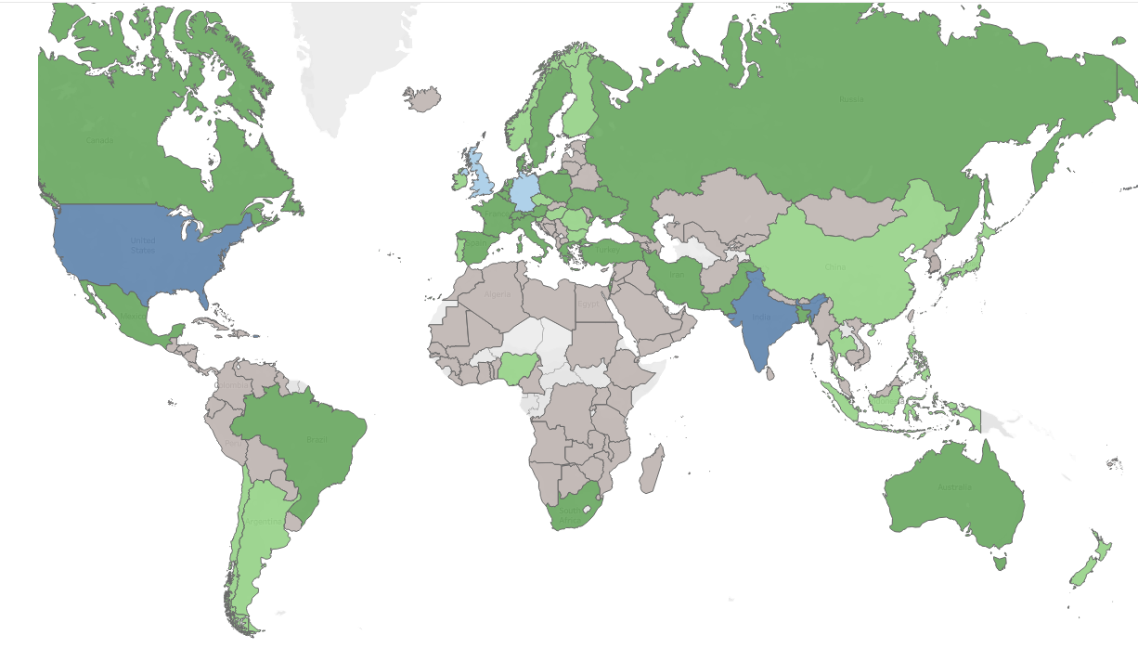
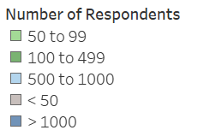
Demographics - Countries
US
India
Turkey,Iran
Pakistan

Slide 5
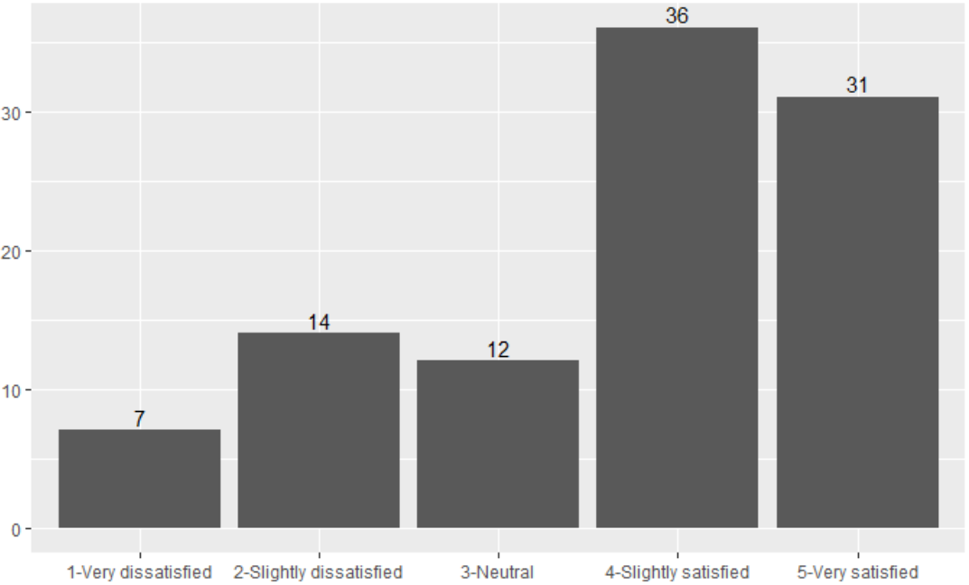
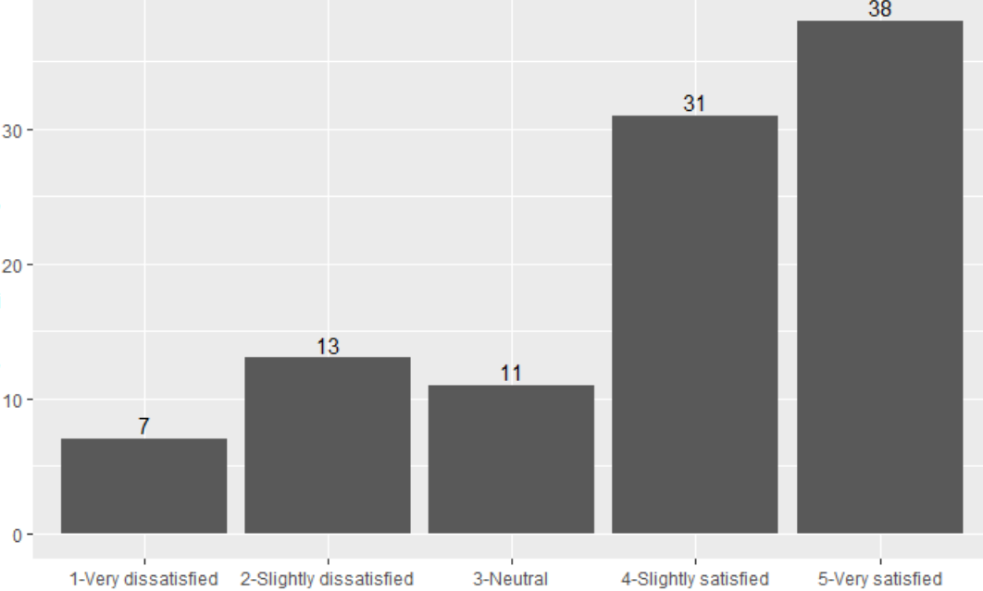
Demographics – Job Satisfaction
Medium response
(countries with 100 – 999 respondents)
High response
(countries with over 1,000 respondents)
Percentage
Satisfaction
Satisfaction

Slide 6
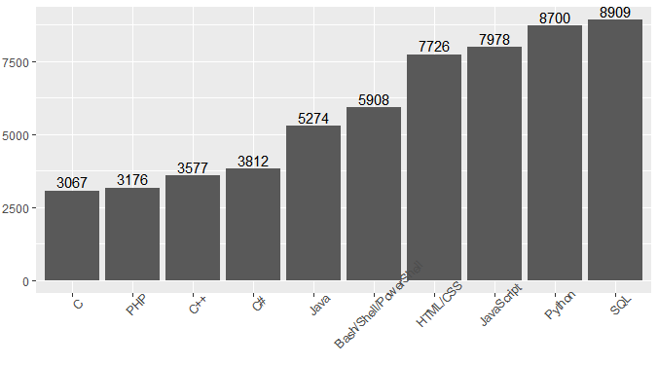
Languages
Most Commonly Used Languages

Slide 7
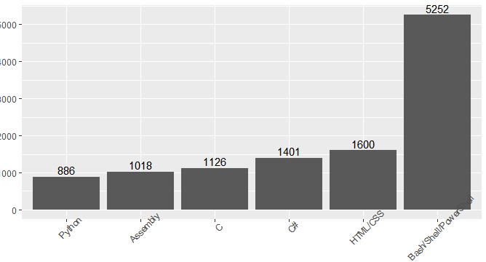
Languages
#1 Preference for Language

Slide 8
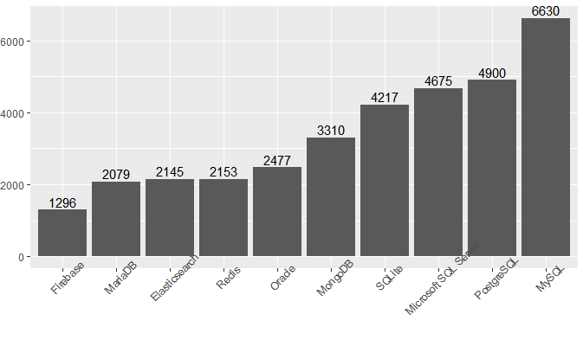
Databases
Most Commonly Used Databases

Slide 9
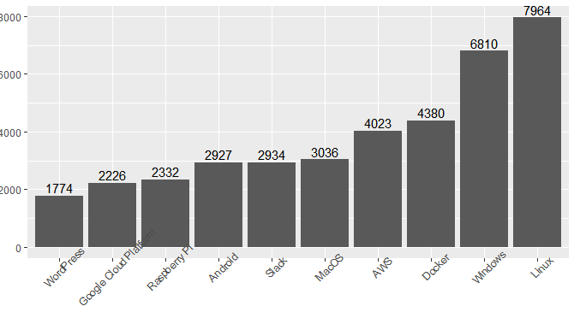
Platforms
Most Commonly Used Platforms

Slide 10
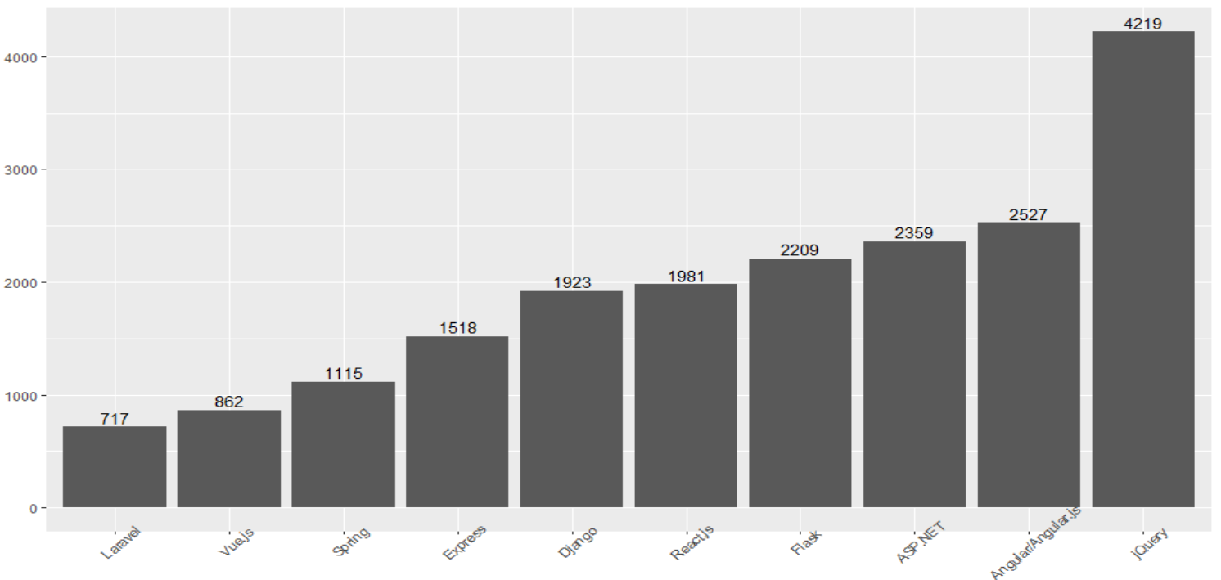
Web Frames
Most Commonly Used Web Frames

Slide 11
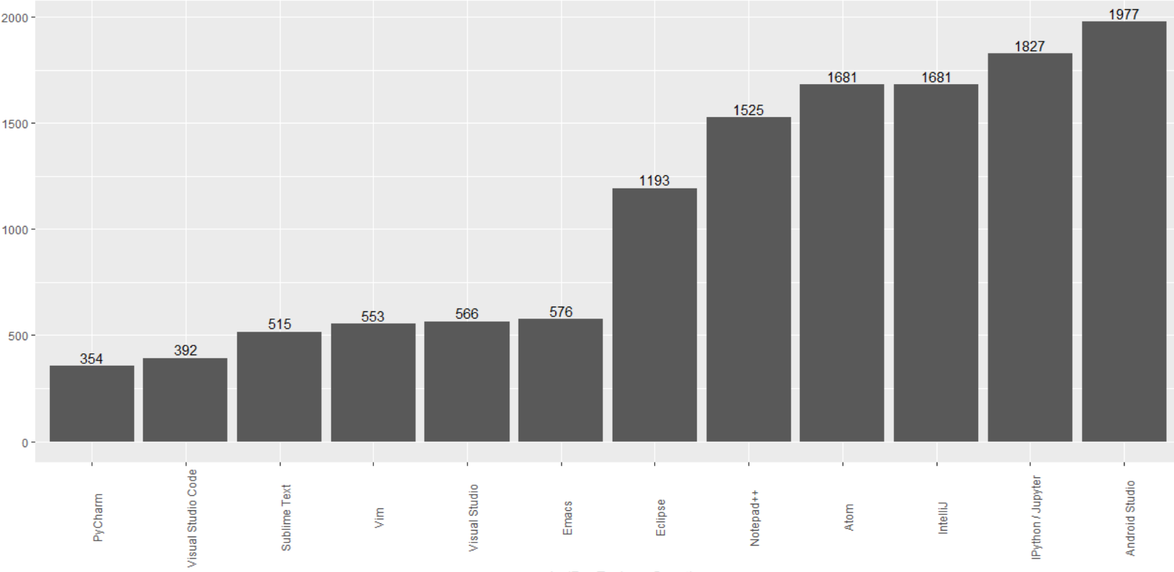
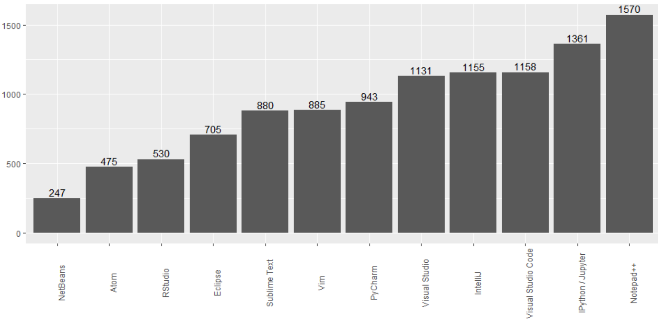
Development Environments
First Choice Environment
Second Choice Environment

Slide 12
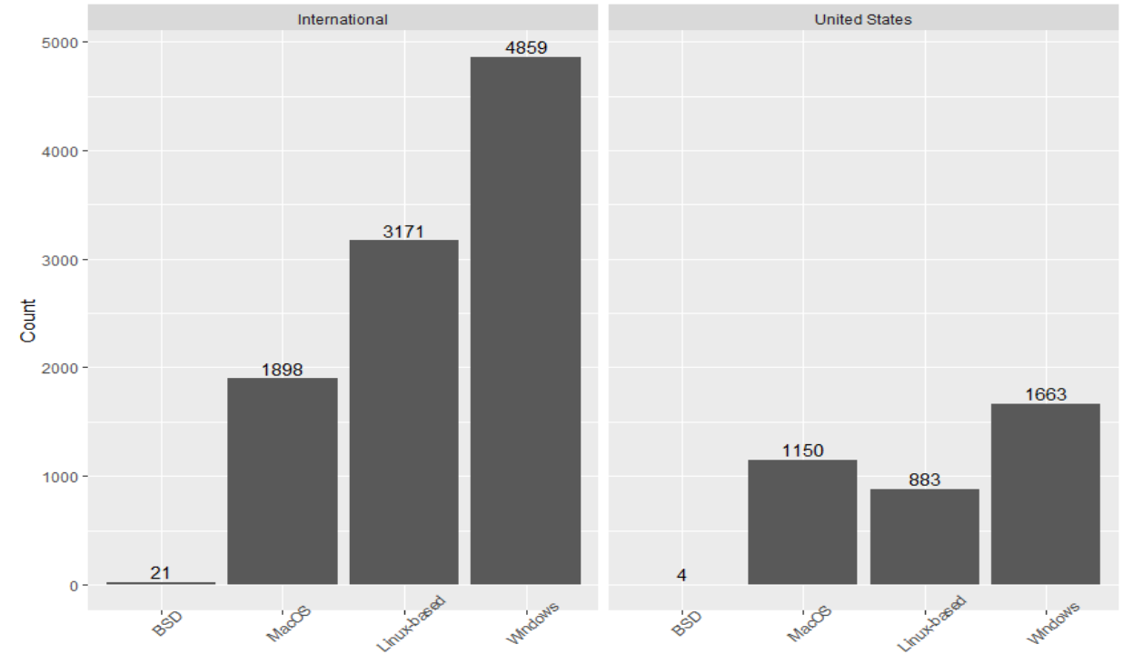
Operating Systems
Operating Systems USA vs. International

