Slide 1

Data Science Skills ”which are the most valued data science skills”

Slide 2
Contents
Methodology
Demographics
Languages
Databases
Platforms
Web Frames
Development Environments
Operating Systems

Slide 3
Methodology
Datasets
Engineering
Database
Discover &
Visualize
Present
findings

Slide 4
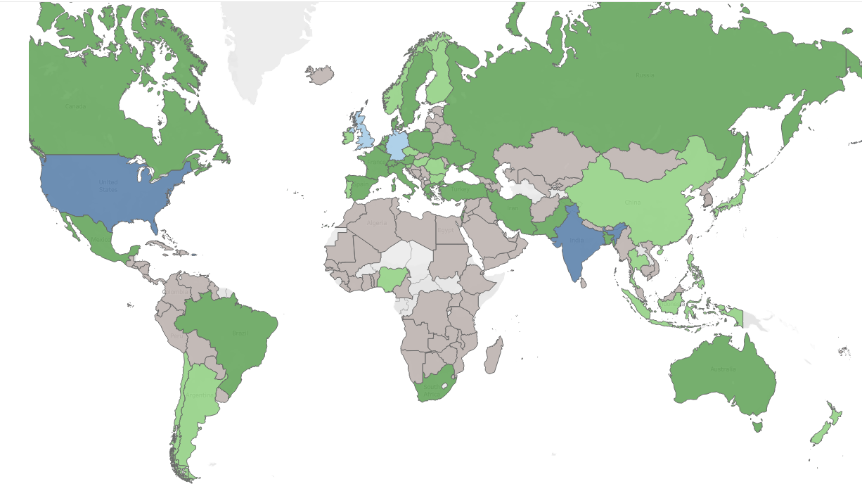
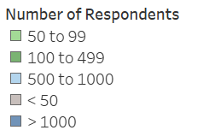
Demographics - Countries
US
India
Turkey,Iran
Pakistan

Slide 5
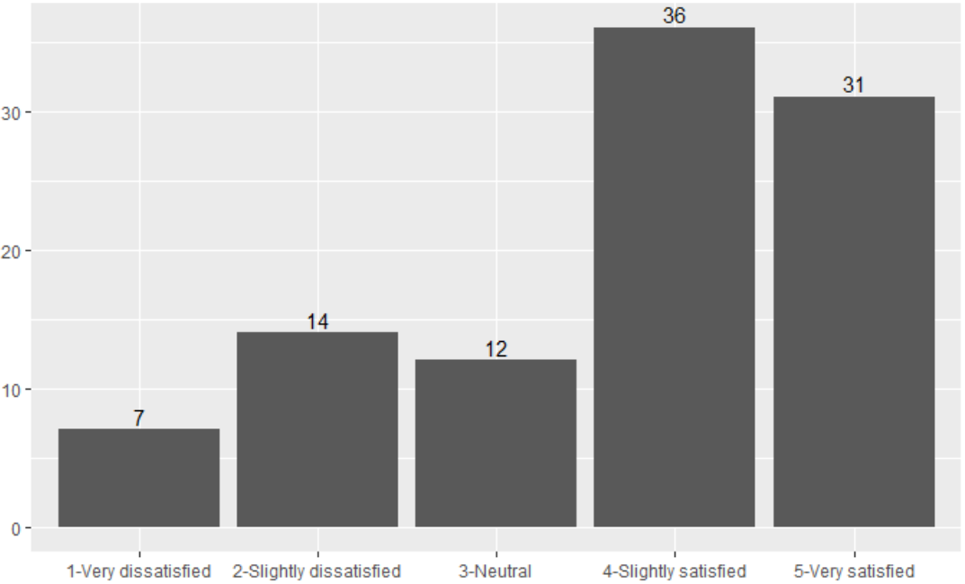
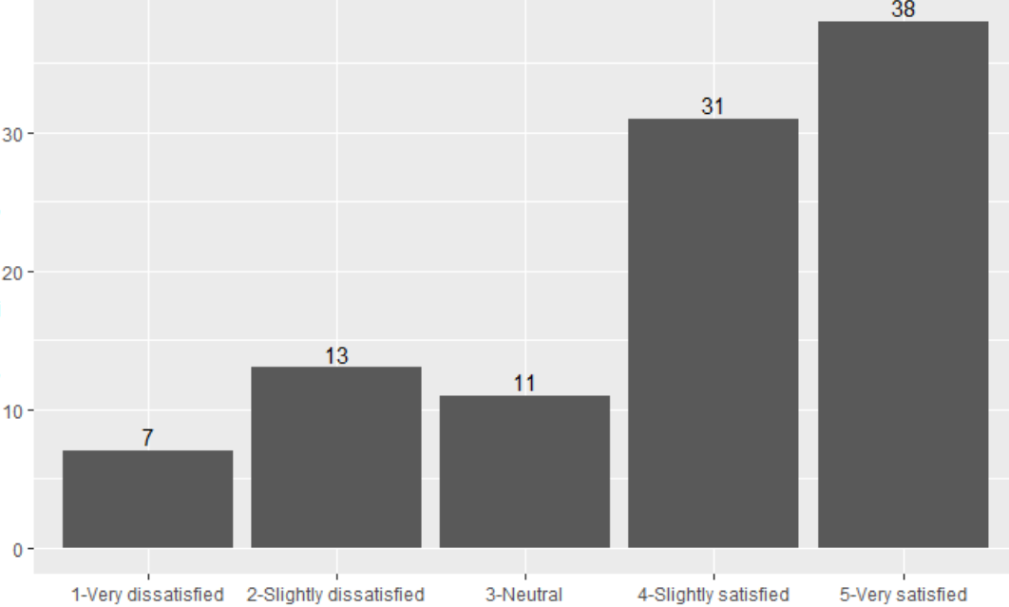
Demographics – Job Satisfaction
Medium response
(countries with 100 – 999 respondents)
High response
(countries with over 1,000 respondents)
Percentage
Satisfaction
Satisfaction

Slide 6
Languages

Slide 7
Databases

Slide 8
Platforms

Slide 9
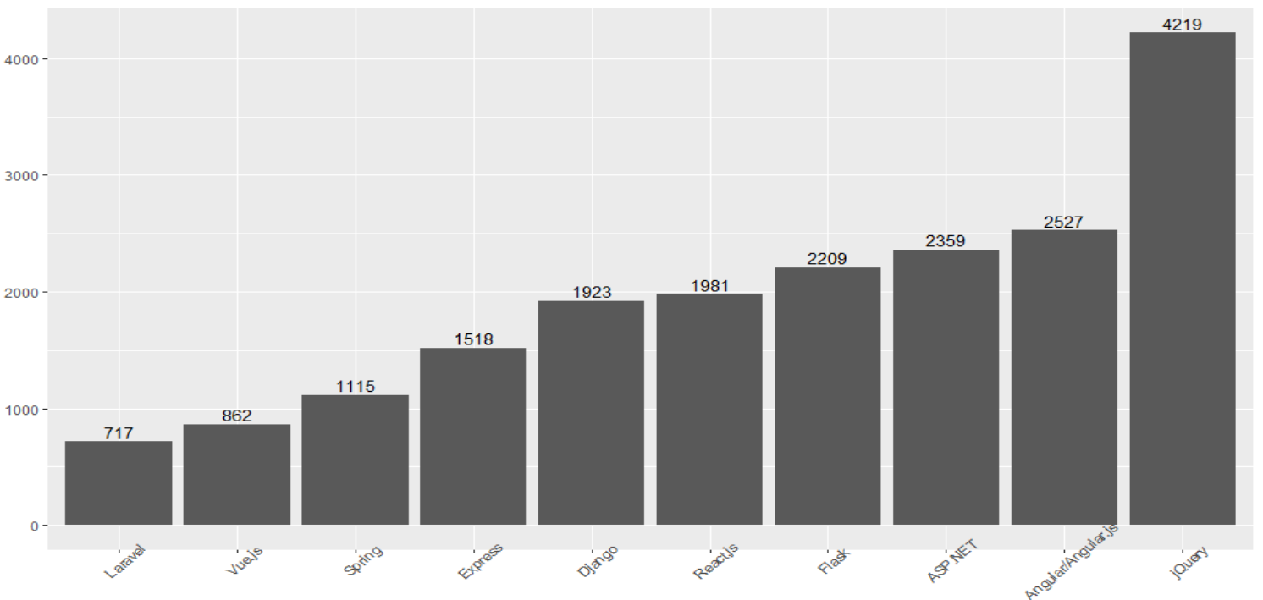
Web Frames
Most Commonly Used Web Frames

Slide 10
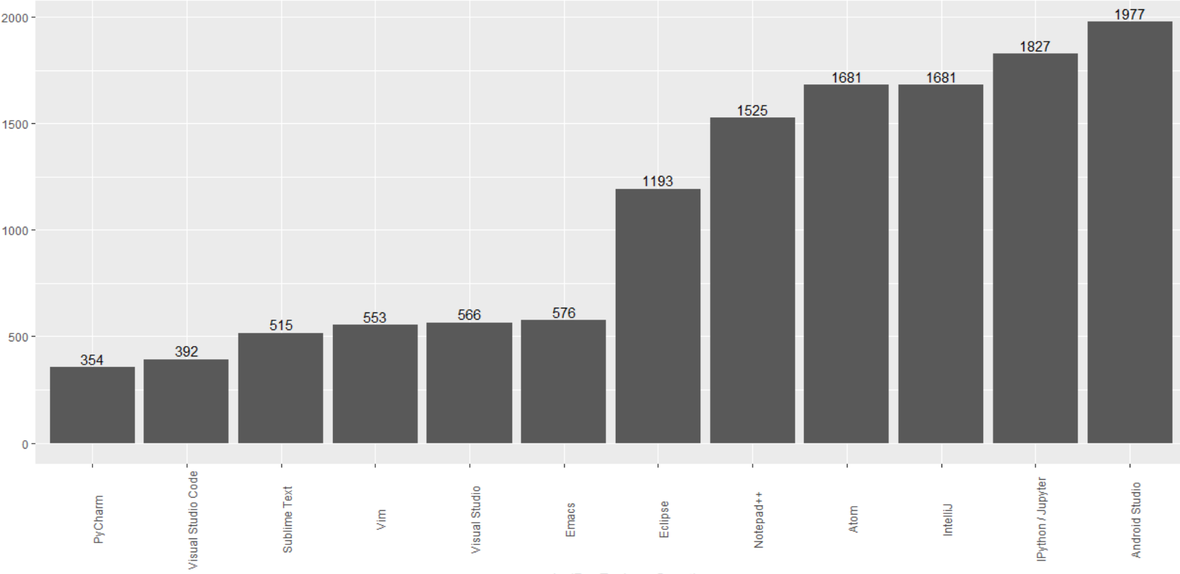
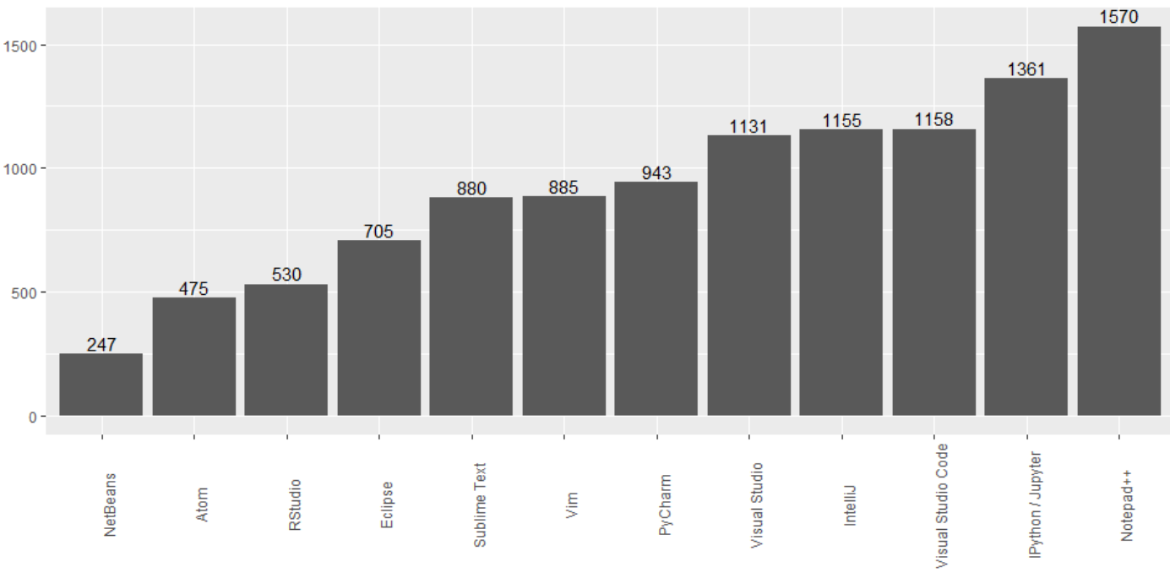
Development Environments
First Choice Environment
Second Choice Environment

Slide 11
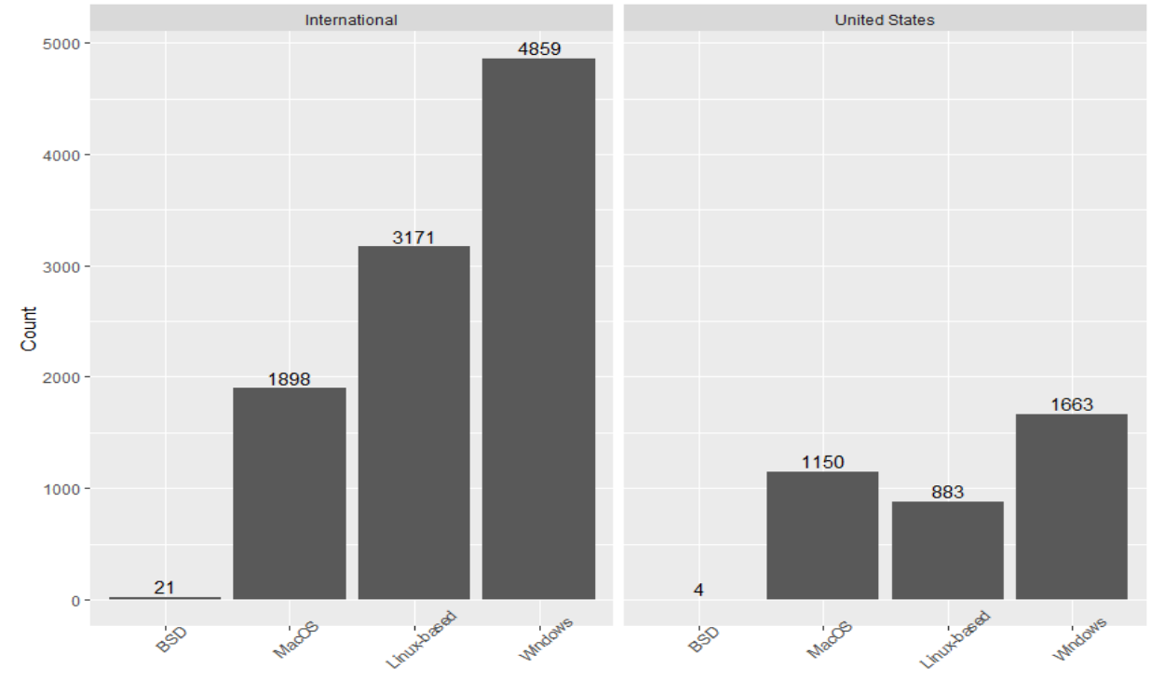
Operating Systems
Operating Systems USA vs. International

