Slide 1

IMS Project

Slide 2
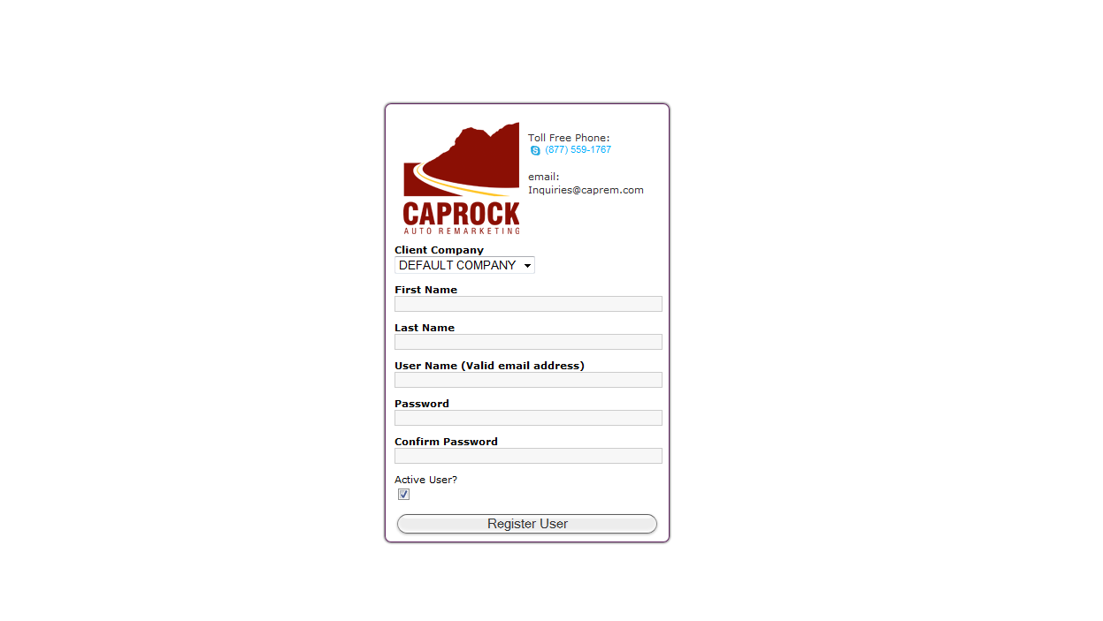
Register User
http://www.marshallalanhill.com/development/caprock/caprockims/web/register-form.php
Notes:
Admin function, user does not self register. Create the user and let them know what their log in credentials are to use the site. Log in routine uses active user flag. If it is not checked the user can not log in.

Slide 3
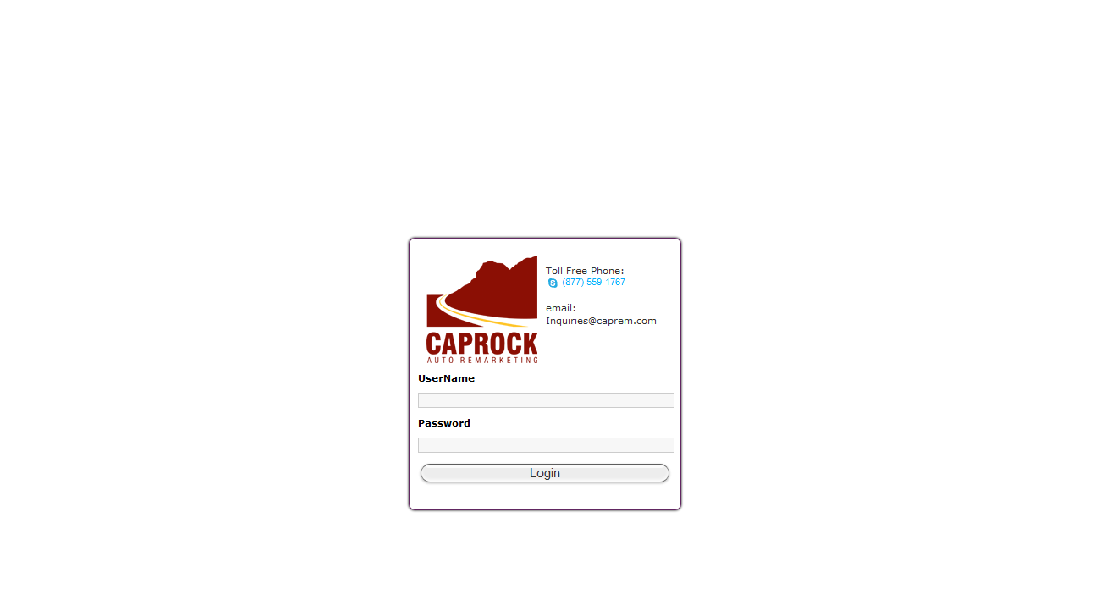
User Login
http://www.marshallalanhill.com/development/caprock/caprockims/web/login-form.php
Notes:
User log in form

Slide 4
Failed Login
http://www.marshallalanhill.com/development/caprock/caprockims/web/login-failed.php

Slide 5
Client Landing
http://www.marshallalanhill.com/development/caprock/caprockims/web/client-landing-form.php

Slide 6
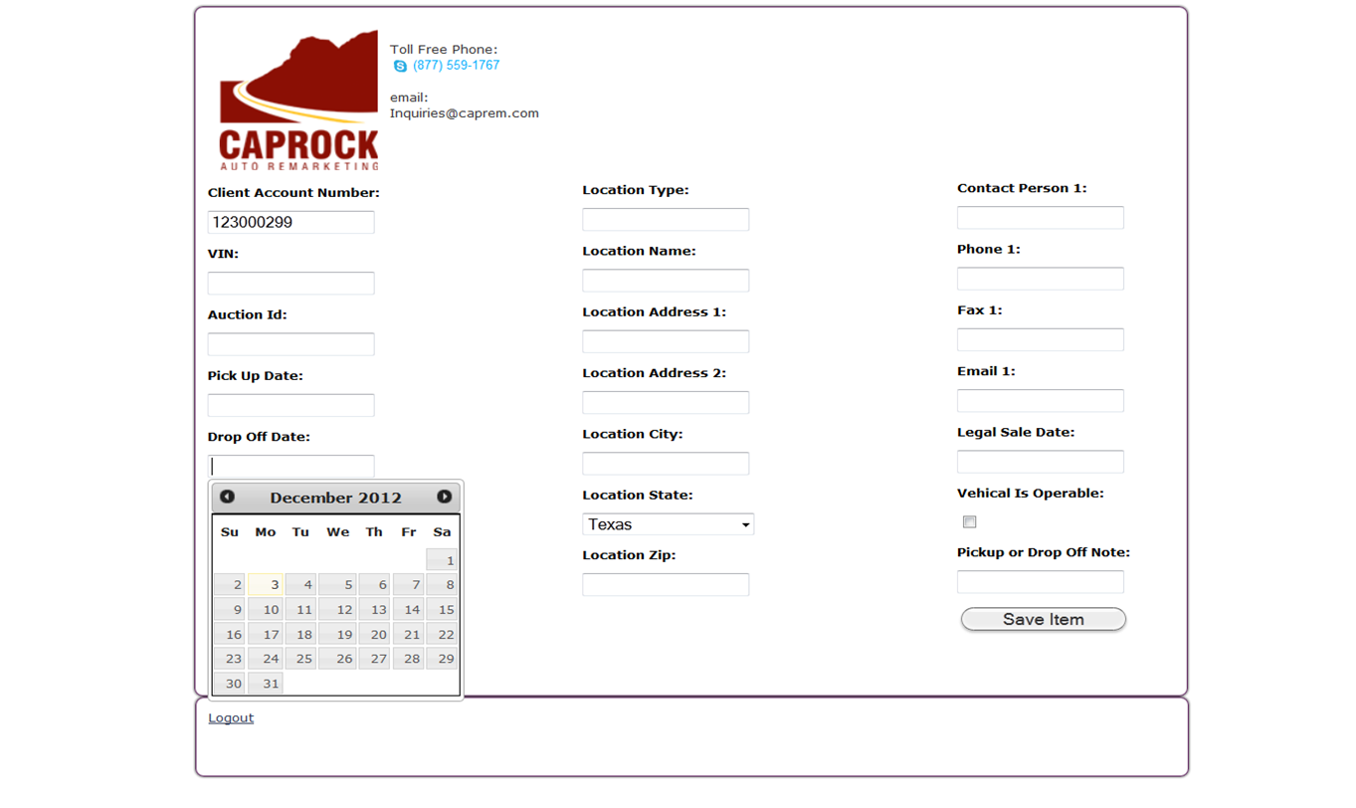
Add Inventory
http://www.marshallalanhill.com/development/caprock/caprockims/web/aasc-inventory-form.php
Notes:
Based on fields highlighted in the binder. All dates are input masked to use the date picker to prevent errant entry formats. Location state is a drop down with states. Client account number is created when the client company is added to the database. ****Which fields are mandatory***** all of them, none?

Slide 7
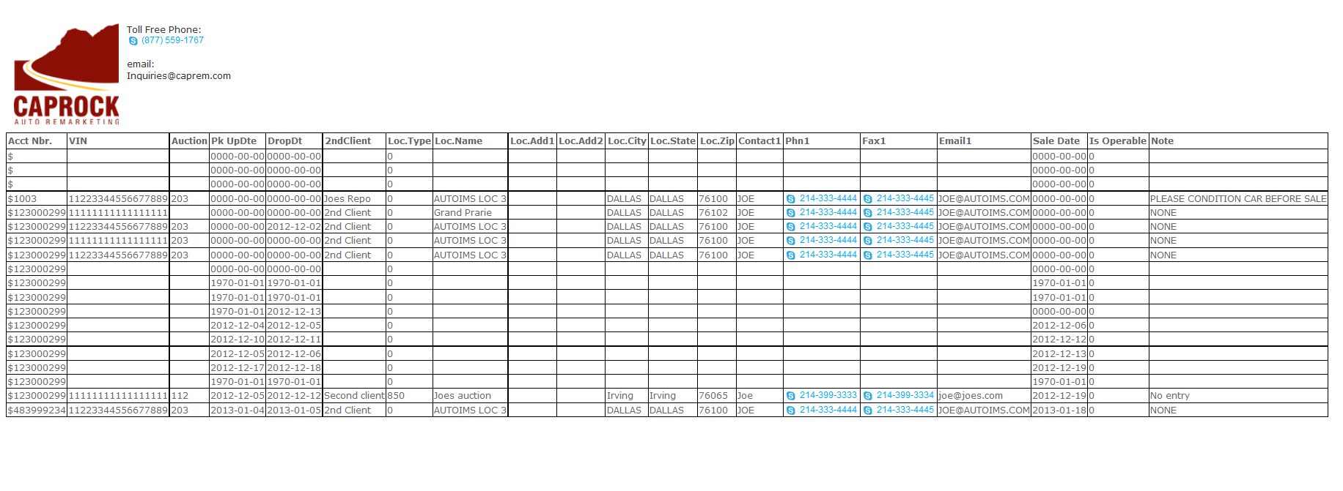
View Inventory
http://www.marshallalanhill.com/development/caprock/caprockims/web/aasc-inventory-view.php
Notes:
Still need to add sorting to the grid. Need to add paging as the grid will get lengthy. Maybe a filter so to only see inventory between certain dates? Re-add logout div.

Slide 8
Notes
IMS Project

