Slide 1
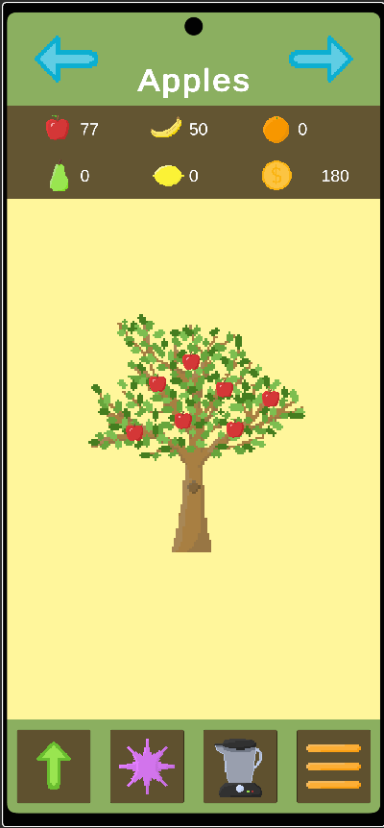
Into the Orchard
UI based idle clicker
Gather fruit, make smoothies, earn gold

Slide 2
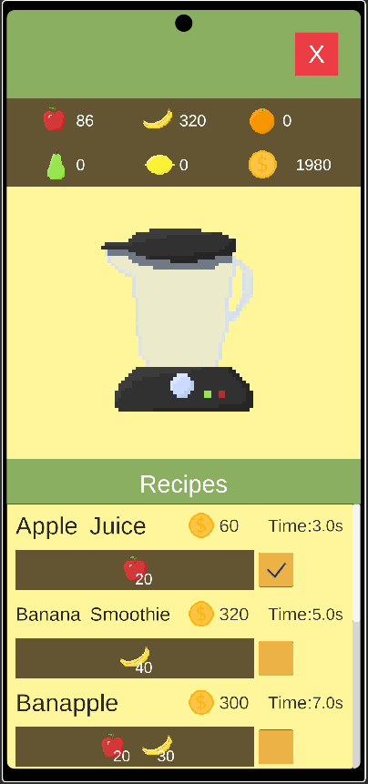
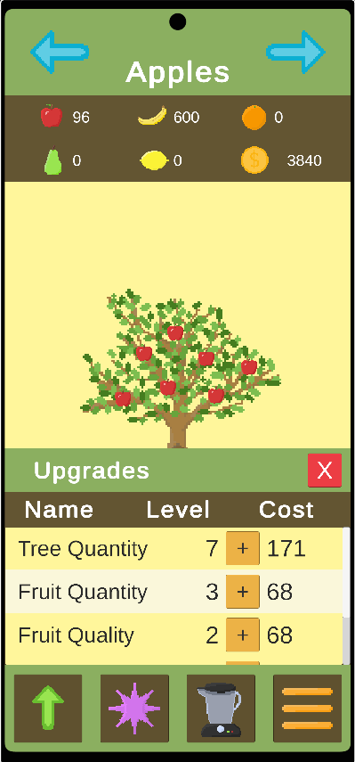
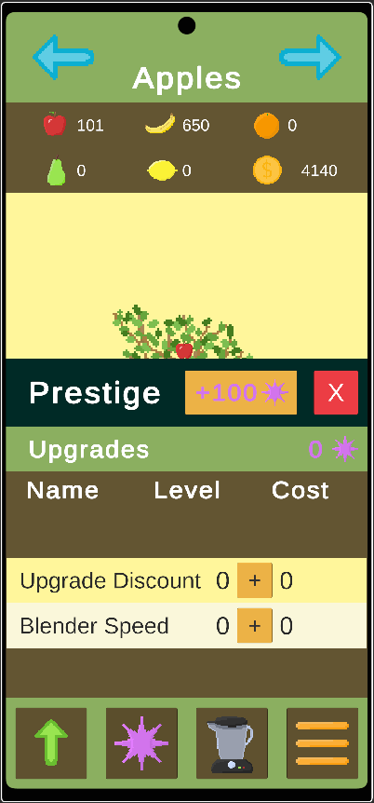
Core Loop
Gather
Blend
Upgrade
Prestige

Slide 3
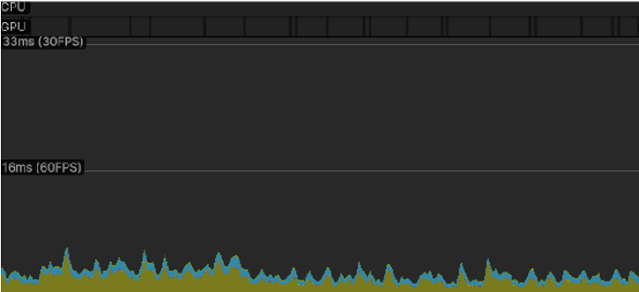
Performance
Unable to test on real phone
No performance issues
UI based
Event driven

Slide 4
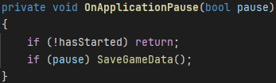
Problems and Solutions
OnApplicationPause() triggering on game launch.
  Added a bool that gets set only after passing the start screen.
  Checked the value of pause before saving data.
Saving the current recipe object caused a NullReferenceException.
  Even though the object data was the same they were stored as different objects in memory.
  Saved the recipe index instead.

Slide 5
What I learned
I learned that when you serialize and load a ScriptableObject, Unity creates a new instance. This means you cannot compare it by reference to existing ScriptableObjects.
  It is better to save indexes or IDs, not entire objects.
I learned that OnApplicationPause() can trigger during startup, not only when leaving the game.

