Slide 1
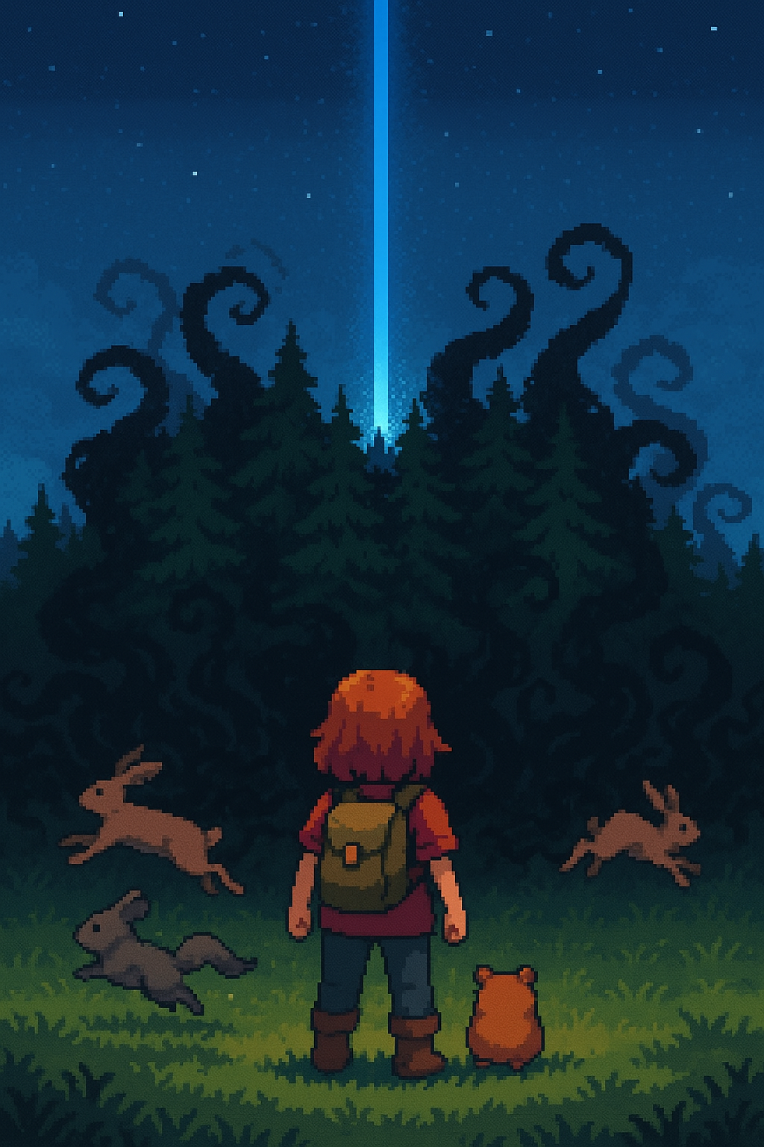
The Mist
2D RPG with turn-based combat

Slide 2
Story
A dark mist is corrupting the creatures in the area.
The player must find the source of the corruption and defeat the villain.

Slide 3
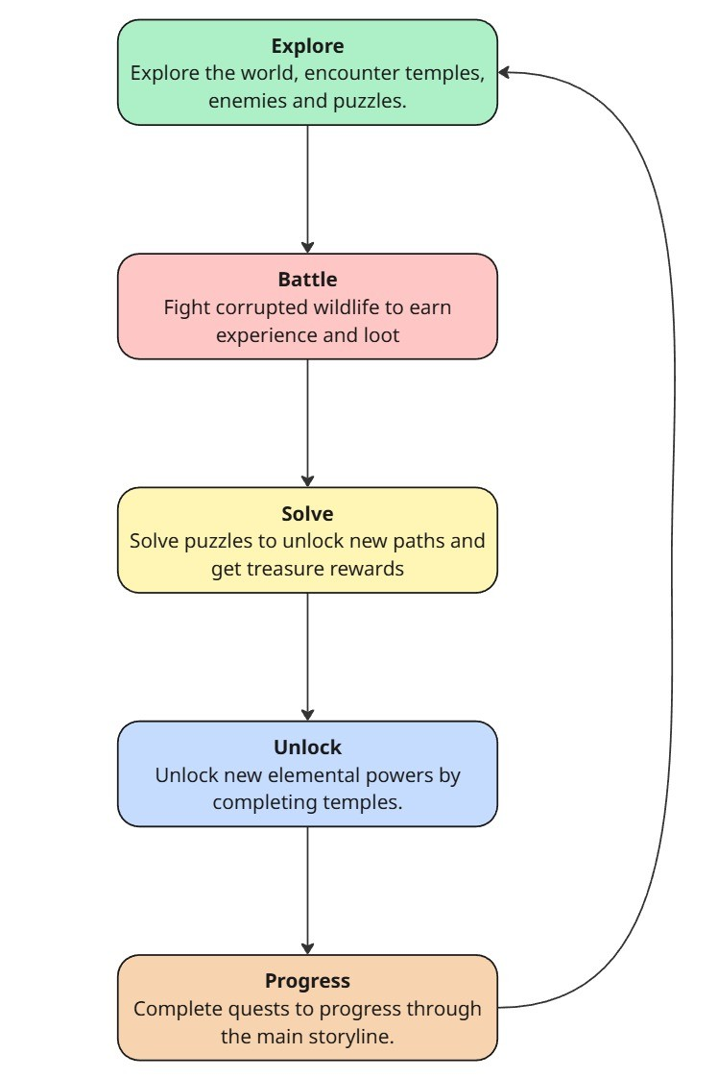
Core gameplay loop

Slide 4
Procedural generation
Temples are generated using Binary Space partitioning.
Enemies are spawned into rooms.
Temples will have puzzles to solve.
Completing a temple will give the player elemental powers.

Slide 5
Elemental Powers
Fire, ice, wind, etc.
These powers can be used to progress through the world by unlocking new paths such as burning vines or freezing water.
Powers can be used to solve puzzles.
Powers can be used in combat to take advantage of elemental weaknesses.

Slide 6
Reactive AI
AI will react in the turn based combat based on what the player does.
For example if the enemy has a healing power and has low health it will heal.

Slide 7
Adaptive Music
Original music that will change harmonies based on what’s happening.
More intense for battles.

