Slide 1

NLS++
A Computational Program for Solving Non Linear Systems of Equations
Developed by:
Anderson Pereira
Ivan Menezes
Glaucio Paulino
Rio de Janeiro, August 24, 2009

Slide 2
Directory Structure
NLS_ROOT
include
(header files)
src
(source code of the NLS++ library)
bin
(applications, i.e., executable files)
obj
(object files)
lib
(released version of the NLS++ library)
docs
(documentation files, e.g. NLS.PPT)
external_libs
(e.g. Linear_Solver,...)
tests
(clients of the NLS++ library)

Slide 3
Creating (coding) a New Application
#include <nls.h>
class cMyModel : public cModel
{
…
};
int main()
{
cMyModel *pcModel = new cMyModel();
cLynSys *pcLinSys = new cCroutProfile( );
…
cCtrl *pcCtrl = new cNewtonRaphson( pcModel, &sCtrl, pcLinSys );
…
pcCtrl->Solver( );
}
File: myapp.cpp

Slide 4
Generating a New Application
Compilation Step:
[~]g++ -c myapp.cpp –I<NLS_ROOT>/include
–I<NLS_ROOT/external_libs/LinSys>/include
Linking Step:
[~]g++ -o myapp myapp.o
<NLS_ROOT>/lib/<System>/libnls.a
<NLS_ROOT/external_libs/LinSys>/lib/<System>/liblinsys.a
Notes:
<NLS_ROOT> is the start directory of the NLS++ (as shown in slide 2)
<System> is the user operational system (e.g., Linux24g3, vc9, gcc3, ...)

Slide 5
General Comments
Once the NLS++ library is generated for a particular operational
system, it does not need to be changed anymore.
The users can derive their own models or use the existing ones
(see directory: “<NLS_ROOT>/tests”).
The libraries for the solution of LINEAR systems of equations
are provided for several operational systems (see directory:
“<NLS_ROOT>/external_libs”). The corresponding source code
is NOT available here.

Slide 6
Testing the NLS++ Lib
Main Steps:
<1> Generate the NLS++ Library: Type “make” in the directory “NLS_ROOT/src”
(Note: make sure that the directories “NLS_ROOT/lib” and “NLS_ROOT/obj”
have already been created).
<2> Copy all include files (from all “NLS_ROOT/src” subdirectories) to the
“NLS_ROOT/include” directory (Note: you can use the script file
“copy_includes.sh” which is provided in “NLS_ROOT/src” directory).
<3> Generate your application (see slides 3 and 4).
<4> Run your application by typing:
[NLS_ROOT/tests] ../bin/nls model.inp algorithm.inp
where: model.inp = model file name*
algorithm.inp = algorithm file name*
*model and algorithm files are described in slides 9-12

Slide 7
Available Algorithms in the NLS++ Lib
Newton-Raphson
Displacement Control
Work Control
Arc-Length
Generalized Displacement Control
Orthogonal Residual Procedure
Main Papers:
W.F. Lam and C.T. Morley, “Arc-length method for passing limit points in structural
calculations”, Journal of Structural Engineering (ASCE), 118(1), 169-185, 1992.
M.A. Crisfield, “A fast incremental/iterative solution procedure that handles snap-
through”, Computers & Structures, 13, 55-62, 1981.
S. Krenk, “An orthogonal residual procedure for nonlinear finite element equations”,
IJNME, 38, 823-839, 1995.
Y.B. Yang and M.S. Shieh, “Solution method for nonlinear problems with multiple
critical points”, AIAA Journal, 28(12), 2110-2116, 1990.
Main Books:
J.N. Reddy, “An Introduction to Nonlinear Finite Element Analysis”, Oxford, 2004.
K.J. Bathe, “Finite Element Procedures”, Prentice-Hall, 1996.
M.A. Crisfield, “Non-Linear Finite Element Analysis of Solids and Structures ”,
John Wiley and Sons, Volume 1, 1991.

Slide 8
Available Models for Testing NLS++ Lib
Function Defined by an Equation
Class: cModelFunction
File: modfunc.cpp
Space Truss (Plane Truss is a particular case)
Class: cModelTruss
File: modst.cpp
Plane Frame
Class: cModelBeam2D
File: modbeam2.cpp
Space Frame
Class: cModelBeam3D
File: modbeam3.cpp
Note: The above “cpp” files can be found in “<NLS_ROOT>/tests” directory

Slide 9
“Model” File (Example 1)
von Mises Truss
model type
‘space_truss'
4
0.0 1000.0 0.0
0.0 0.0 0.0
-8.660254037 5.0 0.0
8.660254037 5.0 0.0
4
0 1 0 1
1 1 0 1
2 1 1 1
3 1 1 1
1
0 0.0 1.0 0.0
3
0 1 50.0 0.0
1 2 1.0 0.0
1 3 1.0 0.0
2
0 1
1 1
(modst.cpp)
P
# of nodes
c_{x} c_{y} c_{z}
0
0
3
# of bound. cond.
node d_{x} d_{y} d_{z}
2
1
2
# of loads
node f_{x} f_{y} f_{z}
1
# of elements
node₁ node₂ EA, σ₀
y
Node
x
Element
# of disp. curves
node d.o.f.
z
Initial axial stresses

Slide 10
“Model” File (Example 2)
Lee Frame
model type
'plane_frame'
4
0 0
0 120
24 120
120 120
2
0 1 1 1
3 1 1 1
1
2 0 1 0
3
0 1 4320 2160 1440
1 2 4320 2160 1440
2 3 4320 2160 1440
2
2 0
2 1
(modbeam2.cpp)
# of nodes
c_{x} c_{y}
P
1
2
1
3
2
# of bound. cond.
node d_{x} d_{y} r_{z}
0
# of loads
node f_{x} f_{y} m_{z}
0
# of elements
node₁ node₂ EA GA EI
y
Node
x
Element
# of disp. curves
node d.o.f.

Slide 11
“Model” File (Example 3)
Lee Frame
model type
‘space_frame'
4
0 0 0
0 120 0
24 120 0
120 120 0
2
0 1 1 1 1 1 1
3 1 1 1 1 1 1
1
2 0 1 0 0 0 0
3
0 1 4320 1000 1440 1440 2160 2160 0 0 1
1 2 4320 1000 1440 1440 2160 2160 0 0 1
2 3 4320 1000 1440 1440 2160 2160 0 0 1
2
2 0
2 1
(modbeam3.cpp)
# of nodes
c_{x} c_{y} c_{z}
P
1
2
1
3
2
# of bound. cond.
node d_{x} d_{y} d_{z} r_{x} r_{y} r_{z}
unit vectors to define
member orientation
0
# of loads
node f_{x} f_{y} f_{z} m_{x} m_{y} m_{z}
0
# of elements
node₁ node₂ EA EI_{x} EI_{y} EI_{z} …
… GA _{y} GA_{z} v_{x} v_{y} v_{z}
y
Node
x
Element
# of disp. curves
node d.o.f.
z

Slide 12
“Algorithm” File
Line 1
Linear solver type
Parameter 1
Parameter 2
Crout-Profile
PCG-Profile *
PCG-CSR *
0
1
2
none
Max. number of iterations
Max. number of iterations
none
Tolerance for convergence
Tolerance for convergence
Line 2
Alg. type
Update type **
Initial load factor
Parameter 1
Parameter 2
Newton-Raphson
Displacement control
Arc-length
Work control
Gen. disp. control
Ort. residual proc.(unified)
Strain ratio control
Strain control
Ort. residual proc. (original)
0
1
2
3
4
5
6
7
8
none
D.o.f. of the controlled equation
Type (Constant <0>, Variable <1>)
none
none
Initial inc. scale factor
Load increment for the first step
D.o.f. of the controlled deformation
Initial inc. scale factor
none
Type (Constant <0>, Variable <1>)
none
none
none
none
none
Type (Constant <0>, Variable <1>)
none
Line 3
Max. # of steps
Max # of iterations
Tolerance for convergence
*Profile = Skyline Storage; CSR = Compressed Sparse Row
(see slide 13 for more details about CSR scheme)
**Stiffness Matrix Update : <0>Standard <1>Modified

Slide 13
CSR Storage Scheme
4 0 2 5 0
0 0 3 9 0
[ A ] =
1 0 0 0 7
8 0 6 0 0
0 4 1 0 0
Nonzero values of [A]
{ a } =
{ 4 2 5 3 9 1 7 8 6 4 1 }
{ j } =
{ 1 3 4 3 4 1 5 1 3 2 3 }
Corresponding columns
{ i } =
{ 1 4 6 8 10 12 }
Position of first nonzero
element of each row in
vector { j}

Slide 14
Example (Lee Frame)
'plane_frame'
11
0.000000E+000 0.000000E+000
0.000000E+000 2.400000E+001
0.000000E+000 4.800000E+001
0.000000E+000 7.200000E+001
0.000000E+000 9.600000E+001
0.000000E+000 1.200000E+002
2.400000E+001 1.200000E+002
4.800000E+001 1.200000E+002
7.200000E+001 1.200000E+002
9.600000E+001 1.200000E+002
1.200000E+002 1.200000E+002
2
0 1 1 0
10 1 1 0
1
6 0 -1 0
10
0 1 4.320000E+003 2.160000E+003 1.440000E+003
1 2 4.320000E+003 2.160000E+003 1.440000E+003
2 3 4.320000E+003 2.160000E+003 1.440000E+003
3 4 4.320000E+003 2.160000E+003 1.440000E+003
4 5 4.320000E+003 2.160000E+003 1.440000E+003
5 6 4.320000E+003 2.160000E+003 1.440000E+003
6 7 4.320000E+003 2.160000E+003 1.440000E+003
7 8 4.320000E+003 2.160000E+003 1.440000E+003
8 9 4.320000E+003 2.160000E+003 1.440000E+003
9 10 4.320000E+003 2.160000E+003 1.440000E+003
2
6 0
6 1
0
4 0 0.10
250 40 0.0001
Algorithm File
(Crout Solver)
Model File
(Plane Frame)

Slide 15
Example (Lee Frame)
Total # of Elements | CPU Time (s)
10 | 0.374
20 | 0.639
40 | 0.983
80 | 1.888
160 | 3.448
320 | 6.318
640 | 11.684
1280 | 22.543
2560 | 44.772
5120 | 87.985

Slide 16
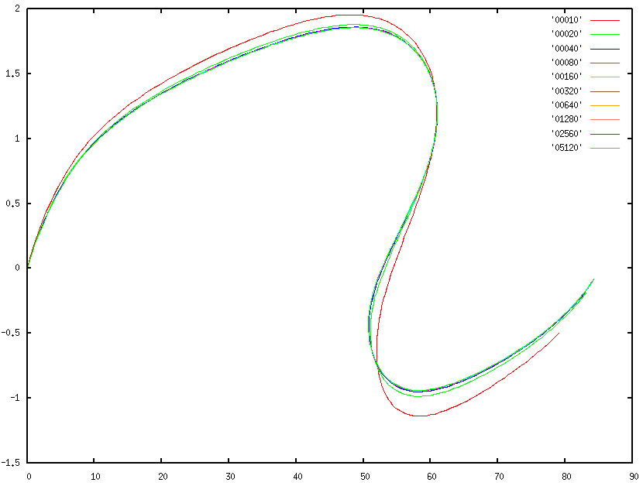
Example (Lee Frame)
# of Elements
Load Factor
Coarsest mesh (00010 elements)
Vertical Displacements (where the load is applied)

Slide 17
Ongoing Work
Implementing NLS++ in the context of TopFEM program
Deriving new models for testing the NLS++
Anderson Pereira (anderson@tecgraf.puc-rio.br),
Ivan Menezes (ivan@tecgraf.puc-rio.br), and
Glaucio Paulino (paulino@illinois.edu)
Rio de Janeiro, August 24, 2009

