Slide 1
qbic-pred accelerator:
fast mutational transcription factor binding
leon riesebos
isaac stier robson
duke university
16 oct 2019

Slide 2
outline
optimization thus far
potential hardwiring
a few questions
leon riesebos + isaac stier robson
qbic-pred accelerator
16 oct 2019 2 / 9

Slide 3
optimization thus far
data pandification
allows for easy vectorization
great for quick file i/o (as currently used)
supports many in-place operations
leon riesebos + isaac stier robson
qbic-pred accelerator
16 oct 2019 3 / 9

Slide 4
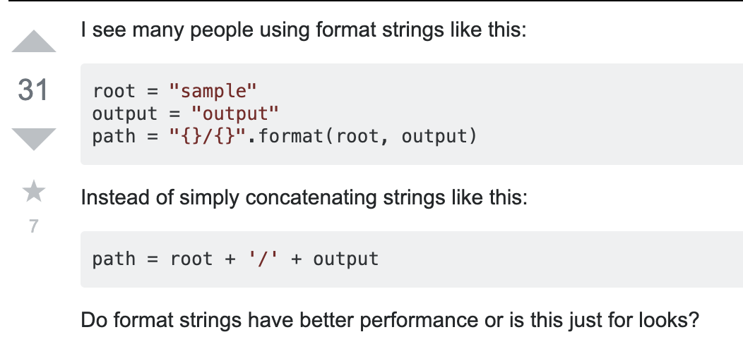
optimization thus far
string formatting / lambda functions
leon riesebos + isaac stier robson
qbic-pred accelerator
16 oct 2019 4 / 9

Slide 5
optimization thus far
preventing unnecessary data movement
prefer memcopy to file i/o
prefer shared memory to memcopy
only initialize data columns when necessary
leon riesebos + isaac stier robson
qbic-pred accelerator
16 oct 2019 5 / 9

Slide 6
optimization thus far
tweak multithreading
switch to bulkier processes for large parallel tasks
splice in multithreading support for file i/o intensive regions
heavy reliance on emerging concurrent.futures api
leon riesebos + isaac stier robson
qbic-pred accelerator
16 oct 2019 6 / 9

Slide 7
potential hardwiring
optimizations thus far have yielded around
200x speedup
on 1 million mutations
(8 cores – aws F1.2x)
likely some hardware opportunities in the is_bound kernel of the main do_predict function
leon riesebos + isaac stier robson
qbic-pred accelerator
16 oct 2019 7 / 9

Slide 8
leon riesebos + isaac stier robson
qbic-pred accelerator
16 oct 2019 8 / 9

