Slide 1
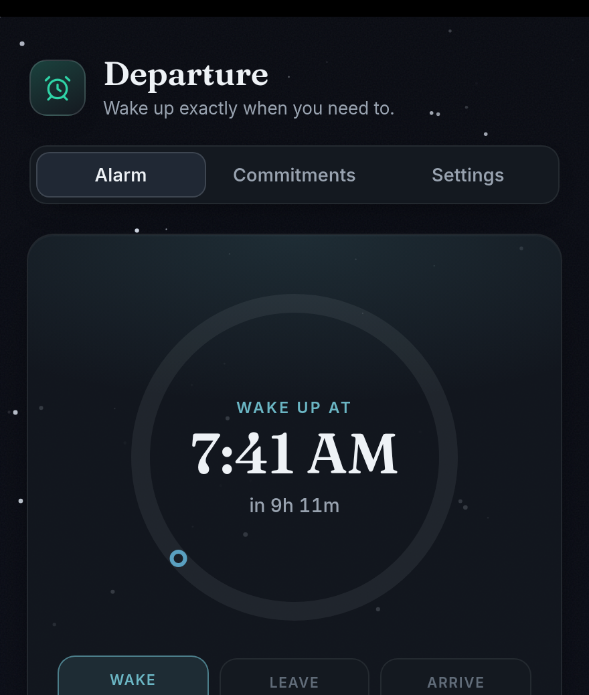
HEADSTART PROJECT
Marketing & Manufacturing
How we find users—and how we build the product.
Departure by Team HeadStart
Notes:
This presentation is about two connected questions: how do we get the right people to try Departure, and how do we reliably produce and deliver the app? HeadStart is the project team; Departure is the product.

Slide 2
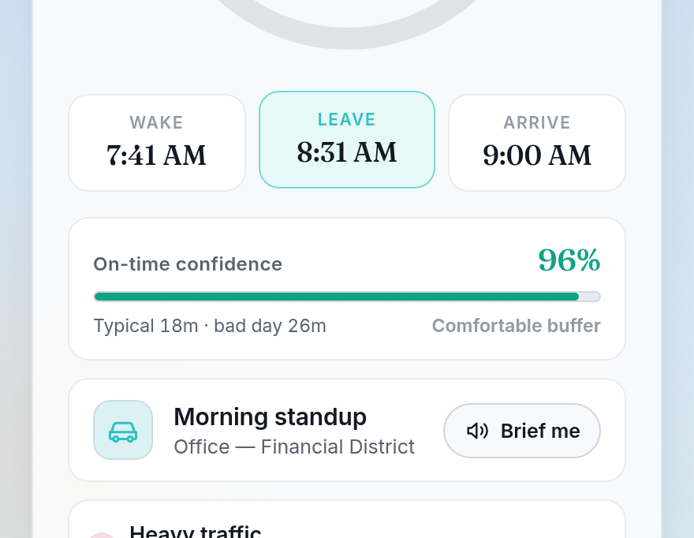
THE PRODUCT
We are selling a calmer morning—not just an alarm.
Departure works backward from where you need to be.
LESS GUESSING
One clear wake, leave, and arrive plan
LESS RUSHING
Traffic changes the plan before it becomes a surprise
MORE CONFIDENCE
The screen shows whether the current buffer feels safe
2
Notes:
For marketing, the product is not a list of APIs or widgets. The real benefit is a morning with less guessing and less rushing. The features are proof that the promise is believable.

Slide 3
TARGET MARKET
Start with students whose mornings keep changing.
PRIMARY USER
SCHOOL
High school students
First bell and changing traffic
Especially students balancing school with practice, clubs, a job, transit, or a ride from someone else.
ACTIVITIES
Practice, clubs, and away games
WORK
Early shifts and part-time jobs
One student can have all three in the same week.
3
Notes:
The target market is deliberately narrow at first. We are designing for students with real schedule changes, not everyone who owns an alarm clock. Parents and schools can help students discover it, but students are the main user.

Slide 4
MARKETING MIX: THE 4 PS
Our launch mix keeps the first version simple.
PRODUCT
PRICE
A traffic-aware wake and leave plan
Free beta first
The useful version stays focused on the next commitment.
Prove the core alarm works before considering paid extras.
PLACE
PROMOTION
Phone and web
Demonstrate the change
iOS, Android, and the installable web app.
Short videos, school demos, and student ambassadors.
4
Notes:
These are launch recommendations, not current promises. The important choice is to keep the first version free and easy to try, then earn the right to add extras later.

Slide 5
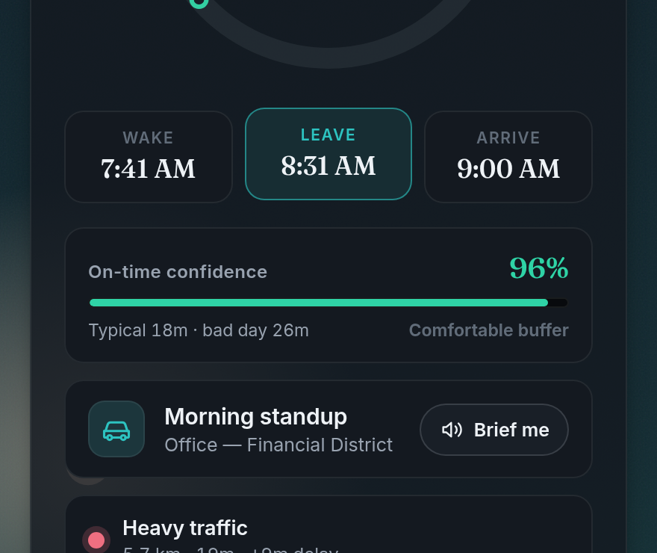
CAMPAIGN IDEA
Show the plan changing instead of over-explaining it.
THE HOOK
Traffic added 9 minutes. Your alarm moved too.
TAGLINE
Know when to wake. Know when to leave.
Use a 15-second before-and-after clip or a live Simulate morning demo.
5
Notes:
The best marketing moment is visual: traffic changes, and the leave and wake plan changes with it. That can be understood in a few seconds without explaining the technology first.

Slide 6
GO-TO-MARKET PLAN
Pilot small, learn fast, then widen the launch.
PHASE 1
PHASE 2
PHASE 3
One-school beta
Fix the rough spots
Wider release
Recruit through friends, clubs, and teachers. Watch setup closely.
Improve onboarding, alarm reliability, and the first-week experience.
Publish to phone and web channels, then add referrals and demos.
What we watch: setup success · alarm delivery · repeat use · honest feedback
6
Notes:
A small pilot is not a weak launch. It is how we learn whether people can set up the app, whether the alarm arrives, and whether they come back after the first week.

Slide 7
MANUFACTURING
For an app, the factory is the release pipeline.
Each release moves through the same five stations.
1
2
3
4
5
DESIGN
BUILD
TEST
PACKAGE
RELEASE
Screens and timing rules
Web and mobile code
Math, alarms, and devices
iOS, Android, and PWA
Stores and the web
Then feedback starts the next version.
7
Notes:
There is no physical assembly line. Our manufacturing process is a repeatable software pipeline. A version should not skip straight from coding to release.

Slide 8
WHAT GETS BUILT
The raw materials are code, services, and device access.
APP EXPERIENCE
CONNECTED SERVICES
NATIVE RELIABILITY
The planner students use
The information it needs
The system-level delivery
Screens, schedule math, settings, and local account data.
Traffic estimates, calendars, place search, and location.
iOS and Android alarms, widgets, and background updates.
A release ships only when all three layers work together.
8
Notes:
The product is more than the screen. It combines the app experience, outside services such as traffic and calendars, and native phone features that deliver alarms and updates.

Slide 9
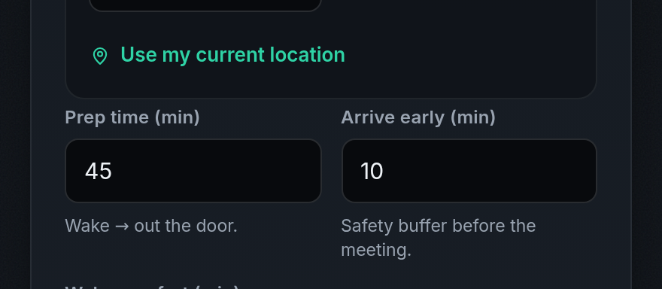
TESTING AND SAFETY
Quality control matters more than flashy features.
✓
TIMING MATH
Automated tests check wake, leave, and arrival calculations.
✓
ALARM DELIVERY
A real 10-second device test checks the operating system.
✓
FALLBACK
An offline traffic model keeps a plan available if live data fails.
✓
PRIVACY
Calendar access is read-only, and schedules stay local-first.
9
Notes:
An alarm product has to earn trust. We test the math, the operating-system delivery, the data fallback, and the privacy model before treating a version as ready.

Slide 10
DISTRIBUTION AND ONGOING COSTS
Production continues after the first download.
HOW USERS GET IT
WHAT WE KEEP PAYING FOR
iPhone Android Installable web app
Store accounts and release fees
Traffic, maps, and calendar services
Hosting and monitoring
One product, packaged for three delivery channels.
Bug fixes, updates, and support
Digital manufacturing is cheaper to copy—but not free to run.
10
Notes:
Software can be copied cheaply, but the product still has ongoing costs. We need release accounts, data services, hosting, monitoring, and people who keep the app reliable.

Slide 11
THE FIRST GOAL
Earn trust with a small, reliable pilot.
MARKETING
MANUFACTURING
Make the promise clear enough to understand in seconds.
Make the release process reliable enough to trust on Monday morning.
Would students trust it for a real school morning?
11
Notes:
Marketing gets the first try. Manufacturing earns the second. Our first success is not a huge download number; it is a group of students who trust the app enough to use it on a real morning.

