Slide 1
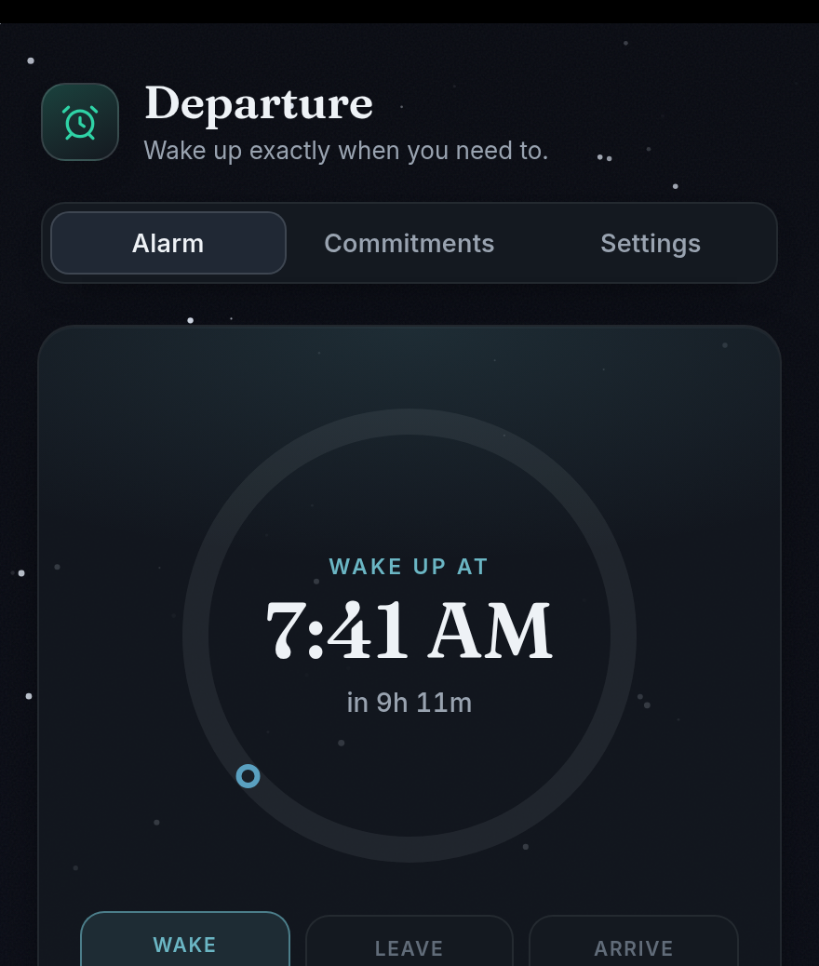
HEADSTART PROJECT
How We'd Market & Make It
Our plan for getting students to try HeadStart—and making sure it works.
Departure by Team HeadStart
Notes:
We made this project to help with mornings that do not always go the same way. We are going to explain how we would get students to try it and how we would keep the app working.

Slide 2
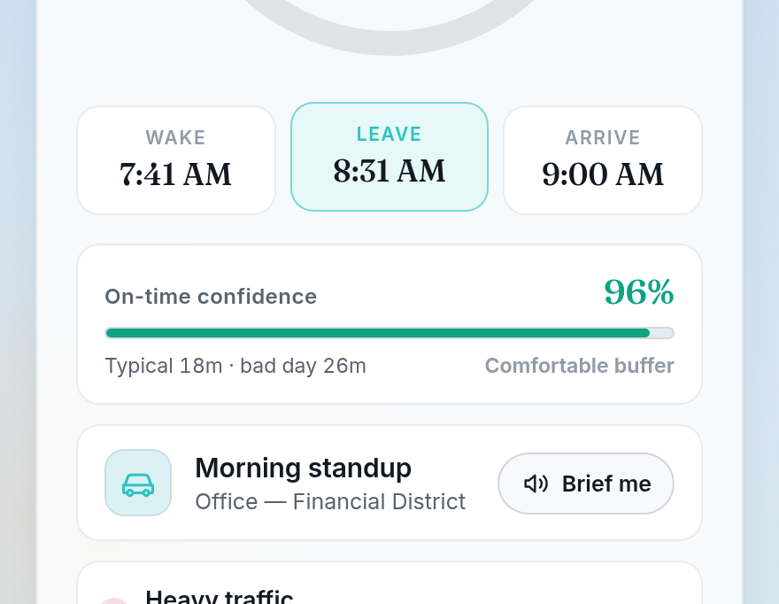
WHAT IT DOES
The idea is pretty simple.
HeadStart tells you when to wake up and leave, based on where you're going and what traffic is like.
Less guessing
Less rushing
More on time
Made for students with school, practice, clubs, jobs, or rides that keep changing.
2
Notes:
The easiest way to explain the app is that it plans backward from where you need to be. We think it makes the most sense for students because our schedules can be different every day.

Slide 3
MARKETING PLAN
Here's how we'd get people to try it.
PRODUCT
PRICE
A smarter alarm
Free beta
It plans around traffic and your schedule.
Let people test it before adding extras.
PLACE
PROMOTION
Phones + web
Show it working
Make it easy to use on the devices students have.
Use quick videos, school demos, and friends sharing it.
3
Notes:
This is our simple version of the four Ps. We would keep the beta free, put it on phones and the web, and promote it by showing the app doing something useful.

Slide 4
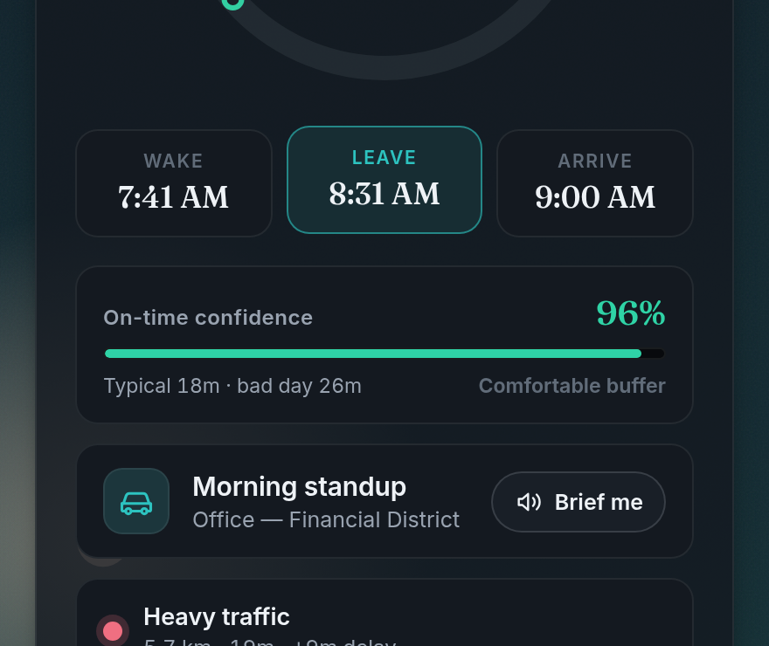
CAMPAIGN IDEA
Our best ad is a quick before-and-after.
THE WHOLE IDEA
Traffic got worse. The alarm moved earlier.
Know when to wake. Know when to leave.
We'd use a short video or just demo it live.
4
Notes:
We do not think the ad needs a huge explanation. A short before-and-after shows the main point: when the trip changes, the morning plan changes too.

Slide 5
FIRST LAUNCH
Start with one school, not the whole world.
1
2
3
Try it
Fix stuff
Share it
Ask a small group of students to use it for real mornings.
Make setup easier and solve the problems they find.
If it works, show it to more students and schools.
Small launch = easier feedback and fewer giant mistakes.
5
Notes:
We would not try to launch everywhere right away. A small school beta gives us honest feedback and makes it easier to fix problems before more people depend on the app.

Slide 6
MANUFACTURING
Making an app is basically a loop.
We keep going through the same four steps.
1
2
3
4
PLAN
CODE
TEST
RELEASE
Choose what the next version needs
Build the screens and timing rules
Check the math and real alarms
Send it to phones and the web
Then feedback starts the next version.
6
Notes:
Since this is software, there is no physical factory. Manufacturing means having a repeatable way to plan, code, test, and release each version.

Slide 7
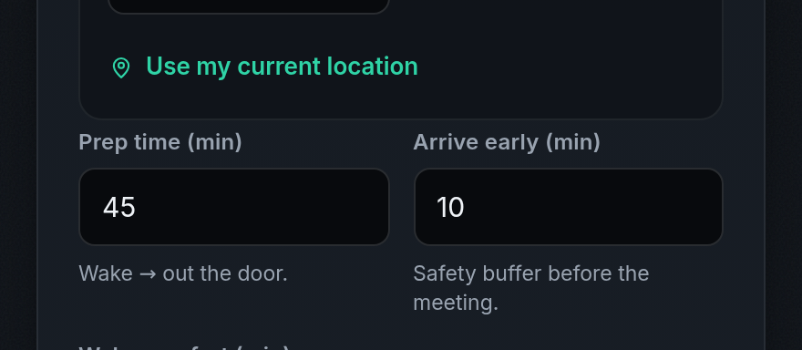
TESTING AND RELEASE
If the alarm fails, the whole idea fails.
✓
TIMING
Check the wake and leave math
✓
ALARMS
Test it on real phones
✓
BACKUP
Keep a plan if traffic data fails
✓
PRIVACY
Only ask for the access we need
When it's ready: iPhone · Android · Web
7
Notes:
The app has to be reliable before we release it. We would test the timing, use a real phone alarm test, keep a fallback if live data fails, and keep calendar access read-only.

Slide 8
OUR FIRST GOAL
Make it work for real students.
MARKETING
MAKING IT
Get a few people to try it.
Make it good enough that they keep using it.
Start small. Listen. Fix stuff. Then grow.
8
Notes:
Our first goal is not millions of downloads. It is a small group of students who use the app on real mornings, tell us what is wrong, and choose to keep using it.

