Slide 1
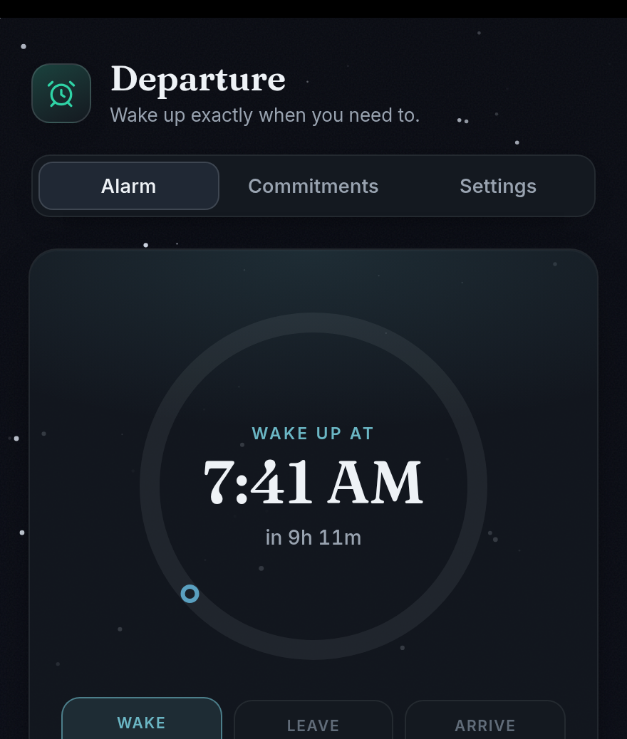
HEADSTART PROJECT
Meet Departure
A smarter alarm for school mornings.
It plans backward from where you need to be—then updates when the trip changes.
Team HeadStart
Notes:
HeadStart is the project. Departure is the prototype we built. The idea is simple: instead of asking only when to wake up, the app starts with where you need to be and works backward.

Slide 2
THE PROBLEM
A normal alarm knows the time.
It doesn't know your morning.
Traffic changes. The bus runs late. Practice is across town.
Your 7:00 alarm stays exactly the same.
2
Notes:
Ask the room: who has set an extra-early alarm just in case? The problem is not that alarms fail to ring. It is that they ignore everything between your bed and your first commitment.

Slide 3
EXAMPLE SCHOOL MORNING
Start with the time you need to be there.
Departure does the backward math so you don't have to.
WAKE
LEAVE
FIRST BELL
6:58 AM
7:43 AM
8:15 AM
45 minutes to get ready
22-minute trip + 10-minute buffer
The deadline stays fixed
Arrive by − buffer − travel − get-ready time = wake time
3
Notes:
This is just an example. First bell is 8:15. Take away a 10-minute arrival buffer and a 22-minute trip, so leave at 7:43. Take away 45 minutes to get ready, so wake at 6:58.

Slide 4
You set the goal once. The plan keeps doing the math.
1
2
3
Add your first commitment
Add your real routine
Let the trip update the plan
School, a game, work, or a bus. Type it in or pull it from your calendar.
Tell it how long you need to get ready and how early you want to arrive.
If travel takes longer, the app moves your leave and wake times earlier.
The arrival time is the goal. Everything before it can adjust.
4
Notes:
The setup should feel familiar: choose where and when, then tell the app what your morning really takes. After that, the plan can change without you redoing the math.

Slide 5
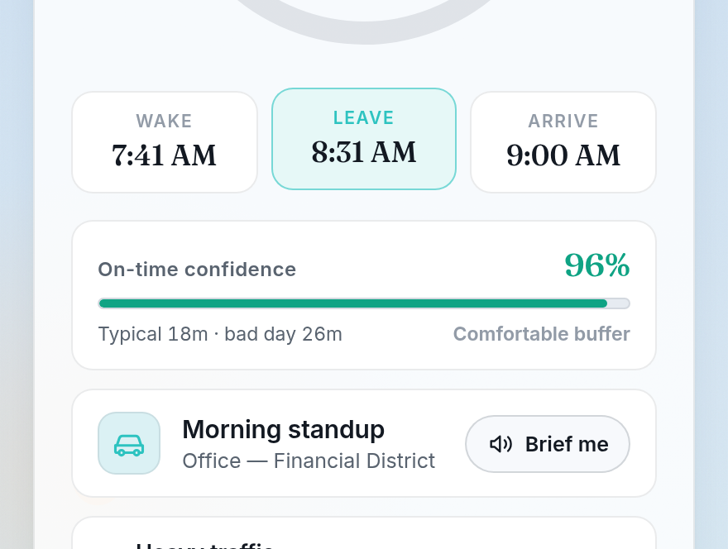
One screen answers the three questions that matter.
WHEN DO I WAKE UP?
7:41 AM
WHEN DO I LEAVE?
8:31 AM
WILL I MAKE IT?
96% confidence
Prototype example shown
5
Notes:
This is the main screen. You do not need to read a spreadsheet or guess from a map. The biggest information is wake, leave, and arrive. The confidence bar is a quick check on whether the current plan has enough cushion.

Slide 6
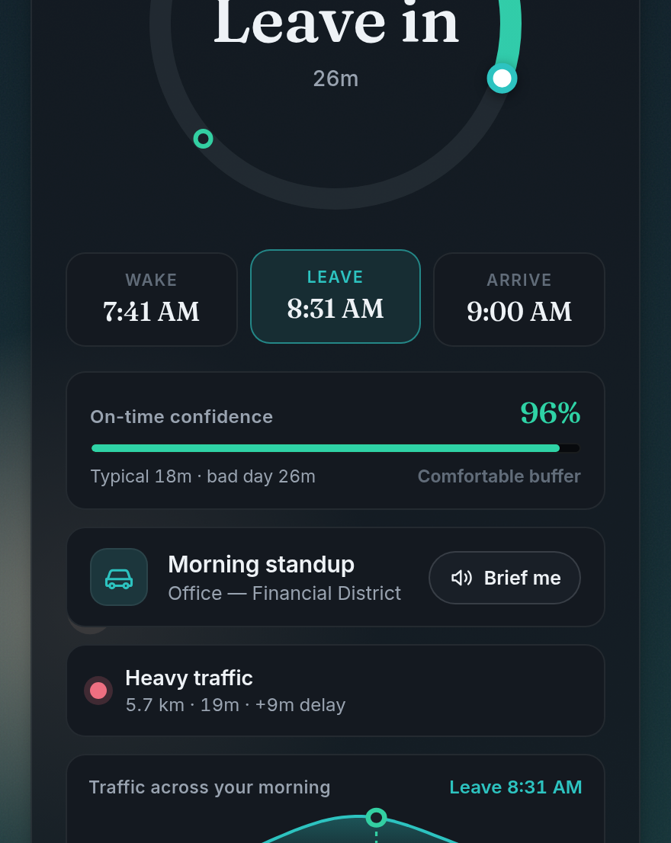
Traffic changes the plan—not the deadline.
Same 9:00 AM arrival. Same 10-minute buffer.
TYPICAL ROUTE
HEAVY TRAFFIC
10 min
19 min
Leave at 8:40
Leave at 8:31
The wake time moves 9 minutes earlier too.
6
Notes:
The screen shows a 19-minute trip with a nine-minute delay. Since the arrival goal and buffer stay the same, the leave time moves from 8:40 to 8:31. The wake time follows it earlier by the same amount.

Slide 7
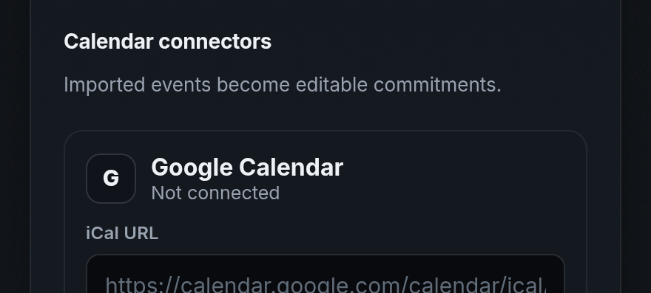
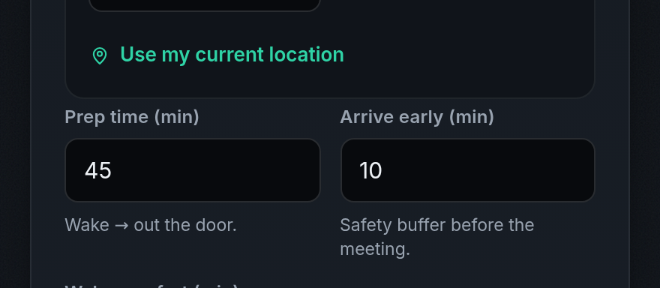
It fits the messy parts of real mornings.
Calendar in, less typing
Your morning, your buffer
Bring in school, practice, or work events, then edit what matters.
Set getting-ready time, arrive-early time, and how you are traveling.
Drive · transit · bike · walk | alerts when the plan changes
7
Notes:
The app is not built around one perfect routine. It can use calendar events, different travel modes, personal prep time, and an arrival buffer. Those choices are visible and editable.

Slide 8
A regular alarm wakes you at a time. Departure wakes you for a reason.
REGULAR ALARM
DEPARTURE
7:00 every day
Plans around what comes first
No idea how the trip looks
Updates when travel time changes
You do the buffer math
Shows wake, leave, and arrive together
The difference is context.
8
Notes:
We are not trying to make the loudest alarm. The useful difference is context: what you are doing, where it is, how long the trip takes, and how much time you need before leaving.

Slide 9
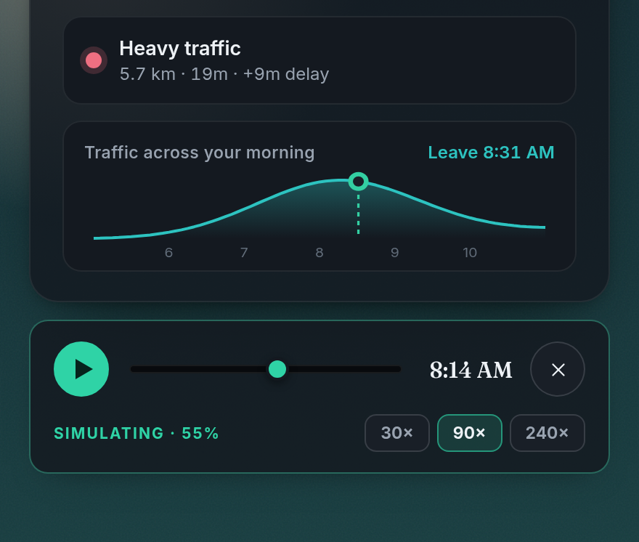
LIVE DEMO
Let's run a morning in fast-forward.
1
Add a commitment
2
Set prep time
3
Hit Simulate morning
Would this make your morning easier?
9
Notes:
Now show the simulation. Add or choose a commitment, point out prep time, then fast-forward. End by asking the room what would make this useful enough to trust on a real school morning.

