Slide 1

Keep Driving
By: Vaughan Hilts, Giovanni Romano, Brandon Smith

Slide 2
Description
EV-Go is a web application for electric car drivers.
It allows them to plan trips with their electric car, creating a route that passes through charging stations.
It takes into account the properties of their car, such as its range on a full charge and its compatibility with different types of charging stations.

Slide 3
Features
can choose car by model and specific spec
displays map with route through optimal necessary stops
can export route to Google Maps
auto complete for search boxes using Google Maps API
works on mobile devices
server is multithreaded

Slide 4
Architecture - Client
AngularJS 2.0 (web framework)
Materialize (style/CSS)
NPM (dependency management)
Typescript (statically typed JavaScript)

Slide 5
Architecture - Server
Node.js (API server)
zeroMQ/zeroRPC (message queue)
Restify (API framework)
MySQL (database engine)
Mocha (unit tests)
Python
Google Maps API
Open Charge Map API (data source)
A zeroRPC server
NGIX (HTTP Server)

Slide 6
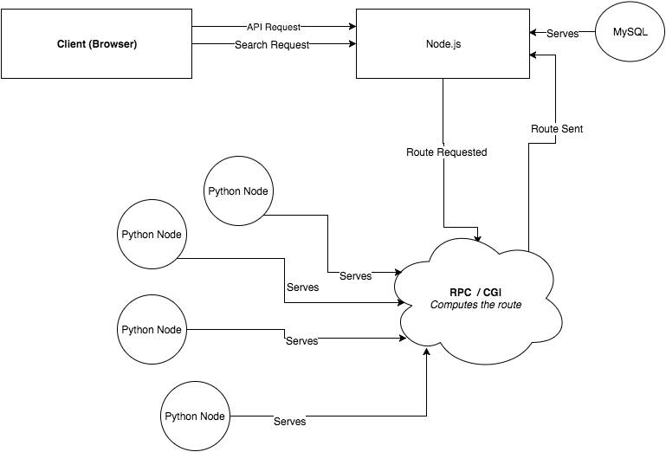
Architecture - Overview

Slide 7
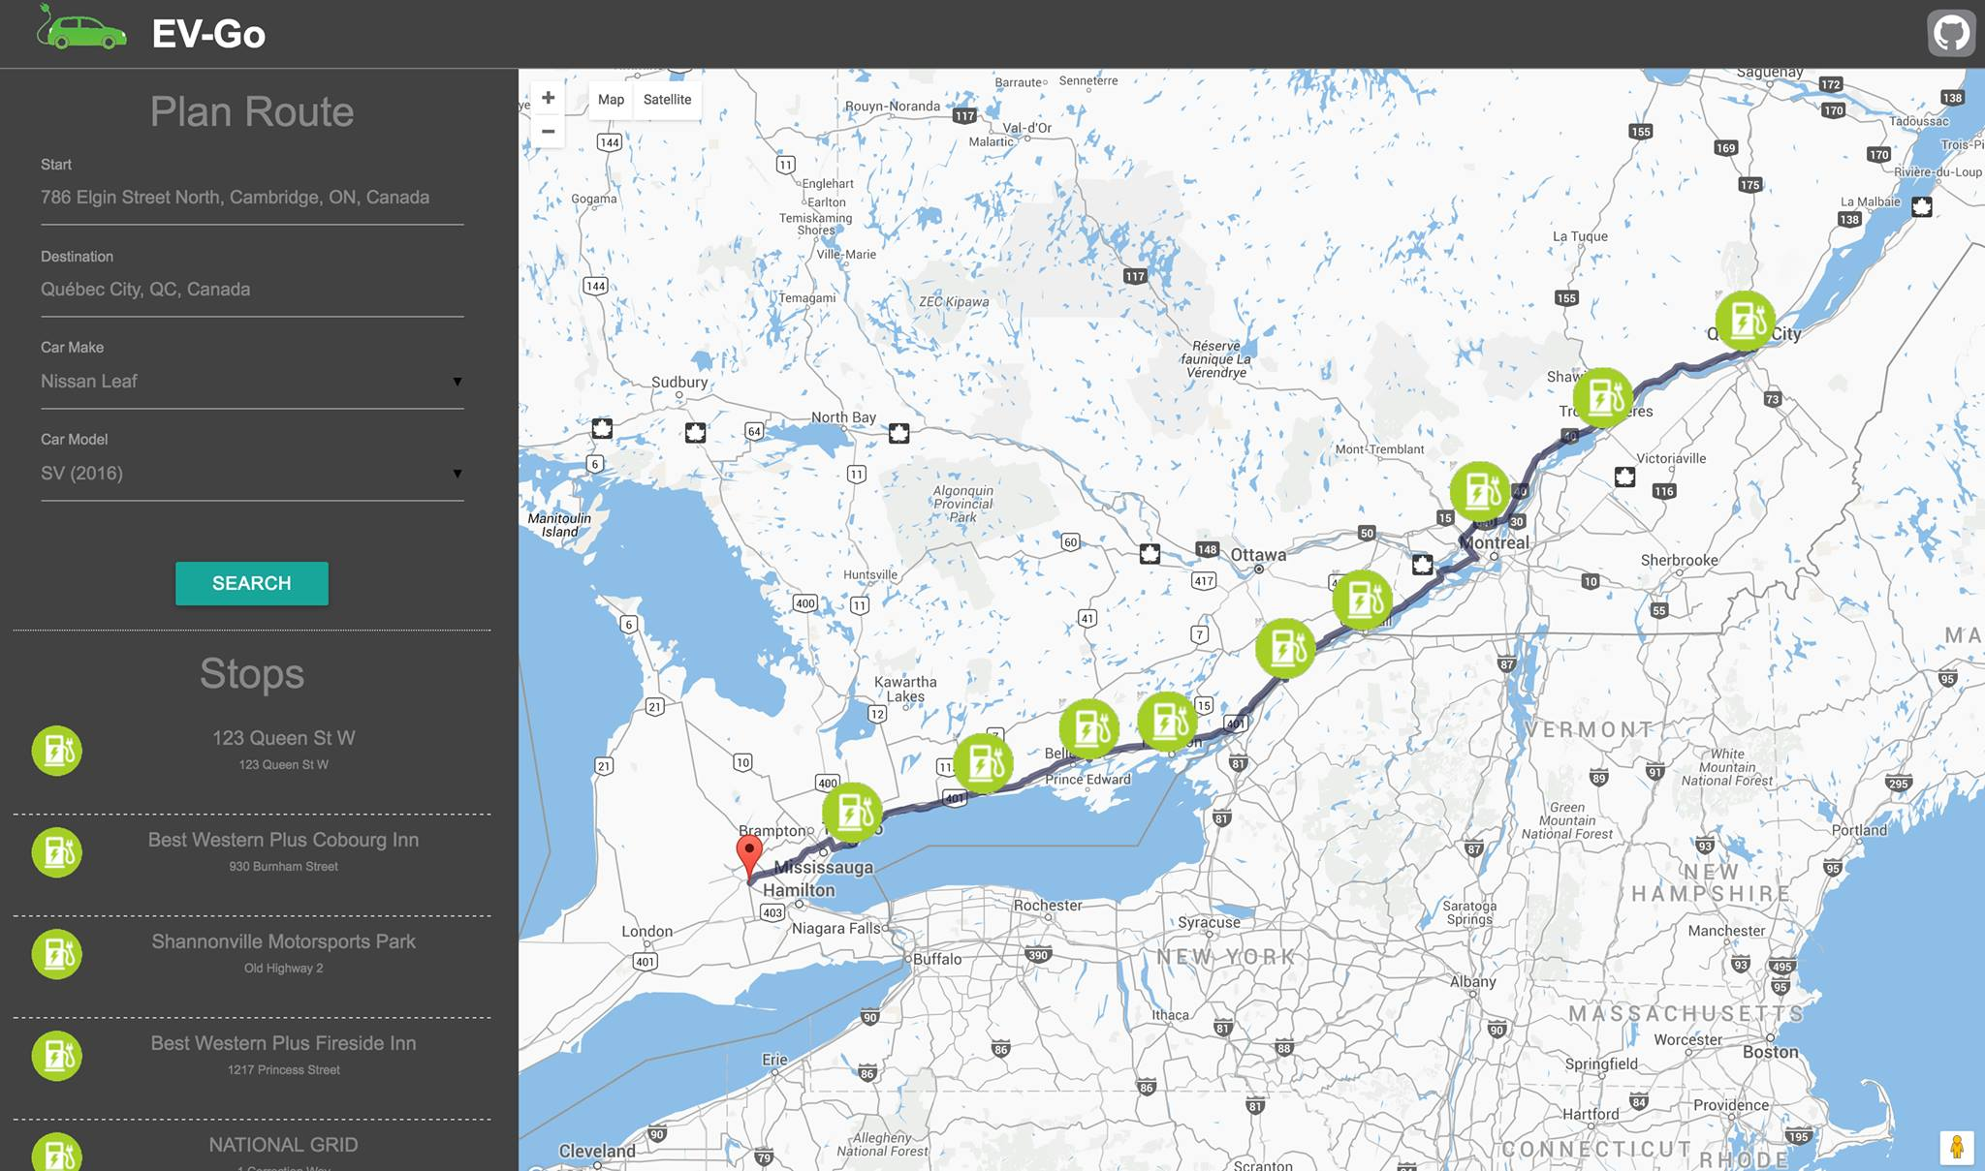

Slide 8
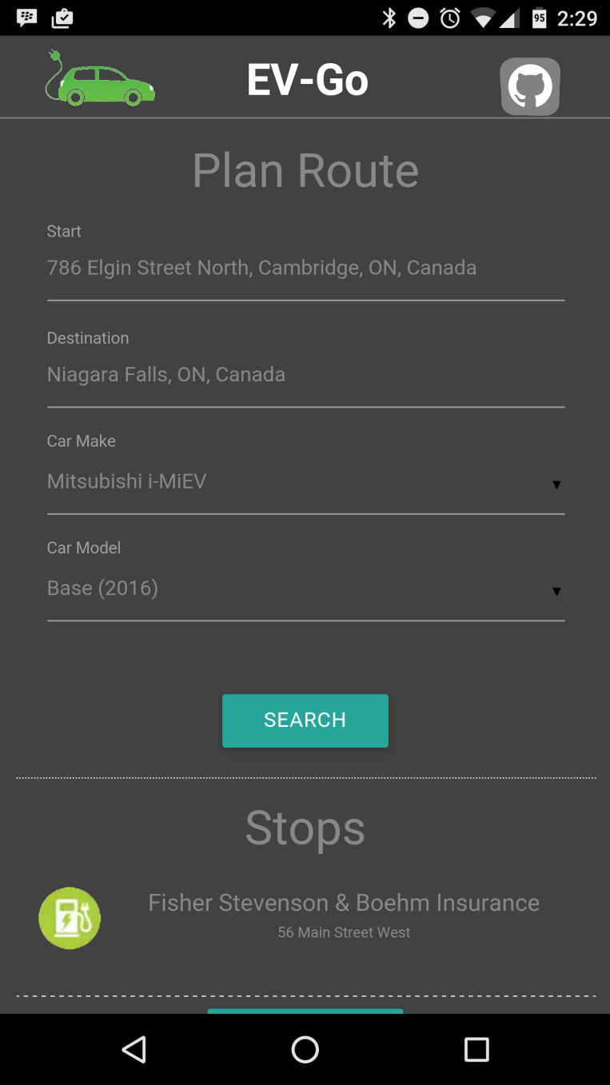

Slide 9
