Slide 1
DSA + JAVA
Date: 31/08/2025

Slide 2
Arrays
Definition: A linear data structure in which similar type data is stored in contigous / continous memory locations having fixed size.
Initialization:
int arr[] = new int[`size`];
int arr[]={ , , , , , };
int arr[]=new int[]{ , , , , ,};
JVM throws ArrayIndexOutOfBoundsException to indicate that the array has been accessed with an illegal index.
In Java, array is given memory at runtime. During rt , when array is created a proxy class is created .

Slide 3
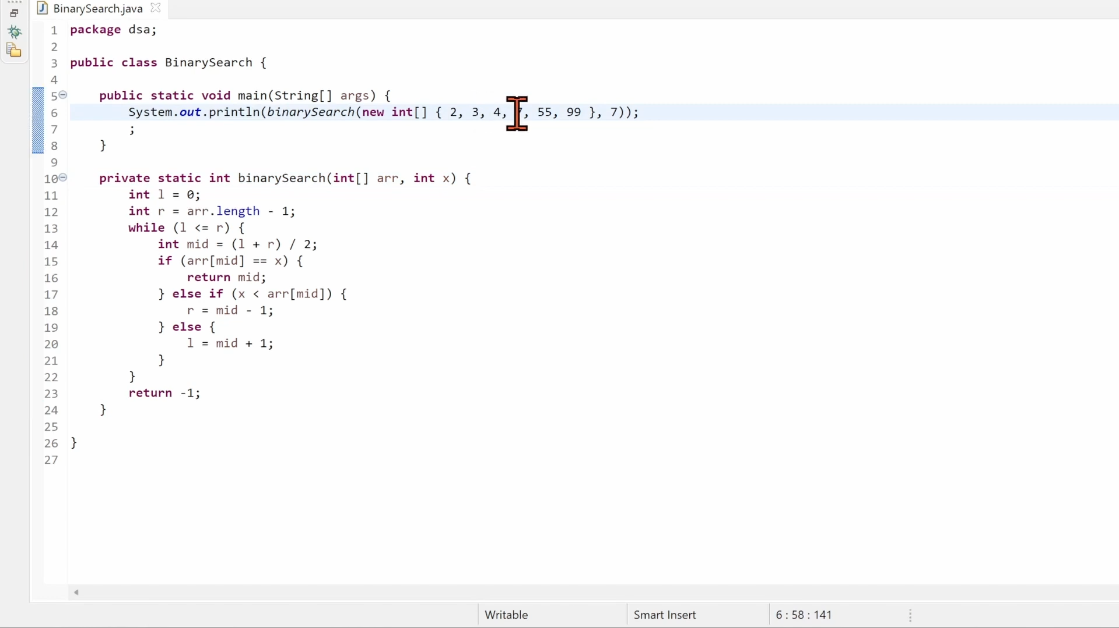
Arrays
Searching : Linear & Binary

