Slide 1

FAMILY AI AGENT
Hi, I’m
Cheese!
A little help for Mom and Dad,
right in the family chat.
CHEESE
0:00–0:06
Notes:
0:00–0:06 (6 seconds)
Narration
Hi, I’m Cheese. I help Mom and Dad in the family chat.
Recording cue
Use this frame for the opening. If animating the mascot in Higgsfield, give Cheese a small wave and a gentle blink, with a steady camera. Keep the title as a separate slide layer. Smile and pause after “Cheese.”
Source
https://github.com/him55710-sudo/personal-ai-agent-for-aging-people/tree/main/fa-kakao-demo

Slide 2

THE PROBLEM
It starts with a small favor
1
Talk it through
“Could you help me cancel
a subscription?”
2
Get stuck at sign-in
3
Go over to help
A quick favor can turn into a house call.
CHEESE
0:06–0:23
Notes:
0:06–0:23 (17 seconds)
Narration
Mom asks me to cancel a subscription. Sounds easy, right? Then we’re on the phone trying to sign in, and before long I’m saying, “I’ll come over and help.”
Recording cue
Read Mom’s line like a familiar conversation. Reveal the steps in order in the video edit, or hold on the whole slide.
Source
https://github.com/him55710-sudo/personal-ai-agent-for-aging-people/blob/main/docs/submission/SUBMISSION.md

Slide 3
THE SOLUTION
One family chat. The right person’s agent.
Cheese figures out whose account the request is about.
Family chat
Separate workspaces
Son
Mom’s workspace
“Check Mom’s subscriptions.”
Cheese
Personal agent in her VM
Routes the request
Dad
Checks access first
Dad’s workspace
“Show my subscriptions.”
Personal agent in his VM
Family members can help from the chat. Each owner controls access.
CHEESE
0:23–0:42
Notes:
0:23–0:42 (19 seconds)
Narration
Cheese works from one family chat. When I ask about Mom’s subscriptions, it routes the job to Mom’s personal agent. When Dad asks about his own, it goes to Dad’s workspace. Each person decides who can help with their account.
Recording cue
Follow the top row first, then the bottom row. The routes illustrate the product design. The following demo uses sample workspaces.
Source
https://github.com/him55710-sudo/personal-ai-agent-for-aging-people/tree/main/fa-kakao-demo

Slide 4
THE TECHNOLOGY
Cheese checks before acting
Who asked? Whose account is it? Who needs to approve?
Access already granted
Needs a closer look
“Show Mom’s subscription list.”
“Move money from Mom’s account to mine.”
Go ahead in Mom’s workspace.
Pause and ask for approval.
Alert the family if it looks suspicious.
Claude tool calls suggest actions. FA policy decides what can run.
fa-trust checks devices with Schnorr proofs and splits session keys with Shamir shares.
KakaoTalk-style chat / Letsur and Vercel model APIs / Node.js and SQLite CLI
CHEESE
0:42–1:08
Notes:
0:42–1:08 (26 seconds)
Narration
If Mom has already shared her list, Cheese can check it right away. If someone asks to move money out of her account, Cheese pauses for approval and alerts the family if it spots signs of a scam. Claude can suggest actions in the FA Engine. Policy code decides what can run, and fa-trust checks registered devices and splits session keys.
Recording cue
Show the routine request and the transfer request side by side. The KakaoTalk subscription demo uses a rule-based router. Claude tool calls belong to the separate FA Engine. Additional family approvals depend on the policy.
Source
https://github.com/him55710-sudo/personal-ai-agent-for-aging-people#기술-스택과-신뢰-설계

Slide 5
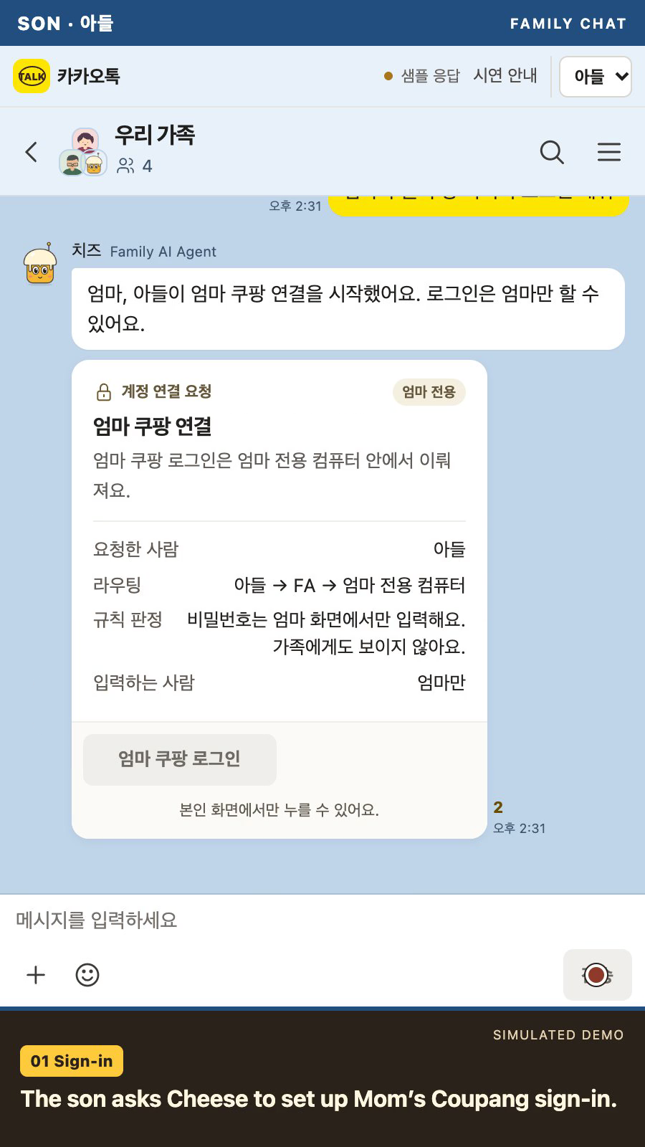
DEMO
Let’s help Mom
1
Ask Cheese
The son asks Cheese to set up Mom’s sign-in.
2
Mom stays in control
Mom grants access and approves the TVING cancellation.
Video starts automatically · 49 sec
KakaoTalk mockup with a sample account and VM
CHEESE
1:08–1:57
Notes:
1:08–1:57 (49 seconds)
The embedded demo video starts automatically. It includes English narration. Leave the simulated-demo label visible.

Slide 6
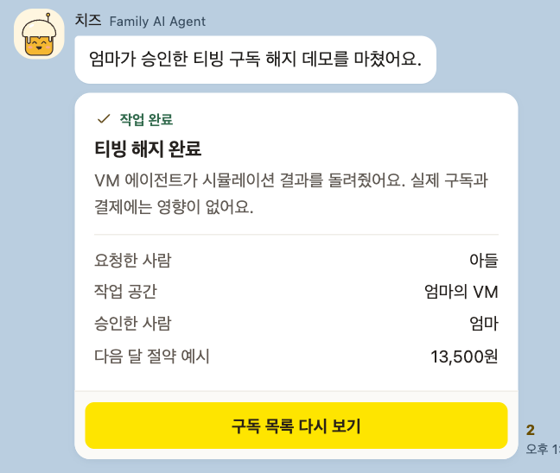

DEMO RESULT
All set, Mom!
Mom made the call.
The family sees the result.
KakaoTalk mockup with a simulated cancellation
CHEESE
1:57–2:00
Notes:
1:57–2:00 (3 seconds)
Narration: That’s Cheese.
Hold the result card and close on the mascot.

