Slide 1
FinRisk AI
AI-Powered Financial Risk Intelligence & Event-Driven Stress Testing
Hima Agarwal · VIT Bhopal University
S&P Global & Crisil Hackathon 2026

Slide 2
Problem & Approach
The problem
Our approach
Scope
Risk teams drown in unstructured news but need structured signals and a fast answer: what happens to our portfolio?
A rule-based NLP engine turns headlines into sentiment, event type and impact score. Impact above 7 triggers a stress test.
Unified NLP Risk Engine plus Module B, event-driven portfolio stress testing, built end to end.
News text
NLP engine
Risk signal
Impact > 7?
Stress test
Dashboard

Slide 3
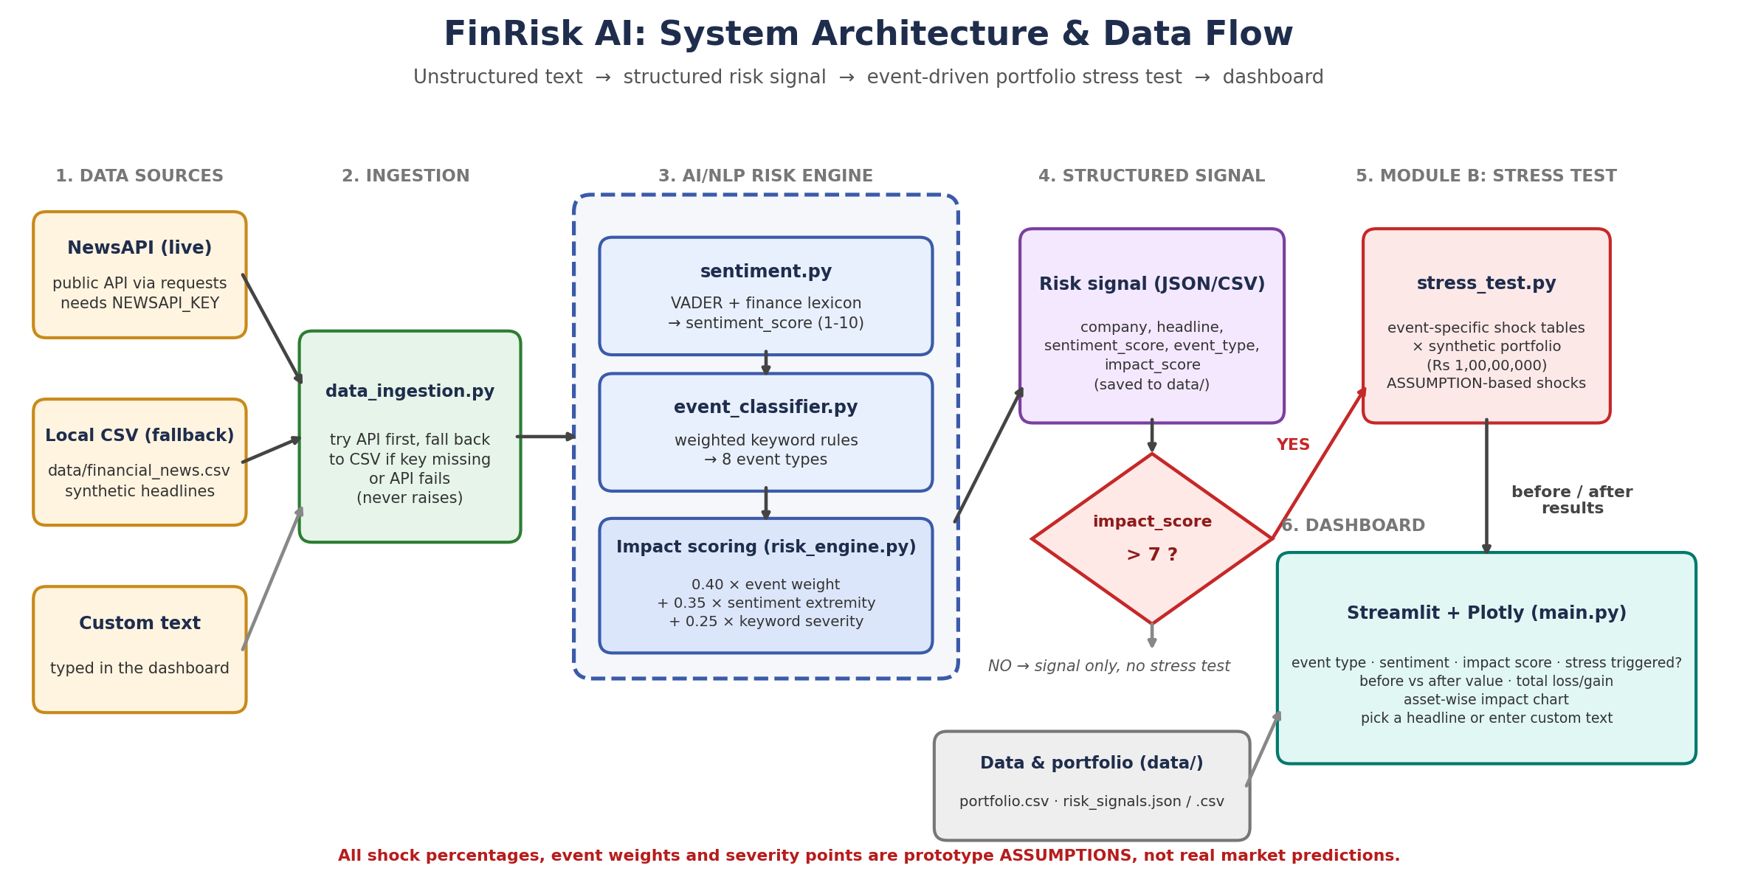
System Design

Slide 4
Implementation Highlights
Module | Tech choice | Why
Ingestion | NewsAPI + CSV fallback | Demo never fails offline
Sentiment | VADER + finance lexicon | Plain VADER misses "downgrade", "default"
Event & impact | Weighted keyword rules | Fully traceable, no black box
Stress test & UI | Shock tables, Streamlit, Plotly | Event-specific and interactive
impact = 0.40 × event weight + 0.35 × sentiment extremity + 0.25 × keyword severity

Slide 5
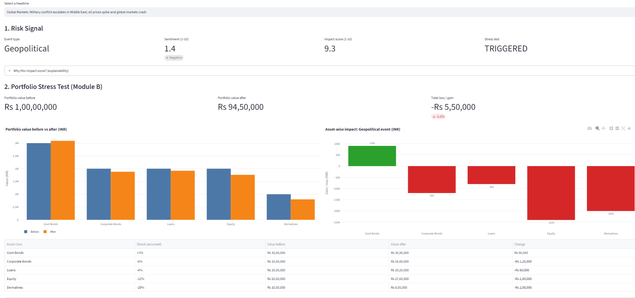
Key Results
20
Headline | Event | Impact | Change
Military conflict, crash | Geopolitical | 9.3 | -Rs 5,50,000
Sanctions, supply fears | Geopolitical | 8.4 | -Rs 5,50,000
Yes Bank downgrade | Fin. Performance | 7.7 | -Rs 5,30,000
Recession, GDP falls | Macroeconomic | 7.6 | -Rs 5,20,000
SEBI probe, Adani | Regulatory | 7.3 | -Rs 4,50,000
headlines analyzed
5
triggered the stress test
Positive news (profit, launches) scored low and correctly did not trigger a stress test .20 headlines analyzed ->5 stress tests triggered.

Slide 6
Domain Impact
1
Structured signals
2
Event to loss
Turns unstructured text into machine-readable risk signals other systems can consume.
Links an event to a portfolio-level loss figure for early warning and scenario talks.
3
Explainable by design
4
Extensible
Every score shows its components, which suits audit and model-risk review.
Ready for custom portfolios, live feeds and stronger models like FinBERT.

Slide 7
Limitations & Next Steps
Limitations
Next steps
Rule-based NLP can miss sarcasm and negation
No labelled-data validation, so no accuracy claim
Shock tables and weights are assumptions
One static synthetic portfolio
FinBERT or zero-shot classifier
Validate on a Kaggle financial-news dataset
Calibrate shocks with historical prices
Custom portfolios and the GDELT feed
Thank you
DEMO VEDIO:https://youtu.be/6XBeXS6_SW4?si=slWE46omuLbArPBU
GITHUB LINK:https://github.com/hima-agarwal-11/FinRisk_AI

