Slide 1

HACKATHON OS
HackVault
The Unified Command Center for Competitive Builders
Eliminating the "Context-Switching Tax" — one sandbox, one source of truth, zero friction.

Slide 2
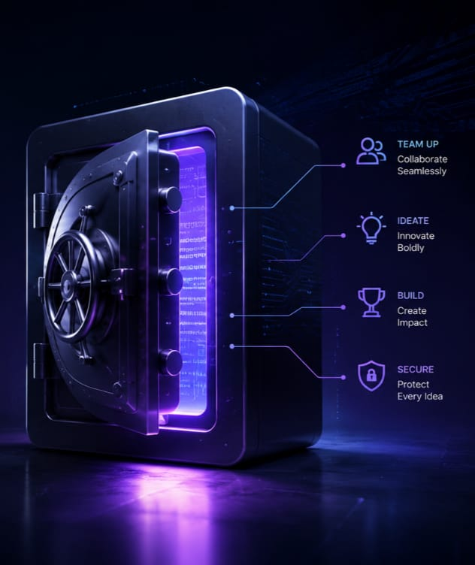
THE PROBLEM
The Fractured Builder Workflow
Hackathon builders bleed hours across 7+ disconnected tools — Claude, ChatGPT, Lovable, GitHub, Figma, Discord, Drive. Every context switch is a tax.
🔄 Alignment Drift
⏰ Buried Deadlines
AI tools receive conflicting project specs, generating off-target outputs.
Registration windows close in Discord threads nobody reads.
📦 Scattered Assets
Code, designs, and docs live across Drive, GitHub, and DMs.

Slide 3






THE SOLUTION
The Unified Orchestration Layer
HackVault replaces tool chaos with three coordinated systems — one per competition, one source of truth, one-click execution.
Dedicated Sandbox Blocks
Context Engine
Smart Launcher
Every competition gets an isolated environment housing all assets, deadlines, and project context.
A central source of truth storing project specs and keeping all AI tools aligned on the same vision.
One-click execution into external tools with context pre-loaded. No re-explaining, no copy-paste.

Slide 4
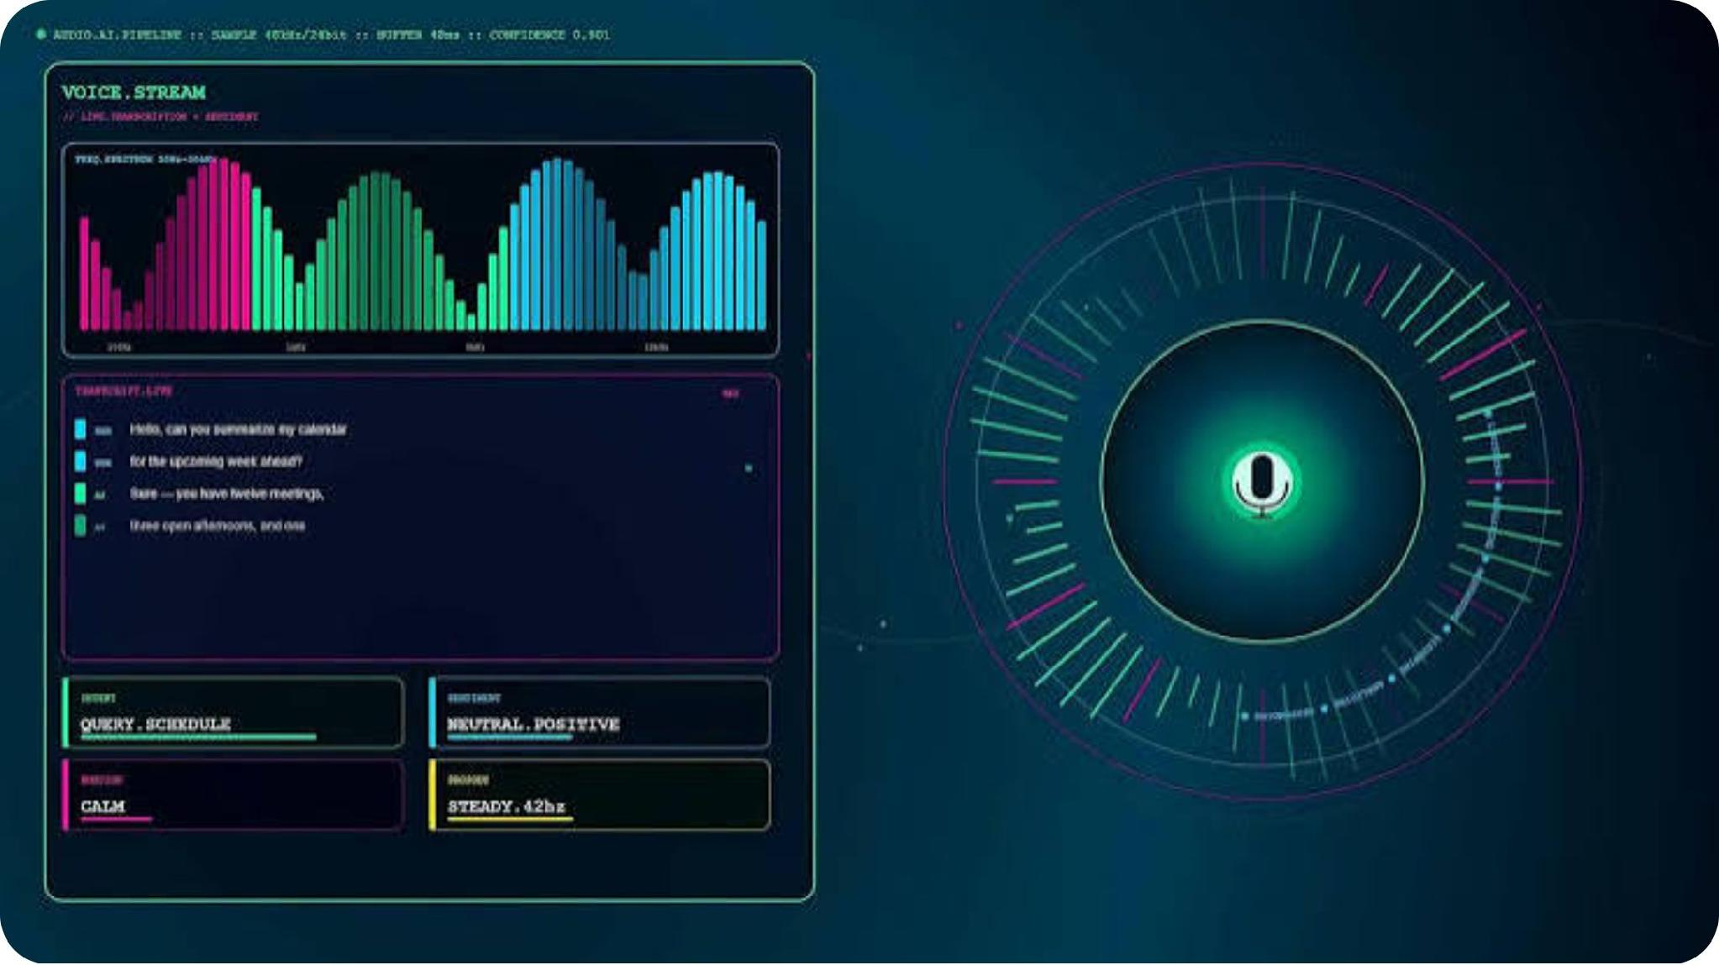



CORE WORKFLOW
Drop Once, Build Everywhere
From Raw Concept to Structured Output
A builder drops a raw project idea — via natural text or voice entry. The Context Engine automatically parses the vision into structured metadata, then pre-loads prompts into downstream production tools.
Input — Raw concept via text or voice
Parse — Context Engine structures metadata
Deploy — Prompts pre-loaded into AI tools

Slide 5




DASHBOARD ARCHITECTURE
Three Streams of Focus
Ongoing Stream
Upcoming Stream
Active hackathon blocks with live round status and time-remaining progress bars.
Verified registrations queued by deadline proximity to prevent schedule overlaps.
Completed Stream
Historical read-only archive storing past submission assets, code snapshots, and badges.

Slide 6
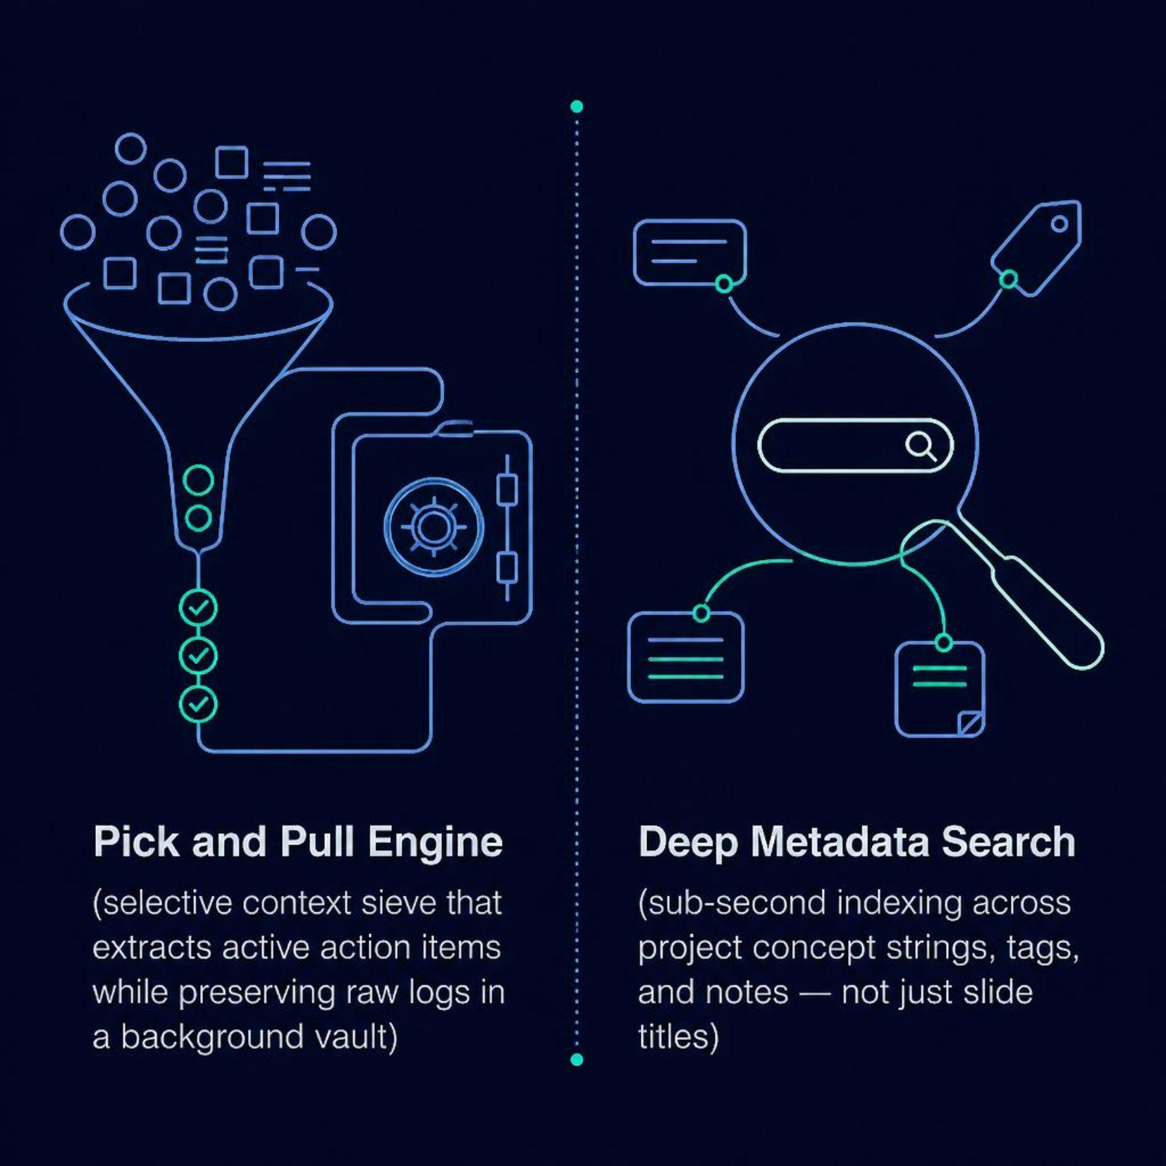
KEY FEATURES
Precision Tools for Builders
Engineered for Speed & Clarity
Every feature is designed to reduce cognitive load and eliminate redundant work during high-pressure hackathon sprints.
Pick & Pull Engine
Selective context sieve — extracts active action items while preserving raw logs in a background vault.
Deep Metadata Search
Sub-second indexing across concept strings, tags, and notes — not just slide titles.

Slide 7




PROOF OF WORK
The Validation Wall
Completed Blocks convert into a public proof-of-work portfolio — verified completion badges, rank certificates, submission links, and team photographs, all in one place.
Verified Badges
Completion credentials tied to each hackathon block.
Rank Certificates
Placement and ranking documentation for every submission.
Submission Links
Direct links to repos, demos, and pitch decks.

Slide 8

BUSINESS MODEL
Scalable Platform Tiers
Free tier for individual builders. Premium for teams and power users who need full orchestration.
Feature
🆓 Free
⭐ Premium
Search
Title Query
Deep Metadata Scan
Gallery
1 Asset / Block
5 Assets / Block
Input
Text Only
Voice Parsing Engine
Alarms
Basic Reminders
Multi-Channel Cascading Alerts
Premium unlocks the full Context Engine, Smart Launcher, and Proof-of-Work Portfolio.

Slide 9
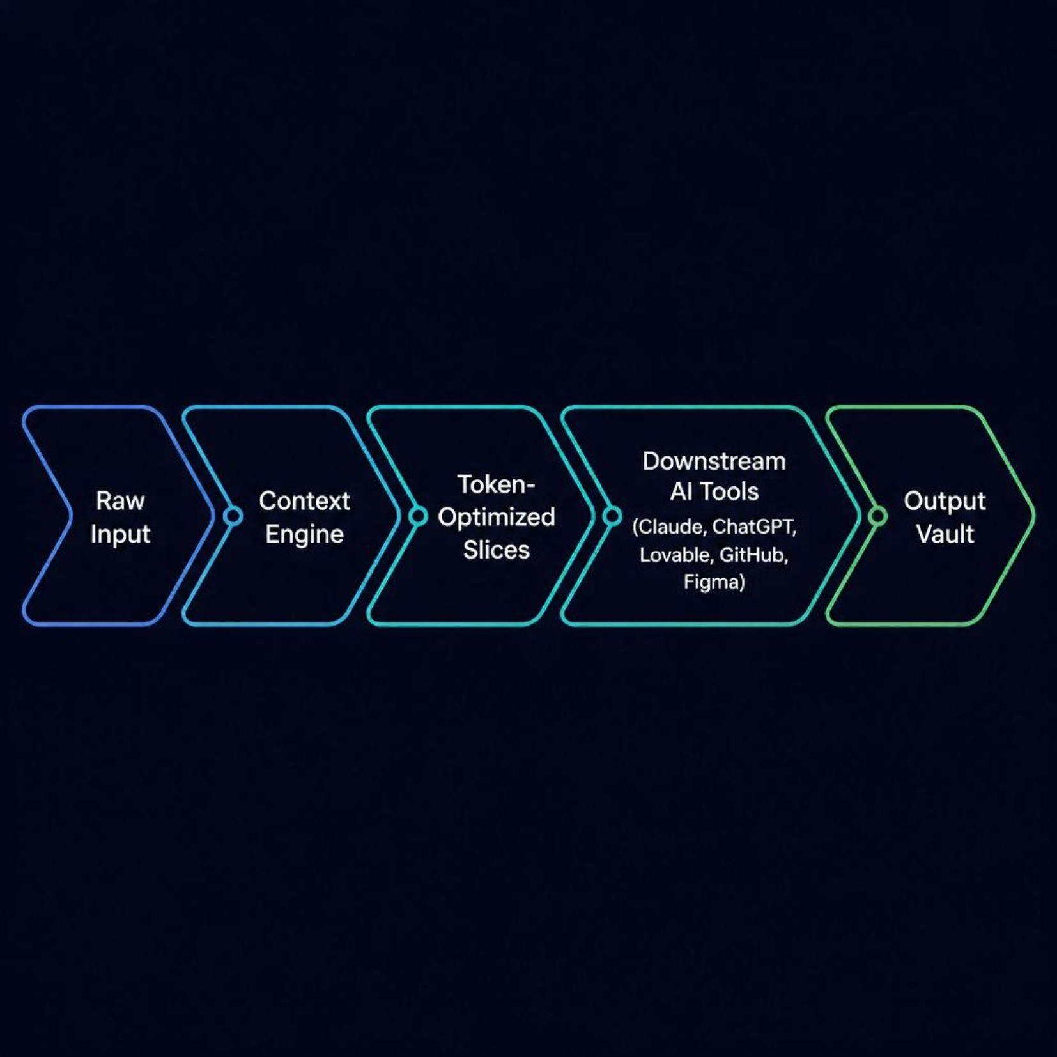
ROADMAP
Architecture Principle
MVP Pillars & Engine Architecture
Token-optimized infrastructure passes only relevant context slices to downstream tools — minimizing API costs while maximizing alignment.
MVP Pillars
01
Block Sandbox — Isolated competition environments
02
Context Indexing — Structured metadata parsing
03
Smart Redirect Framework — One-click tool handoffs
04
Deadline Hooks — Automated schedule tracking
05
Output Vault — Persistent asset archive

Slide 10

JOIN THE VAULT
From Raw Concept to Submission-Ready Prototype
One source of truth. Zero context tax.
🔗 HACKVAULT.DEV
Alpha access now open for competitive builders.
🚀 Alpha Access
Early adopters get Premium features at launch pricing.

