Slide 1
Web Scraping using Python
by Sarath Chandra

Slide 2
Agenda
Introduction to Web Scraping.
Introduction to HTML.
Inspecting a website.
Demo Web scraping program using Python.

Slide 3
What is Web Scraping?
Why?
Web Scraping is the technique of automatically extracting data from websites using software/script.
1. Extract product details including price, images etc. from eCommerce websites for populating other websites, competition monitoring etc.
2. Extract business contact details including name, address, email, phone, website etc. from Yellow Pages, Google Maps etc. for marketing and lead generation.
3. Extract property details as well as agent contact details from real estate websites.

Slide 4
Is it legal to scrape data from websites using software?
The answer to this question is not a simple yes or no.
The real question here should be regarding how you plan to use the data which you have extracted from a website.
Because the data displayed by most website is for public consumption.
It is totally legal to copy this information to a file in your computer.
If the data is downloaded for your personal use and analysis, then it is absolutely ethical.
But in case you are planning to use it as your own, in your website, in a way which is completely against the interest of the original owner of the data, without attributing the original owner, then it is unethical, illegal.

Slide 5
Basic steps of Web Scraping
Find the URL that you want to scrape.
Inspecting the Page.
Find the data you want to extract.
Write the code.
Run the code and extract the data.
Store the data in the required format.
Websites
Web Scraping
Local structured data storage

Slide 6
HTML
The <HTML> is a markup language which is used by the browser to manipulate text, images and other content to display it in required format.
Tags in HTML: Tags are one of the most important part in an HTML Document. HTML uses some predefined tags which tells the browser about content display property, that is how to display a particular given content. For Example, to create a paragraph, one must use the paragraph tags(<p> </p>) and to insert an image one must use the img tags(<img />).

Slide 7
Basic Structure of HTML
<!DOCTYPE html>
<html>
<head>
<title> </title>
</head>
<body>
</body>
</html>

Slide 8
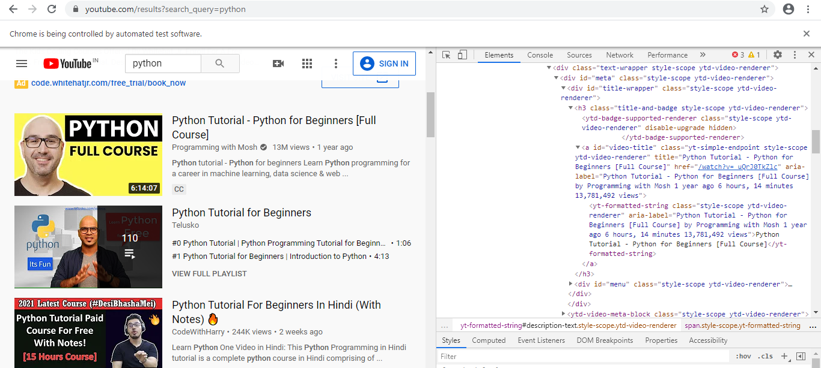
Inspecting a Website

Slide 9
Shall we start the fun part now?

