Slide 1
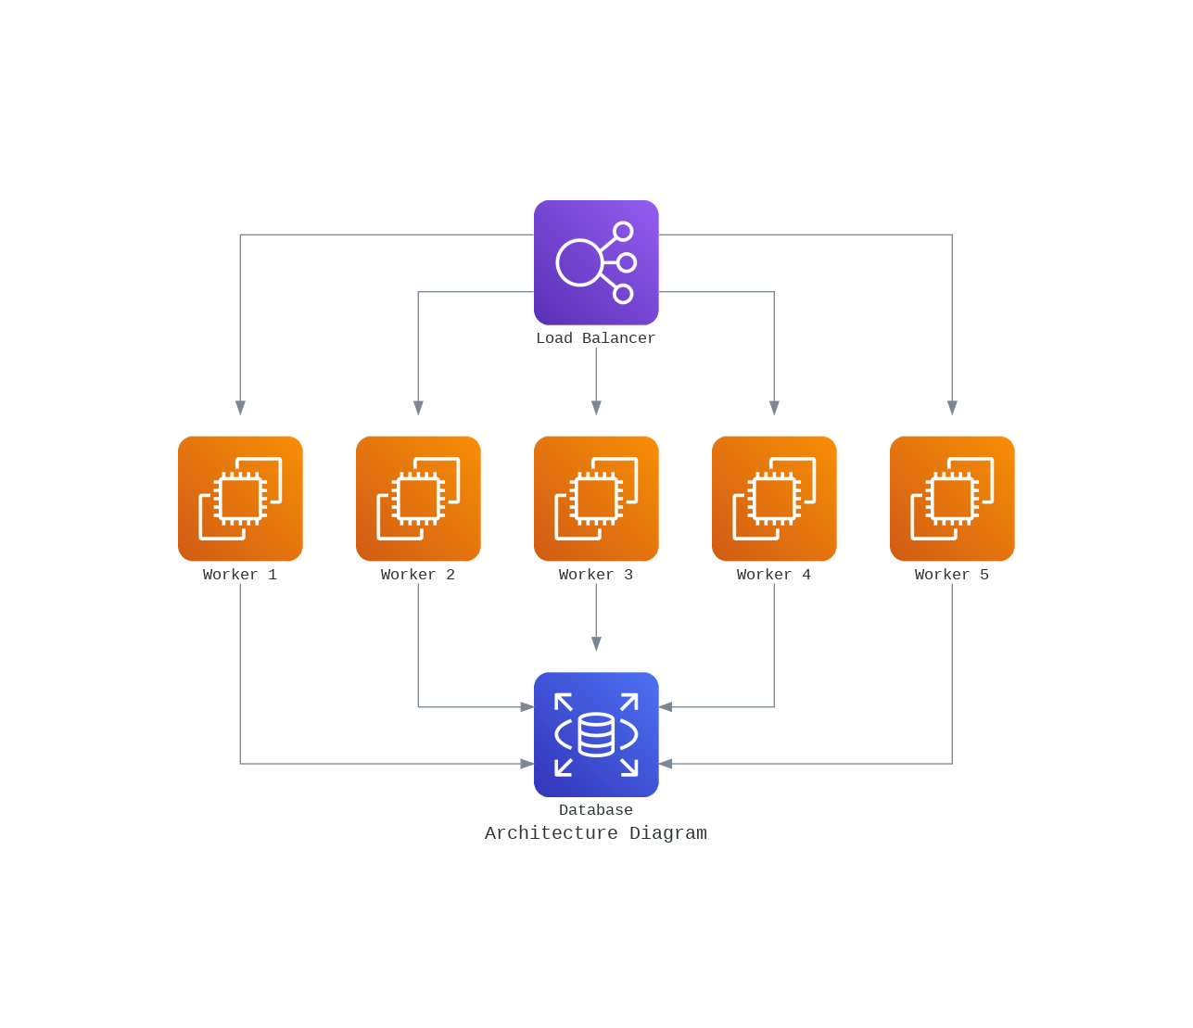
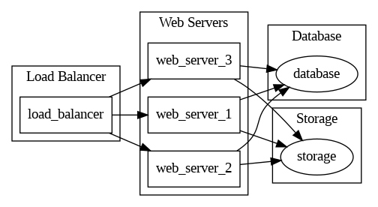
Challenges: Complexity of Architectural Diagrams: Architectural diagrams can be highly complex, with numerous components, connections, and dependencies. It can be challenging for generative AI to capture the intricacies of these systems accurately and comprehensively through text descriptions alone. Ambiguity and Subjectivity: Architectural descriptions may contain ambiguous or subjective elements. AI models may struggle to disambiguate such descriptions and may not always align with the intended understanding of the architecture. Fine-Tuning Prompt: Crafting an appropriate prompt for the GPT model is crucial to get relevant and accurate for generating diagrams. Experimentation and expertise are often required to fine-tune the prompt effectively. Token Limit Issue: GPT models have token limitations, and prompts for fine tuning can run into token count restrictions. Managing this constraint while retaining the consistency of the diagram can be a significant challenge. API Key and Environment: Implementing GPT-model requires setting up the API key and the environment for using the model, which may involve integration into existing systems, cloud computing, and other technical considerations. Benefits: Efficiency: Generative AI can quickly provide textual descriptions of complex architectures. This can expedite the initial phase of creating architectural diagrams, saving time in the early planning and design stages. Idea Generation: AI can help generate new architectural ideas or alternative approaches that might not have been considered, providing fresh perspectives for architects and designers. Automation Integration: With advancements in AI and diagramming tools, there is the potential for more seamless integration, allowing for AI-generated descriptions to be automatically translated into visual diagrams. Prototype Generation: For simple or small-scale architectures, AI-generated descriptions may be sufficient to create rudimentary prototypes or mockups. Innovation and Experimentation: AI can encourage experimentation and innovative thinking by suggesting alternative architectural solutions based on input descriptions.
Gen-AI Front-End for Architects
The Generative AI approach for generating Interactive Architectural Diagrams leverages GPT-3 models to assist in the creation of textual as well as visual descriptions in a diagram.
The use case incorporates the implementation of two libraries: Diagrams and Graphviz.
The generated Architectural Diagram provides a clear and concise overview of the key components and their interactions within a cloud service.
The following diagrams showcase two approaches for generating Architectural Diagrams:
A Fine-tuned GPT model using Diagrams Library
A GPT model using Graphviz Library

