Slide 1

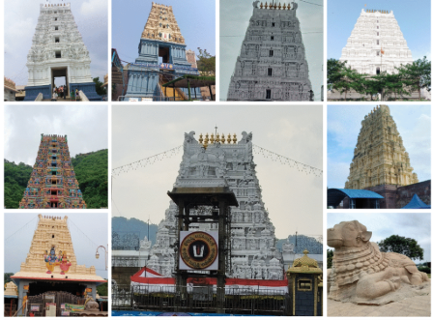
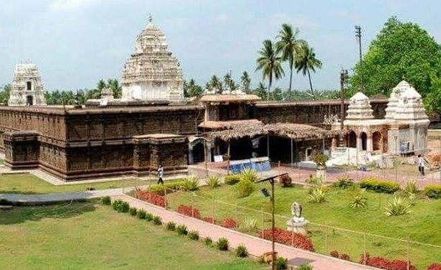
Temple tourism
Introduction
A web platform to discover India’s sacred places
India has thousands of temples rich in history, art and faith.
Temple tourism draws millions of pilgrims and travellers every year.
It supports local culture, jobs and heritage preservation.
Technology can make temple visits easier and better planned.

Slide 2
Problem Statement
1
2
3
4
Scattered Info
Poor Planning
Crowd Issues
Hidden Temples
Temple details like history, timings and rituals are spread across many sites.
Travellers struggle to find routes, nearby stays and the best visiting times.
No easy way to know festival dates or rush hours before visiting.
Lesser-known heritage temples get little visibility online.

Slide 3
Proposed Solution
1
2
3
4
Temple Directory
Live Details
Maps & Routes
Responsive Site
Search temples by name, state or deity with photos and history.
Timings, festivals and weather fetched in real time through APIs.
Interactive map to locate temples and plan the journey.
Clean, colourful website that works on mobile and desktop.

Slide 4
Technologies Used
H
C
JS
API
HTML
CSS
JavaScript
API
Structures the pages: temple listings, details and forms.
Colourful styling, layouts, animations and responsive design.
Adds interactivity: search, filters and dynamic content.
Fetches temple data, maps and weather from external services.

Slide 5
Conclusion
The platform brings temple information into one easy place.
It helps devotees and tourists plan trips with confidence.
Built with HTML, CSS, JavaScript and APIs – simple and scalable.
Future scope: online booking, multi-language support and a mobile app.

Slide 6

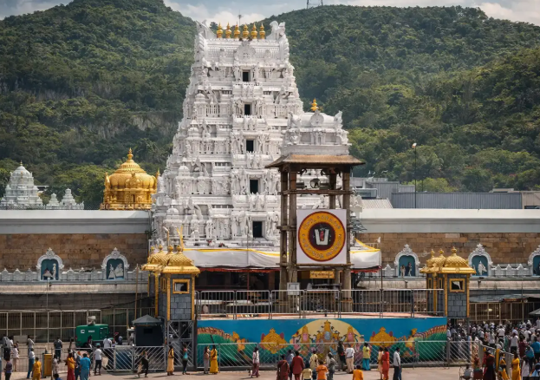
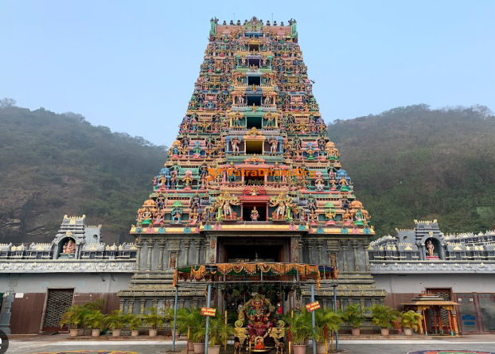
Thank You!
Any Questions?

