Slide 1


SMART INDIA HACKATHON 2026
TITLE PAGE
• Problem Statement ID – SIH26189
• Problem Statement Title - AI-Powered
Criminal Network Analysis System
• Theme-Blockchain & Cybersecurity
• PS Category- Software
• Team ID- AUS_SIH26_309
• Team Name (Registered on portal)

Slide 2
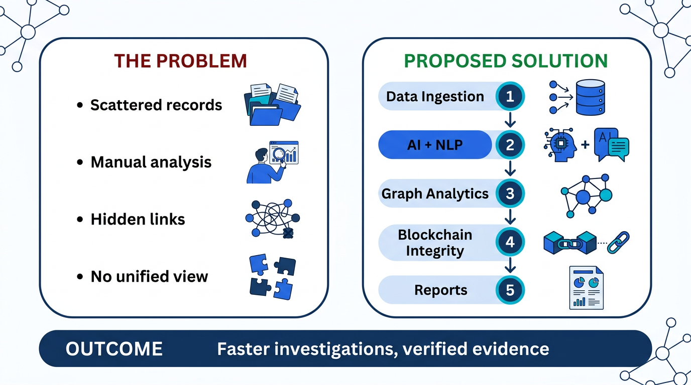
Your
Team
AI-Powered Criminal Network Analysis System
Name
@SIH Idea submission- Template
2

Slide 3
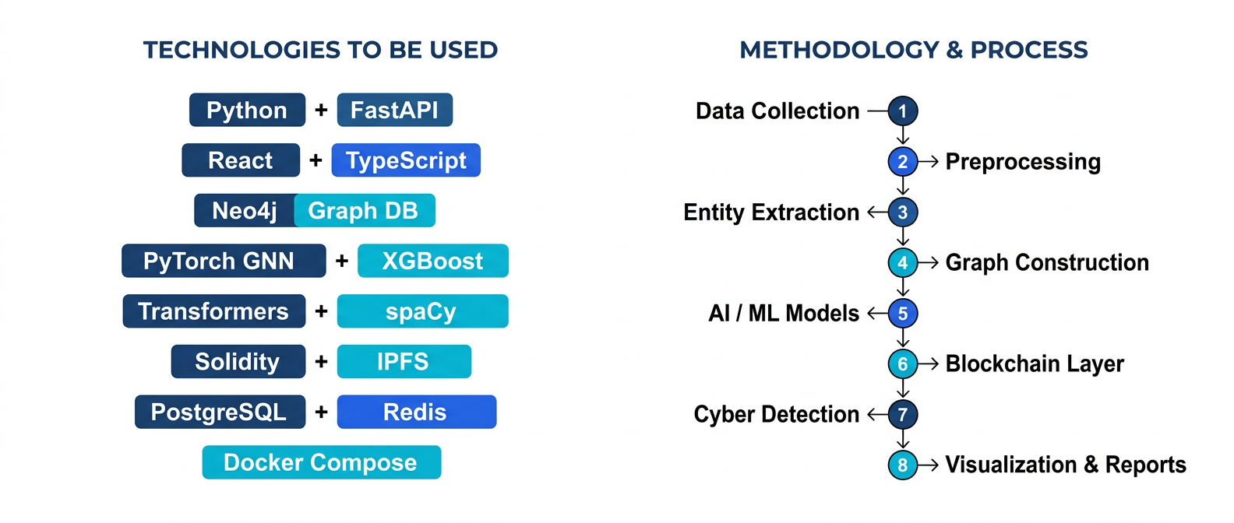
TECHNICAL APPROACH
Your
Team
Name
@SIH Idea submission- Template
3

Slide 4



FEASIBILITY AND VIABILITY
Your
Team
Name
Feasibility
Uses proven AI, graph and blockchain technologies.
Can be tested with anonymised “Operation Mumbai” data.
Scalable for future deployment.
Challenges
Data privacy and security.
Incomplete or inaccurate data.
System integration issues.
Strategies
Secure data access and encryption (JWT, bcrypt, AES-256).
Data cleaning and validation.
Phased implementation and user training.
@SIH Idea submission- Template
4

Slide 5




IMPACT AND BENEFITS
Your
Team
Name
Potential Impact on Target Audience
Helps police investigators identify criminal connections faster.
Supports better decision-making and investigation.
Improves inter-agency coordination via secure data sharing.
Benefits of the Solution
Social: Faster investigations and tamper-proof evidence.
Economic: Reduces crime-related financial losses and saves
investigation resources.
Administrative: Centralised intelligence, immutable audit
trail and inter-agency coordination.
Environmental: Reduces paper-based investigation and manual
documentation.
@SIH Idea submission- Template
5

Slide 6
RESEARCH AND REFERENCES
Your
Team
Name
NCRB – Crime statistics and CCTNS information.
Neo4j Graph Data Science – Graph analysis, link prediction.
PyTorch Geometric (PyG) – Graph Neural Networks framework.
IEEE / ACM Papers – Criminal network analysis with GNNs.
Solidity, Hardhat & IPFS – Evidence integrity, immutable audit.
Useful Links
Neo4j Graph Data Science
PyTorch Geometric
NCRB Official Website
Solidity Documentation
IPFS Documentation
Ganache (Local Blockchain)
@SIH Idea submission- Template
6

