Slide 1

Problem Statement and Team Details
Problem Statement:
Team Name:
Team Leader Name:
Institute Name:
Team Leader Email ID:
Build a Smart Doc Checker Agent that scans multiple docs, flags contradictions, and reports issues clearly.
Binary Brain
Himaja Sadhu
KLH University
sadhuhimaja@gmail.com

Slide 2
Problem and Solution
Problem: Every organization, from startups to universities, manages numerous documents like contracts, policies, and guidelines. Over time, these documents develop hidden contradictions. Manually checking for these conflicts is slow, inefficient, and highly prone to human error, which can lead to disputes, penalties, and confusion.
Solution: We have built the Smart Doc Checker, an AI-powered agent that automates this entire process. Our solution allows users to upload multiple documents, and the AI instantly scans them to:
Identify contradictions and significant overlaps.
Explain the conflicts in simple terms.
Suggest resolutions to ensure consistency. It acts as a fast, accurate, and tireless assistant to maintain document integrity.

Slide 3
Methodology & Implementation
Frontend Interface: The user interacts with a clean web interface built with HTML, CSS, and JavaScript. They can easily upload up to three documents.
API Integration: The core logic resides in the callGeminiAPI function. When the user clicks "Analyze," the frontend sends the text content of the documents to the Google Gemini API.
AI-Powered Analysis: We use a carefully crafted system prompt that instructs the Gemini model to act as a document checker and return its findings in a structured JSON format. This ensures the output is consistent and easy for our application to handle.
Dynamic Results Display: The application parses the JSON response from the AI and dynamically renders the results on the page, creating a color-coded, easy-to-read report of all identified issues.
Simulated Live Monitoring: The "Pathway Live Monitor" feature demonstrates the system's ability to run a new conflict check automatically when an external policy document is updated, showcasing its proactive capabilities.

Slide 4
Technology Used
Frontend: HTML5, CSS3, JavaScript
Styling:Tailwind CSS for a responsive, modern, and utility-first design.
Core AI Engine:Google Gemini API (gemini-2.5-flash-preview-05-20) for its advanced natural language processing, reasoning, and structured data generation capabilities.
Development Environment: Visual Studio Code with the Live Server extension for local development.
Conceptual Integrations:
Flexprice: Demonstrated through UI counters that track usage (documents analyzed, reports generated) for a pay-per-use billing model.
Pathway: Simulated to show how the system can monitor external data sources for real-time updates and trigger new analyses.

Slide 5
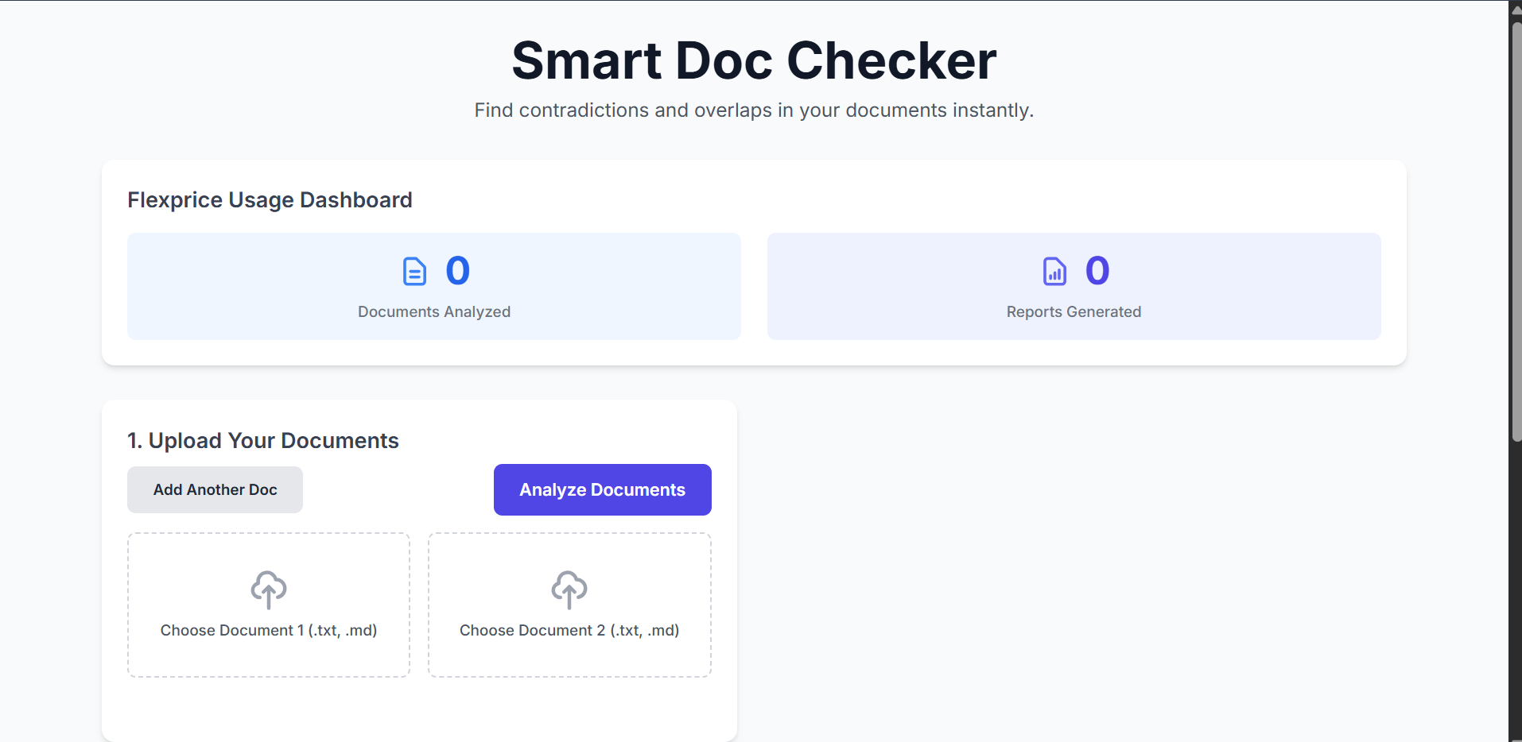
Flowchart & Supporting Images

Slide 6
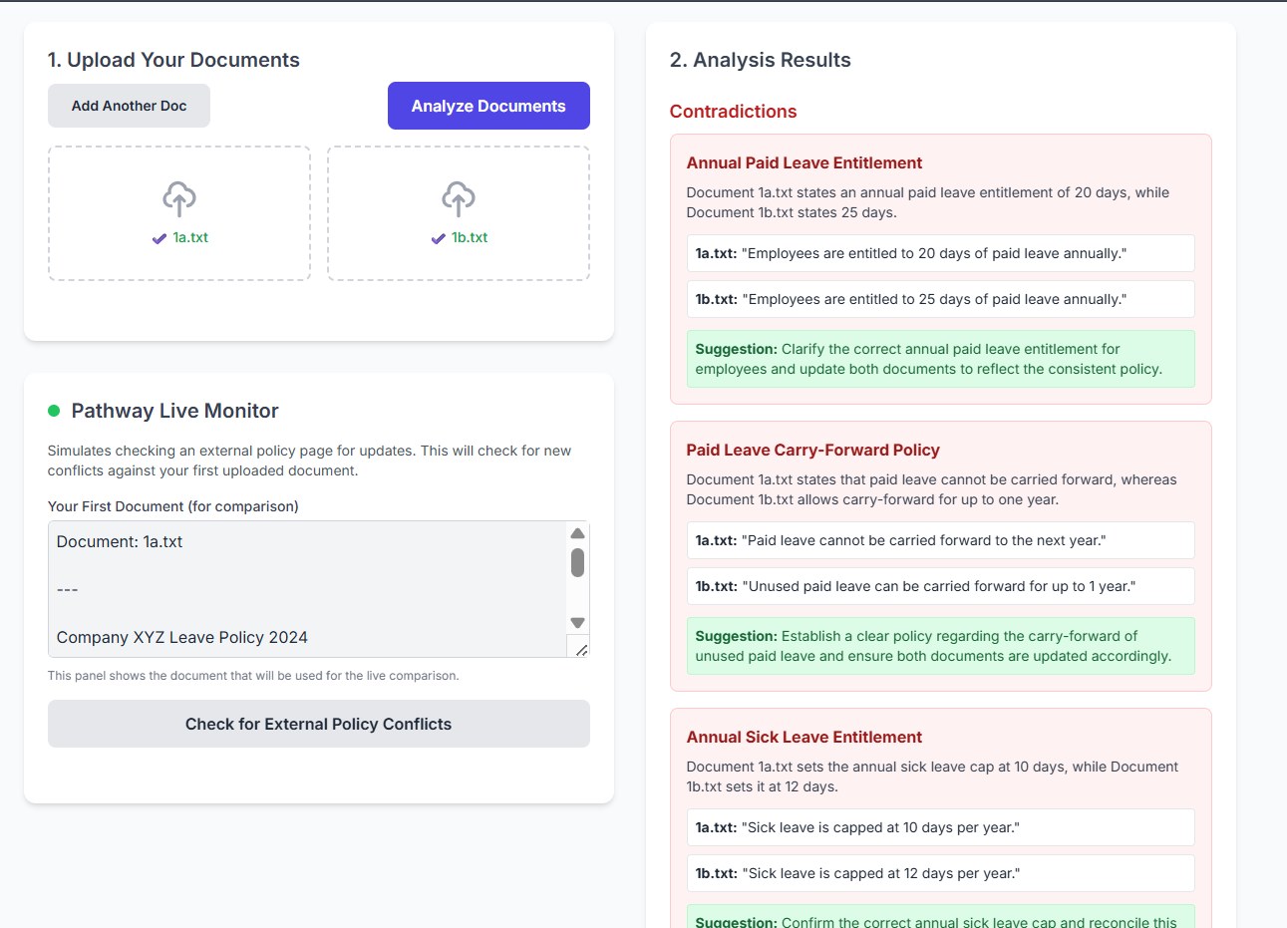
Flowchart & Supporting Images

Slide 7
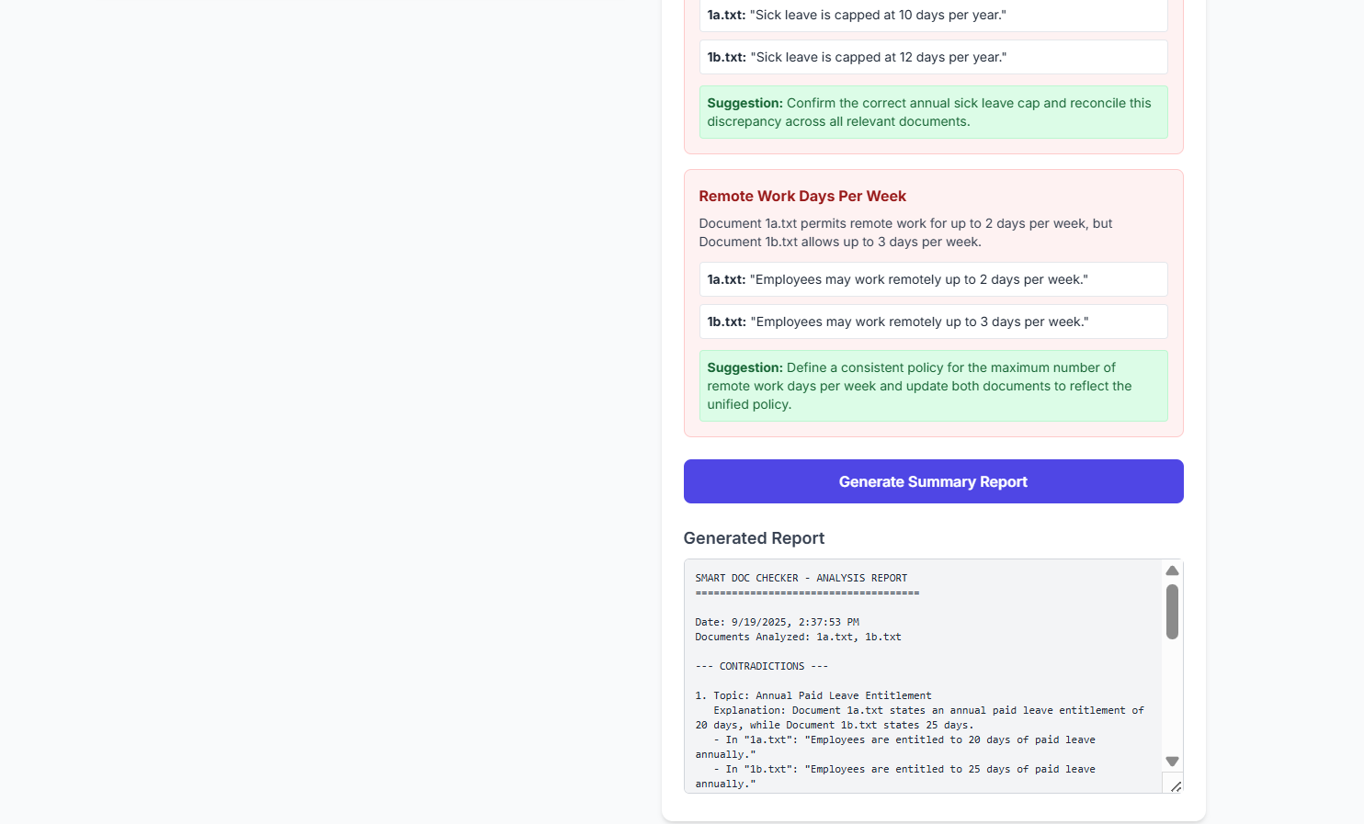
Flowchart & Supporting Images

Slide 8
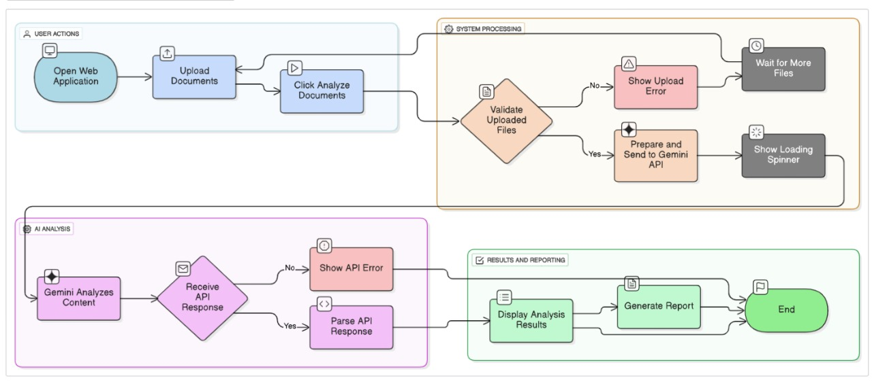
Flowchart & Supporting Images

Slide 9
Feasibility and Market Use
This project is highly feasible. By using a powerful third-party service like the Gemini API, we eliminate the need to build and train our own complex AI models. The frontend is a lightweight web application that can be deployed easily on any standard web server. The primary operational cost is API usage, which can be directly passed to the user via the Flexprice model, making it a sustainable business.
Market Use / Target Audience:
The Smart Doc Checker has a broad and valuable market:
Legal Teams: To ensure consistency across contracts and legal documents.
HR Departments: To find conflicts between handbooks, policies, and employment offers.
Project Managers: To align project guidelines, scope documents, and client requirements.
University Administrators: To check for contradictions in circulars, rulebooks, and course outlines.

Slide 10
Conclusion
The Smart Doc Checker effectively solves the critical and costly problem of document inconsistency. By leveraging the power of modern AI, it transforms a tedious manual task into a fast, automated, and reliable process. Our application not only saves significant time and resources but also reduces the risk of disputes and errors.
Future Scope: The next logical step would be to integrate directly with cloud storage platforms like Google Drive or Dropbox for fully automated, real-time monitoring of an organization's entire document ecosystem.
Github Link:
https://github.com/himaja-56/HackwithHyderabad-KLH_BinaryBrain.git

