Slide 1
AI Assistant User Guide
Himaja Sadhu

Slide 2
Introduction
This user guide will help you understand how to interact with the AI Assistant web application.
The assistant can:
Answer factual questions
Summarize long text
Generate creative stories or poems
Collect feedback from users

Slide 3
How to Ask Questions
1. Select 'Answer a Question' from the dropdown.
2. Enter your question in the text area.
3. Click 'Send'.
The assistant will provide a clear, concise answer.

Slide 4
Summarize Text
1. Choose 'Summarize a Text' from the dropdown.
2. Paste the long text you want summarized.
3. Click 'Send'.
The assistant will return 10-12 bullet points summarizing the content.

Slide 5
Generate a Creative Story
1. Select 'Generate a Creative Story'.
2. Enter a topic, prompt, or idea.
3. Click 'Send'.
The assistant will return a story or poem based on your input.

Slide 6
Giving Feedback
After receiving a response, you'll see:
"Was this response helpful? (Yes/No)"
- Click 'Yes' if satisfied
- Click 'No' to flag issues
This feedback helps improve future responses.

Slide 7
Session & History
Your conversation history is shown during the session.
Closing or refreshing the tab clears history.

Slide 8
Github Link
https://github.com/himaja-56/VaultOfCodes

Slide 9
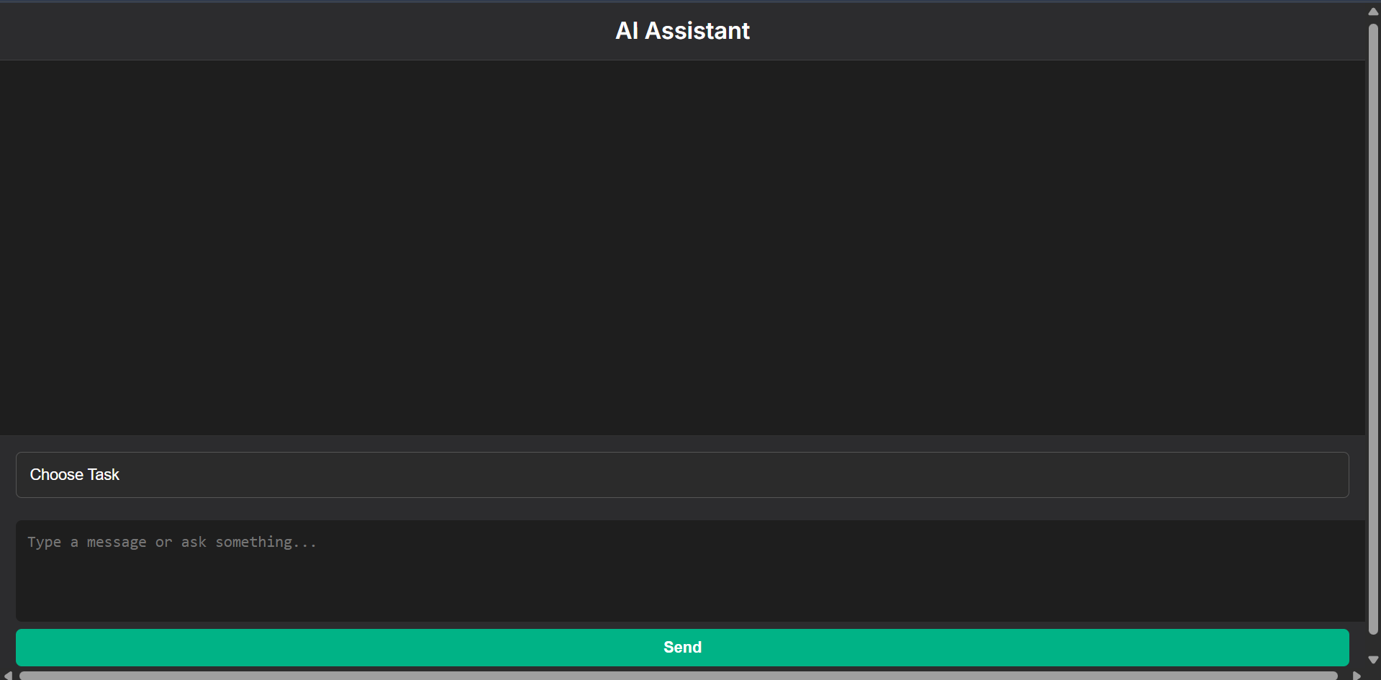
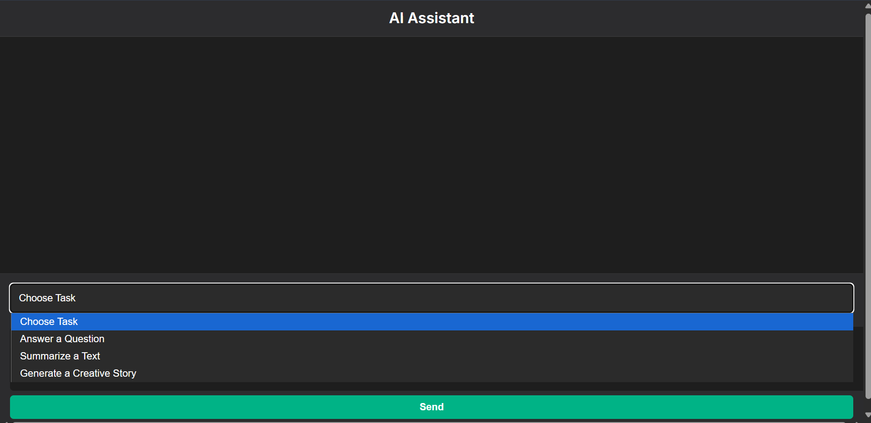

Slide 10
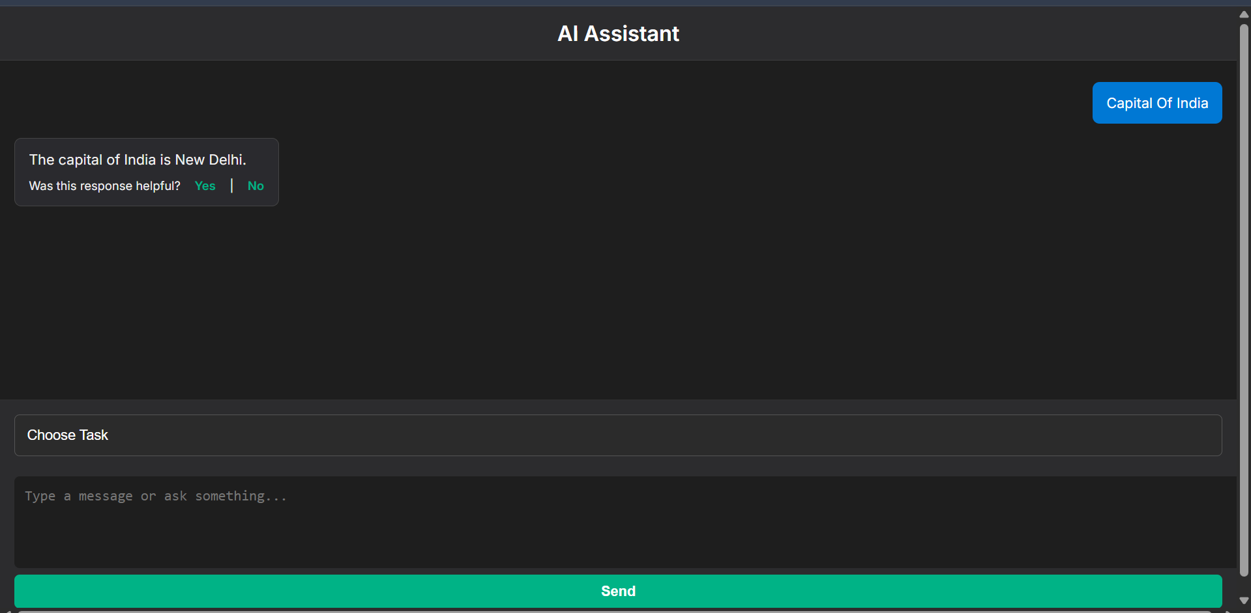
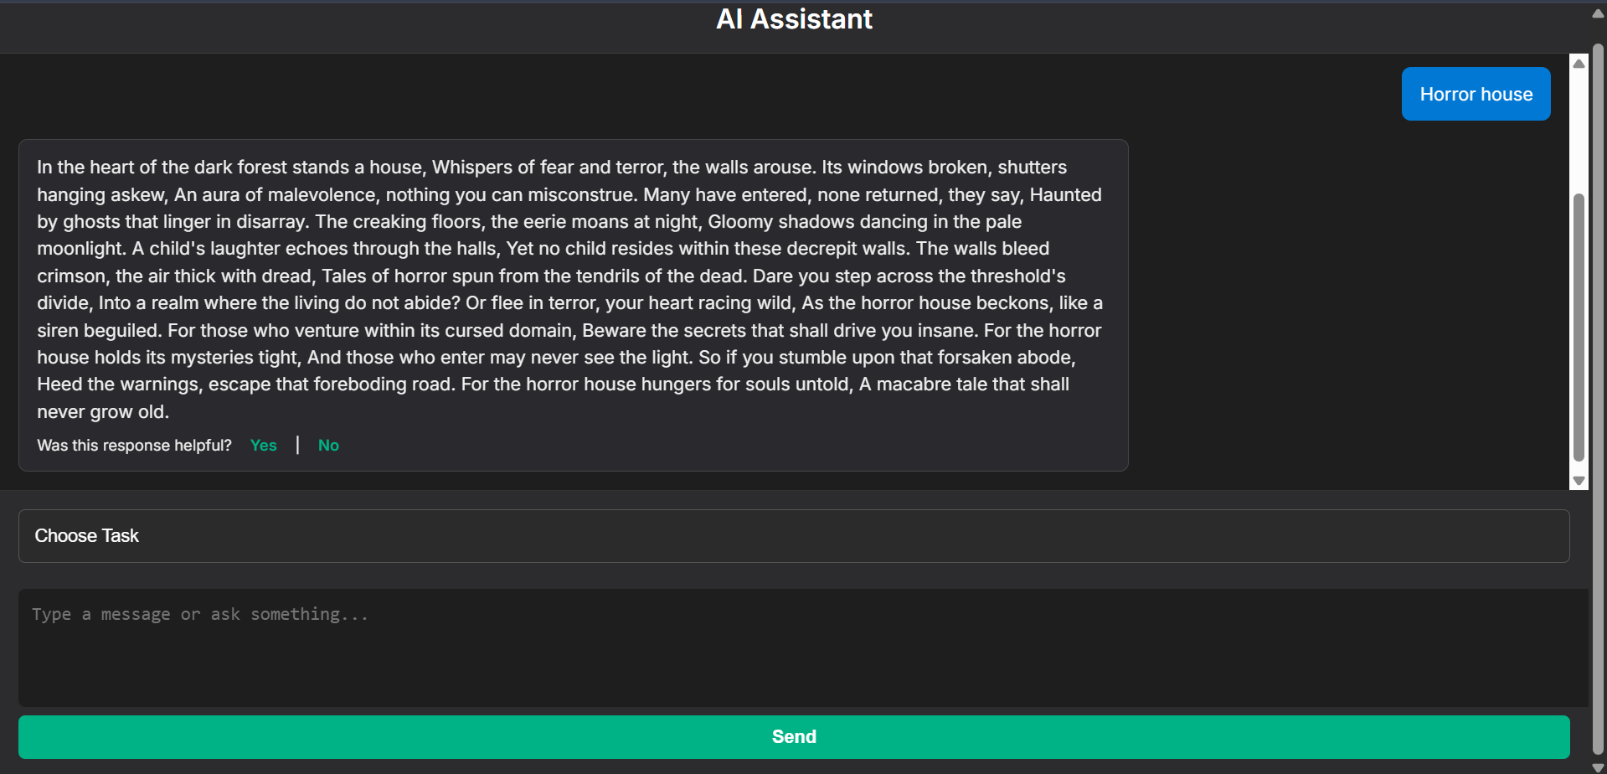

Slide 11
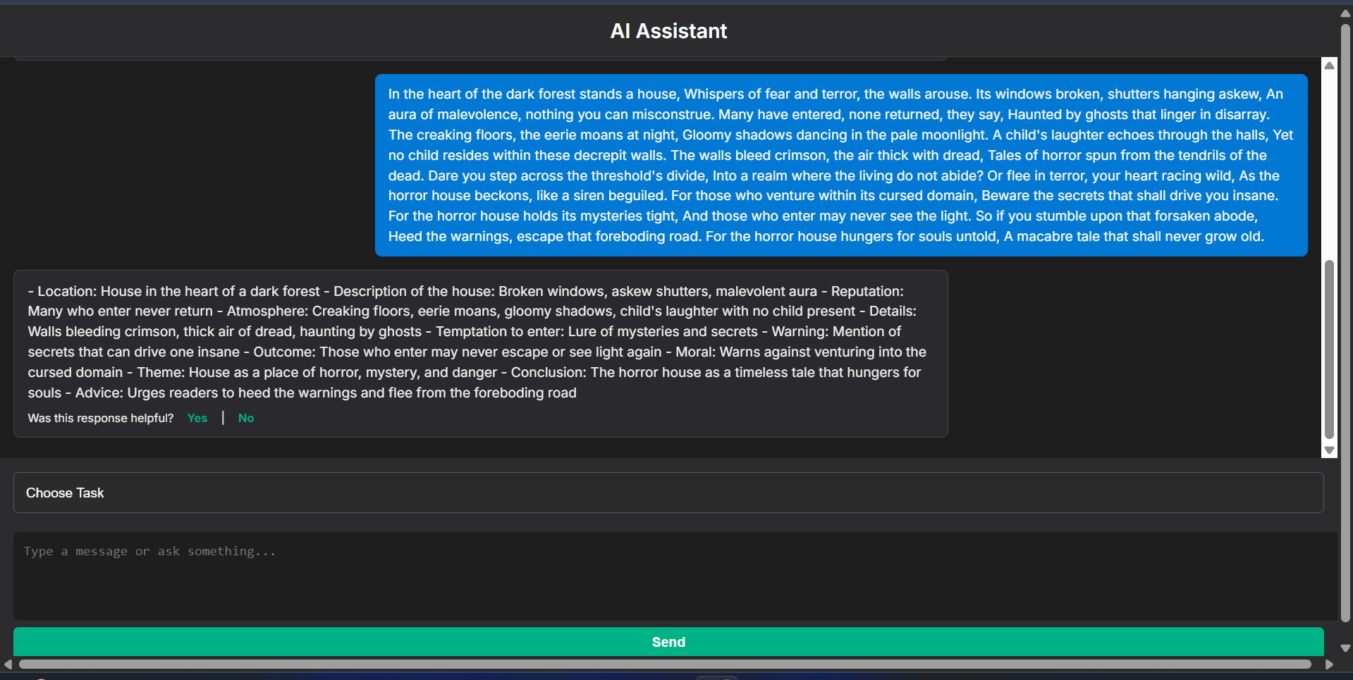

Slide 12
THANK YOU

