Slide 1
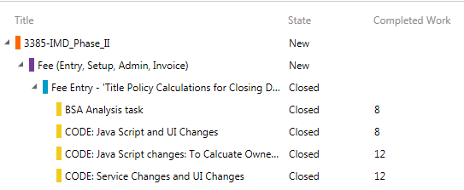
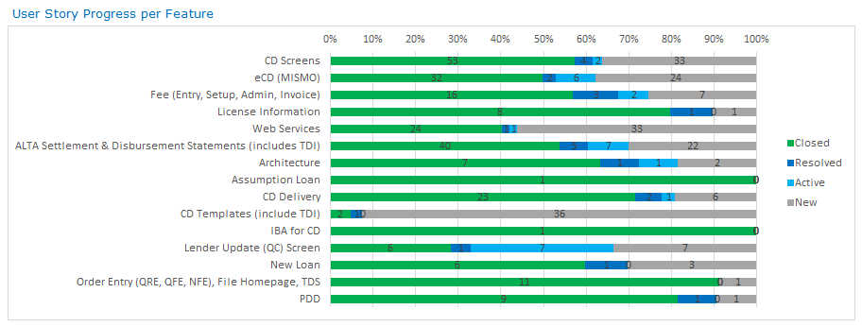
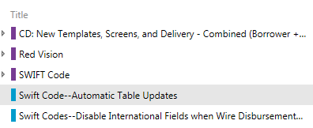
Work Item Organization
Epic created by: TFS portfolio admin, fields managed by Product Owner. Implemented by one or more features.
Feature created by: Product Owner, fields managed by Product Owner. Implemented by user stories with a common objective over two or more iterations.
Parent\Child Link type
User story created by: Product Owner, fields managed by Product Owner. User stories start and finish in one iteration.
Task created by Task Owner, fields managed by Task Owner, Effort managed by Task Owner
Tests\Tested By Link type
Test case title policy calculation
Created by Test Case owner, test case fields managed by Test Case Owner
Policy Calculation off by 0.01
Created by Test Case evaluator, bug fields managed by Assigned To field
Related
Link type
If a test case cannot be found to associate a bug, associate to a user story using the Related link type.
Feature progress is tracked by user story state.
SWIFT Code
User stories must be mapped to a feature to give an accurate picture from the chart above.

Slide 2
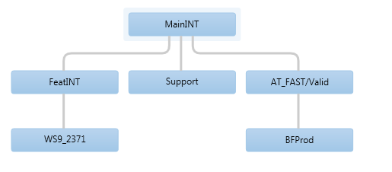
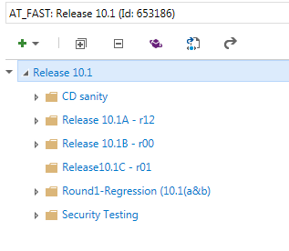
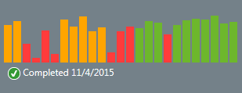
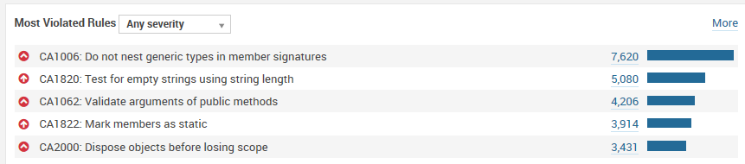
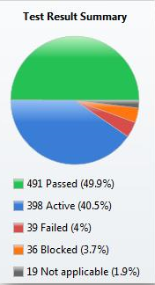
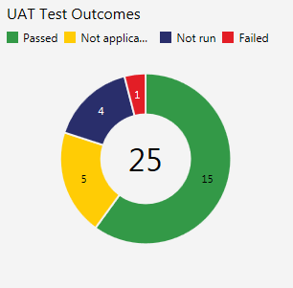
Creating Production Releases
one or more to one
one or more to one
working software
“system increments”
“releasable solution”
production
System Increment objectives:
Merge code and associate merge changeset to user stories
Build quality
Scope testing
FxCop analysis
Releasable Solution objectives:
Automated Regression Use Case Testing
End-to-end system testing
Security testing
UAT guidelines and testing
Use Case updates, iGuide updates
SCM merges code to Valid and associates the merge changeset ID to the user stories in scope.
This build is deployed to a non-production trial environment and finally to production on the deployment weekend.
When build is green, all teams queued for a release merge, merge from FeatInt to their project branch and fix issues before their turn to merge to FeatInt.
Each team merges code from FeatInt daily. The merge changeset ID is associated with a “deploy and merge” user story.
3
A
7
9
Release technical lead merges code to MainInt and associates the merge changeset ID to the user stories in scope.
6
A
6
8
2
4
5
7
Regression testing resumes if started with builds from FeatInt. Otherwise regression testing begins.
End-to-end testing conducted with interface partners. Uses an EVAL environment.
End-to-End testing conducted with interface partners. Uses MTM test plan.
3
1
1
Each team merges code to FeatInt and assigns the merge changeset ID to the user stories in scope
B
After each merge, a team build is launched. The merging team fixes all issues.
2
When the merge changeset ID is associated to a user story or bug, the team build will stamp those associated work items with the build name which can be viewed in the Integration Build field for the work item.
Defect repair is checked in to Support branch. Associate check-in changeset ID with bug work item. Team build and deploy to a FINT environment for evaluation. When defect is repaired, merge to MainInt and associate merge changeset ID to bug work items in merge.
8
After merging is complete, testing of the user stories in scope is executed reusing user story testing from the projects.
5
9
UAT guidelines are created and associated with UAT test cases. UAT is conducted and results are reported from a separate UAT test plan.
Valid is copied to a BFProd branch to support Break Fix updates to production.
4
An FxCop report is created before any merges begin establishing a baseline. After all merges are complete a final FxCop report is created and an assessment is done to determine what progress has been made to reduce violations. FxCop results are reported via SonarQube:
http://snavnappsqub002:9000/sessions/new
B

Slide 3
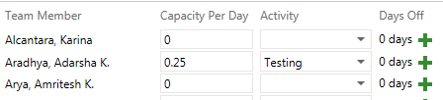
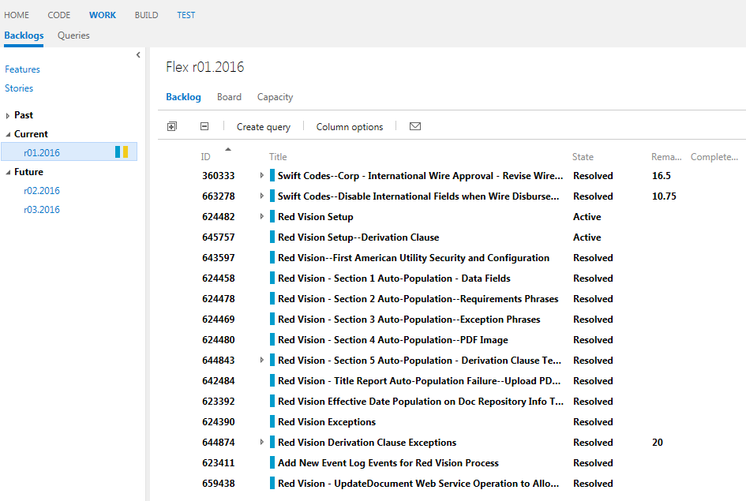
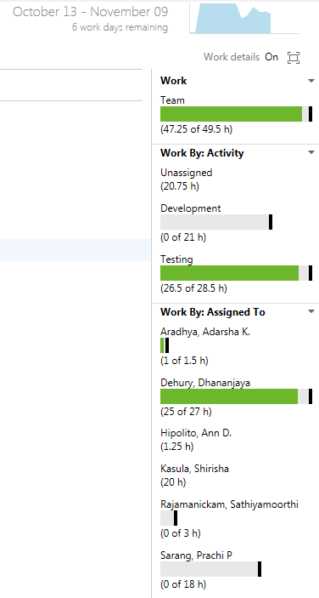
Definition of Done - asserts there is nothing more that must be done for the working software in this iteration to deploy to production.
For all working software iterations
Stories Overview report audit
All effort in all tasks completed, and tasks state = closed
All test cases have test result = pass
All bugs closed, except those agreed with Product Owner to defer
Test plan - Impacted regression use case automated tests passing
Some iterations may have additional DoD items
Creating Working Software
At the iteration planning meeting, set up your team members with their capacity, activity, and days off. Create tasks, assign people, estimate effort, monitor utilization.
4
The burn down chart is updated as task effort is adjusted. A healthy burn down tracks to the computed ideal line. This burn down indicates something not good.
3
5
5
2
4
6
1
7
6
Capacity is monitored by team, by work activity, and by individual. Use these to initially plan an iteration and to assess during the iteration if someone becomes under or over utilized.
7
8
9
8
Project Iteration Title field keywords
Task: Rework
User Story: NFR
Bug: Security
Release Iteration Title field keywords
Bug: UAT
Task: Rework
The iteration end date is the last chance to close out user stories for the iteration. User stories which cannot be closed, for any reason, are returned to the product backlog and rescheduled in a future iteration as prioritized by the product owner.
Task in any state of the current iteration are moved with the user story.
The measure of progress is completed user stories not effort. Therefore, you must know what is required to close a user story which can be found in the “definition of done” for an iteration.
9
NFR - Deploy and Merge Activities
All FAST iterations use the common cadence iteration names such as r01.2016 or r02.2015. Work which will not result in a change to production, like regression use case automation, uses architectural iteration names such as a01.2016.
All FAST teams plan their iteration on the same day and end their iteration on the same day. If you have dependencies on another team, get a voice at their planning meeting. You must know what is required to close a user story in order to not over commit and under deliver. The “definition of done” is the tool used to describe what is needed for a user story to complete and includes: coded, test, SME approval, RM approval by story overview and test plan audit. Test plan must include evaluation of impacted regression use case tests.
1
3
2
All FAST work is organized by team. Flex is the name of this example team.

Slide 4
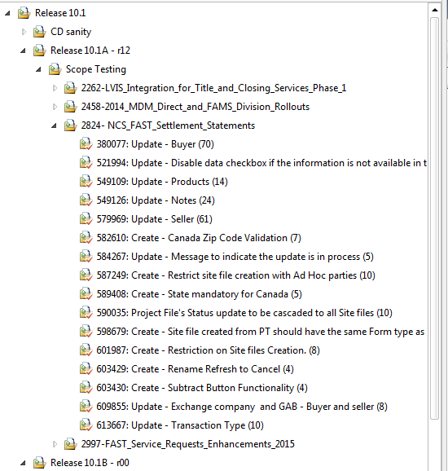
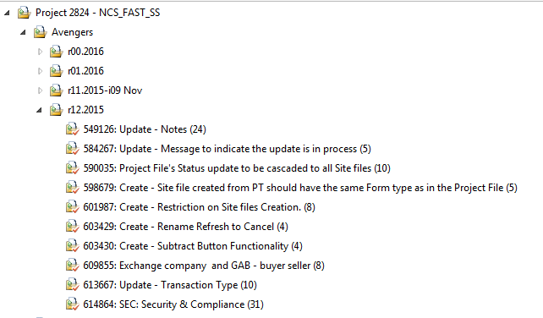


The project test plan is used to ensure the entire project has been implemented as defined by epic and features. Each iteration identifies the testing completed for each increment.
Testing Working Software, System Increment, and Releasable Solution
1
The release test plan is used to ensure the new work in the system increment is stable, then to ensure the entire releasable solution is production ready.
Note: a separate UAT test plan is used for UAT evaluation.
5
Release Test Plan
5
1
Project Test Plan
Each iteration has at least three testing parts: user stories using requirements based suites, security compliance using a static based suite, and impacted use cases using static based suite.
Requirements based suites will roll up to a stories overview report used by release management for DoD evaluation.
6
The release plan contains a suite which retest the scope merged by the various projects and is called “scope testing.”
The plan counts on reusing the testing from the project test plan to minimize testing effort and to validate the scope merged to the system increment works the same way as in the project.
2
6
7
7
2
3
reusing test suite example
4
Impacted Use Cases
FMUC0083 View Settlement Statement (8)
All project test plans and release test plans must evaluate the same 31 test cases to ensure security objectives are being achieved. Copy from the test plan 000-FASTMasterPlan-Regression.
9
3
Plan your automated user story testing to be reused in the release plan and to be reused as project regressions.
The project team evaluates the automated use case regression tests. If the enhancements breaks the regression, the project team is responsible for fixing then merging the fix automated script when the enhancement is merged.
8
The entire collection of automated use case regression tests are executed to ensure the releasable solution is ready for production use. Copy the full set of regressions from the master test plan “??.”
8
4
9

