Slide 1
Information Security Strategy: Application Testing
Information Security
1/05/2016

Slide 2
The Initiative
Information Security Strategy – Application Testing
Description:
Perform regular and as needed testing of all applications to identify Security vulnerabilities and risks.
Objectives: |  | Measures of Success:
Regularly scheduled Static & Dynamic Application code analysis. Regularly scheduled application network analysis. Required Static Code scan for RFC creation In depth application scans |  | All external facing applications have complete static, dynamic, and network scans performed at least annually. Required Static Code scans for RFC creation, with no Critical or High issues. All applications scanned on a regular scheduled basis.
Users: |  | Deliverables:
All IT Team members CAB Network Operations |  | Application scan schedule Application scan results Secure coding training
Risks:
Cost of additional licenses Security resources Application schedule pressure

Slide 3
Drivers
Significant fiscal and reputational harm will be caused by any data breach.
2014 had ~ 80k Security Incidents with over 2k confirming data loss.*
99.9% of exploited vulnerabilities were compromised more than a year after the CVE was published.*
Financial Services, Public, and Information Companies have some of the highest frequencies of incident patterns.*
*Verizon, 2015 Data Breach Investigations Report

Slide 4
Benefits
Early detection of security risks will decrease the impact to application schedules.
Continuous application code analysis and inspection will identify and mitigate exposure risk.
Audits will become easier.

Slide 5
Coverage
Static Analysis Scan (~70%)
Veracode
Dynamic Analysis Scan (~20%)
Veracode
WebInspect
Manual Penetration Testing (~10%)
Annually as identified by CISO
As needed specified customers/clients

Slide 6
Veracode - Roles
All Applications
Executive Viewers
Access to Analytics for All Applications
Access to Reports for All Applications
Report Viewers
Access to Analytics for All Applications
Access to Reports and Flaw Details for All Applications
Application Specific
Report Viewer
Access to Analytics for Specific Application
Access to Reports and Flaw Details for Specific Application
Scan Team
Access to Analytics for Specific Application
Ability to Request Scans for Specific Application
Ability to Create Sandboxes for Specific Application
Dev Team
Ability to Create Sandboxes for Specific Application

Slide 7
Veracode - Policies
Varied Based on Risk to the Company
All Top 80 & External Facing Applications will have the same Policy (Auditors Requested):
No Very High (Critical) or High
Must meet a minimum Veracode score of 80
Must meet PCI Standard
Must meet SANS Top 25 Standard
Must meet OWASP Top 10 Standard
Must meet CERT Standard

Slide 8
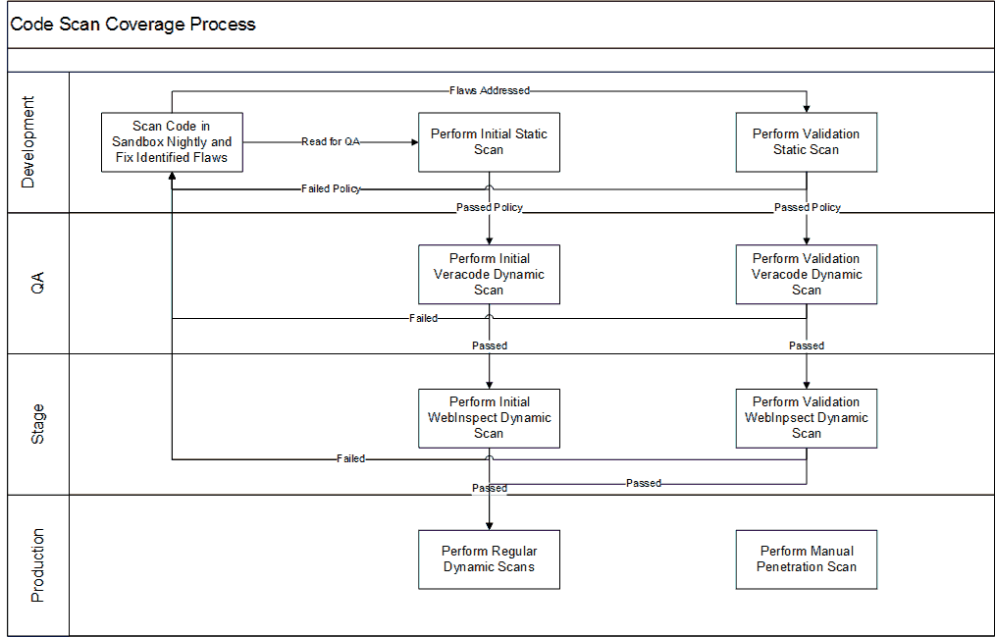
Proposed Process

Slide 9
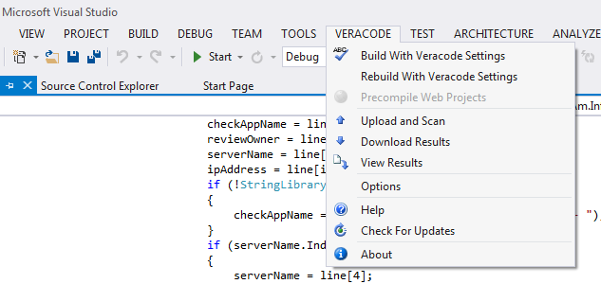
IDE Integration
Integrate IDE with VeraCode
Install VeraCode IDE Integrator

Slide 10
Veracode Sandbox
Utilize Veracode Sandbox

Slide 11
APPENDIX

Slide 12
Approach
Perform automated and manual application testing:
Static Code Analysis
Static Analysis by Developer throughout the Development cycle
Static Analysis of the Application before Production Deployment
Recommended after QA
Dynamic Analysis of the Application before Production Deployment
Recommended after QA
Application Inspection
WebInspect Dynamic Analysis before Production Deployment
Network Inspection
Ongoing Qualys inspections
Remediation
All Critical and High issues resolved before Production Deployment
All existing issues have User Stories on the backlog to resolve

Slide 13
Overall Roadmap 1 Year
Q4 2015
Q1 2016
Q2 2016
Q3 2016
Static Analysis
Top 80 Applications
Static Analysis
External Facing Tier 0 & Tier 1
Application Testing
Static Analysis
External Facing Tier 2 & Tier 3
Static Analysis
External Facing Tier 4 & Tier 5

Slide 14
Overall Roadmap 5 Year
2016
2017
2018
2019
2020
Static Analysis
All External Facing
Dynamic Analysis
All External Facing
Static Analysis
All External Facing to Recommended Schedule
Application Testing
Dynamic Analysis
All External Facing to Recommended Schedule
Static Analysis
All Applications
Dynamic Analysis
All Applications
Static & Dynamic Analysis
All Applications to Recommended Schedule

Slide 15
Overall Roadmap – Top 80 Onboarding 2016 – Quarter 1
January:
FAST
Stand Alone Imaging (SAI)
Trustlink (Trust32)
FASSNotary (FN)
FASTWeb (FW)
February:
FASTSearch
FA Comprehensive Calculator (FACC Legacy)
Examiner Work Bench (EWB; ATP)
Title Resource Database (TRD)
Remitted Policy System (RPS)
March:
Title Resource Starter Service (TRSS)
myFAMS.com
FA Mortgage Operating Systems (FAMOS)
WireLink (WRLNK)
AgentNet2 (AgentNet)
Appraisal Systems (AMP)
SharePoint 2010 (SHPNT)
Eagle Pro (EP)
Commercial Lending E&A Reporting (CLEAR, FACRES)
firstam.com (FSTAM)

Slide 16
Overall Roadmap – Top 80 Onboarding 2016 – April
XMPIE
TIBCO Enterprise Service Bus (Messaging)
Lenders Advantage.com Web Services (la.com, ELSONLINE, FactXL, EquiSmart)
Default WinTrack (with shared environment)
Closing Cost Calculator (CCC)
Management Reporting System (MRS)
Recording Fee Calculator (RFC)
Closing Tracker (CT)
FA Natural Hazard Disclosure (NHD, RED)
FASTrax
Records Information Database (RID RecMan)

Slide 17
Overall Roadmap – Top 80 Onboarding 2016 – May
Real Time Mail (RTM)
TitleSmart (TSMRT)
Oracle EBS Financials (TOF), EBS Financials (STARS), EBS Shared (TOF, STARS)
Title Examiner Network (TEN)
XML Ordering System (XOS)
DataTree.com
Application Extender Co Data
FA Commercial Due Diligence Services (CDDS)
Winscape
Data Tree Database (NOVA)

Slide 18
Overall Roadmap – Top 80 Onboarding 2016 – June
Data Tree Image Delivery (DTD)
Pivotal Agency
Pivotal CRM (Direct)
Funding Dashboard
Total Recording System (tRecs)
CLASS
Streamline ASP Agency
WebSigning (WS)
Common Property Component (CPC)
Optical Character Recognition (OCR)

Slide 19
Overall Roadmap – Top 80 Onboarding 2016 – July
CAMRA
Data Trace – Tax Browser
Resort Innovative Tracking Application (RITA)
StreamlineASP Agentnet (PRS-SMS)
SWAPPS (eDocs)
Wintrack - Lenders (Default TSG & Regional)
Wintrack – National
Data Trace System (DTS, DTLM)
Eagle Search Images (ESI)
Document Management System (DMS)

Slide 20
Overall Roadmap – Top 80 Onboarding 2016 – August
FAST Closing Scheduler (FASTCS)
FreeFlow
Infodex
StreamlineASP PRS-SMS
TIMS - Legacy App
Eagle Search Product (ESP)
Data Tree Image Delivery (DTD)
ELS Production

