Slide 1
Unit Testing using MS Test
Sagar Patil
4 January 2016
Document classification: Internal

Slide 2
Agenda
What is Unit Testing?
Why Unit Testing?
Unit Testing in .NET /Visual Studio
TDD
Common MS Unit Test attributes
3A Pattern
Standards and Guidelines
Testing Different Types of Methods
Fakes
Test Explorer & Code Coverage
Demo

Slide 3
Unit Testing
Unit testing is a software development process.
The smallest testable parts of an application, called units, are individually and independently scrutinized for proper operation.
Unit testing is often automated but it can also be done manually.

Slide 4
Why ?
Unit testing helps to ensure the correctness of the program to verify the code does what is expected to do
Unit tests helps for code-reusability
Better understanding of code
Leads to a better design
Automated tests can run as frequently as required
Makes it easier to change and refactor the code
Reducing the cost of fixing bugs by fixing them earlier, rather than later.

Slide 5
What is a Unit :
A unit of work is any functional scenario in the system that contains logic
Typically a unit is a single method.
This is a Unit
This is a Unit Test
public class MyMath
{
public int Add(int i, int j)
{
return i + j;
}
}
[Test Method]
public void MyMath_Add_Should_Return_Correct_Sum()
{
MyMath m = new MyMath();
Assert.AreEqual(m.Add(2, 3), 5);
}

Slide 6
Which of these is a true Unit ?
public int Multiply(int a,int b)
{
Product(a*b);
//Product looks up value in database.
}
public int Multiply(int a,int b)
{
return Product(a*b);
// Product() is a private method .
}
1
4
public int Multiply(int a,int b)
{
Product(a*b);
//Product is a public method.
}
public int Multiply(int a,int b)
{
return a*b;
}
2
5
public int Multiply(int a,int b)
{
return Product(a*b);
// Product() calls a web service in Hyderabad.
}
public int Multiply(int a,int b)
{
return Product(a*b);
// Product() is a part of .net framework .
}
3
6

Slide 7
Unit Testing in .NET /Visual Studio
Visual Studio has inbuilt support for automated unit testing
Unit Tests execution could be added to build process, which helps in automatic testing of changes after each build.
Test Explorer lets you run unit tests and view their results.

Slide 8
Test Driven Development(TDD)
Test Driven Development is the practice of writing unit tests for our code before we actually write that code.
By writing a test and then writing the code to make that test pass we have a much better idea of what the goal and purpose of the code is.
We will write cleaner, more maintainable code.
We will use refactoring tools and techniques.
As code gets larger it does not get harder to maintain

Slide 9
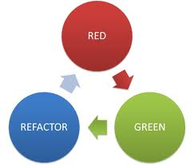
How TDD works in visual studio
Write the unit test
Compile the unit test which will fail(RED)
Implement enough of the target code to compile.
Run the test and see it fail.(RED)
Write enough code in the target to pass.(Green)
Refactor the code as required(REFACTOR)
Repeat

Slide 10
MS Unit Test Attributes
Attribute | Description
[TestClass()] | Used to identify classes that contain test methods
[TestMethod()] | Used to identify test methods.
[AssemblyInitialize] | Called before all the tests in the assembly have run to free resources obtained by the assembly.
[AssemblyCleanup] | Called after all the tests in the assembly have run to free resources obtained by the assembly.
[ClassInitialize()] | Called before any of the tests in the test class have run to allocate resources to be used by the test classes.
[ClassCleanup()] | Called before any of the tests in the test class have run to allocate resources to be used by the test classes.
[TestInitialize()] | Called before the test to allocate and configure resources needed by all tests in the test class.
[TestCleanup()] | Called after the tests have run to free resources obtained by all the tests in the test class.
[Timeout()] | Used to specify the timeout period of a unit test.
[Ignore] | disable a test or make it temporarily unavailable

Slide 11
MS Unit Test Assertions
Assert Class | StringAssert Class
AreEqual<T>(), AreEqual() | Contains()
AreSame() | DoesNotMatch()
Equals() | EndsWith()
Fail() | Matches()
Inconclusive() | StartsWith()
IsFalse()
IsInstanceOfType()
IsTrue()
IsNull()
AreNotEqual<T>()
AreNotSame()
IsNotInstanceofType()
IsNotNull()

Slide 12
Arrange-Act-Assert (3A Pattern)
Arrange/Act/Assert(AAA) is a pattern for arranging and formatting code in Unit Test methods.
Arrange – setup and initialize objects required for you test.
Act – perform the actual work of test.
Assert – verify the result.
[Test Method]
Public void MyMath_Add_should_return_correct_result()
{
MyMath ObjMyMath = new MyMath();
Int ExpectedSum = 11; ← Arrange
ActualSum = ObjMyMath.Add(5+6); ← Act
Assert.AreEqual(ActualSum , ExpectedSum ); ← Assert
}

Slide 13
Naming conventions to follow according to First American Guidance
Classes in test projects
[ClassName]Tests
Example:
PersonServiceTests
How we name our unit tests: The UnitOfWorkName refers to the method or group of methods or classes you are testing.
[UnitOfWorkName]_WhatAreYouTryingToDo_ExpectedResult()
Examples:
PersonService_AddValidPerson_Succeeds()
PersonService_AddInvalidPerson_ThrowsInvalidOperationException()

Slide 14
Demo -\\FAIBLR06L1255\Share1

Slide 15
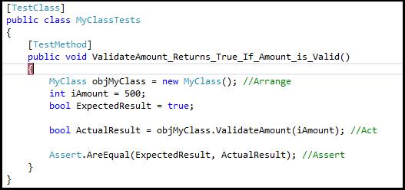
Testing Public methods
Public Methods

Slide 16
Demo

Slide 17

Testing Private methods
Private Methods

Slide 18
Demo

Slide 19
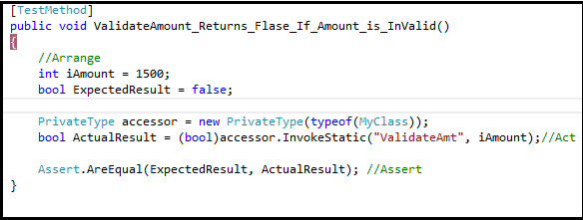
Testing Private Static methods
Private static Methods

Slide 20
Demo

Slide 21
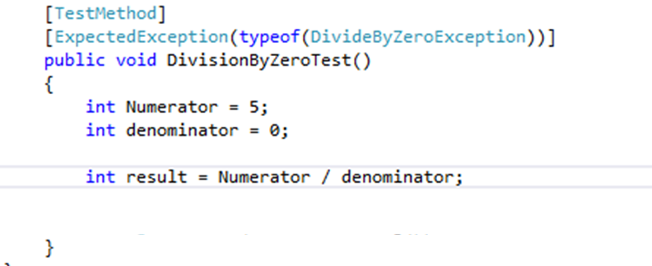
Testing Expected Exceptions
Sometimes codes throw Exceptions which is normal and need to be tested
We need to use the attribute [ExpectedExceptions()]

Slide 22
Demo

Slide 23
FAKES
Fakes is a concept in unit testing commonly used for removing dependencies like database , file system access etc.
This prevents those dependencies from interfering with results
It helps developers to test parts of the solution even if other parts are not working/haven’t been implemented yet

Slide 24
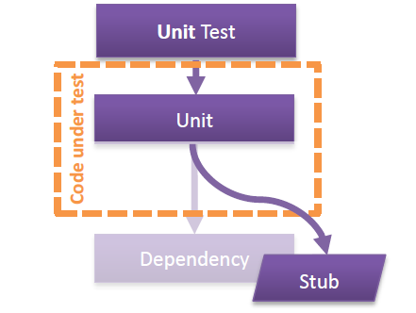
Stubs
When using Stub the approach is to basically replace the class with a small substitute (Stub) that implements the same interface. Stubs can only be used to implement interfaces. Therefore, stub types cannot be used for static methods, non-virtual methods, sealed virtual methods, methods in sealed types, and so on.

Slide 25
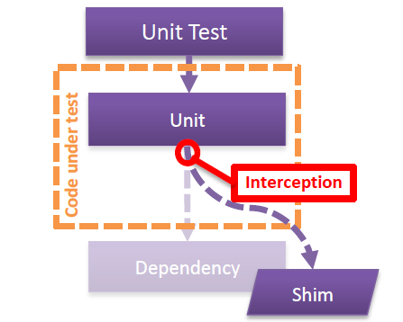
Shims
In case of Shim, compiled code is modified at run time to inject and run the substitute (Shim). Shims are relatively slow than the Stubs as code is being modified at runtime.
Shims are a feature of Microsoft Fakes that allows creating unit tests for code that would otherwise not be testable in isolation. In contrast to Stubs, Shims do not require the code to be tested be designed in a specific way.

Slide 26
Stub or Shim
Stubs provide implementations of interfaces and classes and are most effective when the code was designed with testability in mind. Shims allow support for times when the dependent code, for example legacy or external, cannot be changed and a detour of method calls to Shim implementations is needed.
Objective | Consideration | Stub | Shim
Maximum performance? | ●
Abstract and Virtual methods | ●
Interfaces | ●
Internal types | ● | ●
Static methods |  | ●
Sealed types |  | ●
Private methods |  | ●

Slide 27
Demo

Slide 28
Closer look at Test Explorer
Grouping Tests in Test Explorer
Group by Duration
Group by Outcome
Group by Traits
Group by Projects

Slide 29
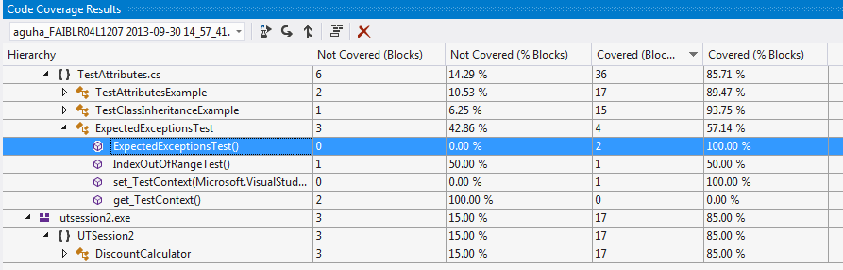
Code Coverage
Analyzing Code Coverage
Code Coverage Results
ExcludeFromCodeCoverage Attribute
100% code coverage does not mean 100% test scenarios coverage.

Slide 30
Demo

Slide 31
Q & A!

Slide 32
Thank You!

