Slide 1
Fast MVC
Presented by:
Jemsheed Kalayath

Slide 2
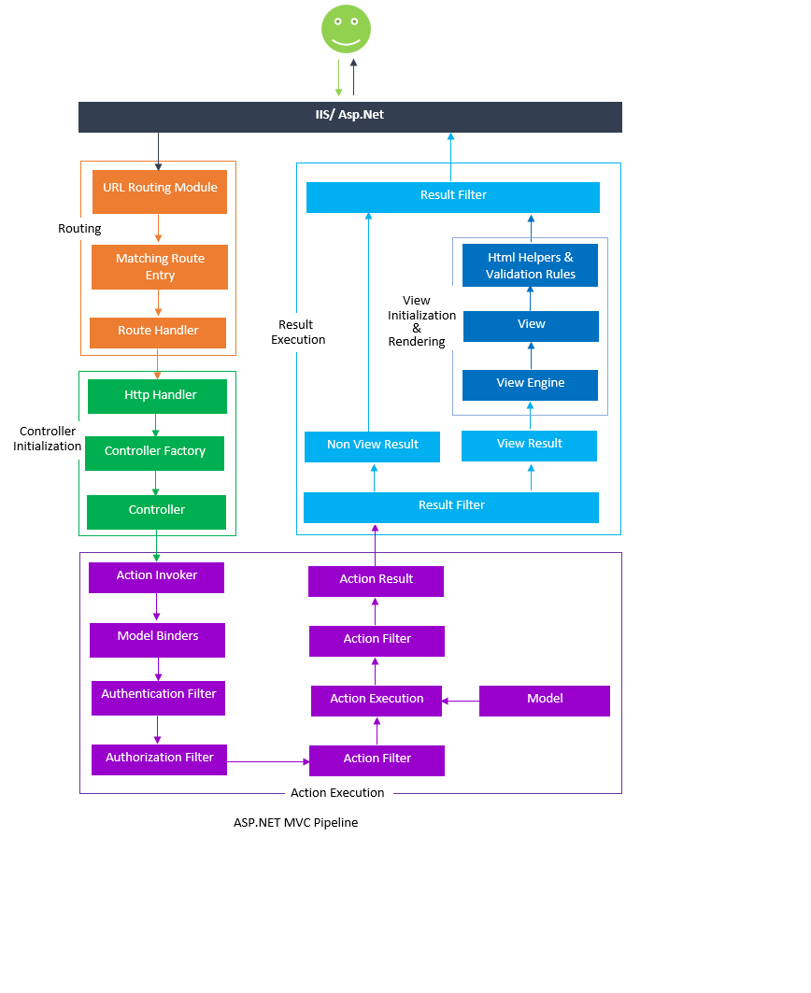
MVC Life Cycle:

Slide 3
MVC Features:
Routing
IRouteHandler
MVCHandler
RouteConfig
2) Controller
3) Action Execution
4) View Result

Slide 4
5) View Engine
6) View
7) Filters
Use
Types
Configuring filters
8) HTML Helpers
9) Areas

Slide 5
MVC FW Features:
MVC Areas
Bundling
Html.FAFBeginForm()
this.PageDataAction(FAFSaveTypes: FAFSaveTypes.Save);
NotifyPropertyChanged
Html.RenderPartial
__FAFdoCallback
setFAFStatus("Loading please wait...");
[FAFPageData(uniquePageData: false)]
ThePageData Usage
HttpGet, HttpPost
10) Filters

Slide 6
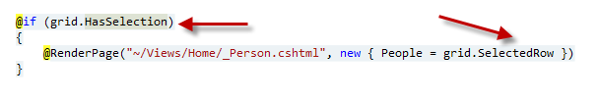
MVC FW Features:
10) FAFGrid
pagerClientAction
sortClientAction
gridSelectionTypes: GridSelectionTypes.MultiRow
onRowDblClick
onRowSelect
onRowRightClick
selectionFieldName

Slide 7
MVC FW Features:
11) Models:
Serializable
FAFSelectListItem
12) RenderPartialViewToString

Slide 8
AOP FW:
ServiceInterfaceLibrary:
[FAService] Attribute
[Dependency] Attribute
Naming of service Handler
Configuration for AOP FW Resolution.

Slide 9
Questions.
Thanks

