Slide 1
Classification of Cyclic vs. Non-Cyclic Lower Limb Motion
CS6140 Final Project
Myra Forester, Himaja Ginkala, Fatima Tourk

Slide 2
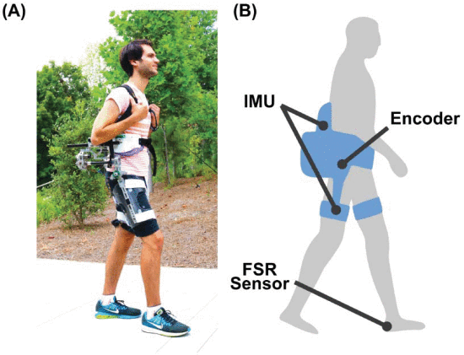
Background
Assistive exoskeletons
Different control systems
Cyclic vs. Non Cyclic motion
Repository of NU Shepherd Lab data
Cyclic | Non-cyclic
Walking Shuffling Skipping Squatting Climbing stairs | Ball tosses Jumps Weight lifts Lunges Tug of war
[1]
Notes:
- Assistive exoskeletons have shown promise in the improvement of quality of life for various groups of people – such as the elderly, people who are going through rehabilitation, and workers who regularly lift heavy loads.
- In order to provide optimal torque at the correct time, assistive exoskeletons need to be tuned to the actions of their wearers. Different control systems refer to whether the amount of torque applied is a general assistive amount or whether it's tailored to a specific motion. Of all the possible motions that users can perform, cyclic tasks are the easiest to control due to their repetitive nature.
- The ability to recognize a motion as cyclic would aid in creating predetermined assistive profiles for such motions, enabling non-assistive modes to be used for non-cyclic motions.
- A repository of data from Northeastern University’s Shepherd lab was used. It is comprised of data for a combination of cyclic and non-cyclic activities: 33 cyclic and 40 non-cyclic activities.

Slide 3
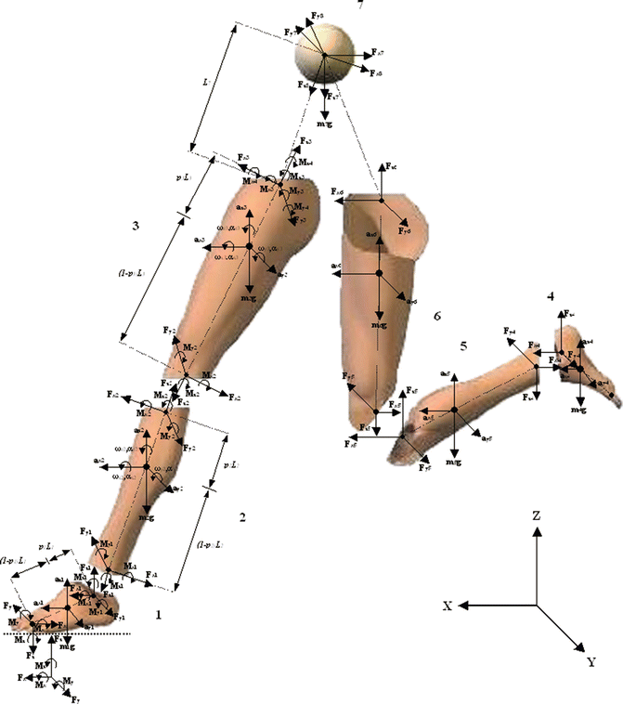
Data Pre-processing
Limb position quantification measurements: hip flexion, hip adduction, hip rotation, knee angle, ankle angle, and subtalar angle
Inertial measurement unit values: shank, thigh, and pelvis accelerometer and gyroscope readings
Velocity measurements: including hip flexion velocity, hip adduction velocity, hip rotation velocity, knee velocity, ankle velocity, subtalar velocity
Biometric time-series data
[2]
Notes:
- Classification of whether an action is cyclic will be made using biometric time series data, similar to that which an exoskeleton would have access to from its sensors.
- Some of the data was sparse and had limited or missing values for certain activities, so only measurements that were more completely recorded were used. These measurements included the following categories: limb position quantification measurements, inertial measurement unit values, and velocity measurements.
- Some of each activity’s biometric data was collected every 0.0005 seconds, while other data was collected every 0.005 seconds. In order to maintain a dense dataset while being able to analyze each feature simultaneously, only time intervals where all data was collected were used. This reduced the amount of data by a factor of 10, of which 9/10ths would have been incomplete.
- Since human movement does not typically happen at a pace above 10 Hz, the models were trained using a downsampled dataset. The downsampled datasets reduced the number of datapoints used – down to one every 0.1 seconds (as opposed to 0.005 seconds, or 200 Hz). The accuracy of the models improved after this change.
- Additionally, a multivariate time series dataset was created by combining the information stored in multiple data points. This was accomplished by creating new data points that combined the previous three data points by merging them into one vector (with three times the number of original features). The number of datapoints, then, was reduced by a factor of three, and each represented the passage of 0.3 seconds. This also improved the overall accuracy of the models.

Slide 4
Data Pre-processing
Limb position quantification measurements: hip flexion, hip adduction, hip rotation, knee angle, ankle angle, and subtalar angle
Inertial measurement unit values: shank, thigh, and pelvis accelerometer and gyroscope readings
Velocity measurements: including hip flexion velocity, hip adduction velocity, hip rotation velocity, knee velocity, ankle velocity, subtalar velocity
Biometric time-series data
Subset of available features
Time (s) | X1 | X2 | X3 | X4 | X5 | X6 | X7 | X8 | X9 | X10 | X11
0
0.0005
…
0.005
Notes:
- Classification of whether an action is cyclic will be made using biometric time series data, similar to that which an exoskeleton would have access to from its sensors.
- Some of the data was sparse and had limited or missing values for certain activities, so only measurements that were more completely recorded were used. These measurements included the following categories: limb position quantification measurements, inertial measurement unit values, and velocity measurements.
- Some of each activity’s biometric data was collected every 0.0005 seconds, while other data was collected every 0.005 seconds. In order to maintain a dense dataset while being able to analyze each feature simultaneously, only time intervals where all data was collected were used. This reduced the amount of data by a factor of 10, of which 9/10ths would have been incomplete.
- Since human movement does not typically happen at a pace above 10 Hz, the models were trained using a downsampled dataset. The downsampled datasets reduced the number of datapoints used – down to one every 0.1 seconds (as opposed to 0.005 seconds, or 200 Hz). The accuracy of the models improved after this change.
- Additionally, a multivariate time series dataset was created by combining the information stored in multiple data points. This was accomplished by creating new data points that combined the previous three data points by merging them into one vector (with three times the number of original features). The number of datapoints, then, was reduced by a factor of three, and each represented the passage of 0.3 seconds. This also improved the overall accuracy of the models.

Slide 5
Data Pre-processing
Limb position quantification measurements: hip flexion, hip adduction, hip rotation, knee angle, ankle angle, and subtalar angle
Inertial measurement unit values: shank, thigh, and pelvis accelerometer and gyroscope readings
Velocity measurements: including hip flexion velocity, hip adduction velocity, hip rotation velocity, knee velocity, ankle velocity, subtalar velocity
Biometric time-series data
Subset of available features
Downsampling
Time (s) | X1 | X2 | X3 | X4 | X5
0
0.0005
…
0.005
Notes:
- Classification of whether an action is cyclic will be made using biometric time series data, similar to that which an exoskeleton would have access to from its sensors.
- Some of the data was sparse and had limited or missing values for certain activities, so only measurements that were more completely recorded were used. These measurements included the following categories: limb position quantification measurements, inertial measurement unit values, and velocity measurements.
- Some of each activity’s biometric data was collected every 0.0005 seconds, while other data was collected every 0.005 seconds. In order to maintain a dense dataset while being able to analyze each feature simultaneously, only time intervals where all data was collected were used. This reduced the amount of data by a factor of 10, of which 9/10ths would have been incomplete.
- Since human movement does not typically happen at a pace above 10 Hz, the models were trained using a downsampled dataset. The downsampled datasets reduced the number of datapoints used – down to one every 0.1 seconds (as opposed to 0.005 seconds, or 200 Hz). The accuracy of the models improved after this change.
- Additionally, a multivariate time series dataset was created by combining the information stored in multiple data points. This was accomplished by creating new data points that combined the previous three data points by merging them into one vector (with three times the number of original features). The number of datapoints, then, was reduced by a factor of three, and each represented the passage of 0.3 seconds. This also improved the overall accuracy of the models.

Slide 6
Data Pre-processing
Limb position quantification measurements: hip flexion, hip adduction, hip rotation, knee angle, ankle angle, and subtalar angle
Inertial measurement unit values: shank, thigh, and pelvis accelerometer and gyroscope readings
Velocity measurements: including hip flexion velocity, hip adduction velocity, hip rotation velocity, knee velocity, ankle velocity, subtalar velocity
Biometric time-series data
Subset of available features
Downsampling
Time (s) | X1 | X2 | X3 | X4 | X5
0
0.005
…
0.1
Notes:
- Classification of whether an action is cyclic will be made using biometric time series data, similar to that which an exoskeleton would have access to from its sensors.
- Some of the data was sparse and had limited or missing values for certain activities, so only measurements that were more completely recorded were used. These measurements included the following categories: limb position quantification measurements, inertial measurement unit values, and velocity measurements.
- Some of each activity’s biometric data was collected every 0.0005 seconds, while other data was collected every 0.005 seconds. In order to maintain a dense dataset while being able to analyze each feature simultaneously, only time intervals where all data was collected were used. This reduced the amount of data by a factor of 10, of which 9/10ths would have been incomplete.
- Since human movement does not typically happen at a pace above 10 Hz, the models were trained using a downsampled dataset. The downsampled datasets reduced the number of datapoints used – down to one every 0.1 seconds (as opposed to 0.005 seconds, or 200 Hz). The accuracy of the models improved after this change.
- Additionally, a multivariate time series dataset was created by combining the information stored in multiple data points. This was accomplished by creating new data points that combined the previous three data points by merging them into one vector (with three times the number of original features). The number of datapoints, then, was reduced by a factor of three, and each represented the passage of 0.3 seconds. This also improved the overall accuracy of the models.

Slide 7
Data Pre-processing
Limb position quantification measurements: hip flexion, hip adduction, hip rotation, knee angle, ankle angle, and subtalar angle
Inertial measurement unit values: shank, thigh, and pelvis accelerometer and gyroscope readings
Velocity measurements: including hip flexion velocity, hip adduction velocity, hip rotation velocity, knee velocity, ankle velocity, subtalar velocity
Biometric time-series data
Subset of available features
Downsampling
Multivariate time
Time (s) | X1 | X2 | X3 | X4 | X5
0
0.1
0.2
0.3
Notes:
- Classification of whether an action is cyclic will be made using biometric time series data, similar to that which an exoskeleton would have access to from its sensors.
- Some of the data was sparse and had limited or missing values for certain activities, so only measurements that were more completely recorded were used. These measurements included the following categories: limb position quantification measurements, inertial measurement unit values, and velocity measurements.
- Some of each activity’s biometric data was collected every 0.0005 seconds, while other data was collected every 0.005 seconds. In order to maintain a dense dataset while being able to analyze each feature simultaneously, only time intervals where all data was collected were used. This reduced the amount of data by a factor of 10, of which 9/10ths would have been incomplete.
- Since human movement does not typically happen at a pace above 10 Hz, the models were trained using a downsampled dataset. The downsampled datasets reduced the number of datapoints used – down to one every 0.1 seconds (as opposed to 0.005 seconds, or 200 Hz). The accuracy of the models improved after this change.
- Additionally, a multivariate time series dataset was created by combining the information stored in multiple data points. This was accomplished by creating new data points that combined the previous three data points by merging them into one vector (with three times the number of original features). The number of datapoints, then, was reduced by a factor of three, and each represented the passage of 0.3 seconds. This also improved the overall accuracy of the models.

Slide 8
Data Pre-processing
Limb position quantification measurements: hip flexion, hip adduction, hip rotation, knee angle, ankle angle, and subtalar angle
Inertial measurement unit values: shank, thigh, and pelvis accelerometer and gyroscope readings
Velocity measurements: including hip flexion velocity, hip adduction velocity, hip rotation velocity, knee velocity, ankle velocity, subtalar velocity
Biometric time-series data
Subset of available features
Downsampling
Multivariate time
Time (s) | X1 t1 | X2 t1 | X3 t1 | X4 t1 | X5 t1 | X1 t2 | X2 t2 | X3 t2 | X4 t2 | X5 t2 | X1 t3 | X2 t3 | X3 t3 | X4 t3 | X5 t3
0.2
0.5
…
Notes:
- Classification of whether an action is cyclic will be made using biometric time series data, similar to that which an exoskeleton would have access to from its sensors.
- Some of the data was sparse and had limited or missing values for certain activities, so only measurements that were more completely recorded were used. These measurements included the following categories: limb position quantification measurements, inertial measurement unit values, and velocity measurements.
- Some of each activity’s biometric data was collected every 0.0005 seconds, while other data was collected every 0.005 seconds. In order to maintain a dense dataset while being able to analyze each feature simultaneously, only time intervals where all data was collected were used. This reduced the amount of data by a factor of 10, of which 9/10ths would have been incomplete.
- Since human movement does not typically happen at a pace above 10 Hz, the models were trained using a downsampled dataset. The downsampled datasets reduced the number of datapoints used – down to one every 0.1 seconds (as opposed to 0.005 seconds, or 200 Hz). The accuracy of the models improved after this change.
- Additionally, a multivariate time series dataset was created by combining the information stored in multiple data points. This was accomplished by creating new data points that combined the previous three data points by merging them into one vector (with three times the number of original features). The number of datapoints, then, was reduced by a factor of three, and each represented the passage of 0.3 seconds. This also improved the overall accuracy of the models.

Slide 9
Data Pre-processing
Cyclic biometric data
Non-cyclic biometric data
Training set
Test set
Notes:
- Classification of whether an action is cyclic will be made using biometric time series data, similar to that which an exoskeleton would have access to from its sensors.
- Some of the data was sparse and had limited or missing values for certain activities, so only measurements that were more completely recorded were used. These measurements included the following categories: limb position quantification measurements, inertial measurement unit values, and velocity measurements.
- Some of each activity’s biometric data was collected every 0.0005 seconds, while other data was collected every 0.005 seconds. In order to maintain a dense dataset while being able to analyze each feature simultaneously, only time intervals where all data was collected were used. This reduced the amount of data by a factor of 10, of which 9/10ths would have been incomplete.
- Since human movement does not typically happen at a pace above 10 Hz, the models were trained using a downsampled dataset. The downsampled datasets reduced the number of datapoints used – down to one every 0.1 seconds (as opposed to 0.005 seconds, or 200 Hz). The accuracy of the models improved after this change.
- Additionally, a multivariate time series dataset was created by combining the information stored in multiple data points. This was accomplished by creating new data points that combined the previous three data points by merging them into one vector (with three times the number of original features). The number of datapoints, then, was reduced by a factor of three, and each represented the passage of 0.3 seconds. This also improved the overall accuracy of the models.

Slide 10
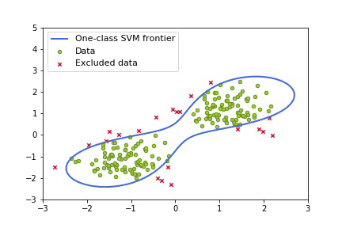
One-Class SVM
[3]

Slide 11
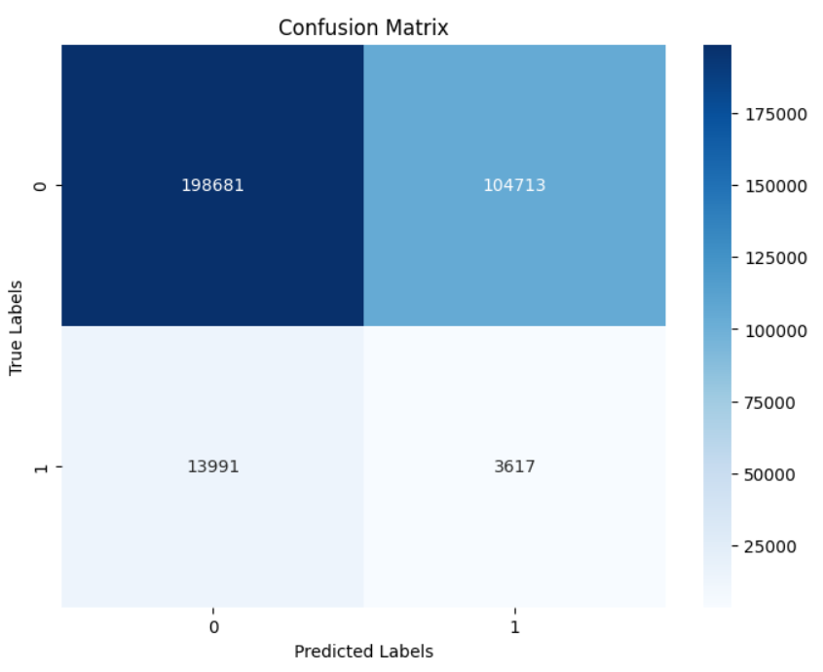
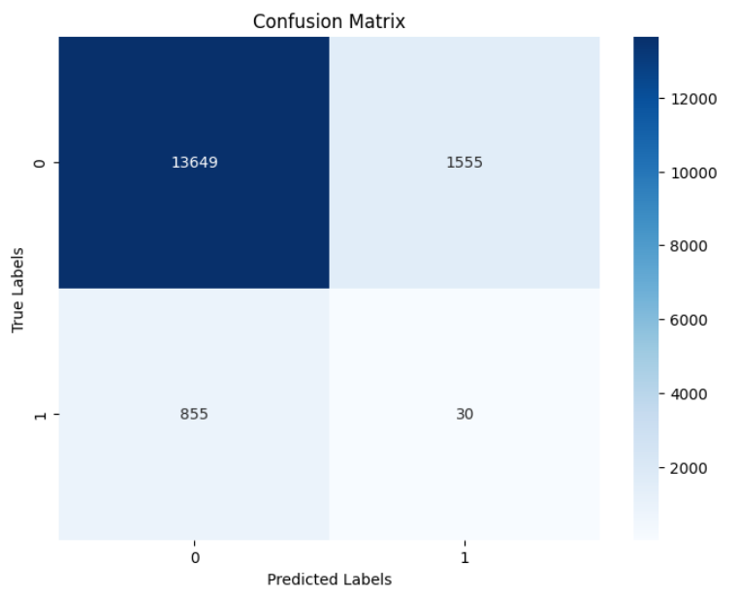
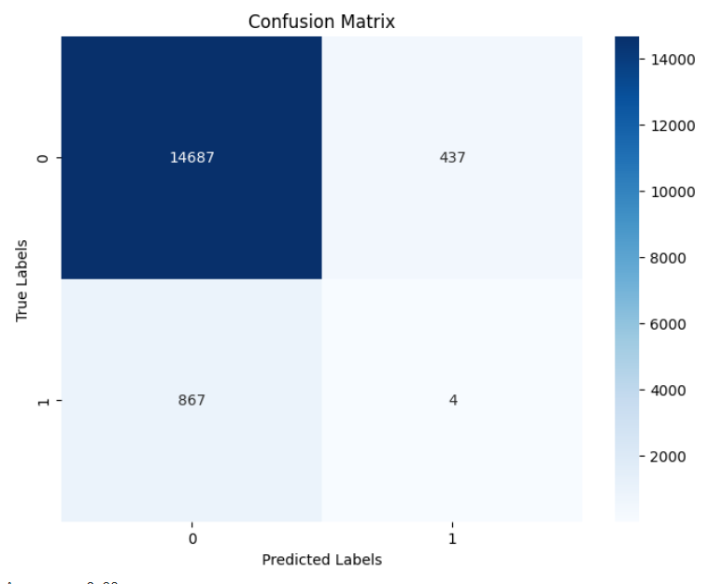
One-Class SVM
A linear kernel applied on the three different configurations of the dataset

Slide 12
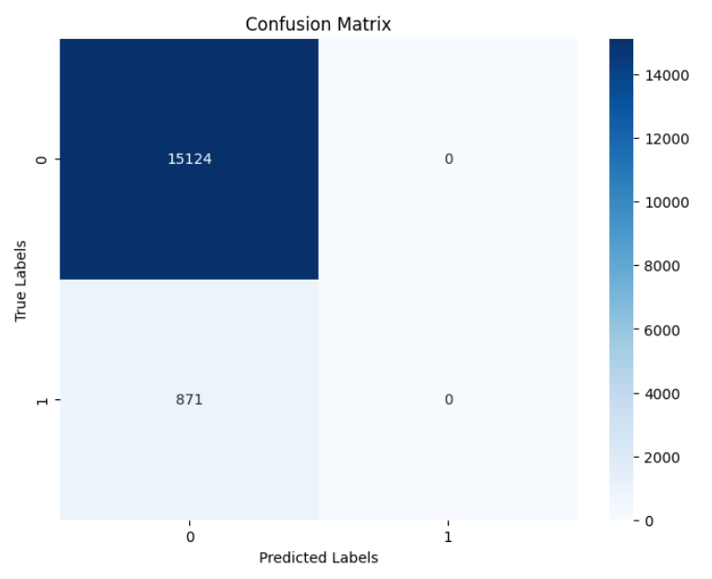
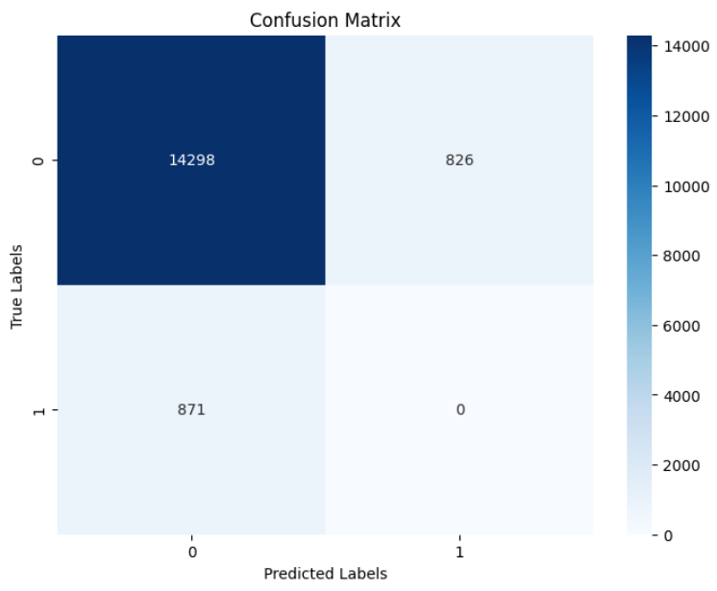
One-Class SVM
An RBF and a polynomial kernel applied on the vectorized dataset

Slide 13
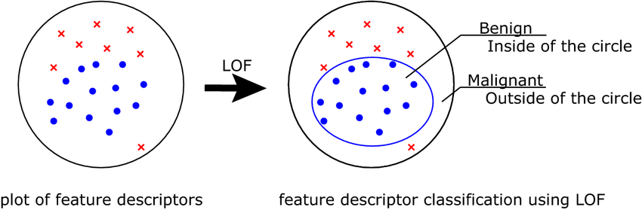
Local Outlier Factor
[4]

Slide 14
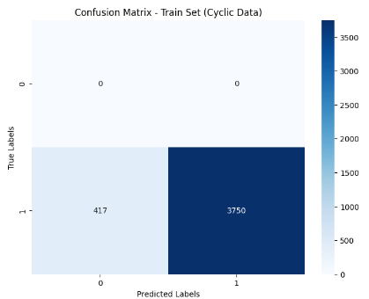
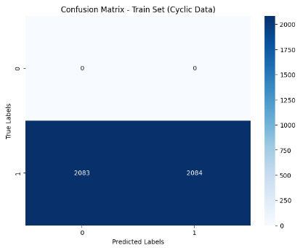
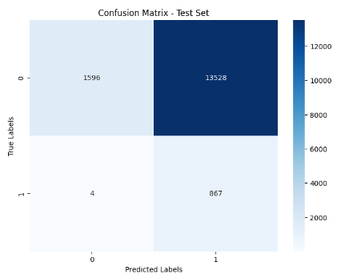
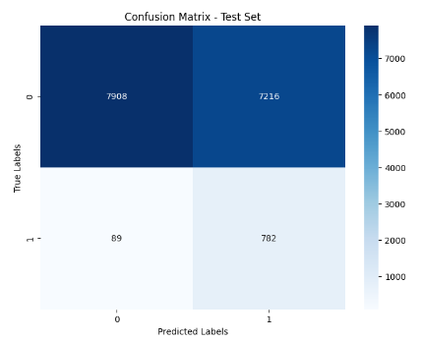
Local Outlier Factor

Slide 15
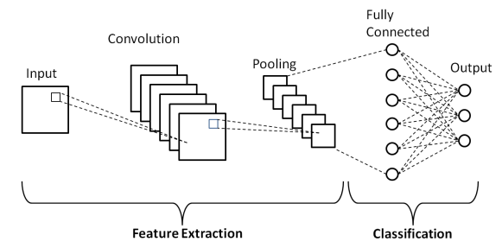
Convolutional Neural Network
[5]

Slide 16
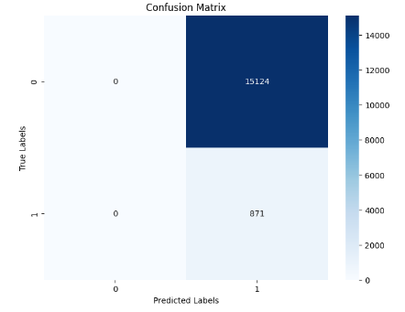
Convolutional Neural Network

Slide 17
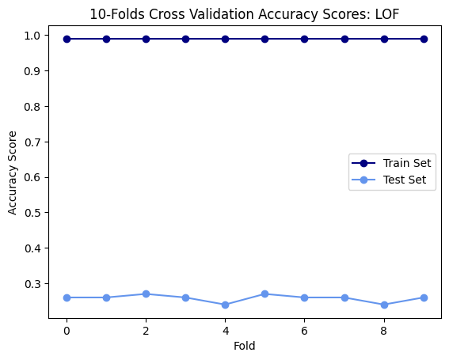
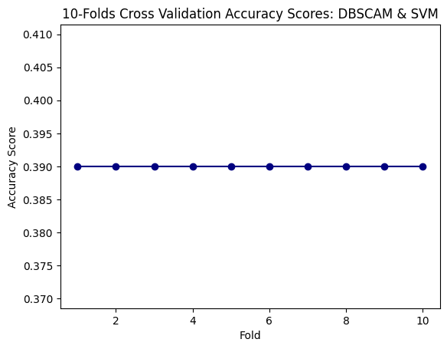
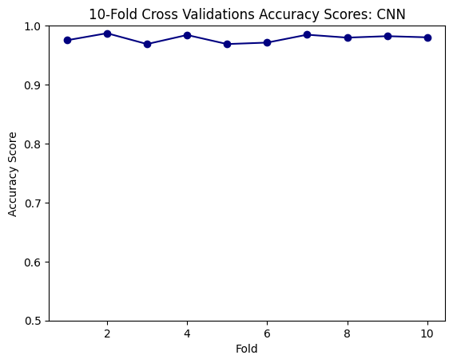
K-Folds Cross Validation

Slide 18
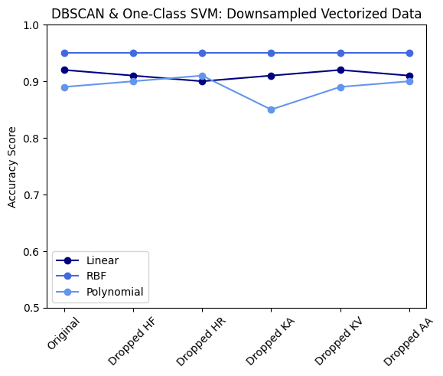
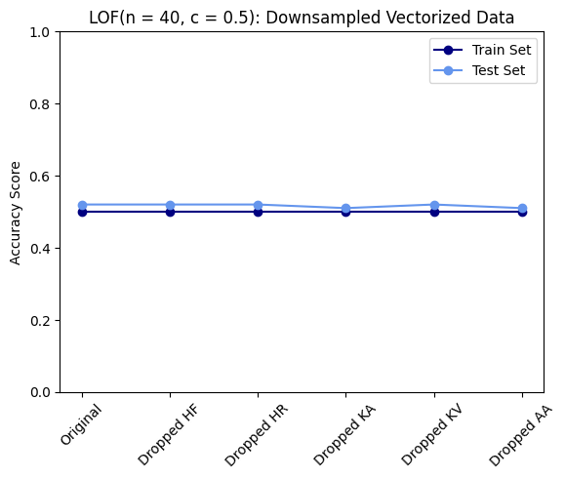
Ablation Study
Removal of variables from original data
hip flexion, hip rotation, knee angle, knee velocity, and ankle angle
Downsampling and vectorizing data
Removal of variables from downsampled, vectorized data
current and previous two measurements of hip flexion, hip rotation, knee angle, knee velocity, and ankle angle

Slide 19
Discussion and Future Work
None of the classical models adequately categorized both cyclic and non-cyclic motion.
Difficult to differentiate based off of only cyclic data.
Only difference between biomechanics of cyclic and non-cyclic data is timing.
Deep Learning could potentially be better suited to capture these complexities.

Slide 20
References
https://ieeexplore.ieee.org/document/8941004
https://link.springer.com/referenceworkentry/10.1007/978-3-642-36801-1_235-1
https://www.researchgate.net/figure/An-example-of-one-class-SVM-building-a-tight-boundary-on-a-synthetic-data-with-a-peanut_fig4_336045405
https://www.researchgate.net/figure/Schematic-illustration-of-L2-constrained-softmax-and-LOF-For-each-case-a-feature_fig4_346516602
https://www.researchgate.net/figure/Schematic-diagram-of-a-basic-convolutional-neural-network-CNN-architecture-26_fig1_336805909

Slide 21
https://link.springer.com/referenceworkentry/10.1007/978-3-642-36801-1_235-1

