Slide 1
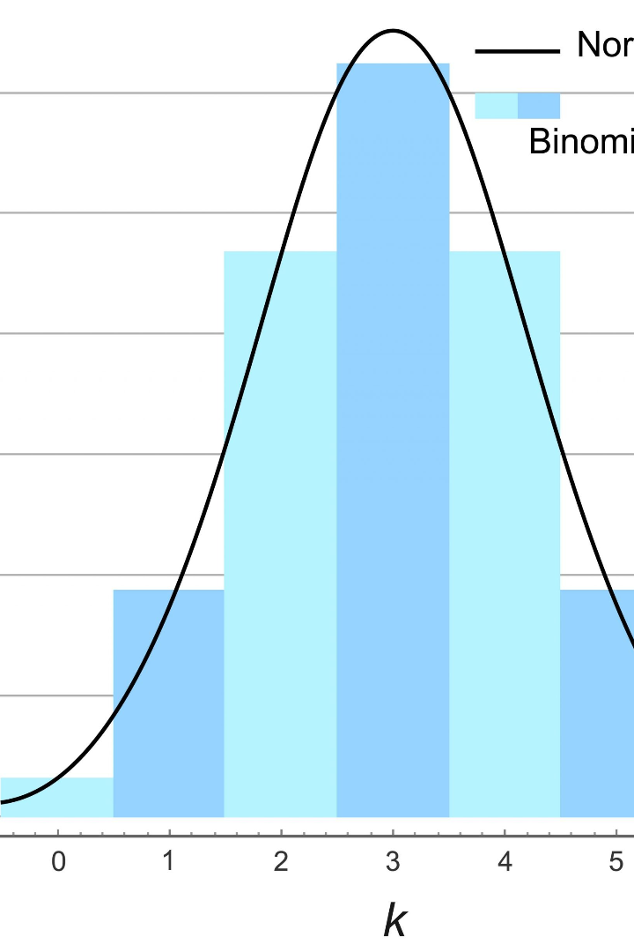
Discrete Distribution in Data Science
In data science, understanding probability and its distributions is crucial. In this presentation, we'll explore what discrete distribution is and its significance in data science.
By Himaja Shree . M
23071A6722

Slide 2
Introduction to Discrete Distribution
1
Definition
2
Example
Discrete distributions describe the probability of occurrences of distinct events. The events must be countable and finite.
If you toss a coin, possible outcomes are heads or tails. These outcomes are countable, finite, and mutually exclusive. This is a classic example of a discrete distribution.

Slide 3

Types of Discrete Distribution
1
Bernoulli Distribution
A Bernoulli distribution is a binary distribution with only two possible outcomes, usually called "success" or "failure."
Binomial Distribution
2
A binomial distribution is the number of "successes" in a set number of "trials," where each trial is independent and has the same probability of success.
3
Poisson Distribution
A Poisson distribution estimates the probability of the number of times an event happened in a given time frame, e.g., the number of cars passing by a street corner in an hour.

Slide 4
Properties of Discrete Distribution
Mean
Variance
Moment Generating Function
Expected value of a discrete distribution, i.e., the average of possible outcomes.
Measures how far from the mean the outcomes are spread.
A function that generates moments of discrete distribution, used to find mean and variance.

Slide 5

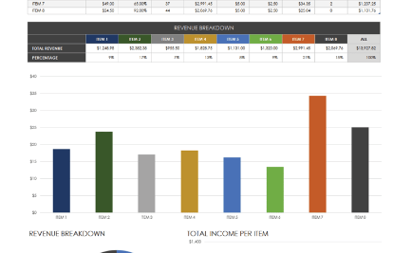

Real-life Examples of Discrete Distribution
Roulette
Sales Reports
Public Transport
The classic game of roulette is based on Bernoulli distribution. Where the coin toss has two outcomes, the roulette wheel has 37 or 38 equally likely outcomes.
When the number of sales can only be a whole number, like item purchases, this is a classic example of a Poisson distribution.
A bus arriving at a station at a given time is an example of a discrete distribution. Not all buses are on time, but they arrive at set intervals.

Slide 6
Application in Data Science
Data Modeling
Statistical Inference
Machine Learning
Discrete distribution is crucial in data analysis. It helps us to model real-world data by estimating the probabilities of different events.
We use discrete distributions to understand the properties of datasets, identify the probable conclusions, and test hypotheses.
It's used as a foundation for decision trees, Bayesian networks, and many more machine learning algorithms.

Slide 7

Conclusion and Summary
1
The importance of Discrete Distribution
Discrete distributions are essential in understanding probability concepts like data modeling, statistical inference, and machine learning.
2
Types of Discrete Distribution
There are three main types—Bernoulli, Binomial, and Poisson—each with unique features and applications.
3
Real-life Examples
Discrete distribution is ubiquitous in real-life data modeling, from roulette at a casino to public transportation to sales reports.

