Slide 1
INFO 7390 Advance DataSciences Midterm
By Team6
(Himaja Vadaga, Sandeep Kumar Bethi, Bryce Brako)

Slide 2
PROBLEM 1
Data for Credit Card Defaults:
This research aimed at the case of customers default payments in Taiwan and compares the predictive accuracy of probability of default among six data mining methods.
https://archive.ics.uci.edu/ml/datasets/default+of+credit+card+clients

Slide 3
Summary OF Observations
POWER BI
Cleansing
Classification using Logistic Regression
Classification using Regression Trees
Classification using Artificial Neural Networks
Final Conclusion

Slide 4
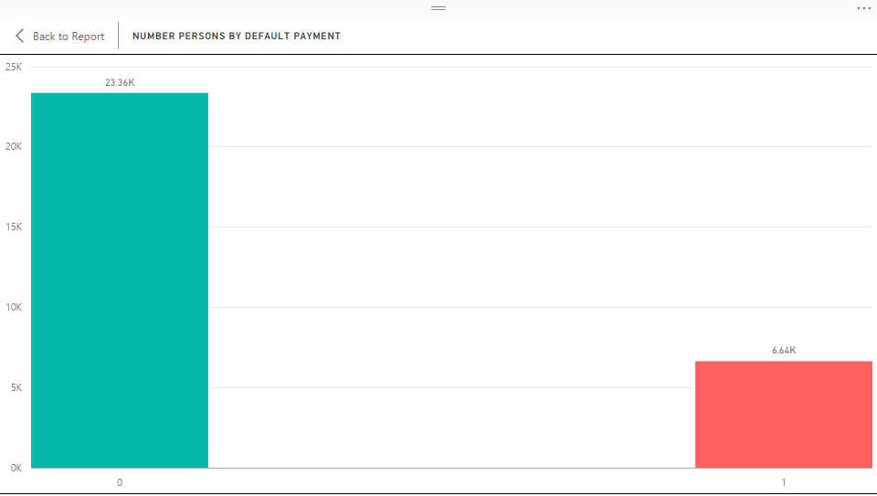
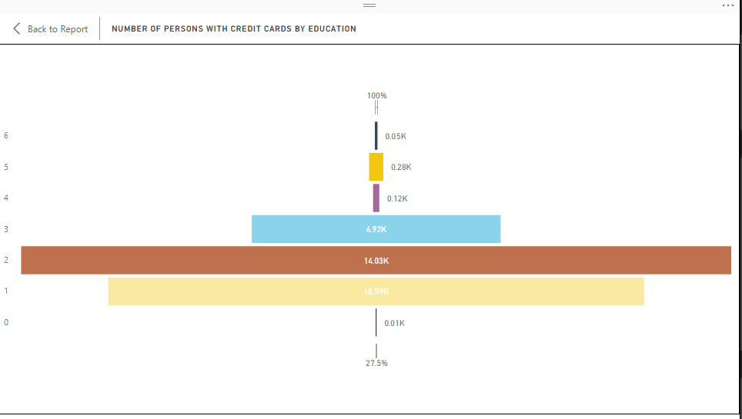
POWER BI

Slide 5
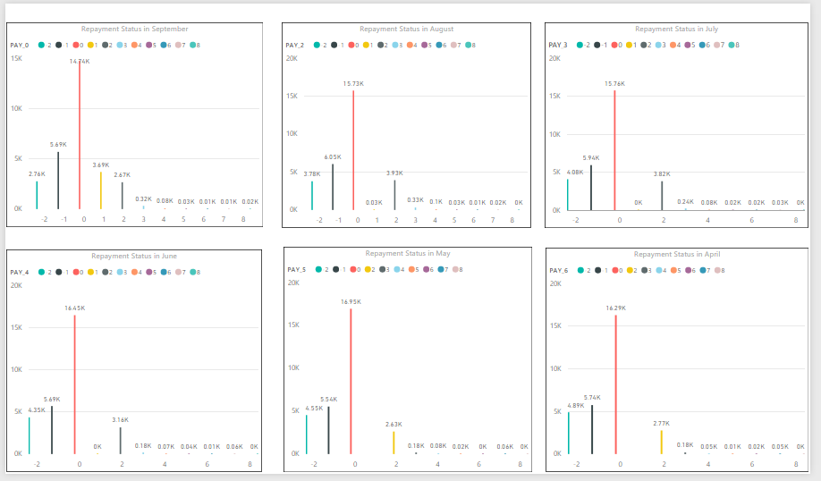
POWER BI

Slide 6
Cleansing
The file was obtained in xls format. Converted the format to .csv and then loaded it into R.
On loading the dataset into R, the column names were not human readable and a reference to the 1st row had to be used to understand what the value of the column is. Thus used the first row as the column names renamed the columns. In order to achieve this used the rename function of the PLYR library.
There were around 795 rows which had the Bill amounts and the payment amount values for all the months as 0. So, deleting the rows to make sure an efficient model is built.

Slide 7
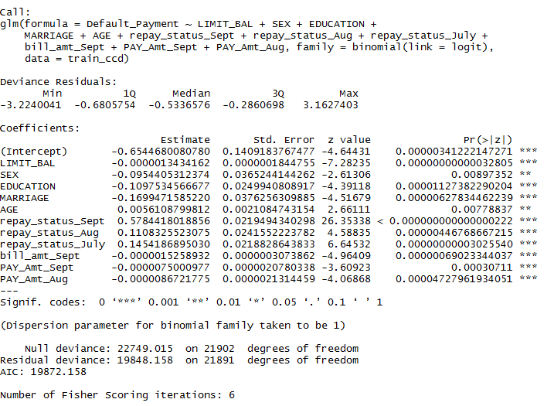
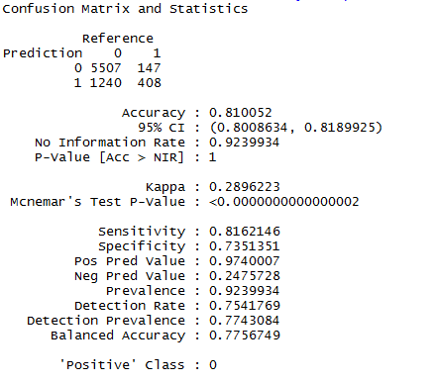
Classification using Logistic Regression

Slide 8
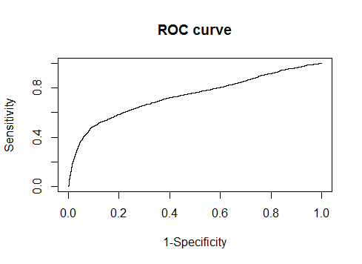
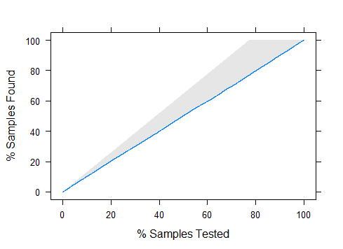
Classification using Logistic Regression

Slide 9
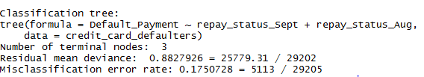
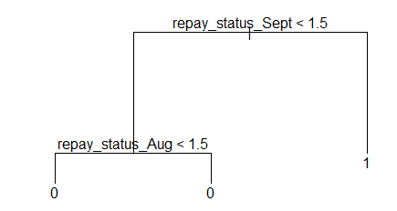
Classification using Regression Trees

Slide 10

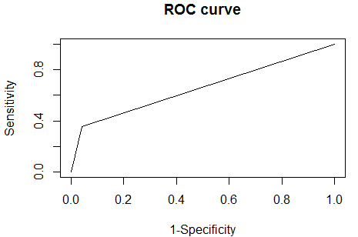
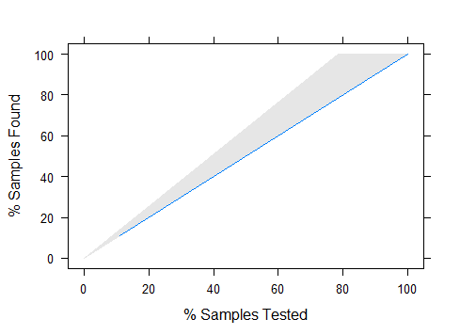
Classification using Regression Trees

Slide 11

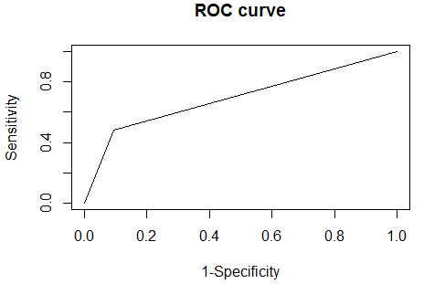
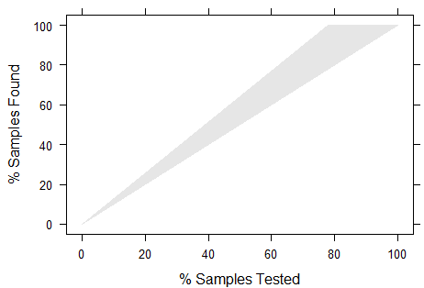
Classification using Artificial Neural Networks

Slide 12
FINAL CONCLUSION
Logistic Regression Error rates
Overall Error rate is 18%
Non-Defaulter Error Rate (0) = 2%
Defaulter Error Rate (1) = 75%
Regression Trees Error Rates
Overall Error Rate = 17%
Non-Defaulter Error Rate (0) = 15%
Defaulter Error Rate (1) = 42%
Artificial Neural Network Error Rates
Overall error Rate = 17%
Non-Defaulter Error Rate (0) = 5%
Defaulter Error Rate (1) = 61%
On Calculating the Overall Error Rate for all the tree model, based on the classification tree having the better error rate calculations compared to the logistic regression and neural network model we would choose the Classification tree model.

