Slide 1
Prudential Life Insurance Assessment - Kaggle
Reema D’mello
Zhaofeng Li
Himaja Vadaga

Slide 2
Problem statement
Develop a predictive model that accurately classifies risk using a more automated approach and to better understand the predictive power of the data points in the existing assessment, enabling Prudential Life Insurance to streamline the process

Slide 3
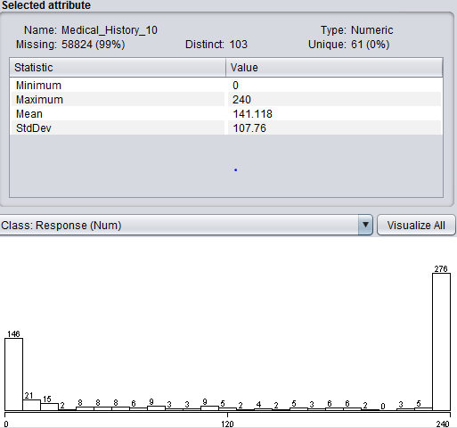
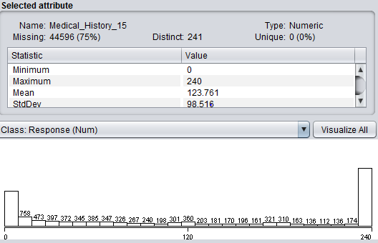
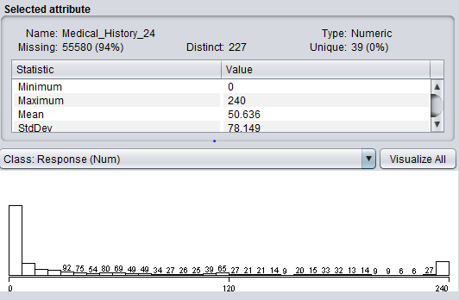
Data Exploration
Checked our dataset (128 variables)
Check the values of the dependent variable
Check the data types of independent variables
Check the missing values and try to find patterns if any

Slide 4
Preprocessing
Fixing the missing values using the median
Converted character columns to numeric
Converting columns with only 2 variables into binary
Convert only those columns with significance to 1 to N transformation
Eliminate the columns which split into more than 6
Eliminate the columns with more than 50% missing data
Initial split included 883 variables and we then finally reduced it to 237 variables

Slide 5
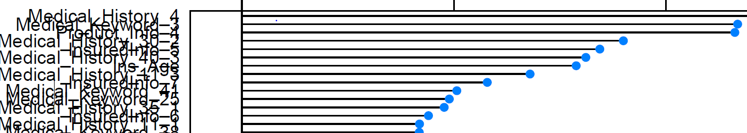
Feature Selection
Rank the features by importance
Apply Linear regression to determine the significant columns
Select only those columns which had highest significance
Combine the features from both these models – 43 features

Slide 6
Linear Regression
We used the LM function to build our linear regression model
The initial Rsquared value was 0.23 when we split all the categorical variables(883 total variables) and our kappa score was 0.32
We now built the model based on the important features determined ( except product_info_2)
The R-squared value was 0.31 and kappa score was 0.4
We then included Product_info_2 and the R-squared value was 0.35 on train data, 0.32 on test and our kappa score was 0.47

Slide 7
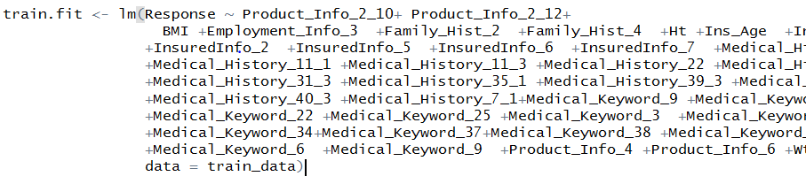
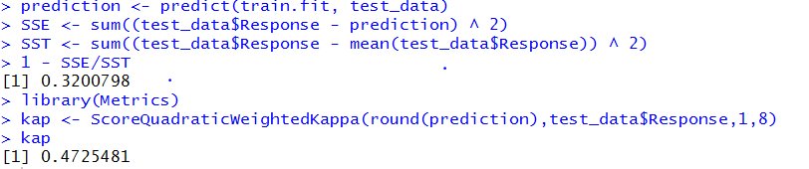
Linear Regression
Code snippet
The best kappa score:

Slide 8
Decision Tree Regression
We used the Rpart regressor to build our tree model
We pruned the tree based on the best cp value =0.01
Using brute force method and tried changing the max depth and min split parameters
The best values were max depth of 10 and min split of 10
The model based on the important features produced an RMSE value of 2.11 on test data and models accuracy was 29% and kappa score was 0.42 (initial RMSE was 2.18 and accuracy was 18% considering default parameters and split of 883 variables)

Slide 9
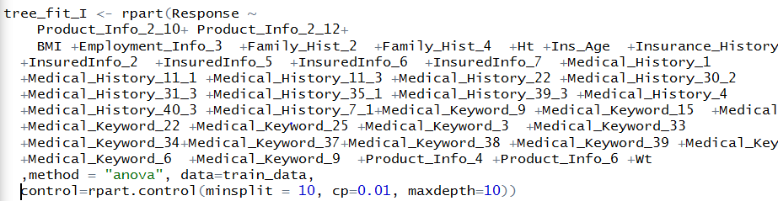
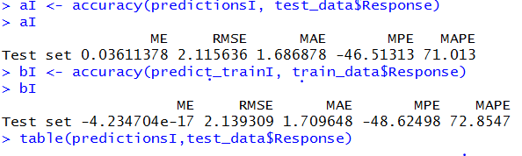
Decision Tree Regression
Code
The best accuracy and kappa score

Slide 10
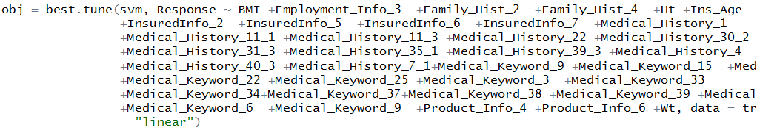
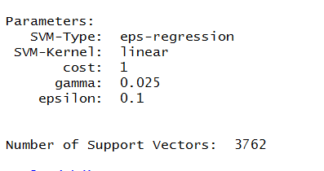
Support Vector Machines
We have considered 10 % of the entire dataset
Split this data into train and test
Built the model considering cost=1 and gamma=1
Tuned the model on based on best.tune

Slide 11
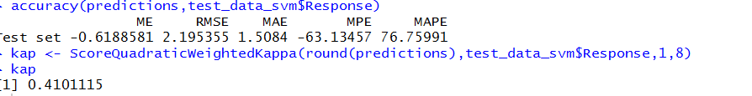

Support Vector Machines
Calculated RMSE and Kappa value for the tuned model

Slide 12
Conclusion
 | Linear Regression | Decision Tree Regression | SVM (10 % of data)
Kappa Score | 0.47 | 0.42 | 0.41

Slide 13
Major Challenges faced
Performing 0-N transformation of the columns
Determining the important features
Calculating the kappa score in all the models
Running the SVM model on the entire dataset

Slide 14
Thank You ☺

