Slide 1
Air Line Recommendation System from Web Scraped Real-time Live Data
Ananthasetty Himakar-121810316009
Pallanti Sai Teja - 121810316058

Slide 2
Abstract
Nowadays, consumers increasingly rely on online resources to aid in purchasing decisions. Online resources also help companies learn from customer reviews, how different types of customers have different priorities and how customer choice affects their review. In the U.S, 82% the adult says that they have been referring to online reviews and ratings provided by the customer before purchasing items for the first time, including 40% who say that they have always referred or almost always do so. In the proposed work, we have been performed predictive analysis for qualitative reviews on the data that different online sites have collected. We have also been performed a descriptive analysis of the different classes of airline services. The findings of this paper show that the review of most of the business class is on the food and friendliness of staff, whereas most of the economy class views were on legroom and seat comfort.

Slide 3
What Inspired us?
The recommendation system is beneficial in this generation, especially in this after COVID unlockdown situation, where millions of people are retrieving the habit of travelling, migrating to other countires for studying,working. Moreover, thousands of applications widely acquired the concept of a recommendation system, which helps the user find the appropriate needs. The two famous recommendation systems are the Content-Based recommendation system and the Collaborative Filtering recommendation system. Content-Based systems recommend with respective customer similarities to previously high-rated items by the customer. Collaborative filtering is based on identical people (based on the genre interest). It predicts which product a user will like based on the item preferences of other similar users. In this case, this paper recommends a customized recommender system with a Recommendation System built with Random forest Classifier, Real time data extracted from “www.airlinequality.com”

Slide 4
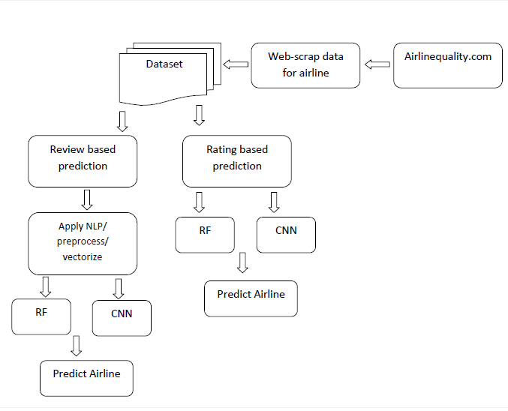
System Architecture

Slide 5
LIBRARIES AND PACKAGES
PANDAS
It is a python library mainly used for data manipulation.
Pandas is a fast, powerful, flexible and easy to use open source data analysis and manipulation tool, built on top of the python programming language
NUMPY
Mathematical and logical operations on arrays can be performed.
Is a library consisting of multidimensional array objects and a collection of routines for processing arrays.

Slide 6
LIBRARIES AND PACKAGES
MATPLOTLIB AND SEABORN
Matplotlib is a multi-platform data visualization library built on NumPy arrays and designed to work with the broader SciPy stack. It was introduced by John Hunter in the year 2002. It provides an object-oriented API that helps in embedding plots in applications using Python GUI toolkits such as PyQt, WxPythonotTkinter. Both are the data visualization library used for plotting graph which will help us in understanding the data.
SCIKET-LEARN
Scikit-learn is a free software machine learning library for the Python programming language. It features various classification, regression and clustering algorithms including support vector machines, random forests, gradient boosting, k-means and DBSCAN, and is designed to interoperate with the Python numerical and scientific libraries NumPy and SciPy Mathematical and logical operations on arrays can be performed.

Slide 7
LIBRARIES AND PACKAGES
FLASK
Flask is a web application framework written in Python. It is developed by Armin Ronacher, who leads an international group of Python enthusiasts named Pocco. Flask is based on the Werkzeug WSGI toolkit and Jinja2 template engine. Both are Pocco projects.
It is a python library mainly used for data manipulation.
Pandas is a fast, powerful, flexible and easy to use open source data analysis and manipulation tool, built on top of the python programming language
REGULAR EXPRESSION
A Regular Expressions (re) is a special sequence of characters that uses a search pattern to find a string or set of strings. It can detect the presence or absence of a text by matching with a particular pattern, and also can split a pattern into one or more sub-patterns. Python provides a re module that supports the use of regex in Python. Its primary function is to offer a search, where it takes a regular expression and a string. Here, it either returns the first match or else none.

Slide 8
LIBRARIES AND PACKAGES
TENSORFLOW
TensorFlow is an end-to-end open source platform for machine learning. It has a comprehensive, flexible ecosystem of tools, libraries and community resources that lets researchers push the state-of-the-art in ML and developers easily build and deploy ML powered applications.
KERAS
Keras is a deep learning API written in Python, running on top of the machine learning platform TensorFlow. It was developed with a focus on enabling fast experimentation.
Being able to go from idea to result as fast as possible is key to doing good research.

Slide 9
Convolutional Neural Networks
It is assumed that the reader knows the concept of Neural networks.
When it comes to Machine Learning, Artificial Neural Networks perform really well. Artificial Neural Networks are used in various classification tasks like image, audio, words. Different types of Neural Networks are used for different purposes, for example for predicting the sequence of words we use Recurrent Neural Networks more precisely an LSTM, similarly for image classification we use Convolution Neural Networks. A basic convolutional neural network comprises three components, namely, the convolutional layer, the pooling layer and the output layer. The pooling layer is optional sometimes. The typical convolutional neural network architecture with three convolutional layers is well adapted for the classification of handwritten images as shown in Figure 1. It consists of the input layer, multiple hidden layers (repetitions of convolutional, normalization, pooling) and a fully connected and an output layer.

Slide 10
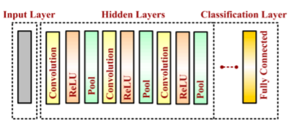

Slide 11
Input Layer: The input data is loaded and stored in the input layer. This layer describes the height, width and number of channels (RGB information) of the input image.
Hidden Layer :
The hidden layers are the backbone of CNN architecture. They perform a feature extraction process where a series of convolution, pooling and activation functions are used. The distinguishable features of handwritten digits are detected at this stage.
Convolutional Layer :
The convolutional layer is the first layer placed above the input image. It is used for extracting the features of an image. The n × n input neurons of the input layer are convoluted with an m × m filter and in return deliver (n − m + 1) × (n − m + 1) as output. It introduces non-linearity through a neural activation function. The main contributors of the convolutional layer are receptive field, stride, dilation and padding, as described in the following paragraph. CNN computation is inspired by the visual cortex in animals . The visual cortex is a part of the brain that processes the information forwarded from the retina. It processes visual information and is subtle to small sub-regions of the input.

Slide 12
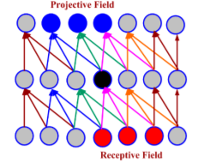
Similarly, a receptive field is calculated in a CNN, which is a small region of an input image that can affect a specific region of the network. It is also one of the important design parameters of the CNN architecture and helps in setting other CNN parameters . It has the same size as the kernel and works in a similar fashion as the foveal vision of the human eye works for producing sharp central vision.
Pooling Layer
A pooling layer is added between two convolutional layers to reduce the input dimensionality and hence to reduce the computational complexity. Pooling allows the selected values to be passed to the next layer while leaving the unnecessary values behind. The pooling layer also helps in feature selection and in controlling overfitting. The pooling operation is done independently. It works by extracting only one output value from the tiled non-overlapping sub-regions of the input images

Slide 13
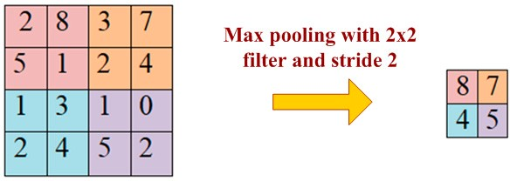

Slide 14
Classification Layer: The classification layer is the last layer in CNN architecture. It is a fully connected feed forward network, mainly adopted as a classifier. The neurons in the fully connected layers are connected to all the neurons of the previous layer. This layer calculates predicted classes by identifying the input image, which is done by combining all the features learned by previous layers. The number of output classes depends on the number of classes present in the target dataset. In the present work, the classification layer uses the ‘softmax’ activation function for classifying the generated features of the input image received from the previous layer into various classes based on the training data.

Slide 15
RANDOM FOREST
A Random Forest is an ensemble technique capable of performing both regression and classification tasks with the use of multiple decision trees and a technique called Bootstrap and Aggregation, commonly known as bagging. The basic idea behind this is to combine multiple decision trees in determining the final output rather than relying on individual decision trees.
Random Forest has multiple decision trees as base learning models. We randomly perform row sampling and feature sampling from the dataset forming sample datasets for every model.
This part is called Bootstrap.
We need to approach the Random Forest regression technique like any other machine learning technique
Design a specific question or data and get the source to determine the required data.

Slide 16
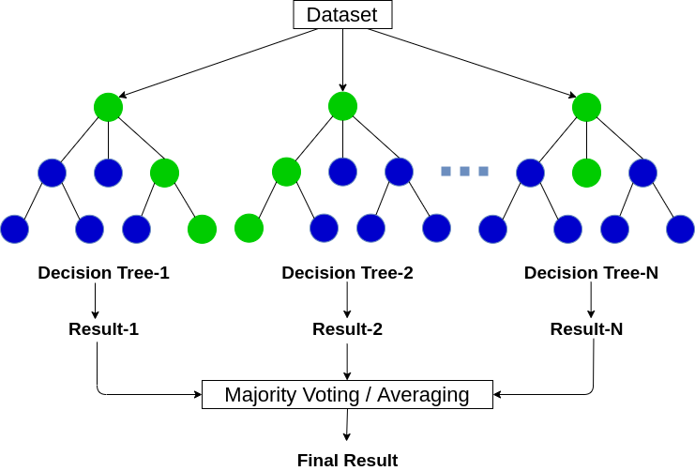

Slide 17
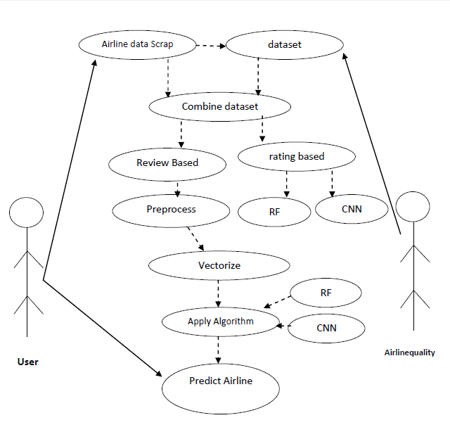
Use Case Diagram

Slide 18
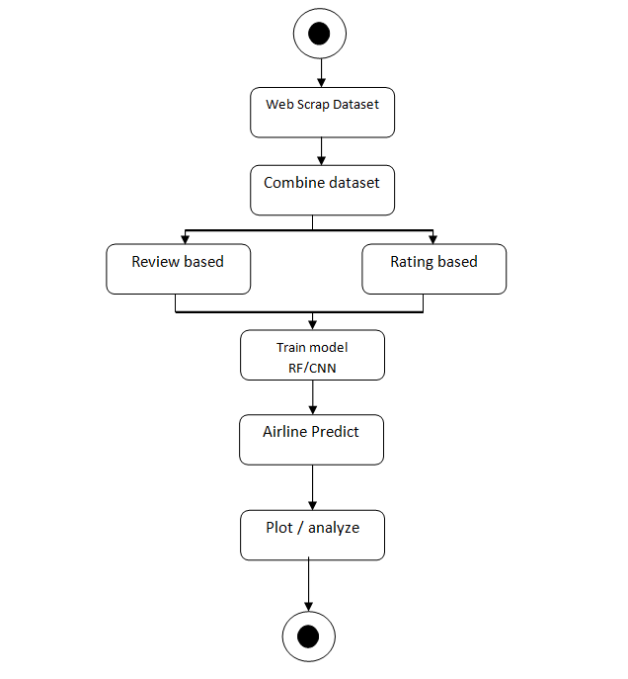
Activity Diagram

Slide 19
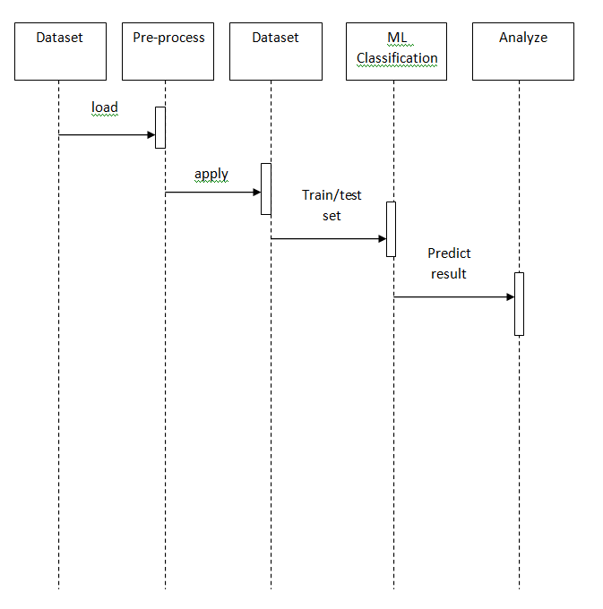
Sequence Diagram

Slide 20
RESULTS
NAME OF THE ALGORITHM | ACCURACY
Random Forest Review Based | 81.84%
Random Forest Rating Based | 92.76%
Convolutional Neural Networks Review Based | 87.89%
Convolutional Neural Networks Rating Based | 93.28%

Slide 21
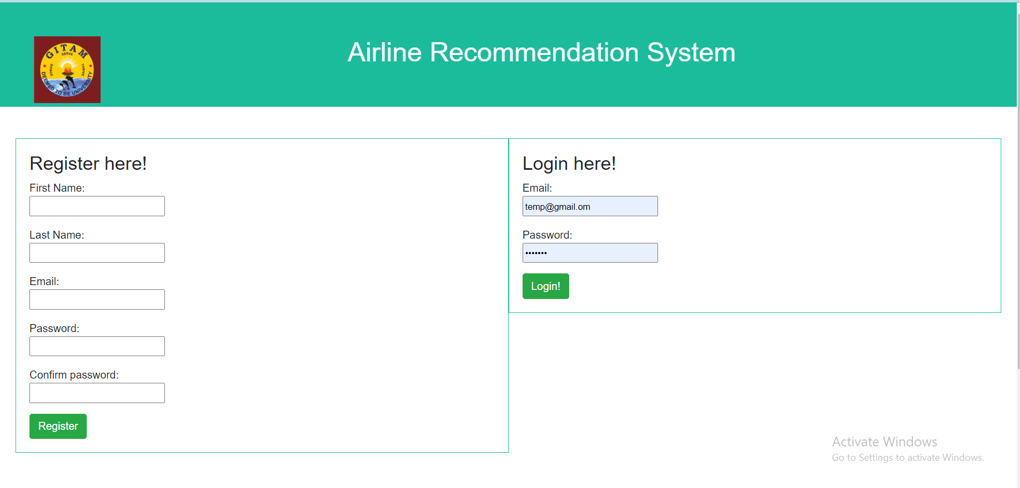
OUTPUT

Slide 22
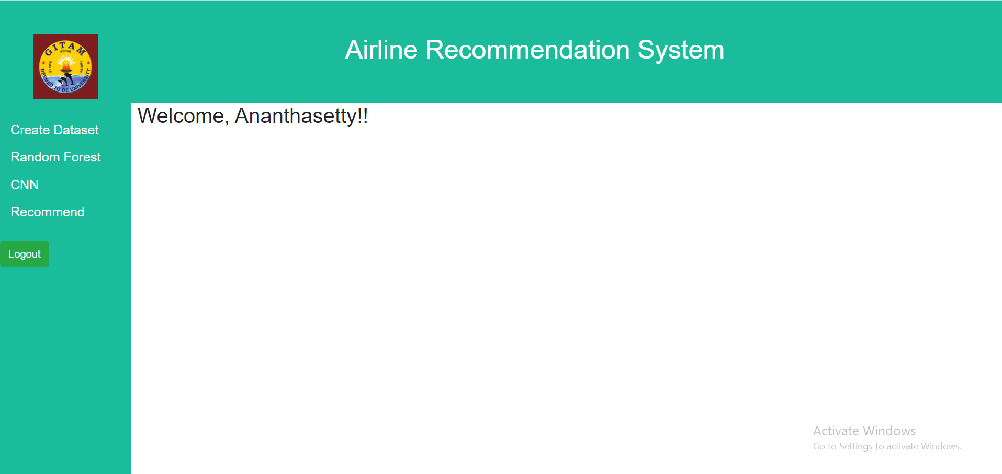

Slide 23
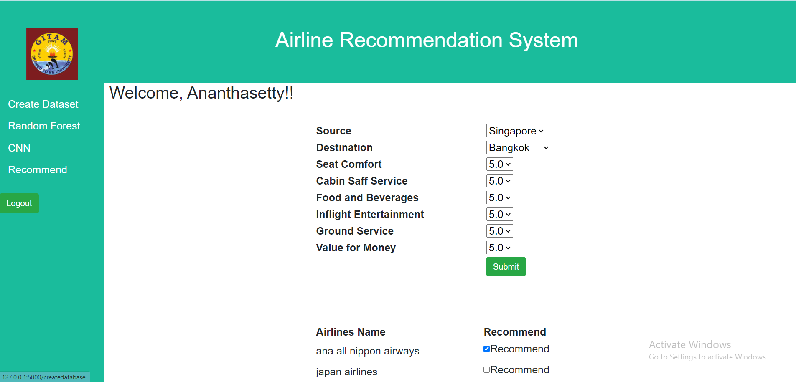

Slide 24
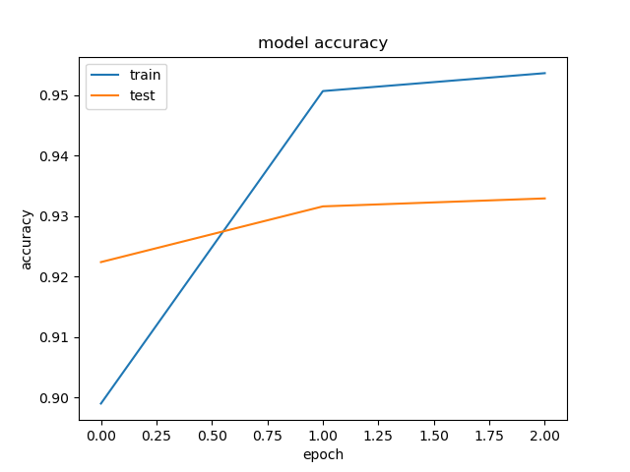
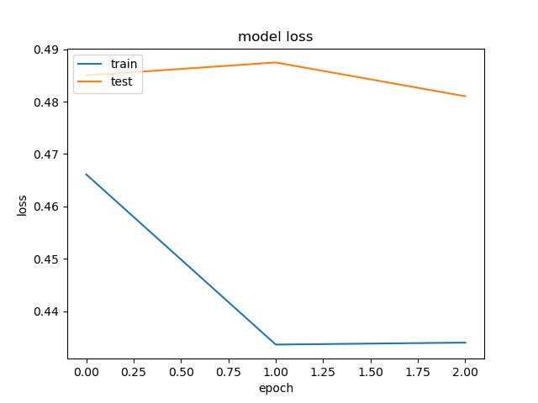
1. CNN Accuracy
2. CNN Review Loss

Slide 25
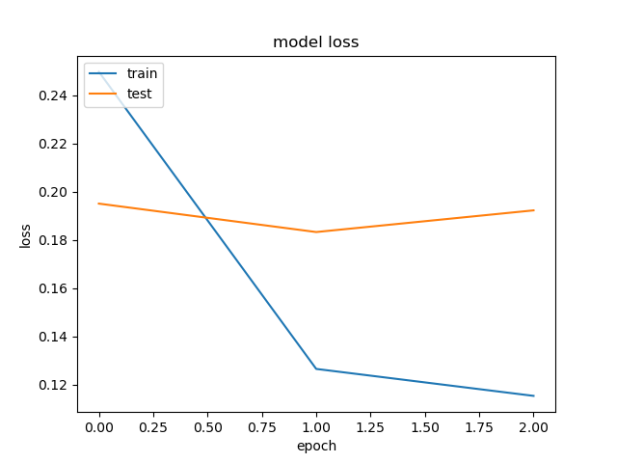
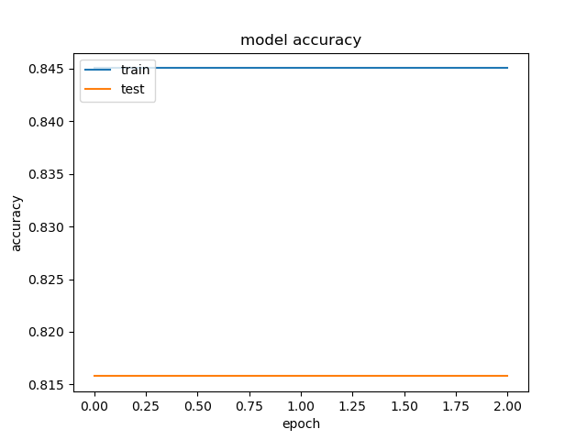
3. CNN Loss
4. CNN Review Accuracy

Slide 26
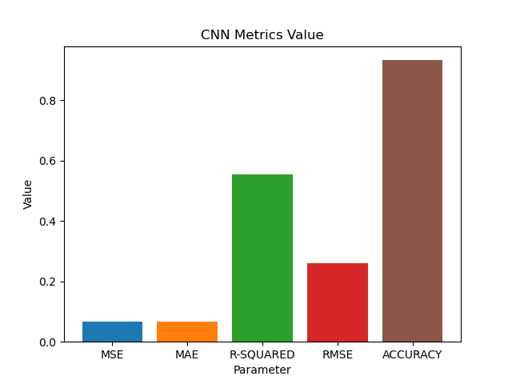
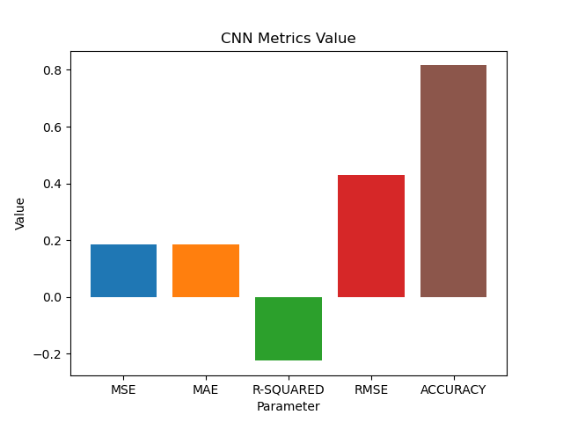
5. CNN Rating Metrics
6. CNN Review Metrics

Slide 27

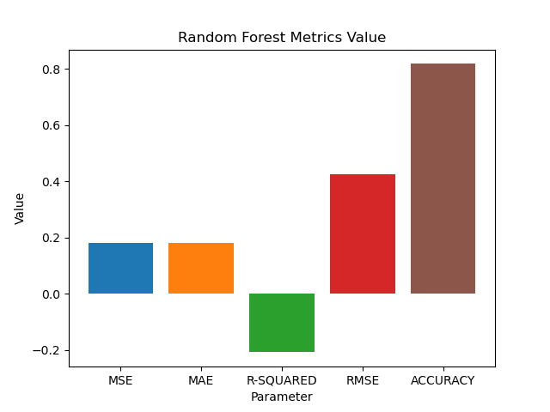
7. Randomforest Metrics
8. Randomforest Review Metrics

Slide 28
Conclusion
The proposed work is airline prediction based on customer reviews and rating with Natural Language processing and machine learning algorithm. The reviews and rating are classified as binary classification for airline recommendation 'yes' or 'no'. This project used Random forest as machine learning algorithm and Convolutional Neural Network (CNN) algorithm for deep learning classification. The dataset used is real time live data from www.airlinequality.com. The application is build with Flask Python, where user can enter the values of rating to get the best predicted airline. Experimental results shows that Rating based Random forest has achieved highest accuracy.

Slide 29
Future Scope
As future enhancement, we are interested to implement feature selection algorithm namely Genetic algorithm or Particle swarm optimization (PSO) algorithm. Similarly, as the future enhancement, we are interested to implement regularization parameter to tune the parameters for accurate prediction. Techniques like GridSearchCV can be implemented in future.

