Slide 1

Machine Learning- (Exploratory Data Analysis , Ensambling Data Modeling)
Department of Computer Science and Engineering
GIT
GITAM (Deemed to be University)
Section : B16
Register Number :121810316009
Student Name : Ananthasetty Himakar
Date & Time : 18th feb 2021 @14:00

Slide 2
Agenda:
1)Exploratory Data Analysis (EDA)
Data Visualization : Line plot ,Scatter plot , Histogram ,
Box plot.
2)Machine Learning
Supervised Learning
Unsupervised Learning
3)Ensambling Data Modeling
KNN , SVM, Random Forest algorithms

Slide 3
Machine Learning: Machine learning is a method of data analysis that automates analytical model building. It is a branch of Artificial Intelligence based on the idea that systems can learn from data, identify patterns and make decisions with minimal human intervention.
It is an application/function of AI that provides the system the ability to automatically learn and improve from the experience.
Types:
Supervised Learning: Occurs when algorithm learns from example data(Target Output) ex : Regression(continuous value) , Classification(discrete value).
Classification types: Binary Classification(Two data) , Multi Class Classification(More than two data).
Un Supervised Learning: Occurs when algorithm learns from plain data(No Target Output) ex: clustering.

Slide 4
Exploratory Data Analysis:
EDA was promoted by John Tukey in 1977 to encourage statisticians visually to examine their data set , to formulate the hypothesis that could be tested on Data sets.
Exploratory Data analysis can never be a full story ,but nothing else can serve as a the foundation stone.
- John Tukey
EDA technique are generally graphical .
They include Box plot ,Histogram , Scatter Plot , Line plot.

Slide 5
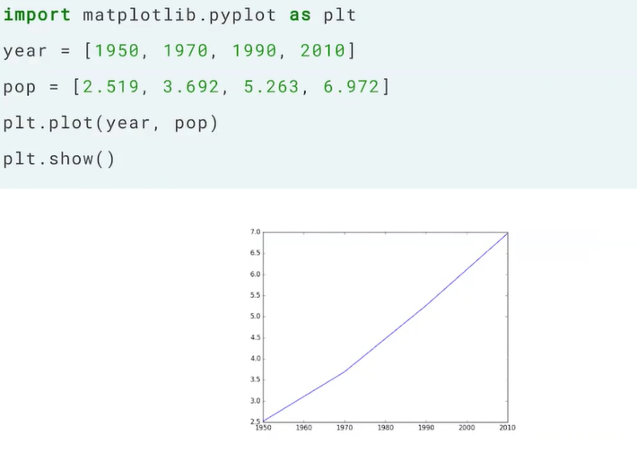
Line Plot:
A line plot or line graph or curve chart which displays information as a series of data points called 'markers' connected by straight line segments.

Slide 6
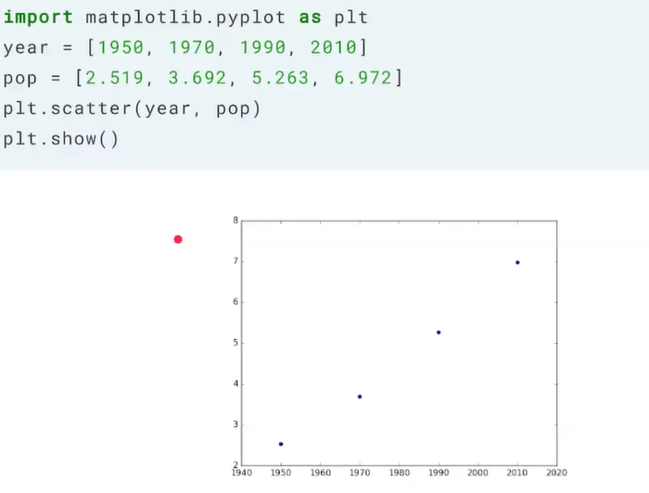
Scatter Plot:
A scatter plot (also called scatter diagram) is a type of plot or mathematical diagram uses Cartesian coordinates to display values for typically two variables for a set of data.

Slide 7
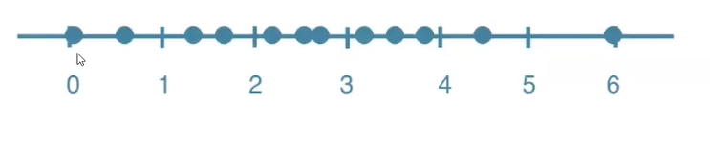

Histogram:
It is a type of visualization used to explore the data set . A histogram is a graphical display of data using bars of different heights .Taller bars show that more data falls in that range.

Slide 8
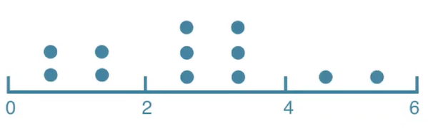
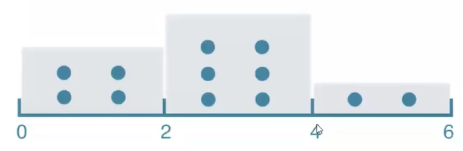

Slide 9
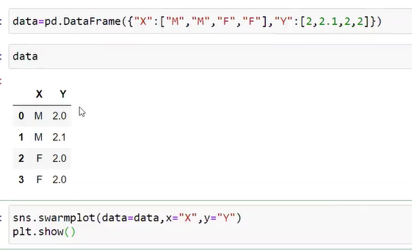
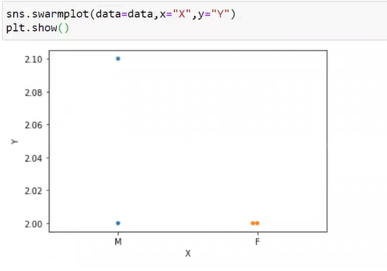
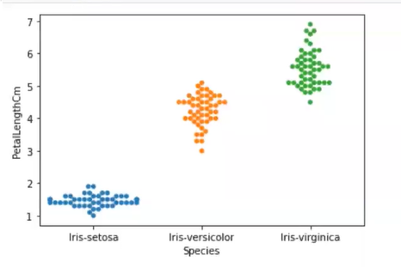
Bee swarm plot:
A bee swarm plot is a one-dimensional scatter plot similar to “stripchart”, except that would-be overlapping points are separated such that each point is visible.

Slide 10
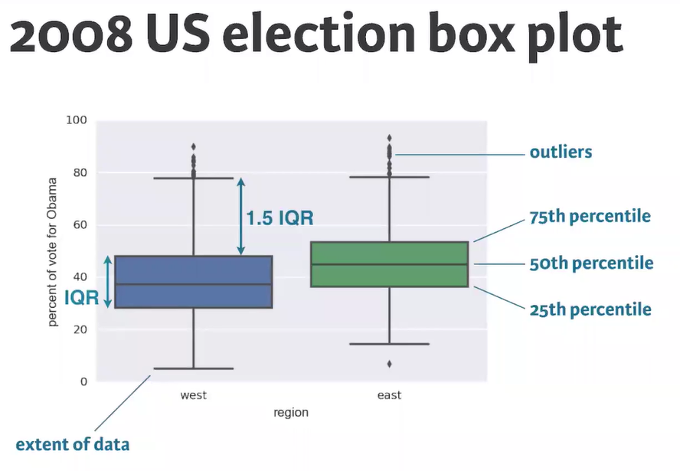
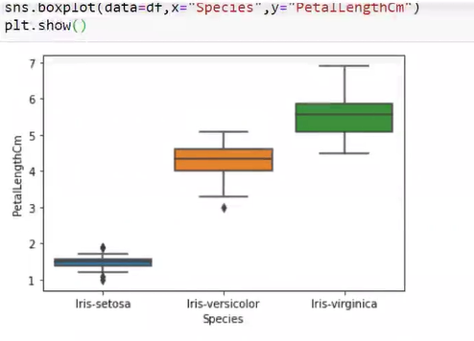
Box plot:
Invented by John Tukey to display the features of data set based on percentiles.
Interquartile range(IQR) : Is a measure of variability, based on dividing a data set into quartiles.

Slide 11
Training and Testing:
Training set is the one on which we train and fit our model .
Basically we try to fit the parameters, whereas testing data is only
to access the performance of the model.
Training data’s output is access to model where as testing data is
unseen data for which prediction have to be made.
Eg:
Predictand and Predictors

Slide 12
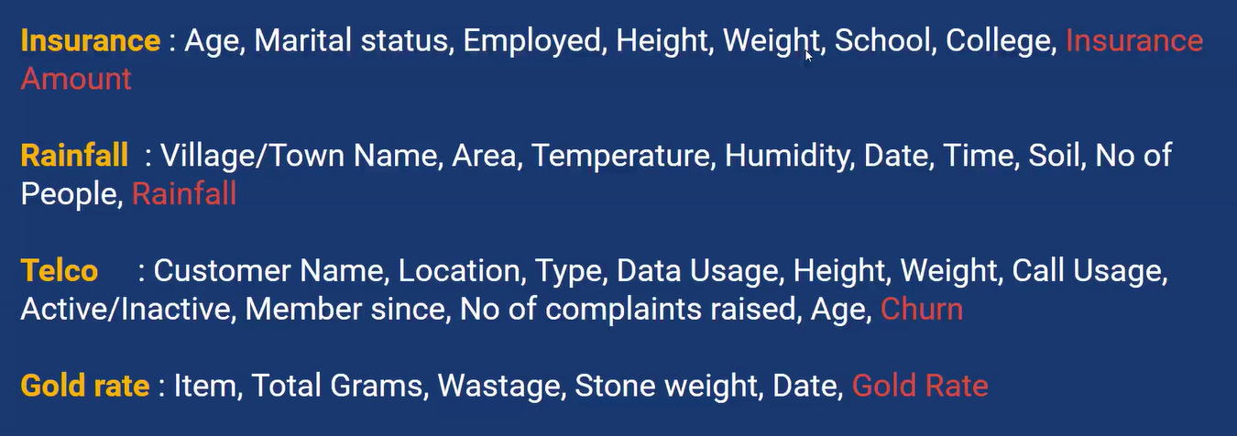
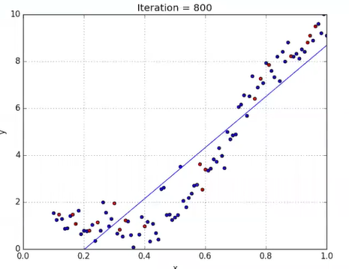
Linear Regression: Linear regression is a Machine Learning Statistical method that can be used to quantify and make predictions based on relationship between numerical variables.
Assumptions: All variables should be in numerical not categorical.

Slide 13
Ensambling Data Modeling:
-Ensemble modeling is a process where multiple diverse models are created to predict an outcome, either by using many different modeling algorithms or using different training data sets. The ensemble model then aggregates the prediction of each base model and results in once final prediction for the unseen data.
eg : Bank investor to n bank advisors.
Types:
1)KNN
2)SVM
3)Random Forest Method
- They are applied to regression(ex : polynomial , etc) and classification

Slide 14

KNN-K Nearest Neighbors:
In statistics , the k-nearest neighbors algorithm (k-NN) is a non- parametric classification method first developed by Evelyn Fix and Joseph Hodges in 1951, and later expanded by Thomas Cover. It is used for classification and regression. In both cases, the input consists of the k closest training examples in data set.
1)It is a lazy algorithm
2)Target variable can be Classification or Regression

Slide 15
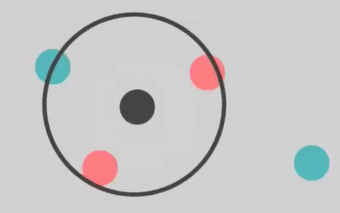
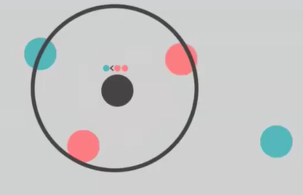
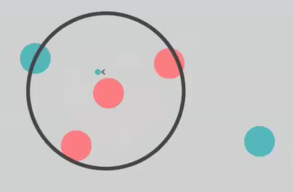

Slide 16
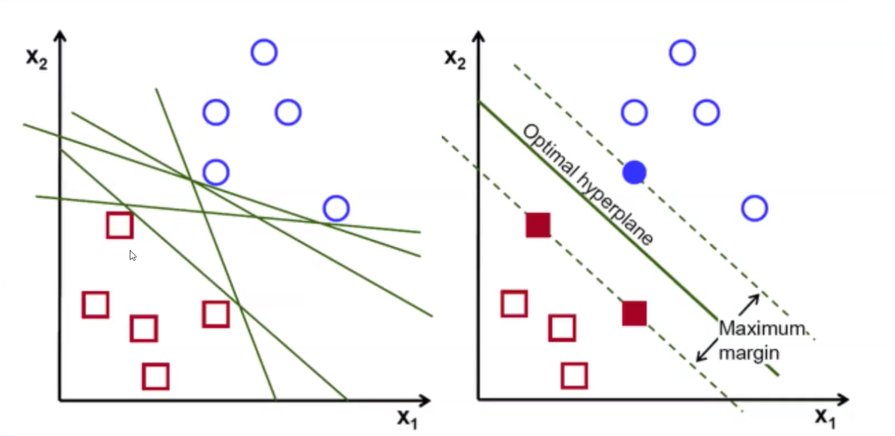
SVM- Support Vector Machine
Support Vector Machine (SVM) is a supervised machine learning algorithm which can be used for both classification or regression challenges. However, it is mostly used in classification problems.
We perform classification by finding the Optimal hyper-plane that differentiates the two classes very well. It can be used for higher dimensions.

Slide 17
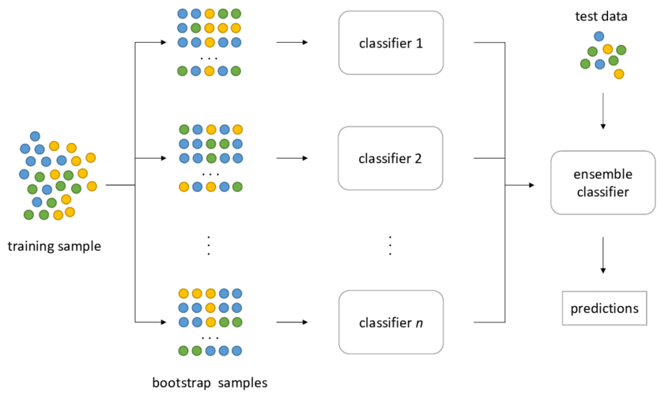
Random Forest Algorithm:
Random forest is a supervised learning algorithm. The "forest" it builds, is an ensemble of decision trees, usually trained with the “bagging and bootstrapping” method. The general idea of the bagging method is that a combination of learning models increases the overall result.

Slide 18
Conclusion
Any task in this world first need to be analyzed and then implement
Data Analysis is one of the important steps in Data Science .
A Data can be imagined good in pictorial format than remembering the data points.
Feature selection plays a vital role in data cleaning.
Making a conclusion and selecting appropriate model for ensambling modeling leads to less errors.

Slide 19
Bibliography
https://towardsdatascience.com/
https://www.slideshare.net/
THANK YOU!

